Slide 1
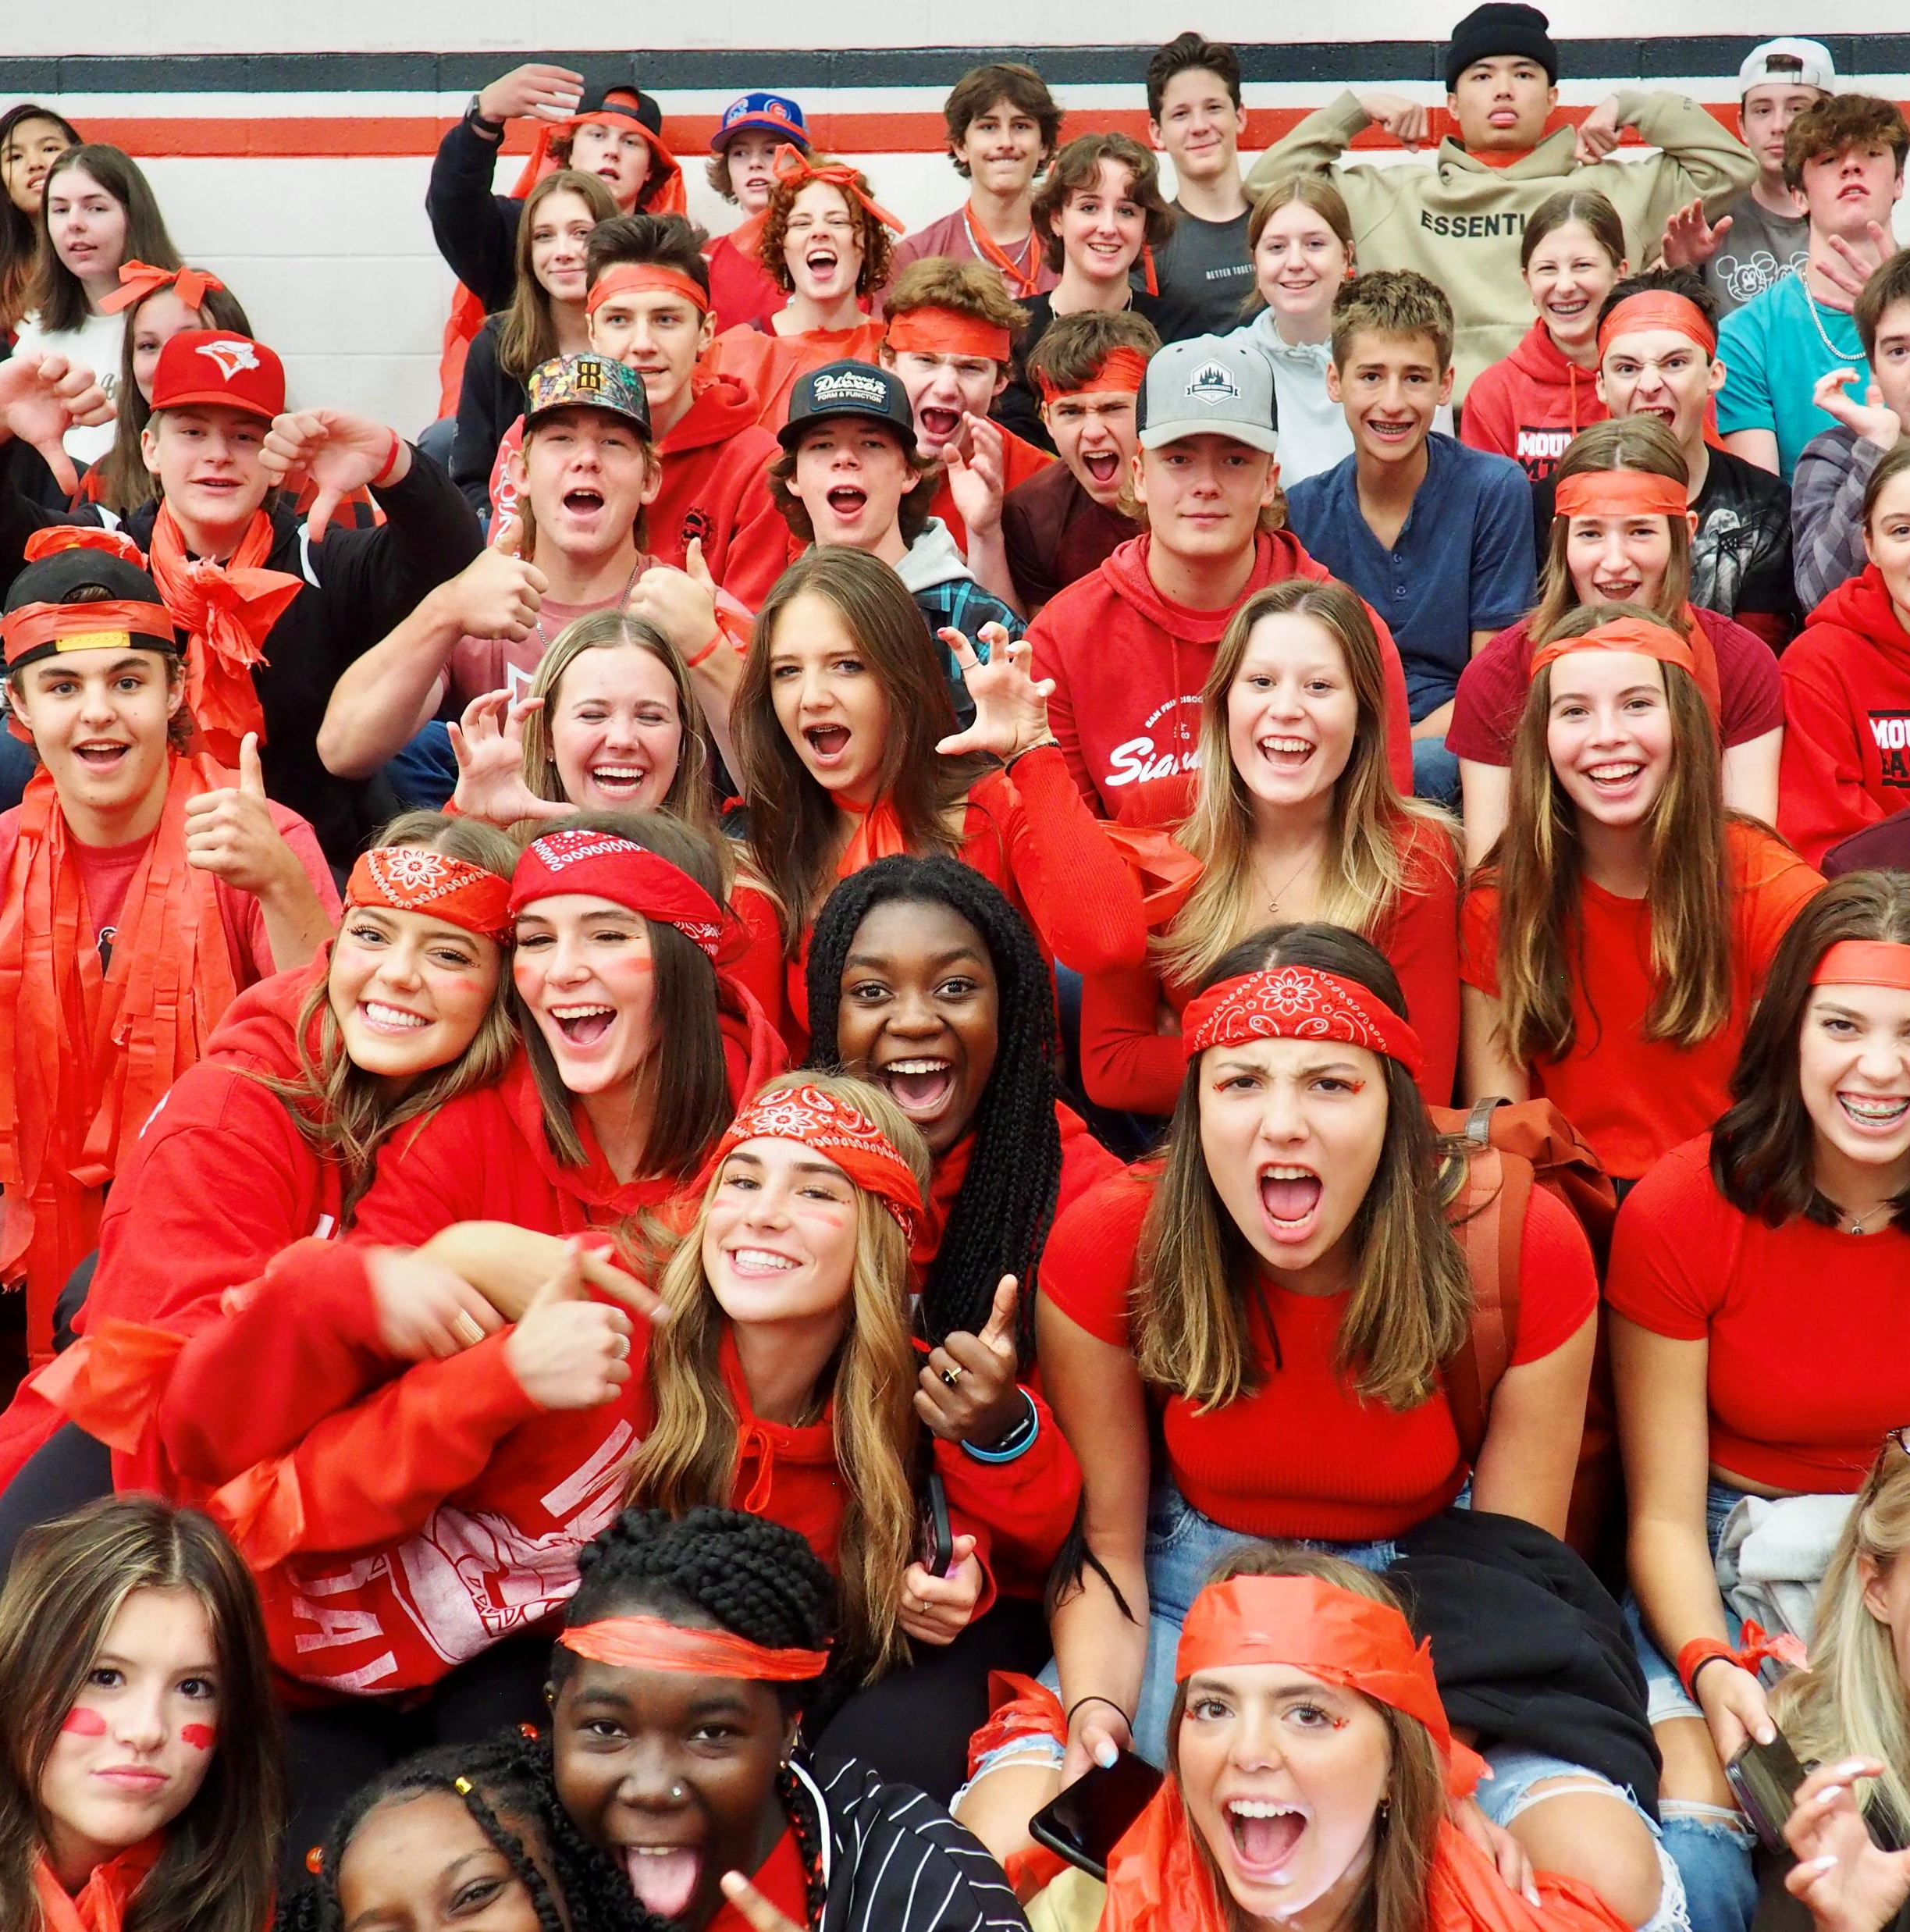
Welcome to Mount Baker Secondary School!

Slide 2
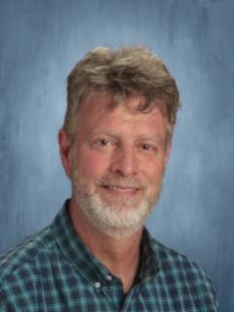
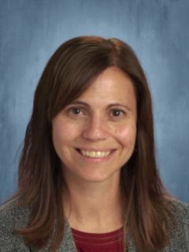
Administration team
Vice Principal
Mr. Sean Sinclair
Vice Principal
Ms. Christie Johnson
Principal
Mr. Dave Hill

Slide 3
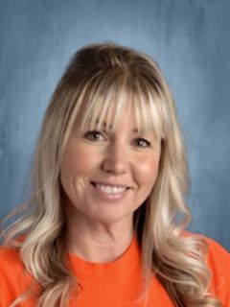
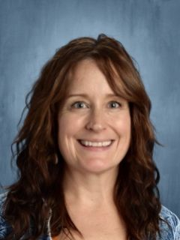
Counseling team
Ms. Jodi Lode-Hoyt
Ms. Leah Draper

Slide 4
Parent Night:
March 14th at 6pm in the Library
*After Spring Break, we will come to your school to support those of you who need help.
2 Handouts Today:
Course Selection Directions
With a QR code to take you to the Course Selection Book to see Electives with videos
&
Course Selection Sheet
(to plan your courses)
Questions?

Slide 5
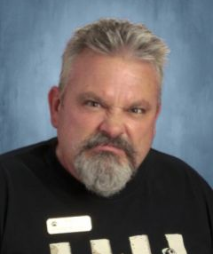
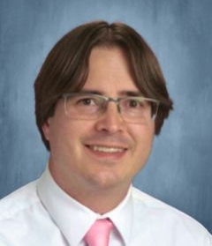
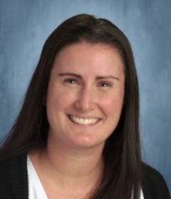
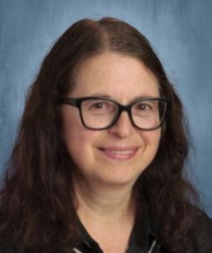
Student services team
Mr. Fred Subra
Mr. Kevin Hogg
Ms. Chantal Walters
Ms. Teresa Luxton

Slide 6
GRADE 10: Course selection
8 Courses Total:
6 Required Courses:
An English 10
A Math 10
Social Studies 10
Science 10
PE 10
Career Life Education 10
Plus :
2 Elective choices
or
1 Elective if you are taking Band
or
1 Elective if you are French Immersion
or
0 Electives if you are in Band and FI
*This course at Baker prepares you for Grade 12 Careers/Capstone
If you choose to do an online course, we recommend choosing one that is not offered at Baker..
Notes:
Social Studies:
Explorations 11 is a non-academic course, but counts toward grad credits.
All grade 12 Socials Studies are academic (Comparrative Cultures/BC First Peoples/Contemporary Indigenous Studies/20th Century World History)
Law and Philosophy are academic, but do not count as a Social Studies entrance course into universities in Alberta.
See your counsellor for clarification.
Math:
(Pre-Calculus, Foundations, OR Computer Science)
Science:
Science for Citizens is a non-academic course, but counts toward grad credits.
Academic options for university: Chemistry/Physics/Life Sciences (Biology)
**any extra core classes you choose count as electives.)

Slide 7
Youth care worker – Mickey DeCosse

Slide 8
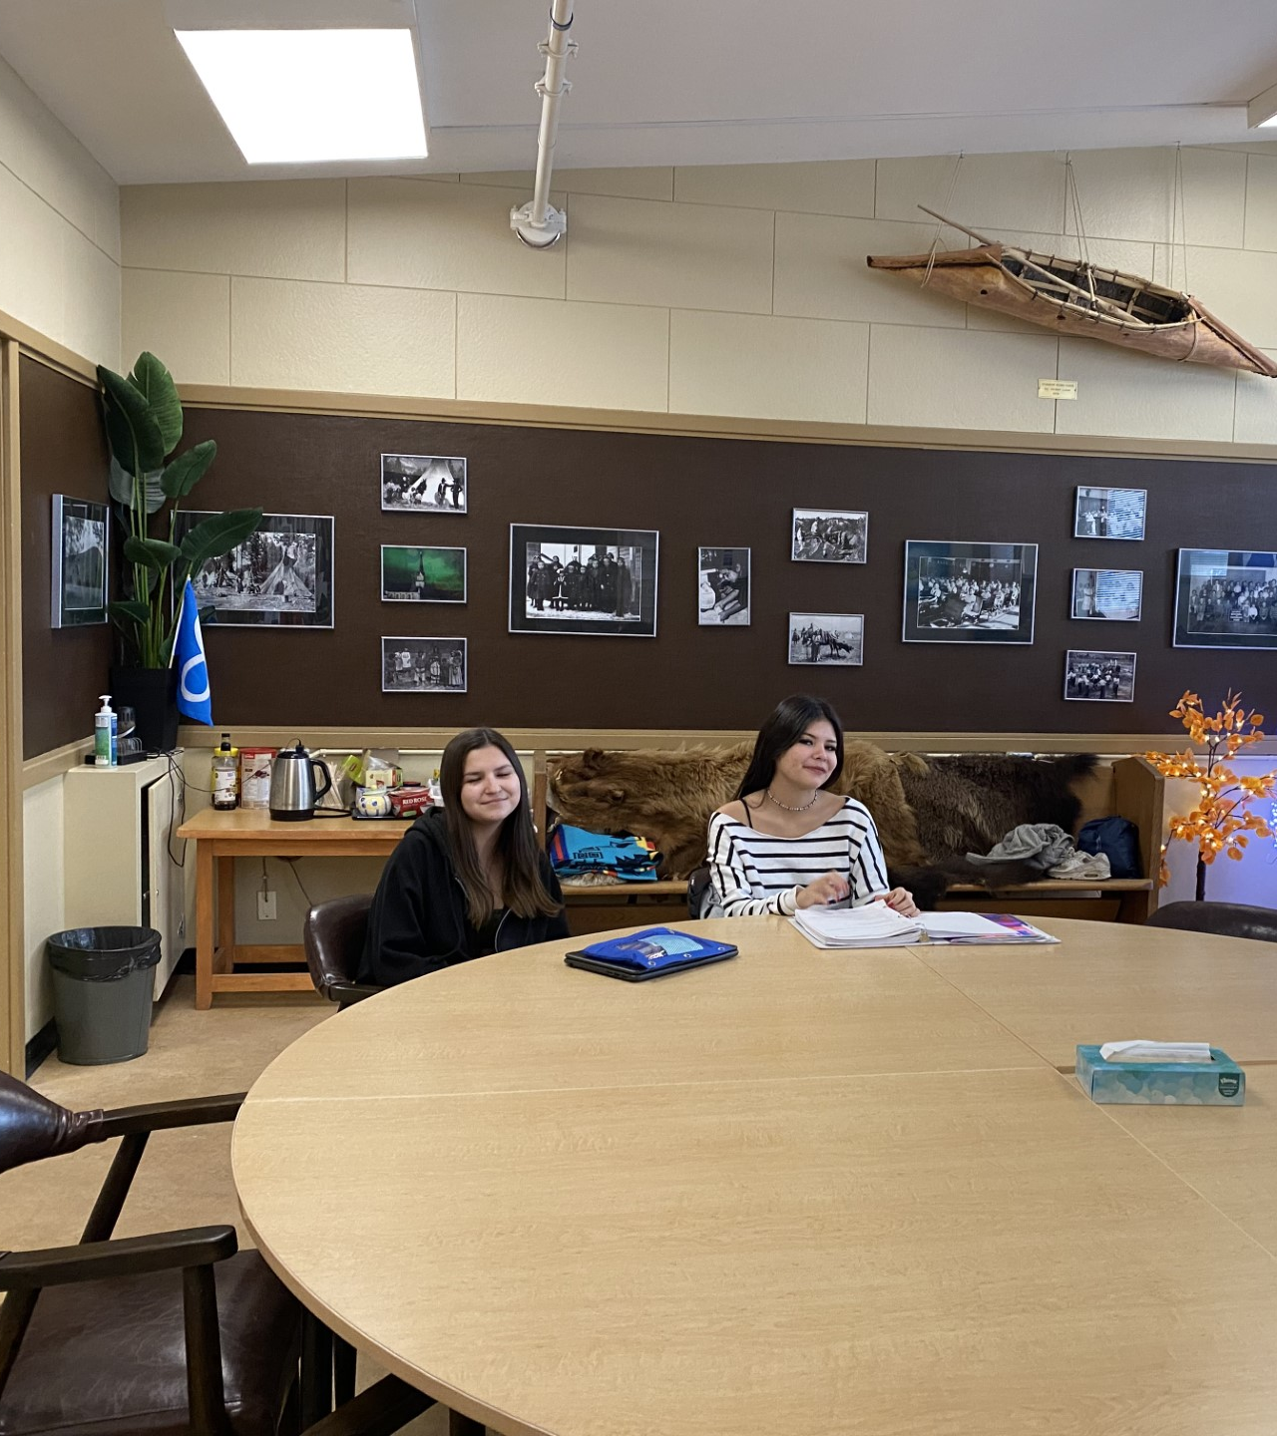
The gathering place
Our Indigenous Gathering Place is a welcoming space for students to work on homework, eat lunch, access academic support, and visit with Elders.
Indigenous Education Team: Alison Farkvam and Marie Dawson

Slide 9
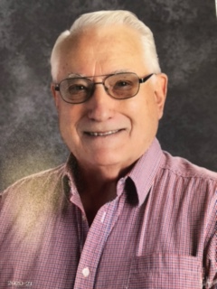
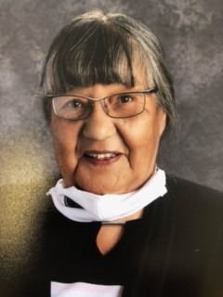
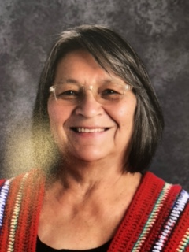
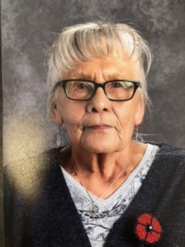
Elders In residence Top left to right – Dorothy ratch, mel ratch, winnie vitaliano bottom left to right: pheb Goulet and Joan o’neil

Slide 10
Erin stevenson School district 5 Gang Violence and exploitation prevention coordinator

Slide 11
80 credits = 20 courses!!!!
THE GRAD PROGRAM
Students need 80 credits to graduate in British Columbia
Most students graduate with 90+ credits
You must meet the learning objectives to graduate
If you do not pass a core course, you must repeat the course
Attend, work, be present

Slide 12
What to expect – the grad program
Credits must be earned in the following subject areas or courses:
A Language Arts 10 (4 credits)
A Language Arts 11 (4 credits)
A Language Arts 12 (4 credits)
A Social Studies 10 (4 credits)
A Social Studies 11 or 12 (4 credits)
A Mathematics 10 (4 credits)
A Mathematics 11 or 12 (4 credits)
A Science 10 (4 credits)
A Science 11 or 12 (4 credits)
Physical and Health Education 10 (4 credits)
An Arts Education and/or an Applied Design, Skills, and Technologies 10, 11, or 12 (4 credits)
Career Life Education (4 credits)
Career Life Connections (4 credits)
Indigenous-focused (4 credits)

Slide 13
Academics, arts, and athletics
Mount Baker has many opportunities to get involved in the academics, arts, and athletics.
Teams include rugby, basketball, volleyball, cross-country running and track and field, soccer, mountain biking, and badminton.
The arts programs include photography, visual arts, the opportunity to participate in art shows and trash fashion.
We offer Advanced Placement courses and many opportunities to push your academic boundaries.

Slide 14
Shape of the day
9:00-9:15 Presentation
9:15-11:30 Rotate through the “stations” with your groups
11:30-11:45 Pizza in the gym
11:45 Parkland students load the buses, Laurie students start to walk back up the hill.

