Slide 1
WHILE YOU WAIT What Digital Literacy skills can be taught by allowing students to have mobile phones in classrooms?
https://yoteachapp.com/Should_Mobile_Phones_Be_Used Room Password: it4k12
Notes:
RYAN
Warm up activity –Give participants about 5 minutes to respond
Discuss:
Were you surprised with any of the responses?
What can teachers do with this data?
Possible answers include: create a pros and cons list and discuss, calculate percentages of yes versus no, create a PSA video either for or against using mobile phones, etc.
How does this activity assess digital literacy?
Social Emotional Competency (respectfully responding to a post) and Photo-visual Thinking (understanding meanings represented by the icons of an app)
Community of Inquiry connection:
-use an icebreaker to a course and Social Presence –community building

Slide 2
You Can't Pause the Game! What the Grade 4 Students Want You to Know
Ryan McKenzie and Kim Froehler
Notes:
Introduce ourselves and what we do...
Ryan's story –Uni Gorilla Tag

Slide 3
Digital Literacy is...
the "ability to make informed judgments concerning what one found online" (Gilster, 1997)
the ability to use "complex thinking competencies" such as
Cognitive
Motor
Emotional and social skills."
(Eshet-Alkalai, 2012)
Notes:
KIM
Do you agree or disagree with these definitions? Why or why not?
Any skills related to living and working with the digital world...

Slide 4
Digital Literacy is
"more than just arming oneself with the technical abilities to operate digital devices, tools, and surfing the Internet..." (Porat, et al, 2018)
Notes:
KIM
It's more than technical skills...

Slide 5
Assessing Digital Literacies
In 2018, a study published in "Computers and Education" assessed 280 junior high students' digital literacies using criteria from six different categories "...with the aim of comparing participants perceived digital literacy competencies and their actual performance in relevant digital tasks. (Porat et al., 2018)
Notes:
KIM – rated themselves the best for SEL and their performance was the worst

Slide 6
Perception versus Reality
"The findings showed that only a few of the participants' perceived skills were related to their actual performance...
The gap was most evident in social-emotional skills, which were, on average, perceived by students as their strongest skills, while their actual performance was very low."
(Porat et al., 2018)
Notes:
In light of this, what does this mean for the Digital Literacy survey that was conducted in 2021-22 with gr 4/5 students from School District 5 (the results of this survey were covered in the first part of the presentation by Ryan McKenzie)?
We need to find practical ways to accurately assess students knowledge, skills, and abilities to obtain more accurate data.
We can use the framework that was used in the study from 2018 as our first steps.

Slide 7
What we did – SD5 FESL Team 2021-22
Survey
Scope and sequence
Growing set of resources
Notes:
Ryan –over 200 grade 4 students, over 30 Teachers and Teacher Librarians across the district – met multiple times (two groups) base survey, modified it and then was given to students...
Scope and Sequence – working on that for a few years
Resources – curating continues

Slide 8
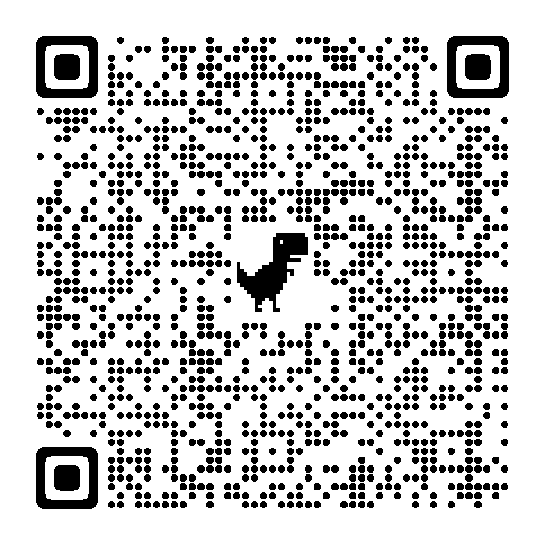
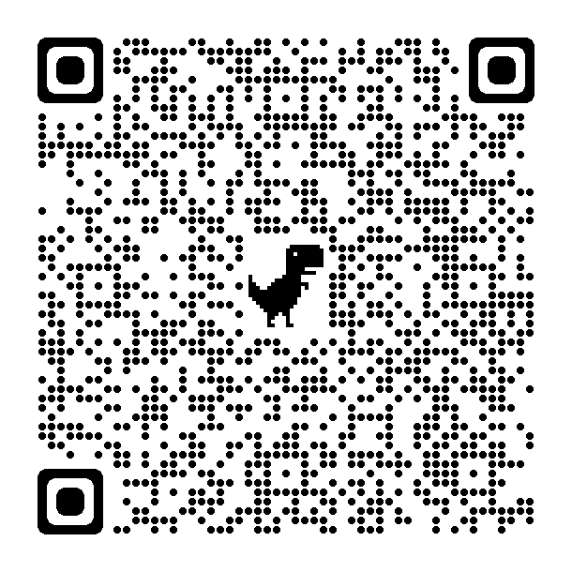
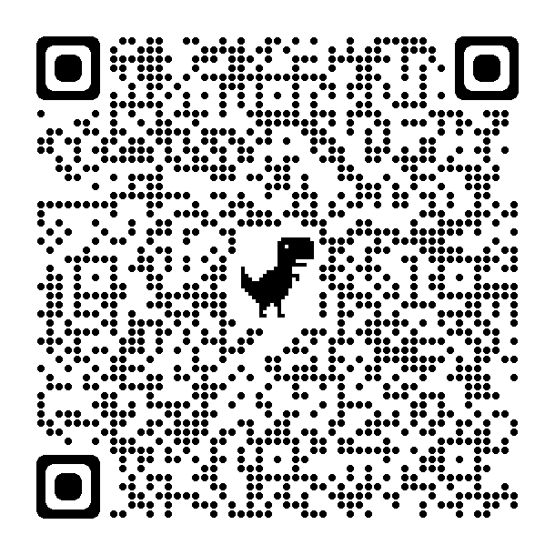
You Can't Pause the Game
Results from the SD5 grade 4 student Digital Literacy Survey
FOLLOW ALONG
Access
Technology Skills
Online Activity
Notes:
Ryan – will open up the results
You can't pause the game! - more social environment than we think – home environment

Slide 9
Grades | SKILLS | ELABORATIONS
K-1-2 | Handling | Safe handling of device, storage, plugging in, turning off log off device
K-1-2 | Dexterity | Mouse pad layout, keyboard layout, touch screens, ports and buttons
K-1-2-3 | Listening | Respect for others, minimize distractions, tilt screen, turn tablet over
K-1-2-3-4 | Sharing | Listening, preparedness, staying on topic
3-4-5-6-7 | Online Behaviour | Staying on task, LanSchool, safe sites and searches, commenting
4-5-6-7 | Security | Passwords, logging off/on, Sharing information
4*-5-6-7-8 | Online Safety | Personal information, communication,
5-6-7-8 | Physical Well-Being | Posture, screen time, screen setup (zoom, font, brightness)
7-8-9-10 | Digital Literacy | Website evaluation, source evaluation and cross checking,
6-7-8-9-10 | Mental Well-Being | Screen time, Online peer group, social media
8-9-10-11-12 | Copyright | Citations, summarizing, sources
Social Skills

Slide 10
Grade | SKILLS | ELABORATIONS
K-1-2 | Login | Learning student number, email, password
K-1-2 | Device Navigation | Finding apps, opening and closing apps, searching applications, finding files
K-1-2-3-4 | Digital Images | Taking photos, copy/paste photos, storage
3-4-5 | Internet Navigation | Different browsers, tabs, search engines, home tabs, bookmarks, extensions, qr codes and links
3-4-5-6-7 | Digital Video | Capturing video, storing, editing (iMovie)
4-5-6-7 | Digital Audio | Kurzweil, audio recording, mics and headsets, audio editing
4-5-6-7 | Basic Programming | Unplugged activities, block-based coding
5-6-7-8 | Keyboarding and Speech to Text | Dictation and Immersive Reader
6-7-8-9-10 | File Management | Files, folders, drives, saving locally and to the cloud, organization and deleting old files
6-7-8-9-10 | Email | To, cc, bcc, subject, attachments, etiquette, digital signature
8-9-10-11-12 | Advanced Research | Filtering search, search operators, fact checking/verifying
8-9-10-11-12 | Advanced Programming | Text based programming, Web Editing, software customization
8-9-10-11-12 | Mastery of Basic Digital Tools | O365, District Approved applications, combining tools into one product
8-9-10-11-12 | Mastery of Specialized Tools | Photoshop, Autodesk, Drafting, video editing...
Technical Skills

Slide 11
 | SKILLS | ELABORATIONS
4-5-6 | O365 Navigation | Opening apps, navigating to home, opening online
4-5-6 | Whiteboard | Drawing ideas, sharing space with others, staying on topic
4-5-6 | Word | Dictation, typing, adding artifacts, shared projects
4-5-6 | Powerpoint | Creating simple slides, animations, audio recordings, presenting without reading
5-6-7 | Sway | Storyline, design, inserting Creative Commons images and videos
5-6-7 | One Drive | Saving folders, files, uploading, downloading, sharing
7-8-9 | Outlook | Digital signature, introductions, salutations, content, adding attachements, CC and BCC
9-10 | Teams | Sharing files
10-11-12 | One Note | Class Notebook
7-8-9 | Forms | Quizzes, tests, creating surveys, gathering data
10-11-12 | Stream | Creating content for channel, sharing with others
10-11-12 | Flow | Customizing workflows to optimize tasks
Tools

Slide 12
Grade | Skills | ELABORATIONS
3-4-5 | Basic Navigation | My site, district, class site
K-9 | Portfolios | Teacher upload, student upload, parent connection
5-12 | Blogs | Tags, profile, adding images, videos and links, comments,
5-12 | Assignments | Opening assignments, turning in assignments, copying to portfolio
7-12 | Discussions | Topic Forums, gathering data, collaboration
LMS

Slide 13
SD5 Resources
Resources for Teachers and Students
Book List

Slide 14
Digital Literacy Competencies
1 Photo-visual literacy
2 Reproduction literacy
3 Information literacy
4 Branching literacy
5 Social-emotional literacy
6 Real-time thinking literacy
Eshet-Alkalai (2012)
Notes:
Definitions taken directly from Table 2 Comparisons of DL measurements –self evaluation and performance (Porat et al., 2018) These definitions are in the handout provided.
Photo-visual literacy: Understanding information presented in illustrations, maps, and meanings represented by icons of an app
Reproduction literacy: Addressing things that other people wrote online when writing a new text of my own, connecting between a number of different online sources when writing a new text of my own, using others' illustrations to create a new illustration/collage of my own, using others' videos to create a new video of my own
Information literacy: Finding the information I'm looking for on the internet, identifying incorrect or inaccurate information in a list of internet search results, comparing information from different websites to check whether the information I found is reliable
Branching literacy: Navigating my way through a complex website with many webpages, constructing meaning from information on a website with many web pages, not "getting lost" on a website with many web pages
Social emotional literacy: Being careful not to post personal information about myself when I send a message through email, forum, SMS, WhatsApp, Facebook, etc., Being careful not to post personal information about my friends when I send a message through email, forum, SMS, WhatsApp, Facebook, etc., staying aware of the possibility that a message that I wrote in an email, forum, SMS, WhatsApp, Facebook, etc., could reach other people, such as parents or teachers, respectfully relating to the opinions of others when responding through email, forum, SMS, WhatsApp, Facebook, etc.,
Real-Time Thinking literacy: Ignoring ads that pop up while looking for information for an assignment, ignoring messages that pop up (for example, friends' statuses) while looking for information for an assignment, responding and reacting quickly when I’m playing a digital game or simulation

Slide 15
Photo Visual Literacy
Competencies
Students must navigate the software by intuitively understanding the icons and symbols without direct instruction from the teacher
Digital Task
Use a "new to students" software to create a greeting card
Software or Resources
sketch.io
(Porat et al, 2018)
Notes:
Researchers used pixlr (but it requires a sign in)
Sketch.io is free and icon based

Slide 16
Reproduction Literacy
Competencies:
Remixing others' ideas, videos, or connecting between a number of different online sources when writing a new text of my own
Digital Tasks
Create an original text by combining, rewriting, and connecting information
Create a digital poster or presentation for a given topic and "digitally recycling" information found on the internet
Software or Resources
Microsoft Word/PowerPoint
Scratch
(Porat et al, 2018)
Notes:
Researchers used pixlr (but it requires a sign in)
Sketch.io is free and icon based

Slide 17
Information Literacy
Competencies:
Finding information on the internet
Evaluating information on a website as being reliable, objective
Comparing information on different websites
Digital Task:
Choose a topic and find 5 websites related to the topic and evaluate the information
Software or Resources
Boolean Operators (AND, OR, NOT, etc.)
BC Digital Classroom resources (World Book, Gale, etc.)
(Porat et al, 2018)
Notes:
Researchers used pixlr (but it requires a sign in)
Sketch.io is free and icon based

Slide 18
Branching Literacy
Competencies:
Navigating through a complex website and not "getting lost"
Constructing meaning from information on a website with many webpages
Digital Tasks:
Create an online travel guide to a city they have never visited including a map, schedule, and information about the destination
Software or Resources
Google Earth, Google Maps
Wander app (VR)
YouTube
Other websites
(Porat et al, 2018)
Notes:
Researchers used pixlr (but it requires a sign in)
Sketch.io is free and icon based

Slide 19
Social Emotional Literacy
Competencies
Not posting personal information about self or others online
Aware that messages written online could be reach other people
Respectfully relating to the opinion of others when responding online
Tasks:
Participate in workshops, lectures, special projects related to internet safety
Think about the positive and negative aspects of the topic, express their opinion and importance of responding appropriately online
Software or Resources
Blogging
Debates
(Porat et al, 2018)
Notes:
Researchers used pixlr (but it requires a sign in)
Sketch.io is free and icon based

Slide 20
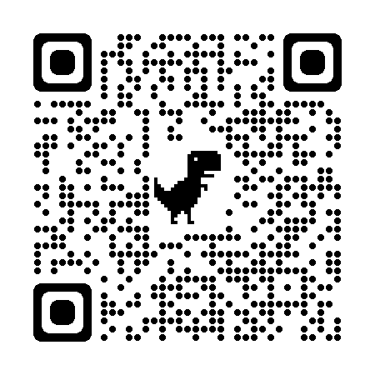
Kialo – Discuss & Debate
https://www.kialo.com/tags/Technology
(Kialo-edu.com sign up for an account without email)

Slide 21
Real-time Thinking Literacy
Competencies
Ignoring ads that pop up when online
Ignoring messages from friends while looking for information on an assignment
Responding and reacting quickly when playing digital games or simulations
Software or Resources
Virtual reality games
Multitasking games - http://multitaskgames.com/multitask-game.html
(Porat et al, 2018)
Notes:
Researchers used pixlr (but it requires a sign in)
Sketch.io is free and icon based

