Slide 1

PLANTING THE SEEDS
SD5 SEL/AEN
2022-23
Kimberly Richards
District Social Emotional Learning Teacher
MEd., EXAT, Neuroeducator (2021)

Slide 2
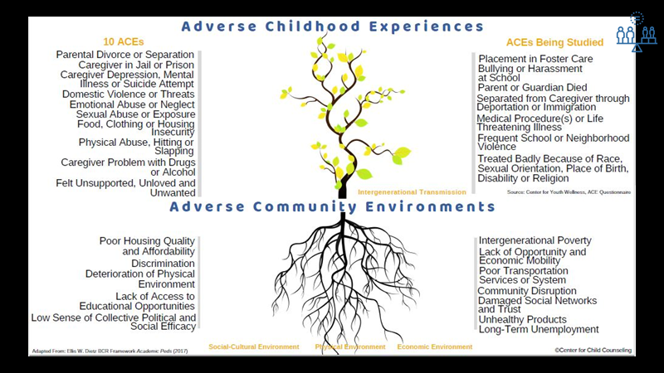

Slide 3
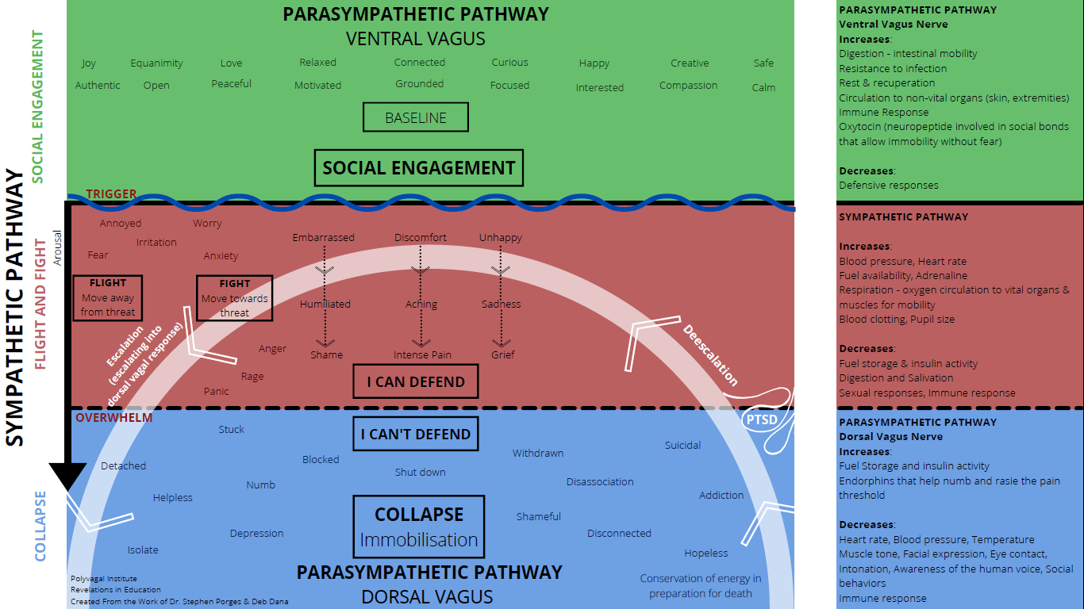
Notes:
Polyvagal Theory for Autonomic Nervous System

Slide 4
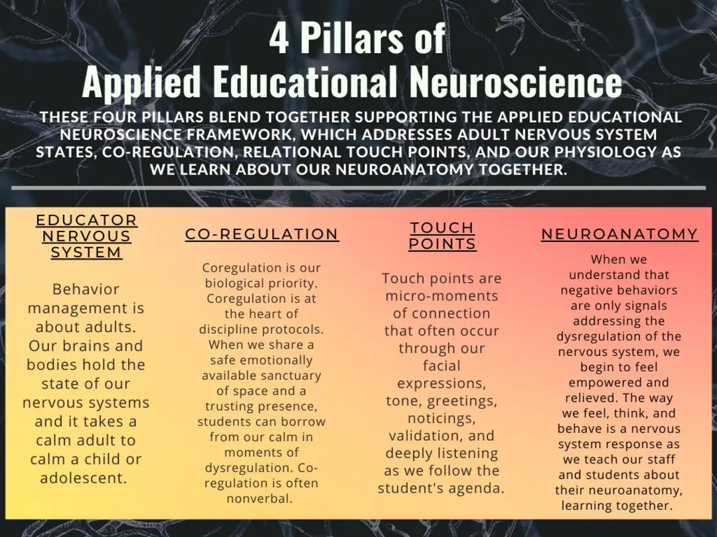

Slide 5
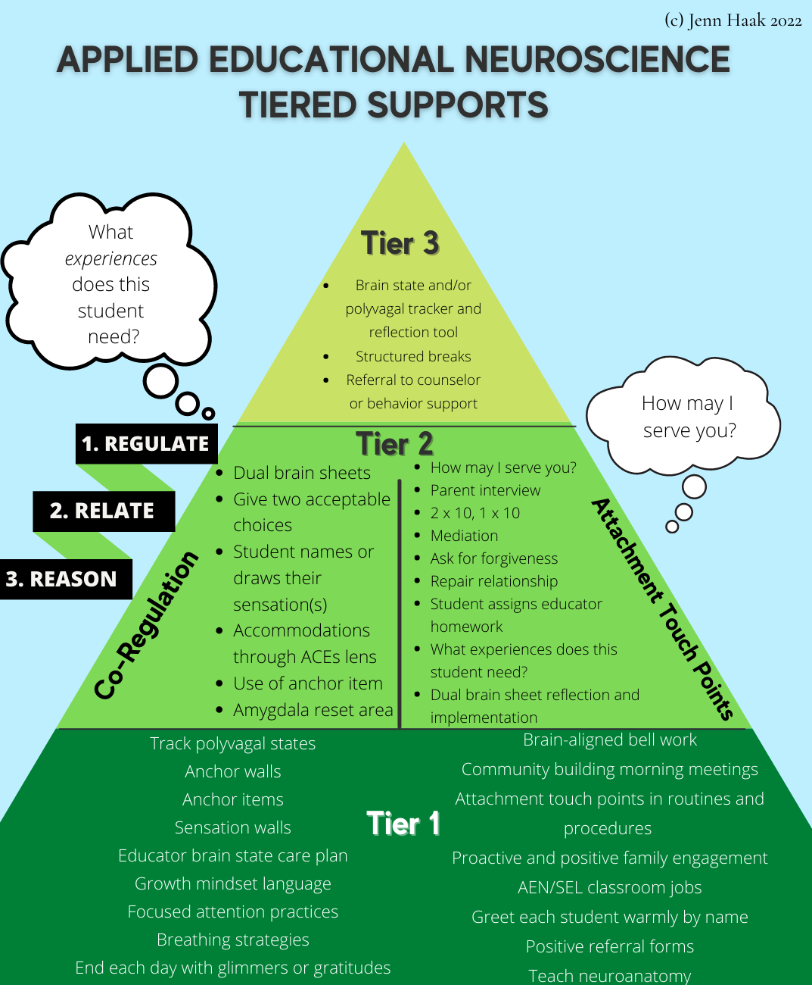

Slide 7

THEN TO NOW...
SD5’s Journey with SEL
Social Emotional Learning Centre Pull-Out
Social Emotional Learning Centre Push-In
Social Emotional Learning Centre beginning Data Baseline & Interoception & Adult Focus
2022/23
Building a strong Tier 1 & 2 Foundation –CAPACITY BUILDING
Changing the lens from a program to a framework that is imbedded in our routines, procedures and focused on building safe, nurturing relationships within our buildings
Connection over Compliance –understanding how to support the nervous system growth and health of our staff and students carrying in toxic stress/trauma
It is a journey…

Slide 8
