Slide 1

MBSS Grad Scholarship Information Night

Slide 2
Does your grad have what they need?
All required courses & a minimum 80 credits
At least 1 Fine Arts or Applied Skill course
16 credits at the grade 12 level (including CLC 12 and English 12)
3 x Assessments (Lit 10, Num 10 & Lit 12)
1 x Indigenous focused course

Slide 3
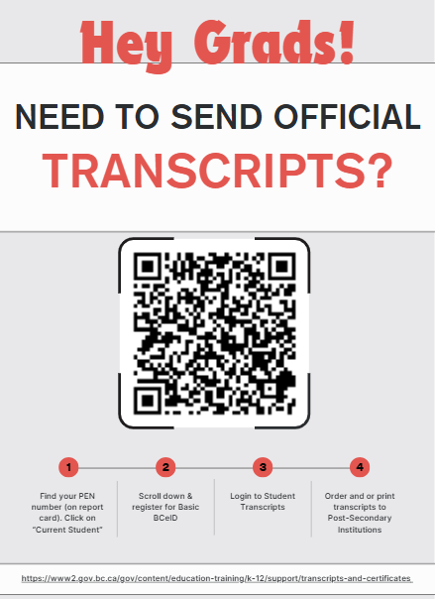
Not sure? Log into the BC Transcript Service →

Slide 4
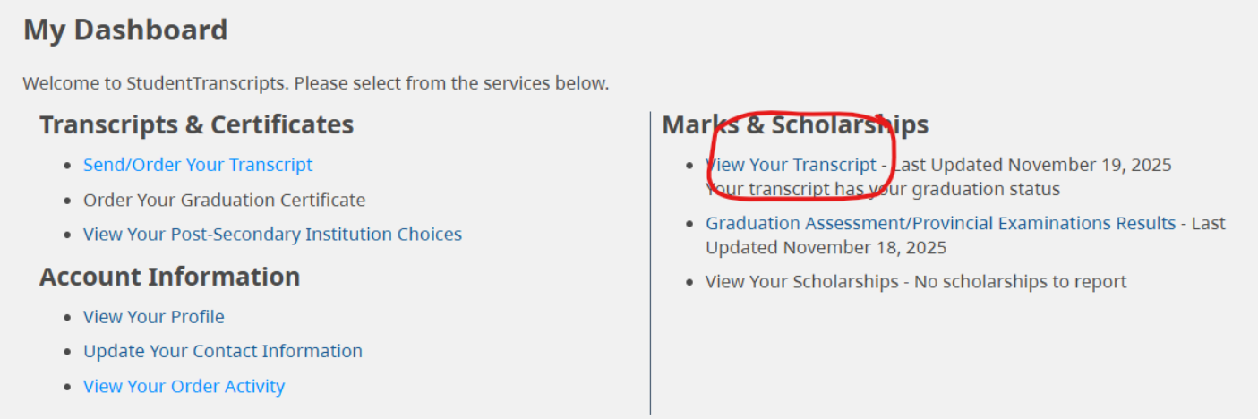
Steps:
1. Go to Ministry Transcript Service → Create a BCEID account
(need PEN number, legal name and a preferred email)
2. Once created, confirm email.
3. Re-login to BC Transcript service and go to “view transcript”.
4. View as PDF.
Notes:
Go to Ministry Transcript Service
Create a BCEID account
(need PEN number, legal name and a preferred email)
Once created, confirm email
Re-login to BC Transcript service and go to view transcript
see below:
View as PDF and it shows tons of information

Slide 5
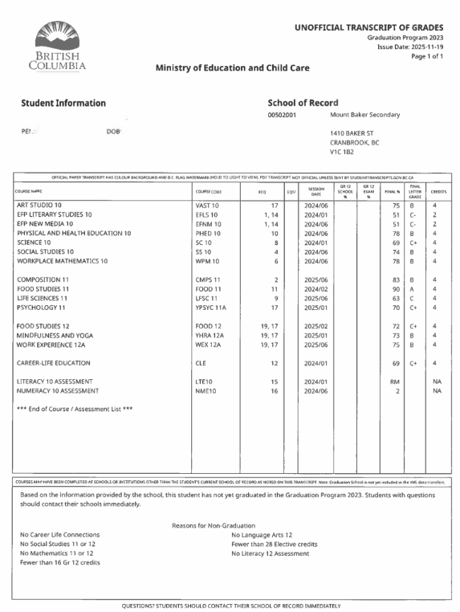
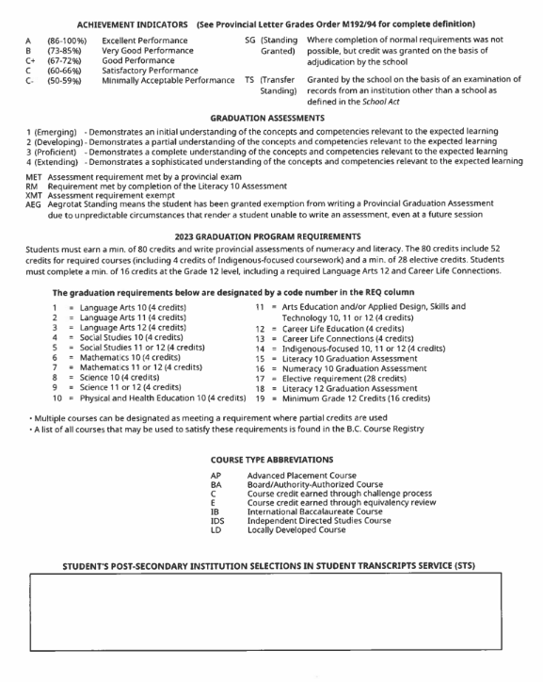

Slide 6
Scholarship Categories
1. Internal: MBSS graduates only
2. District/Provincial: BC graduates
3. External: Any graduate, anywhere.
4. Entrance: Specific to each Post-Secondary

Slide 7
MBSS (Internal) Scholarships
Mount Baker Students ONLY
Apply online on MBSS website:
Opens Feb 17, 2026 – April 2, 2026 (*3:00PM)
https://www.sd5.bc.ca/mbss/graduating-student
Notes:
Application online that covers all local scholarships/bursaries
Preference given to full-time students for the top academic awards
Some require an additional application, see list on website
Awarded on scholarship night from various local businesses and organizations

Slide 8
MBSS (Internal) Scholarship Eligibility:
Graduate in good academic standing
Completed the online application by April 2, 2026
Completed minimum 32 credits through SD #5
Affiliation and/or Citizenship and/or Academic
Academic based on UVIC entrance guide:
https://www.uvic.ca/undergraduate/admissions/how-to-apply/approved-high-school-courses/bc-yukon/index.php#ipn-academic-12
Online courses must be 75% complete and self-reported by May 1, 2025
Notes:
Based on criteria of the donor – (academics, affiliation, or citizenship)
Print the booklet so that you know what the donor is looking for.
Don’t undersell yourself. Put everything you are involved with. Too much
*Fill out application with your student to help with the affiliation
Many are chosen by the donor
The principal will abstain from the scholarship selection committee
Academic averages based on five courses from approved academic courses. Reference University of Victoria entrance guide

Slide 9
Open Awards vs. Limited Awards
Open:
All students who have applied
Generally based on academics and/or citizenship
Limited:
- Criteria specified by donor
- May be based on specific subject area or direct affiliation
Notes:
Open:
General (examples)
Cranbrook Lions Club– deserving graduate
Cranbrook Rotary Club Scholarship – deserving graduate w/ preference to student demonstrating community involvement
Career-Related (examples)
F.W. Green Scholarship – deserving graduate entering health care / medicine
Brian Mackie Memorial Art Scholarship – deserving art student pursuing career in Visual Arts
Closed:
Subject Area (examples)
Apex Accounting Scholarship – Top student who has chosen accounting as Post-Secondary field of study (must have taken Accounting 11 & 12)
Larisa Zak Memorial Drafting Award – deserving Drafting student
Organization / Affiliation (examples)
Gyro Open Scholarship – deserving graduate. Preference given to a child/grandchild of a Gyro member
Chris Williams Bursary – deserving graduate of Indigenous Ancestry

Slide 10
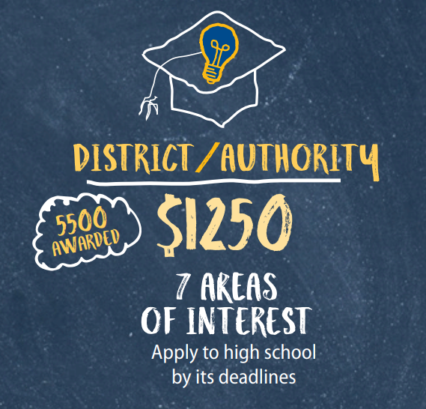

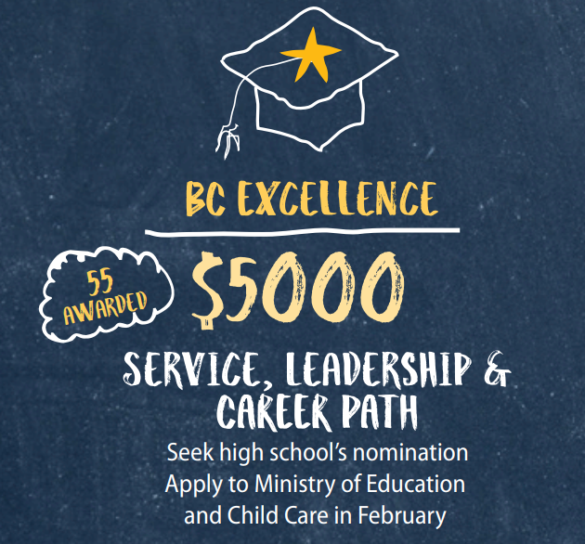
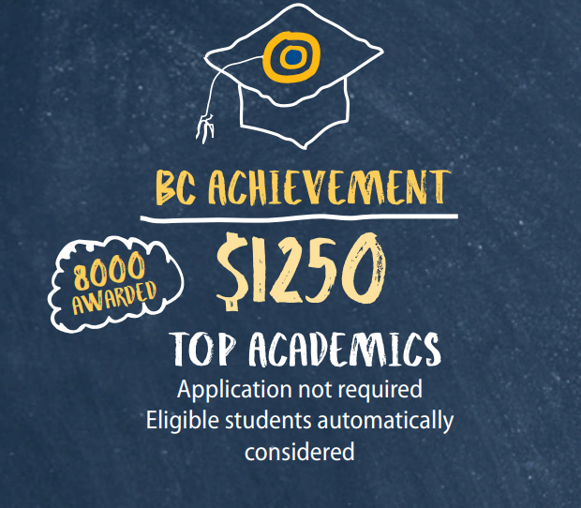
District/Provincial Awards
Apply by May 1st
(Involves presentation)
Apply by Feb. 15th
No application required
Apply to MBSS by Feb. 6
Check SD5 District Scholarship page:
https://www.sd5.bc.ca/scholarships
Notes:
Separate applications required
Closing dates vary
Examples include:
Sarah Whetham Memorial Scholarship
$1000, female graduate
Highest mark on the Euclid Exam – continuing studies in Math, Physics, Engineering or Computer Programming
School District No.5 Top Student Award
$1000, best final mark in English 12 or English First Peoples 12
Leadership qualities (ability to inspire others)
Extra curricular activities both inside and outside of school

Slide 11
External Scholarships & Awards
https://www.sd5.bc.ca/mbss/external-scholarships
Self directed: No connection to school district
Available to any student, anywhere.

Slide 12
Entrance Scholarships, Awards, & Bursaries
Applications typically open October 1st
Search “Financial Aid” on specific Post-Secondary Institution websites
Example: College of the Rockies
https://cotr.bc.ca/student-services/student-support/financial-aid/

Slide 13
Support with Scholarships:

Slide 14
How to Apply & Send Official Transcripts
https://apply.educationplannerbc.ca/
https://www.postsecondarybc.ca/
https://learnerregistry.ae.alberta.ca/Home/StartAsnRequest
https://prod.applyalberta.ca/
https://www2.gov.bc.ca/gov/content/education-training/k-12/support/transcripts-and-certificates
https://studentaidbc.ca/sabc-home-page

