Slide 1
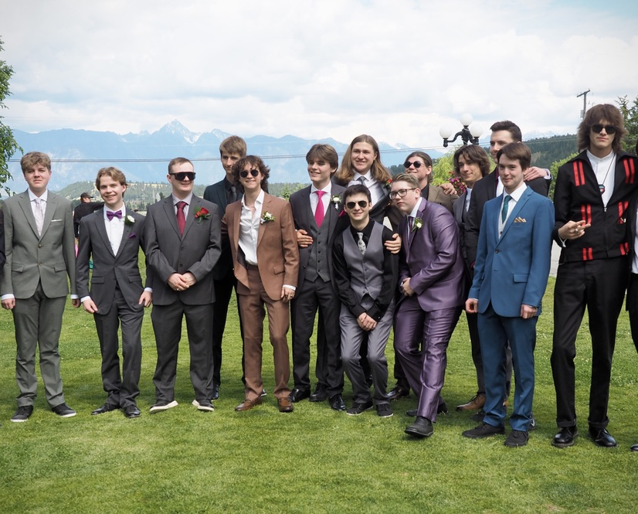
Title Slide Option 1
Pre- Prom
The
2024
Grad Class
@ St. Eugene’s

Slide 2
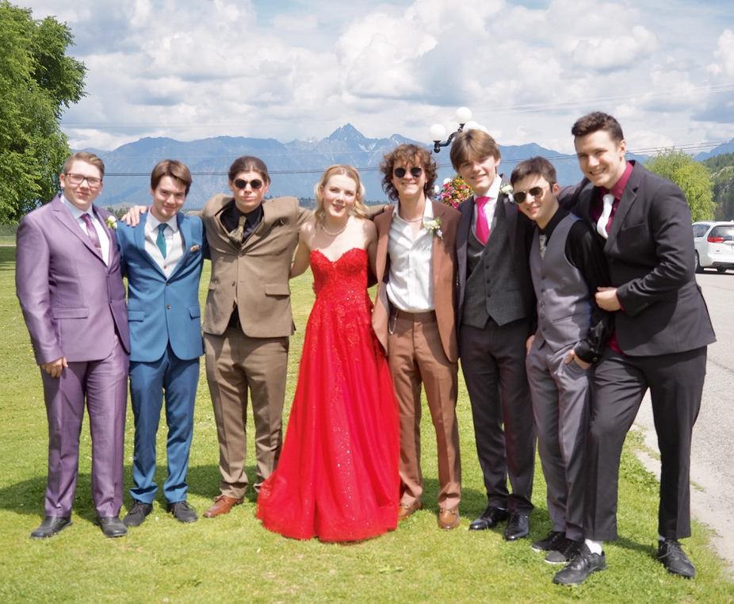
Title Slide Option 2
Pre Prom
The
2024
Grad Class
At St. Eugene

Slide 3
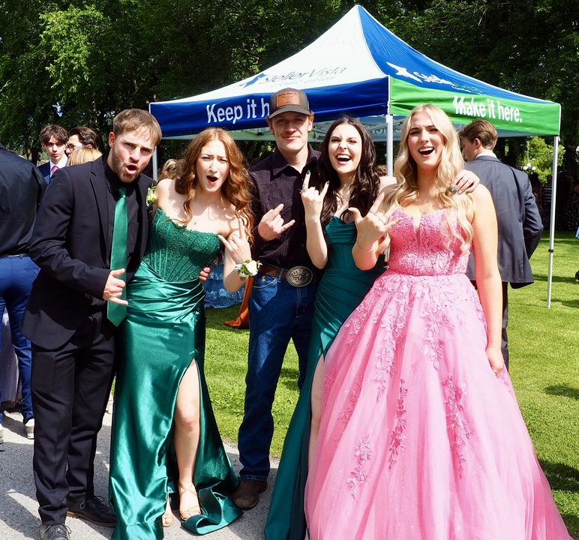
Title Slide Option 3
Pre Prom
The
2024
Grad Class of
At St. Eugene

Slide 4
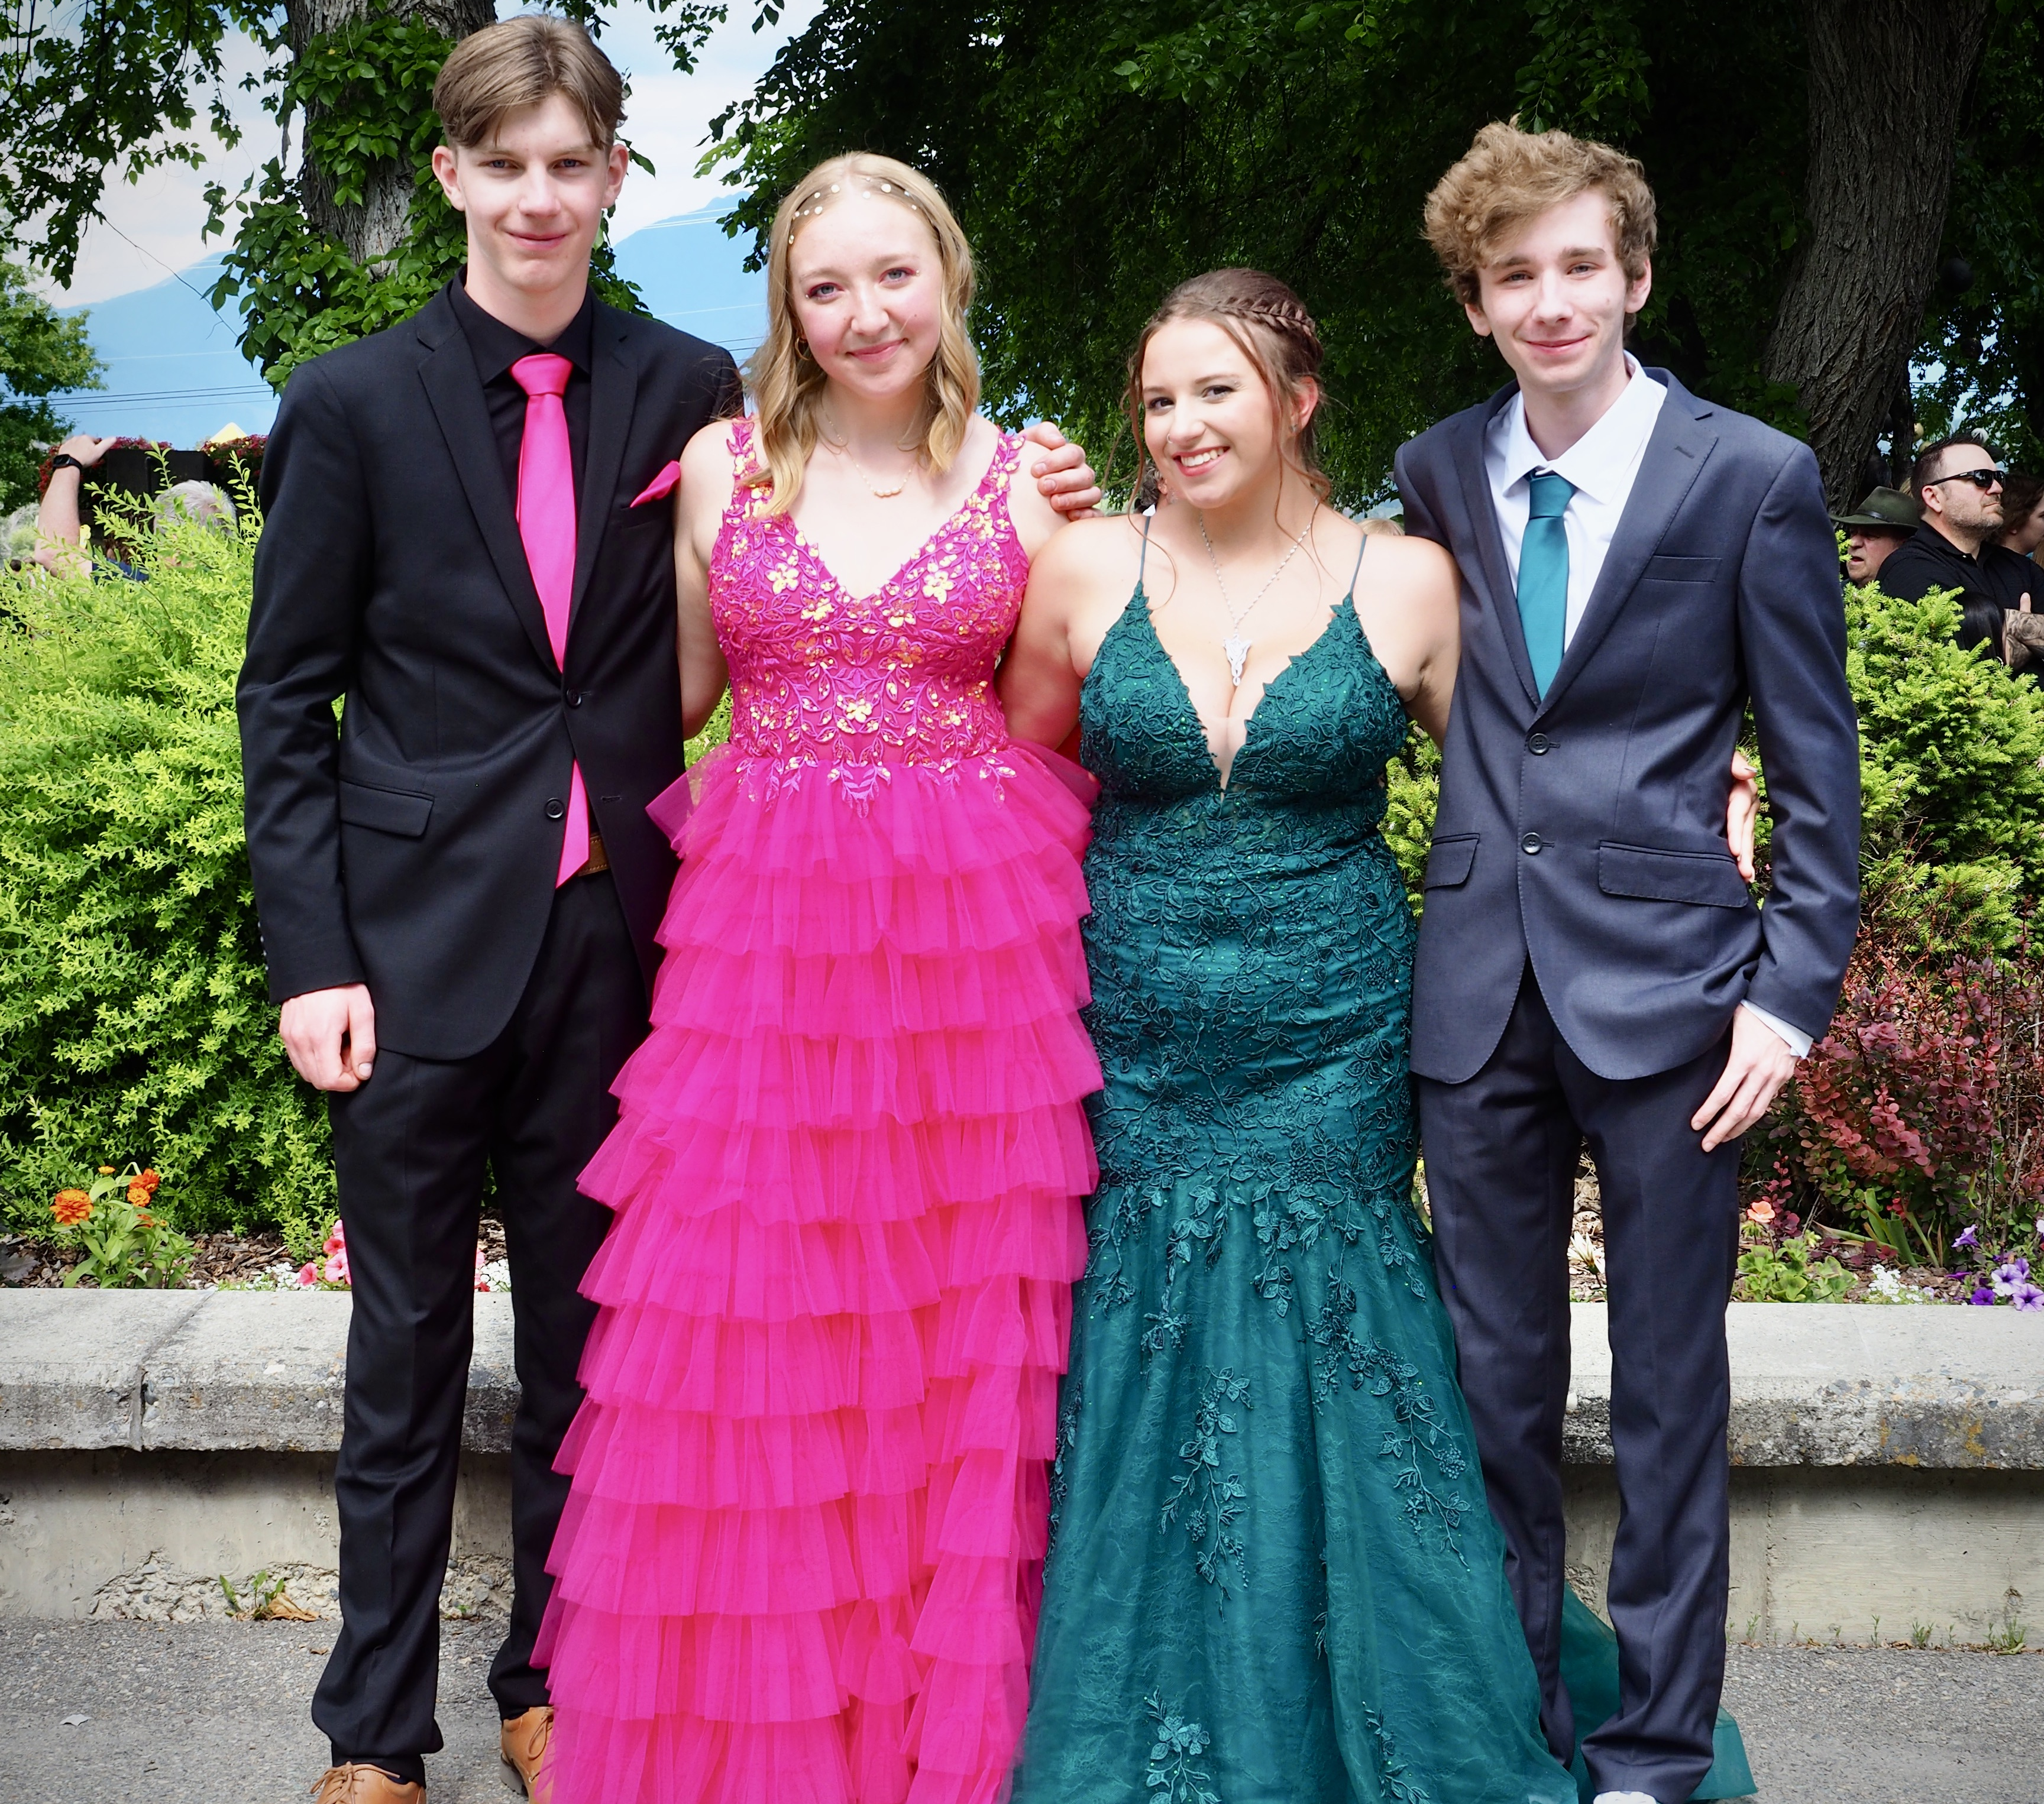
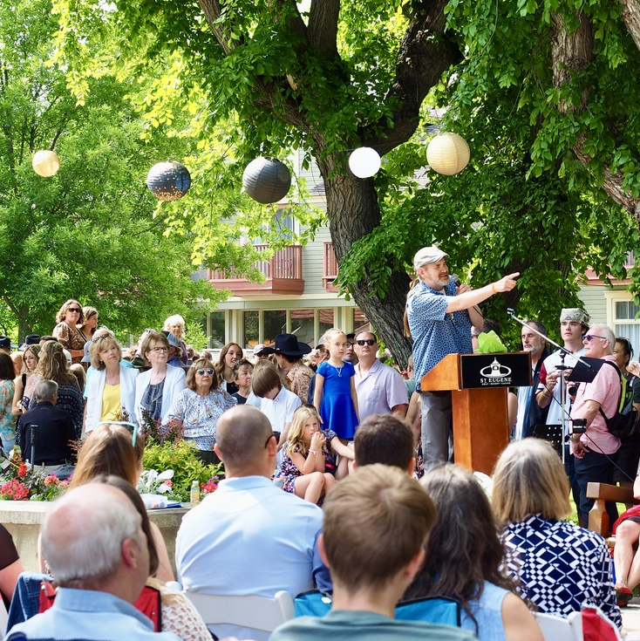
2 Images Option 1
Chief Joe Pierre

Slide 5
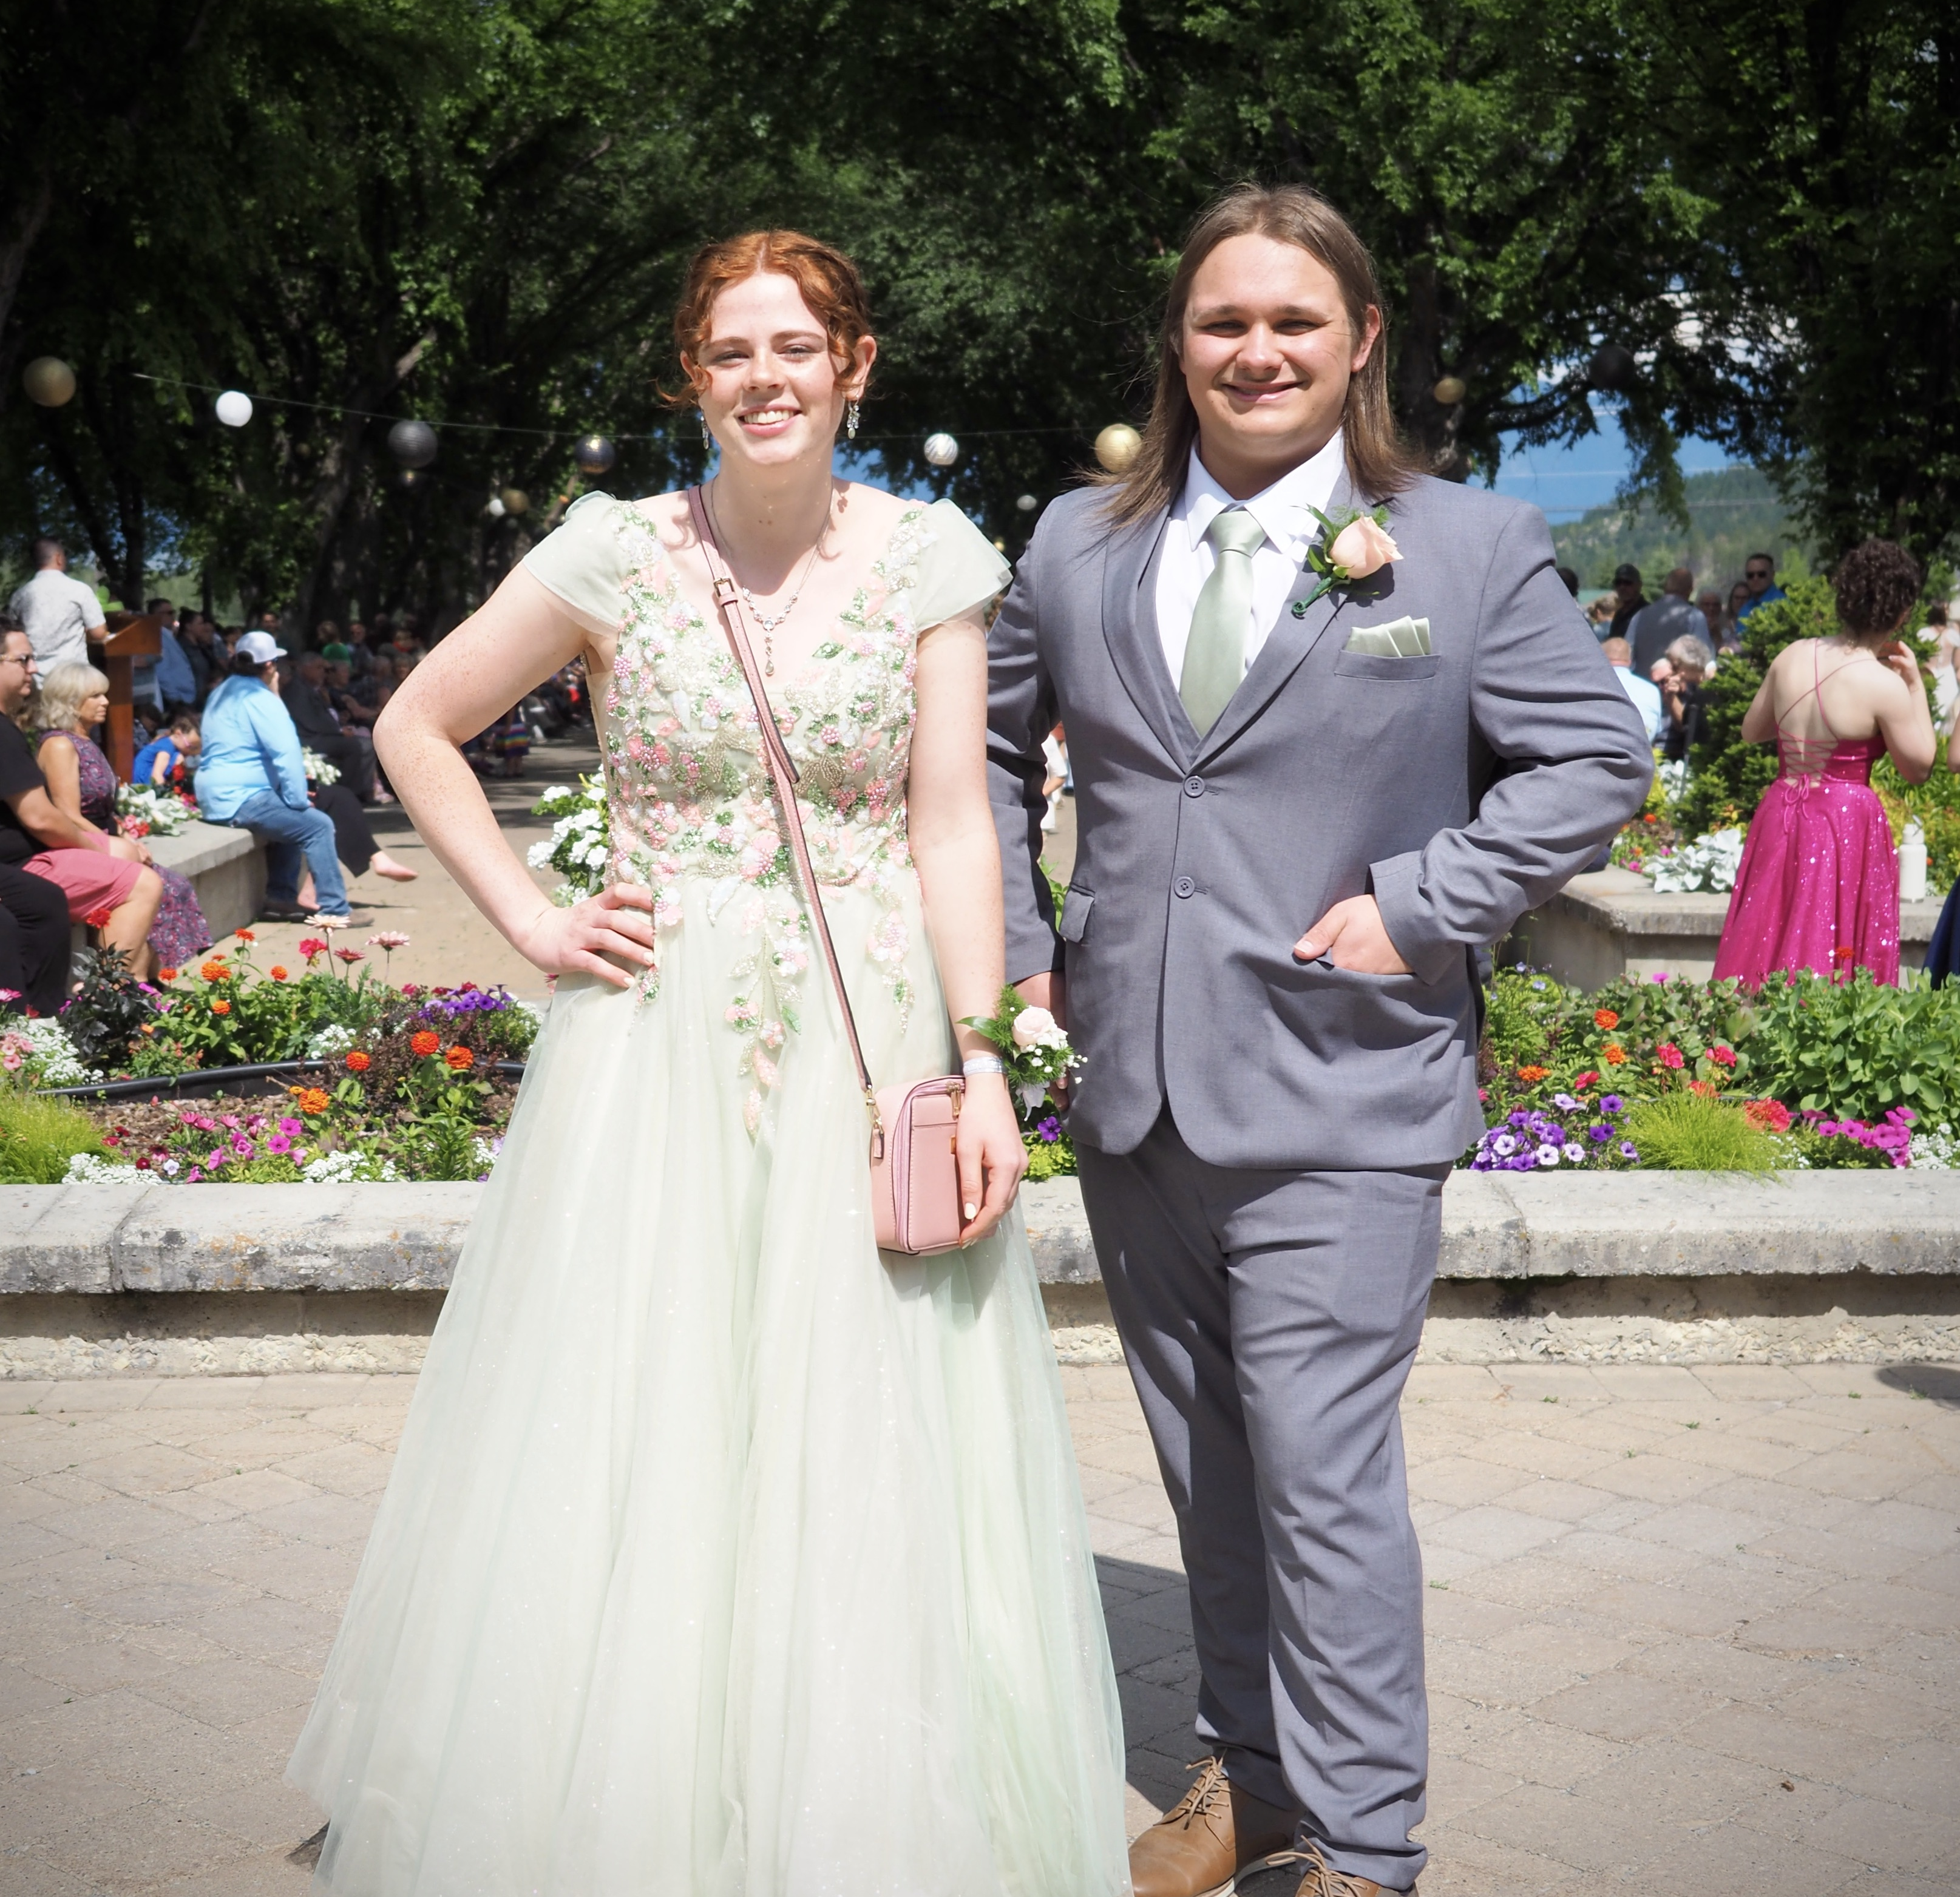
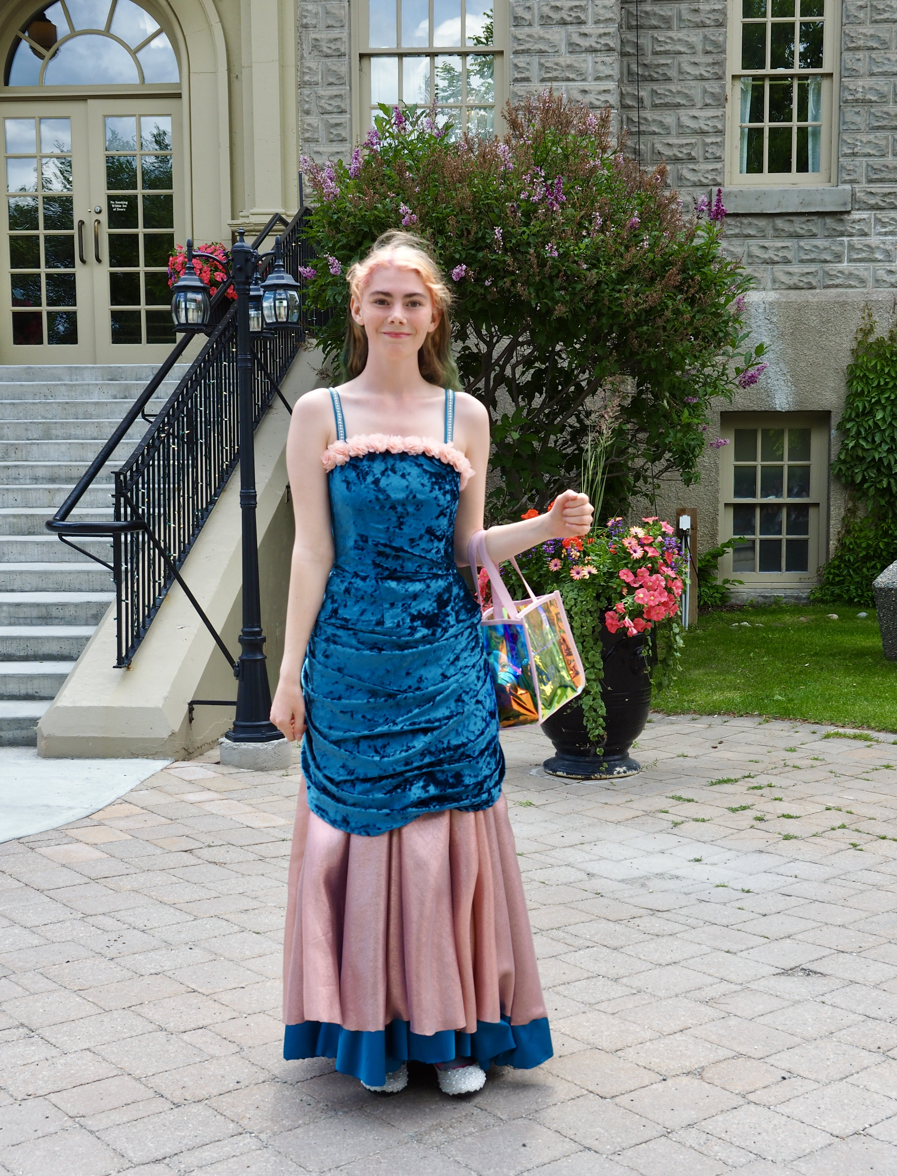
2 Images Option 2
2024
Pre Prom
St. Eugene

Slide 6

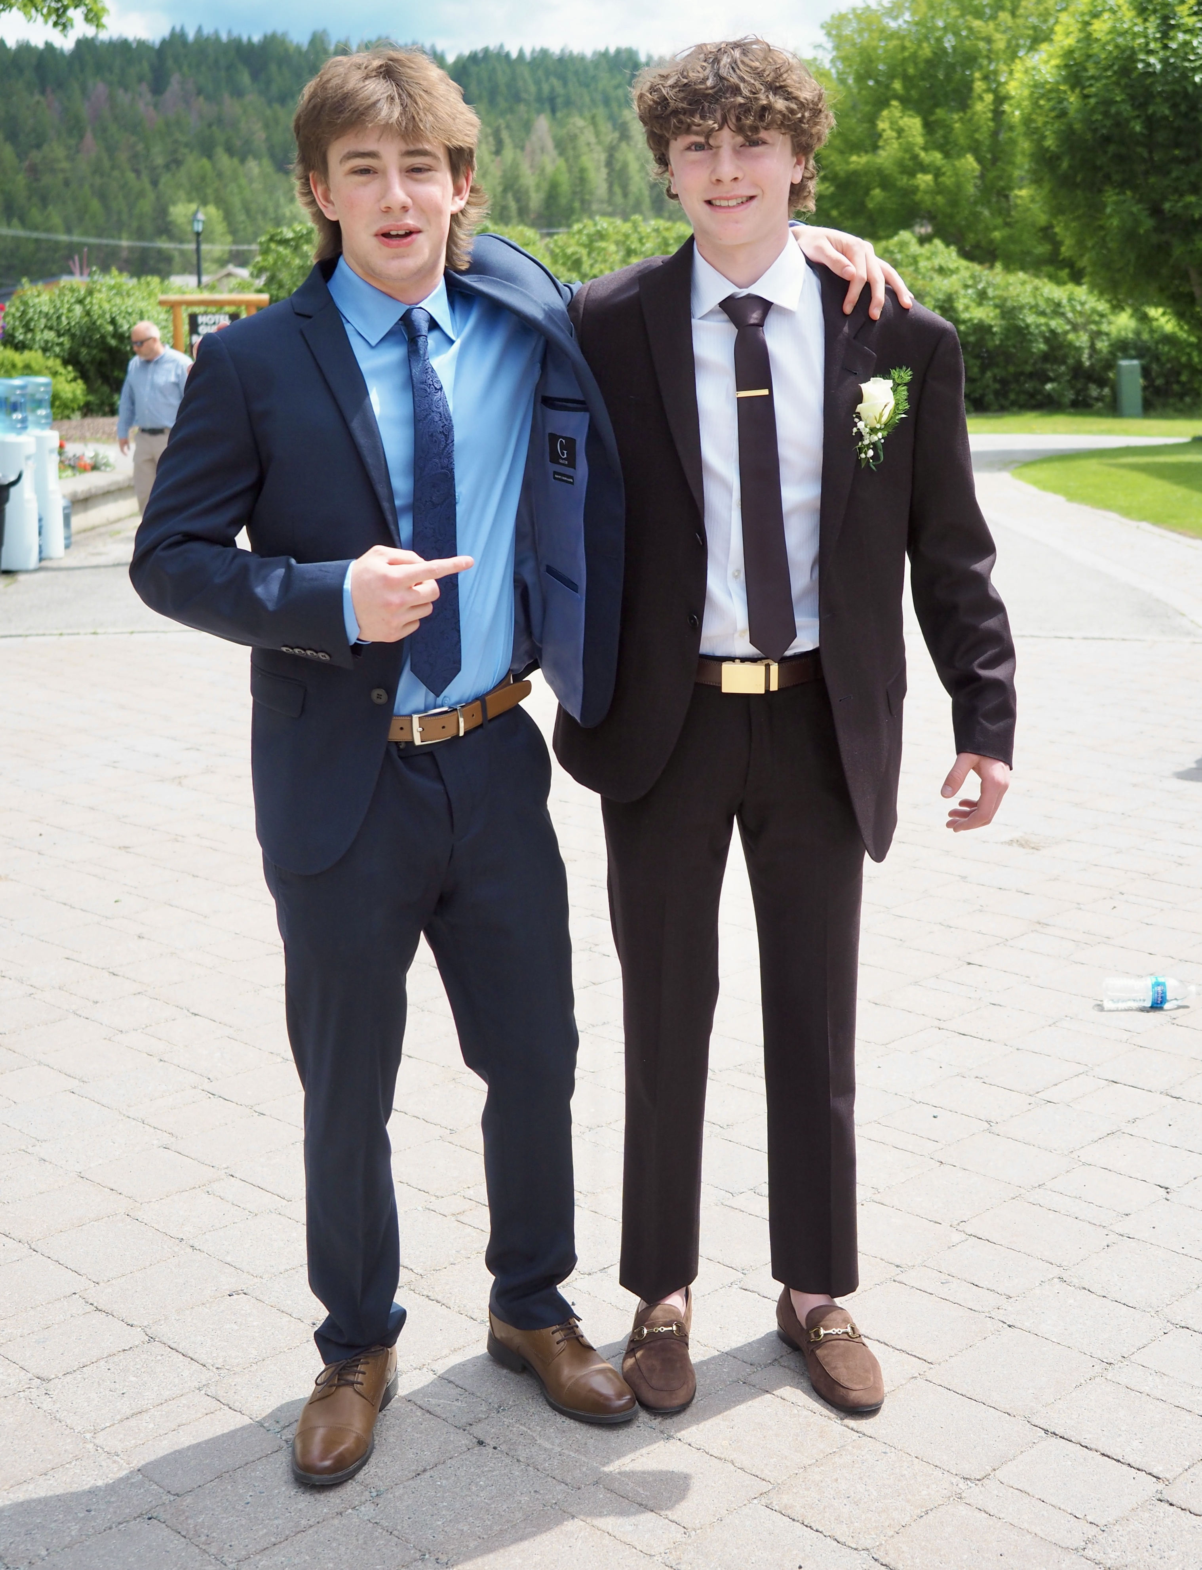
2024
Pre Prom
St. Eugene’s

Slide 7
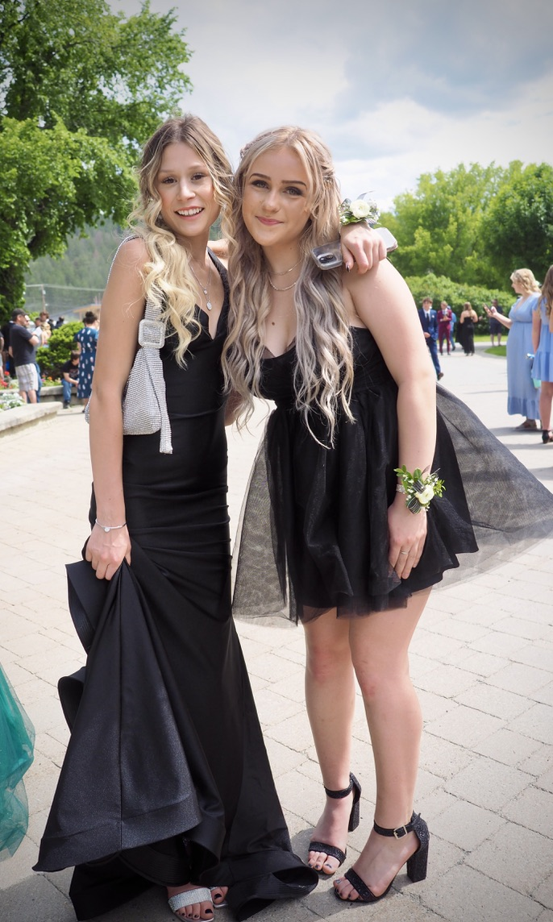
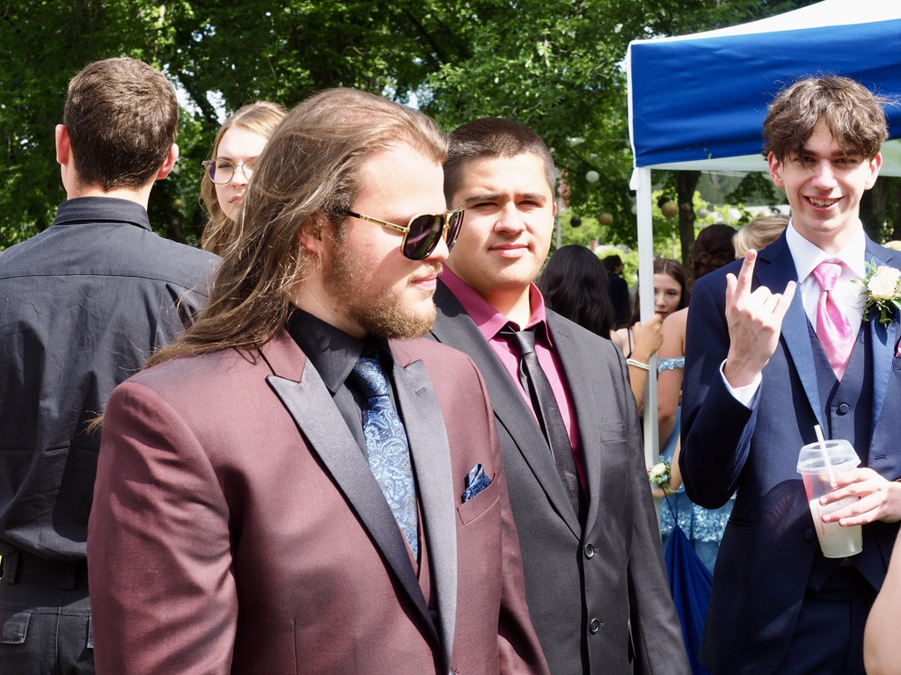
2 Images Option 3
Gorgeous faces
The
2024
Pre Prom
St. Eugene’s

Slide 8
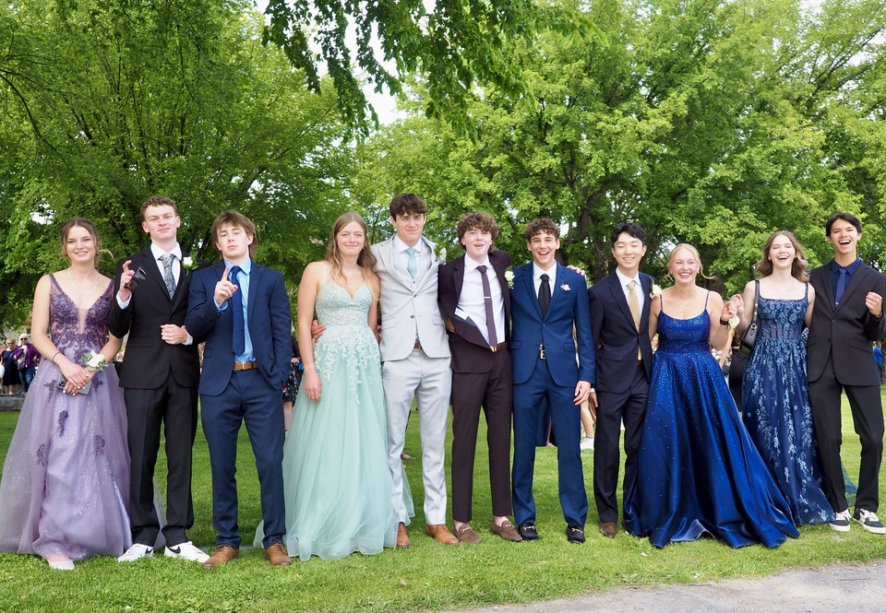
Fullscreen Image Option 5
2024
Shades of Blue
Smile!

Slide 9
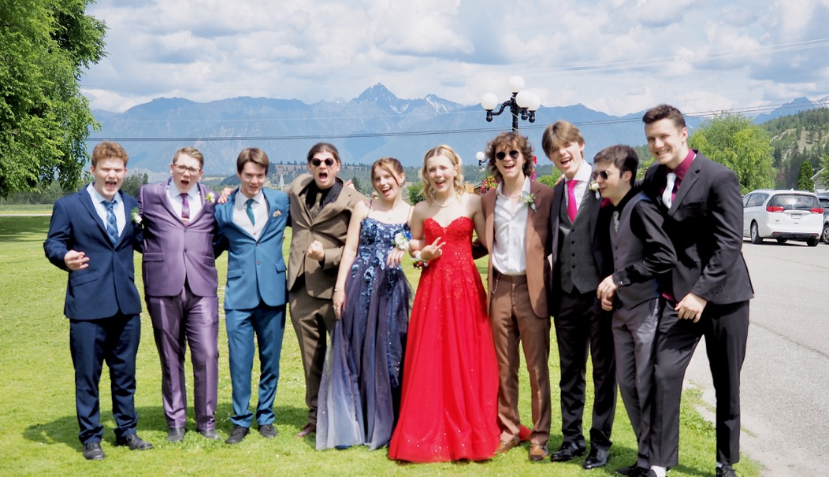
Fullscreen Image Option 4

Slide 10
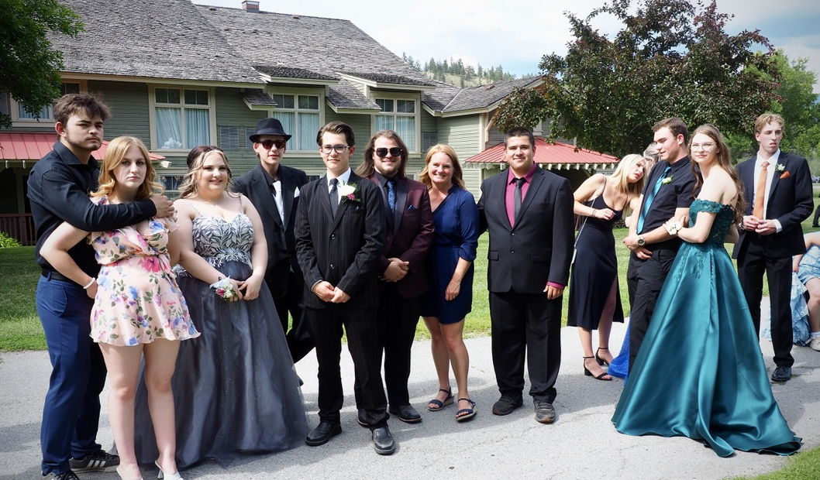
Fullscreen Image Option 3

Slide 11
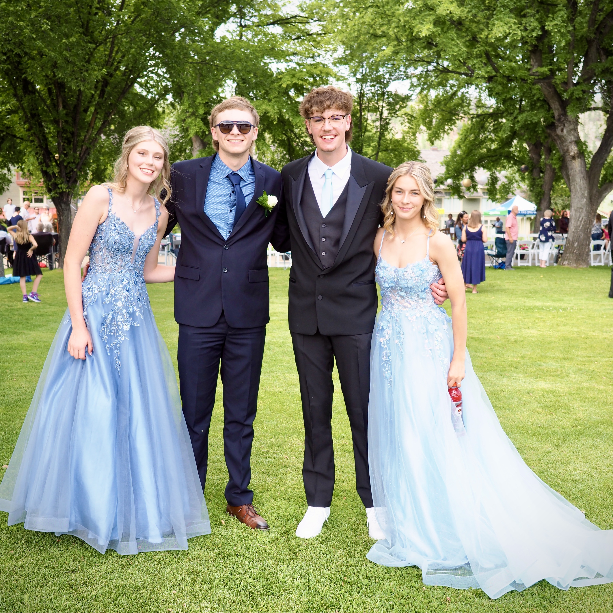
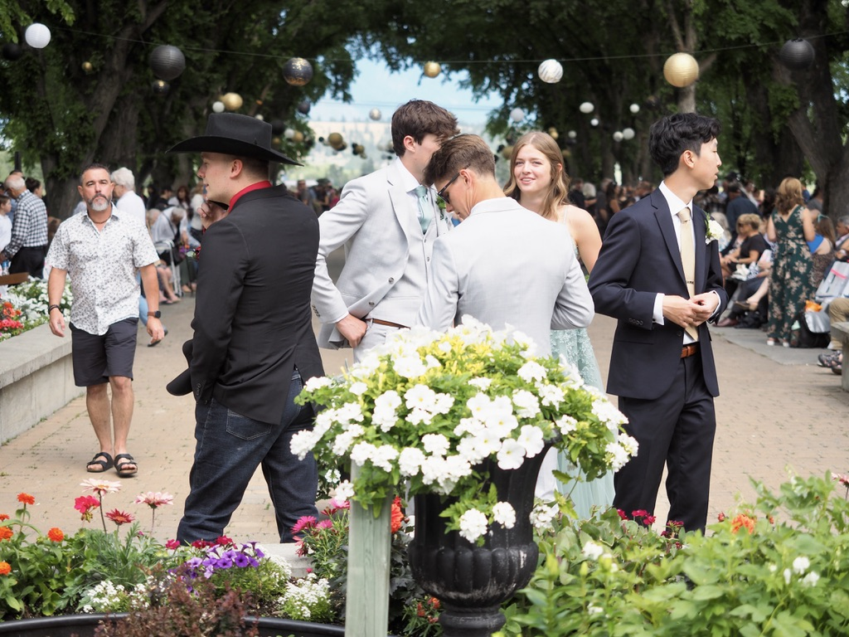
Pre Prom
The
2024
Smiles
St. Eugene’s

Slide 12
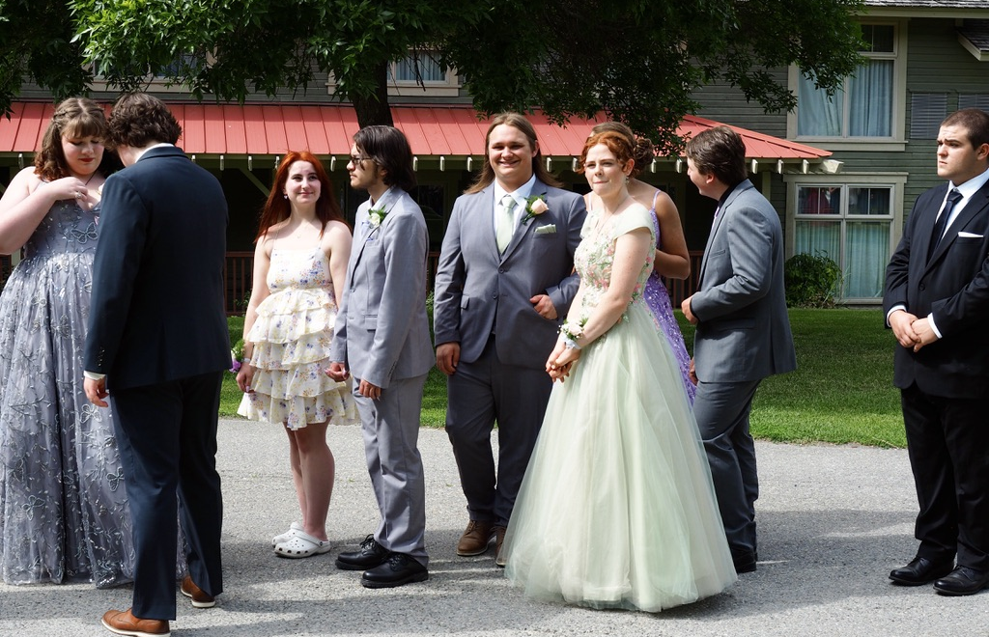
Fullscreen Image Option 2

Slide 13

Fullscreen Image Option 1
2024
Too cool for school
Pre Prom

Slide 14
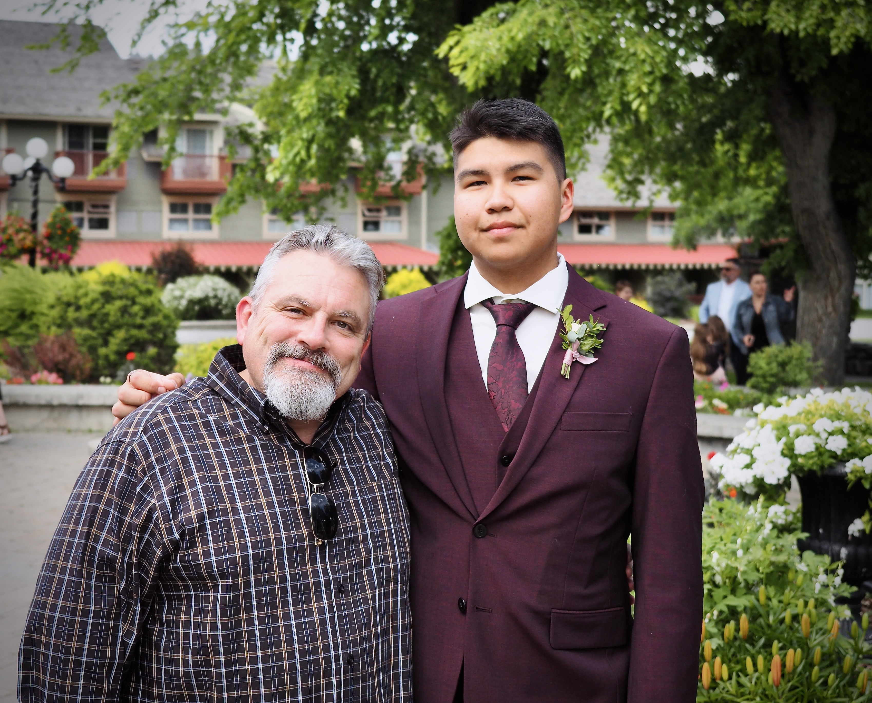
Pre Prom
2024
St. Eugene’s
Looking sharp
Fred

Slide 15
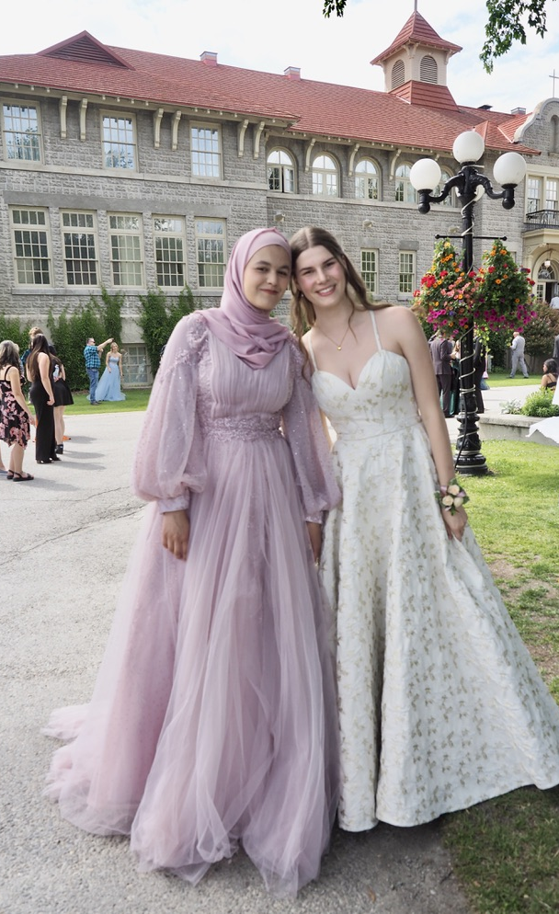
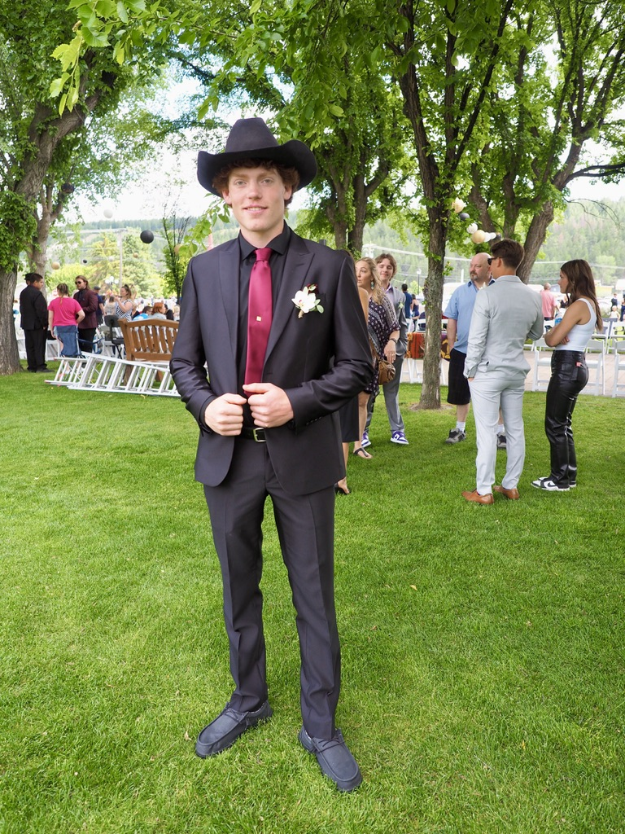
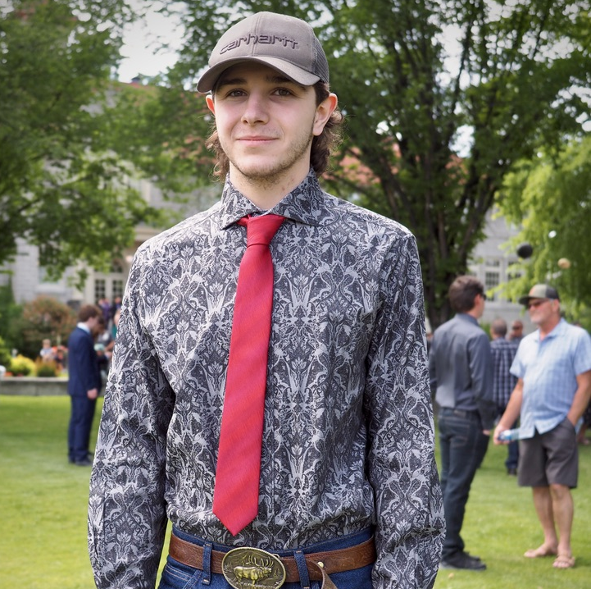
3 X Images Option 1
The faces
Pre Prom

Slide 16
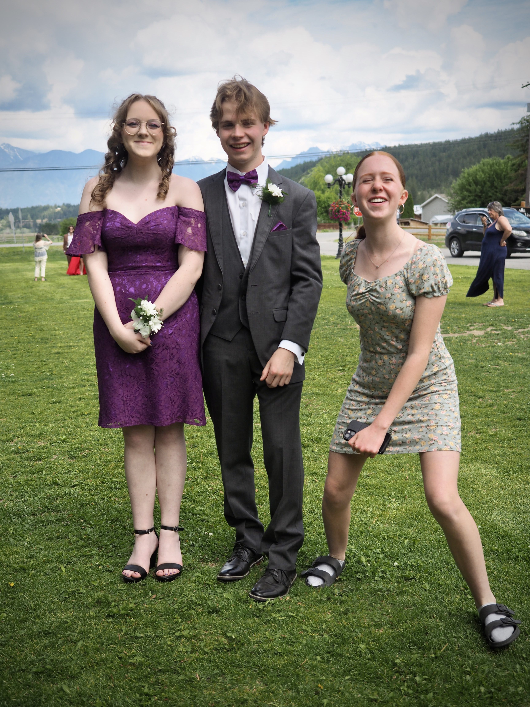
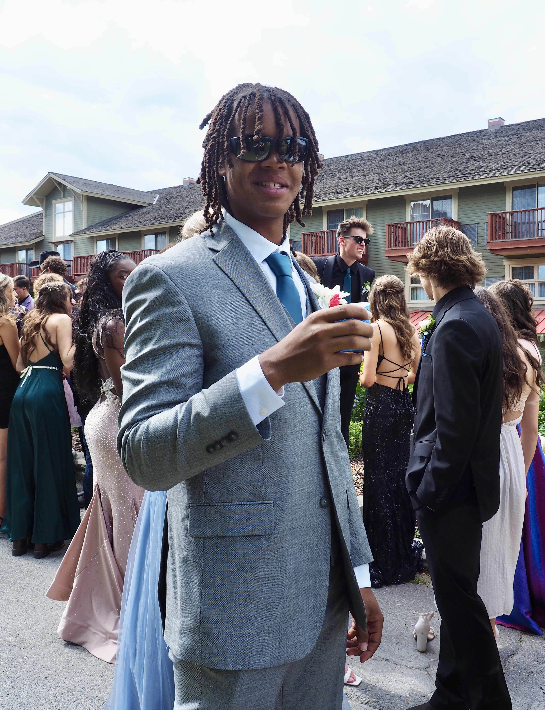
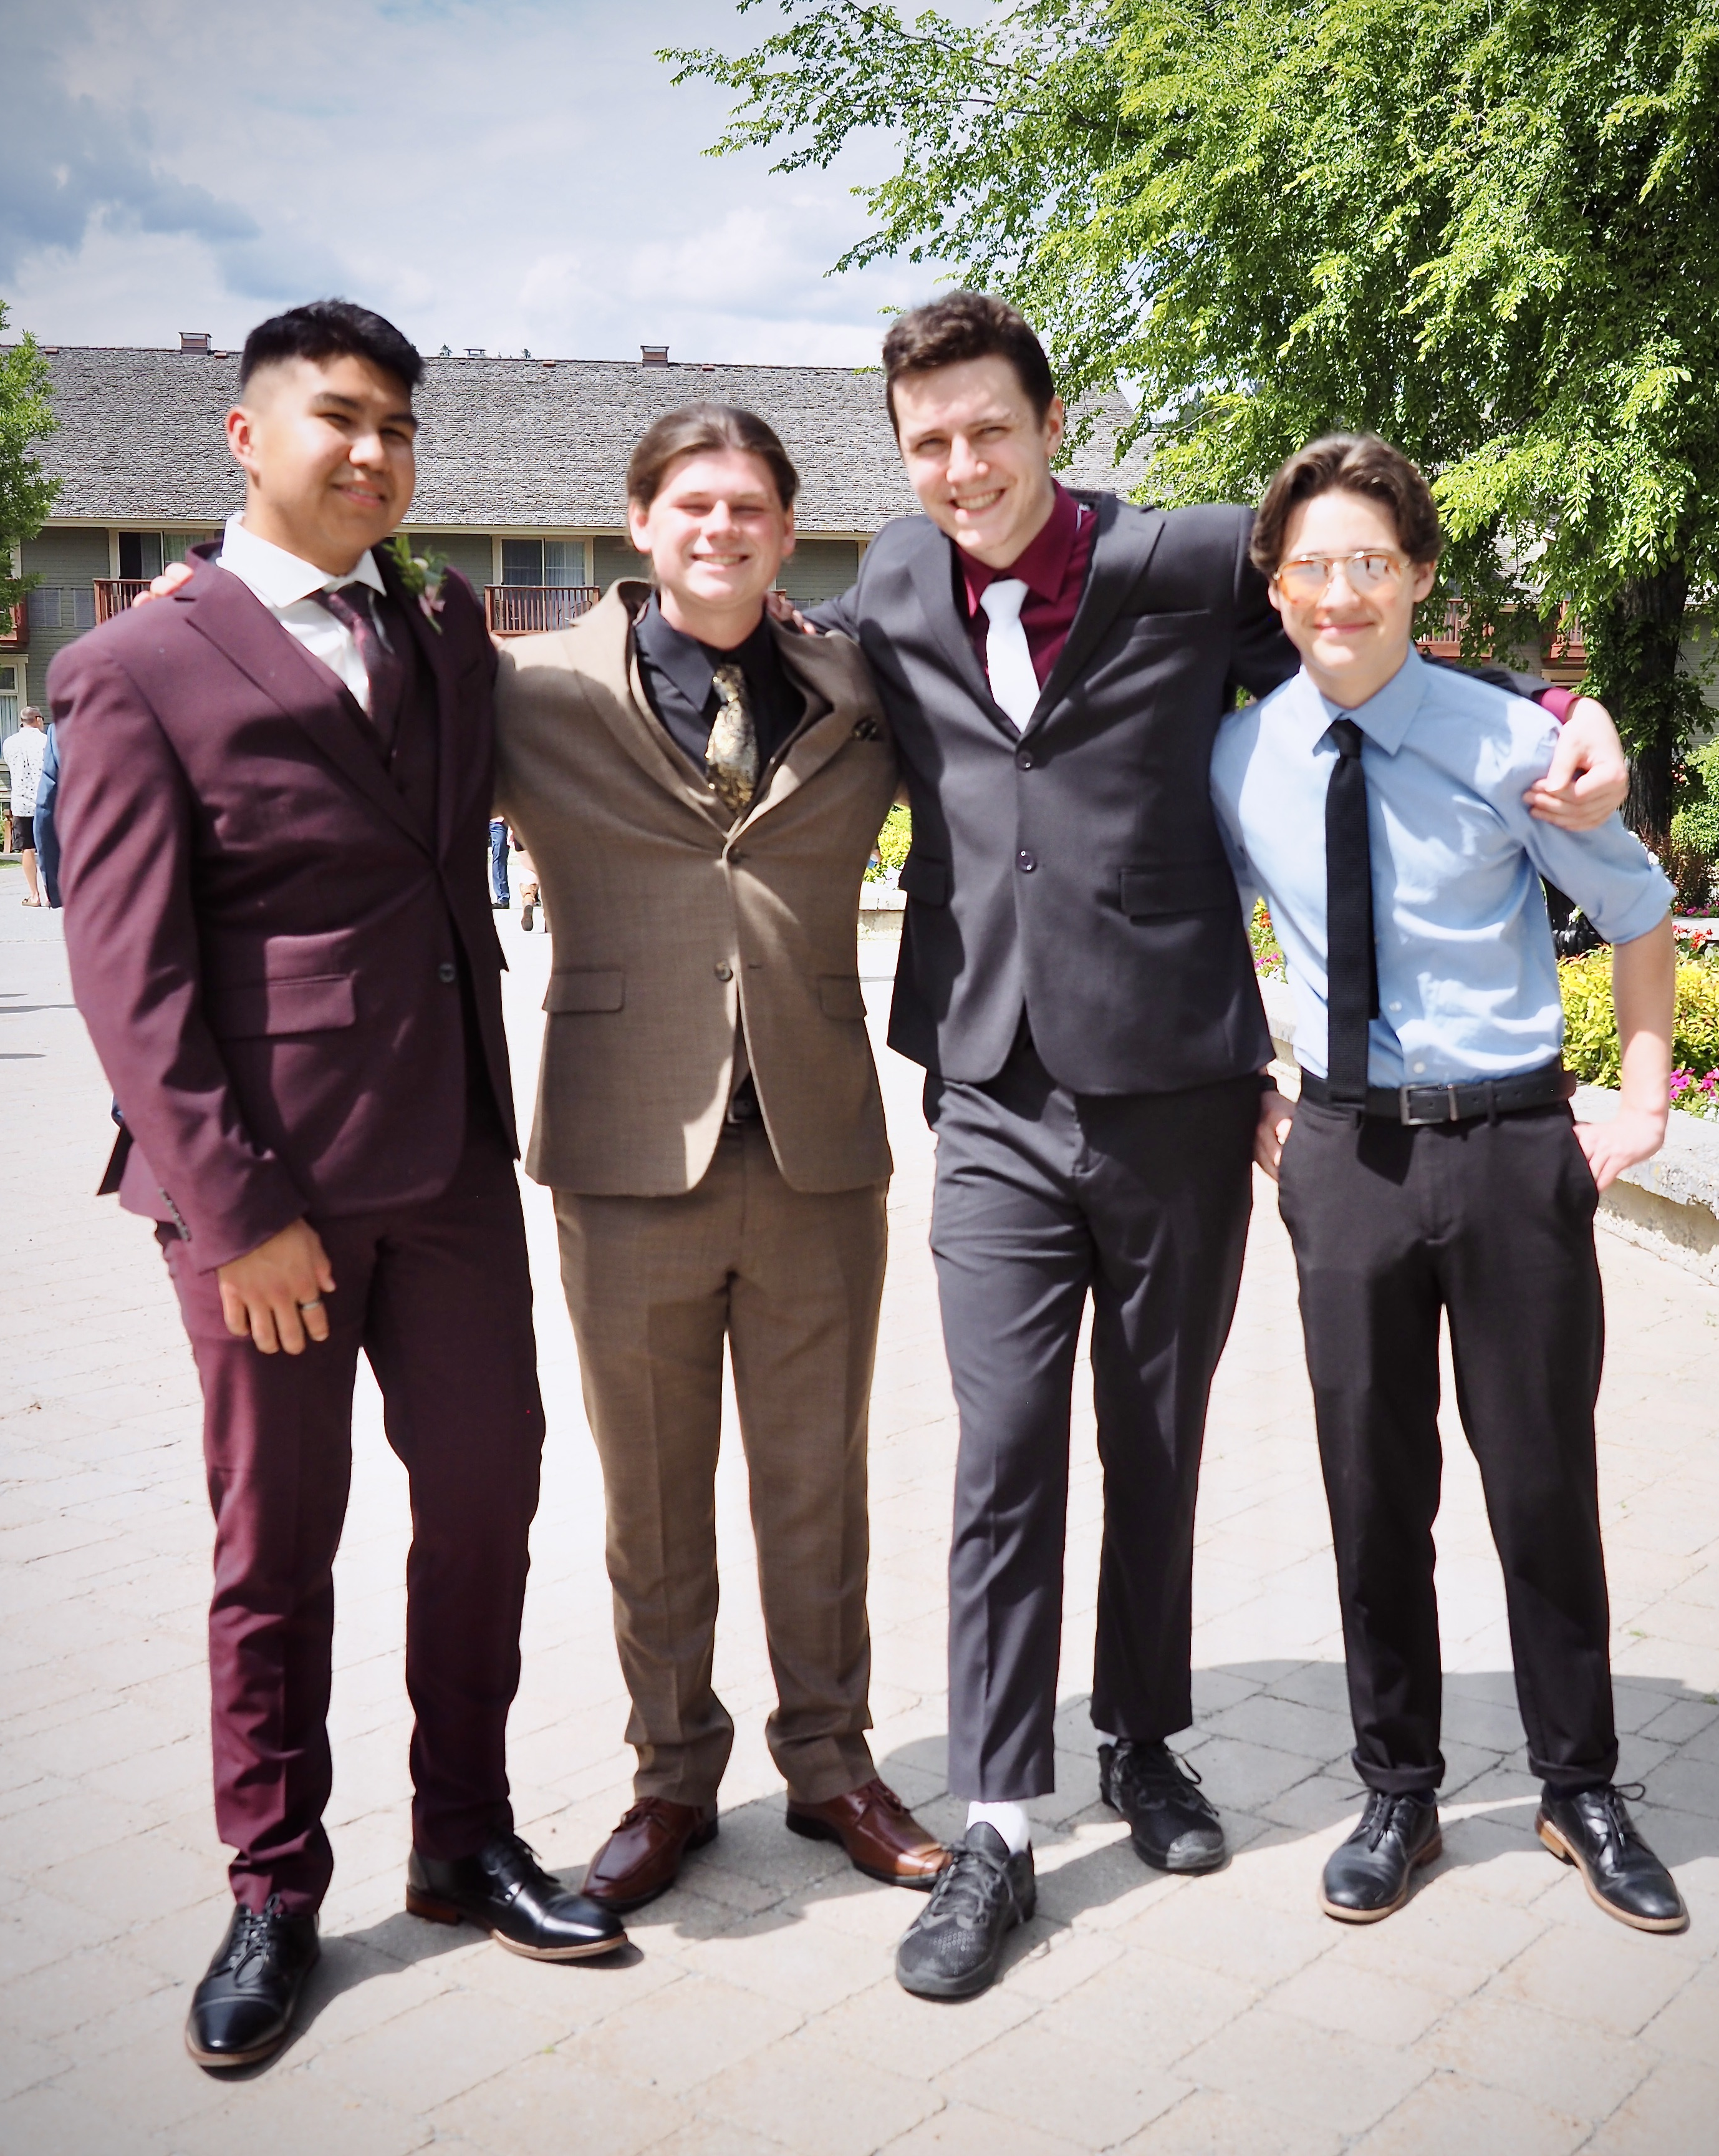
3 X Images Option 2
2024
Pre Prom
St Eugne’s

Slide 17
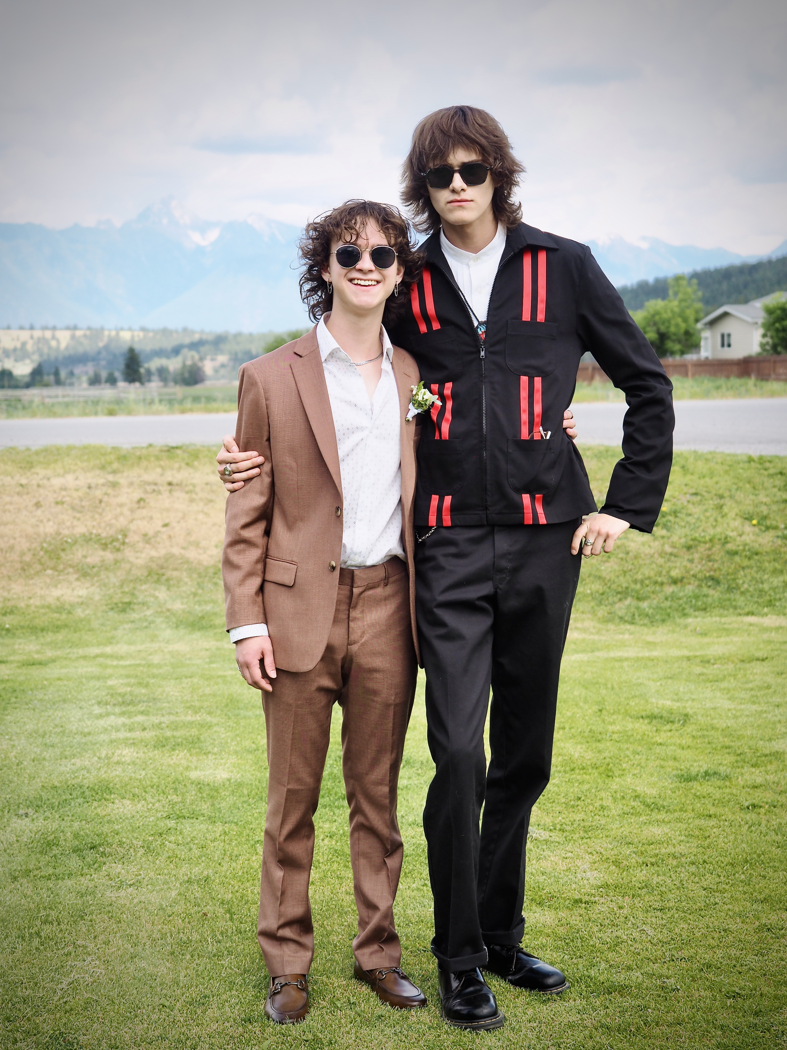
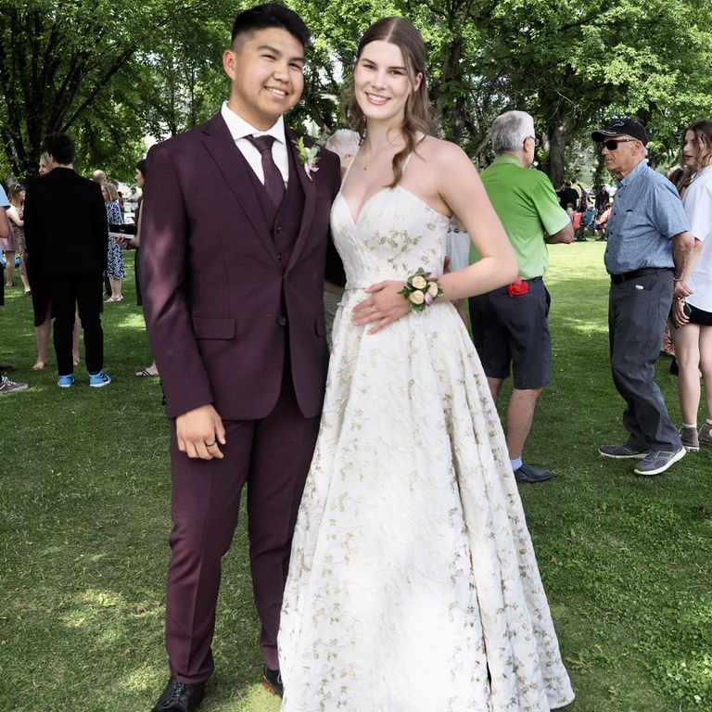

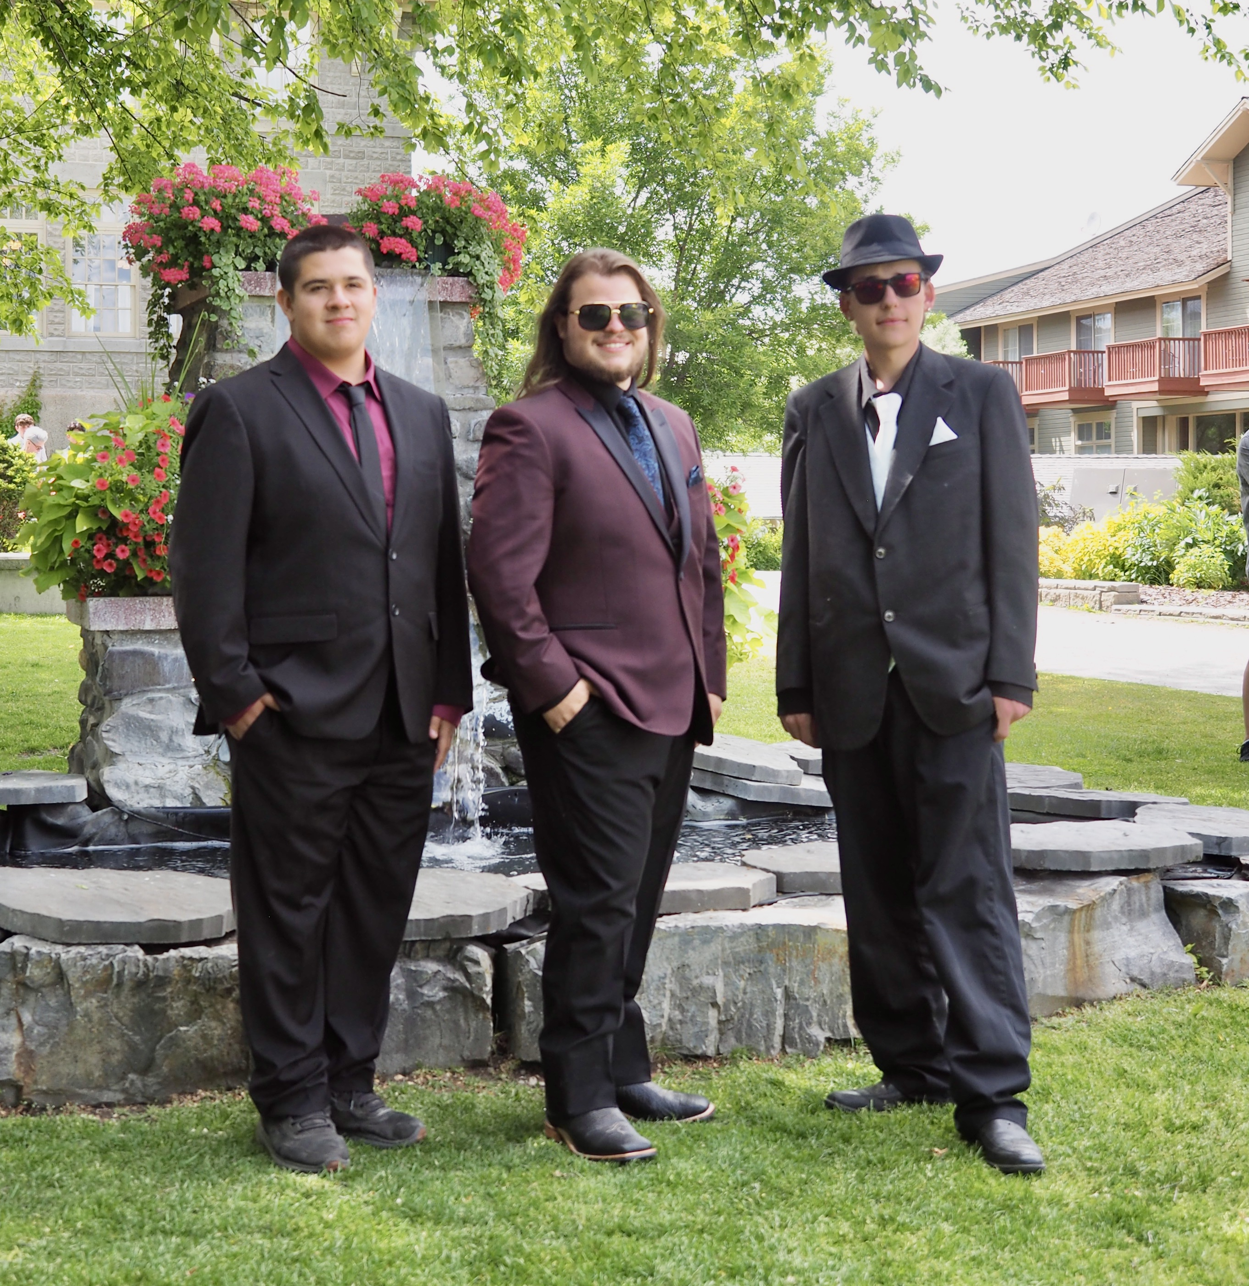
4 X Images Option 1
2024
Pre Prom
St. Eugene’s

Slide 18
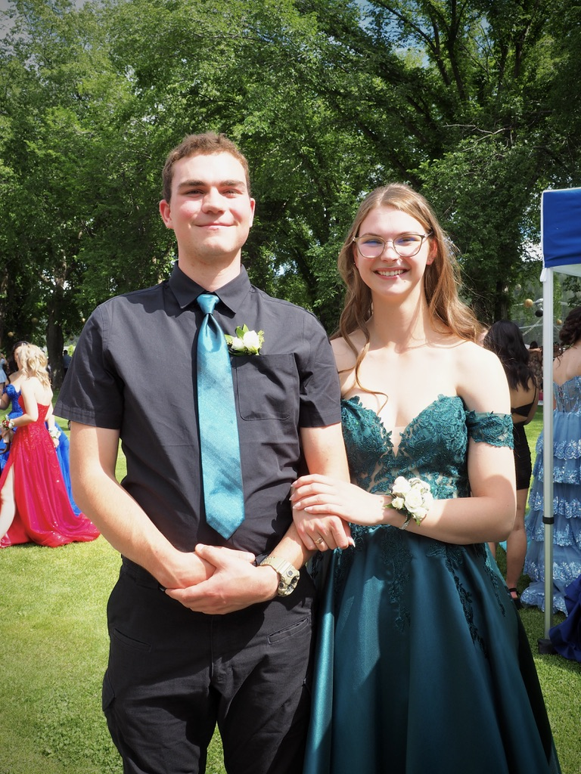
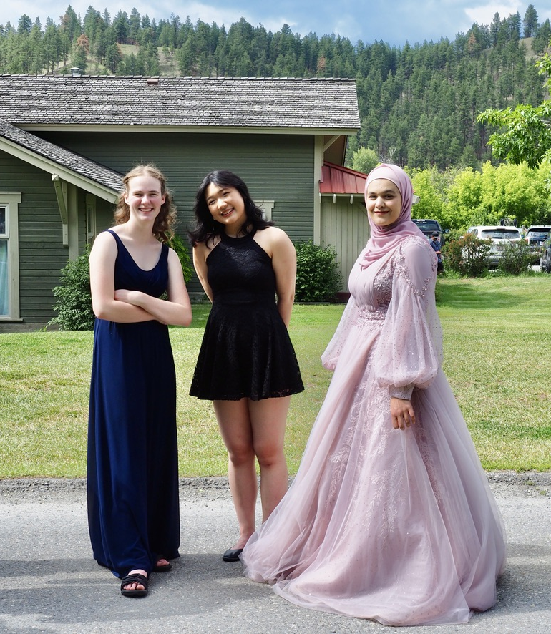
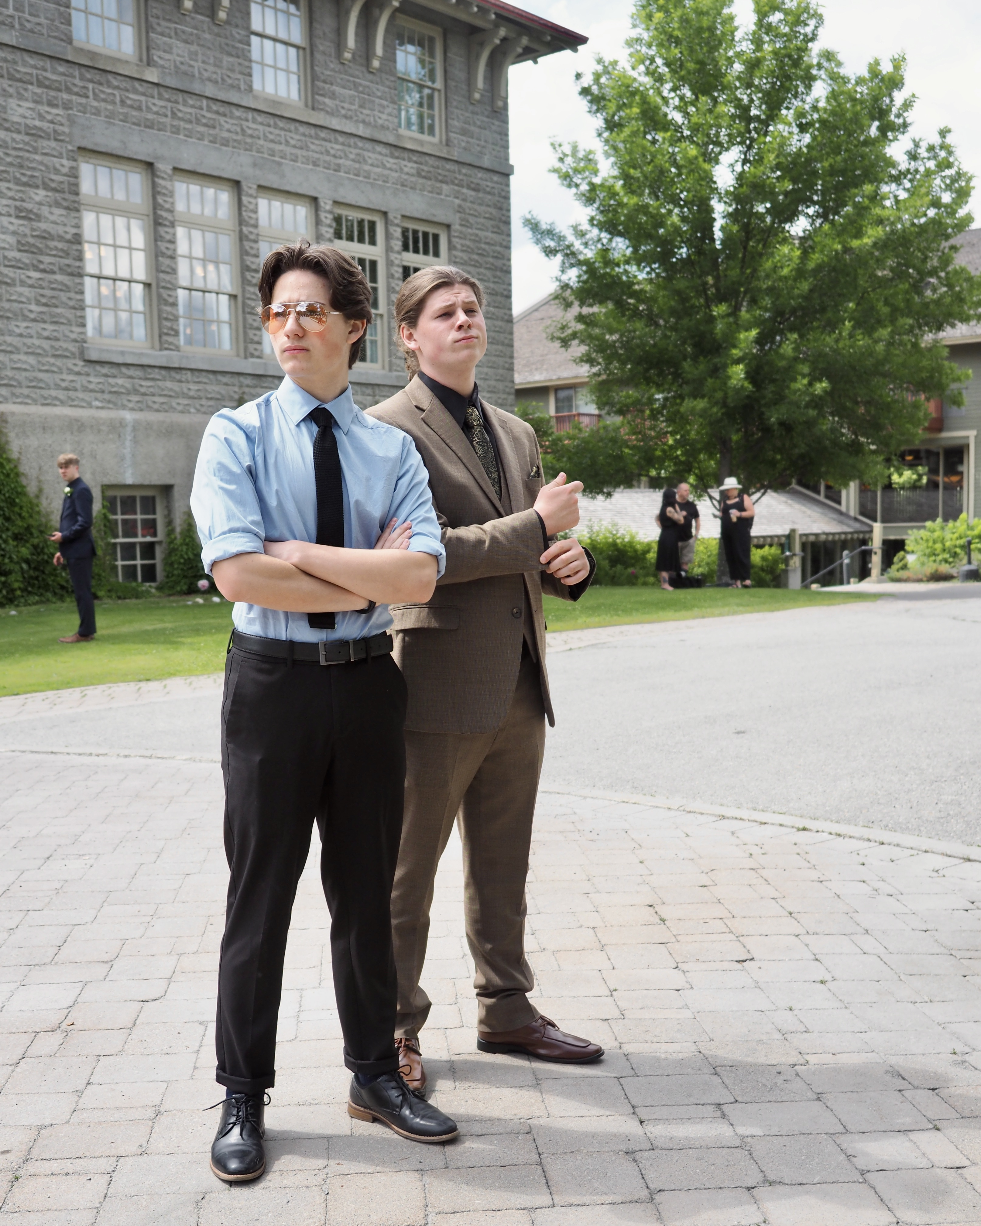
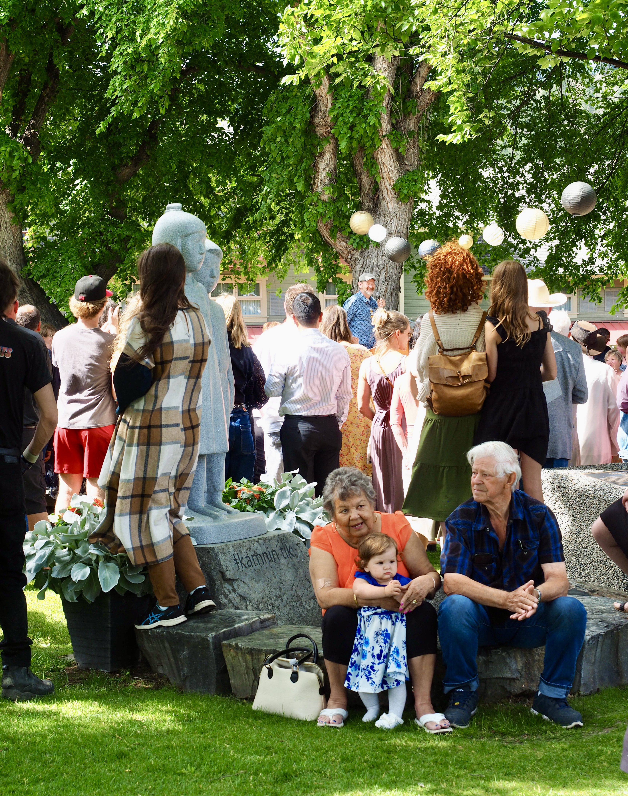
4 X Images Option 2
2024
Pre Prom
St. Eugene’s

Slide 19
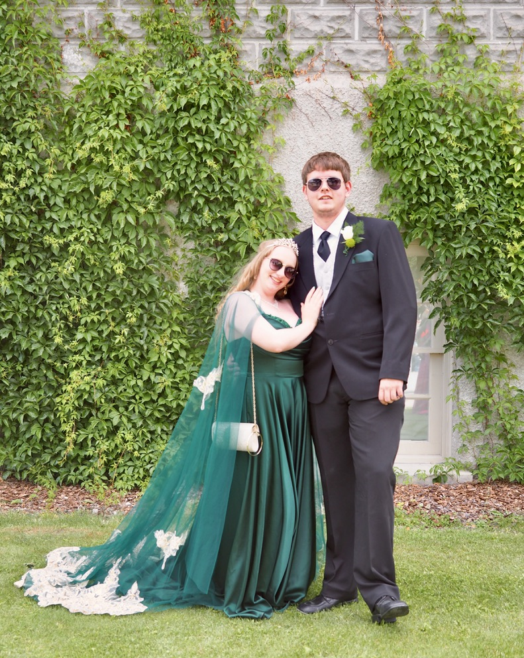
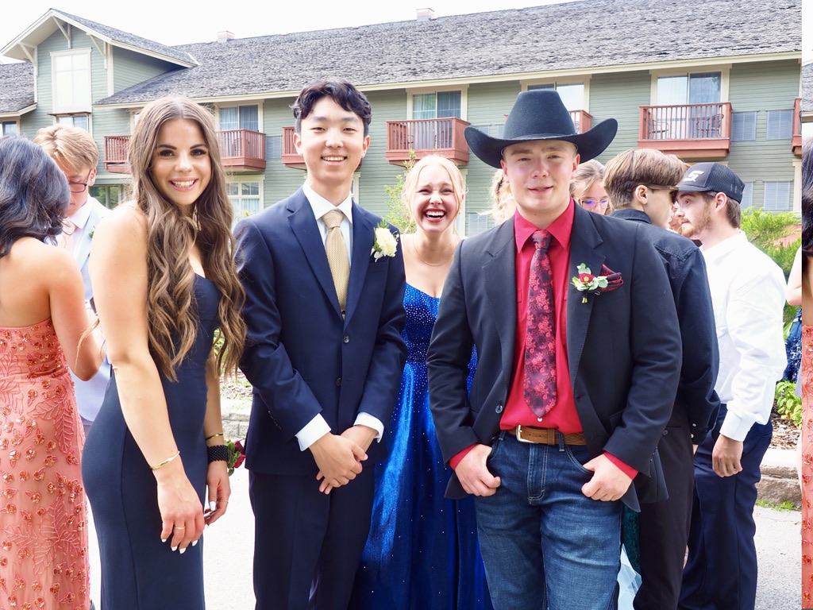

Slide 20
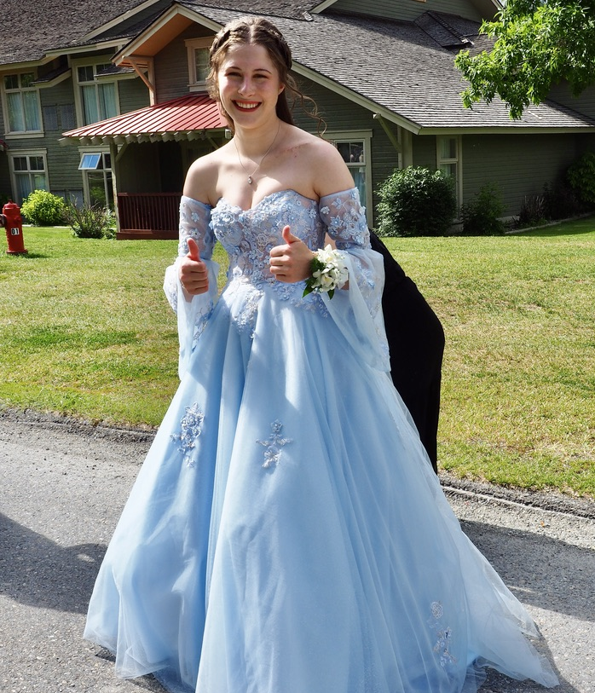
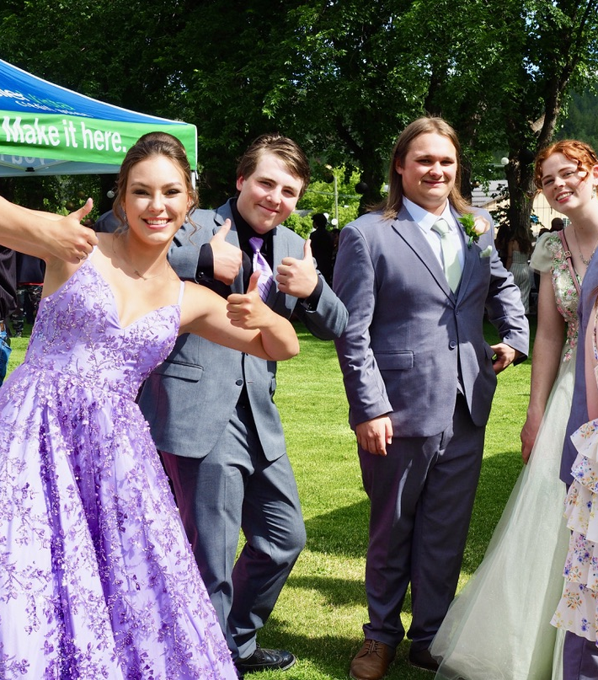
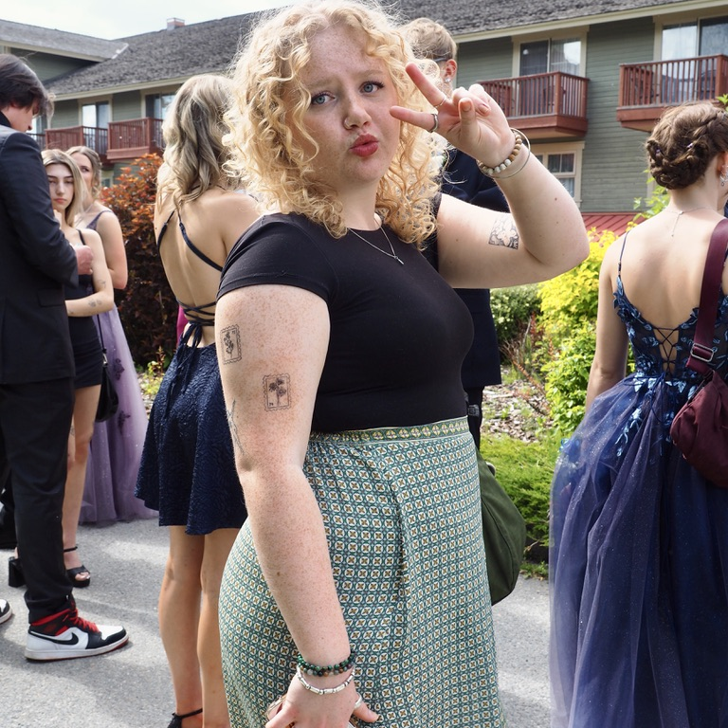
2024
Pre Prom
St. Eugene’s

Slide 21
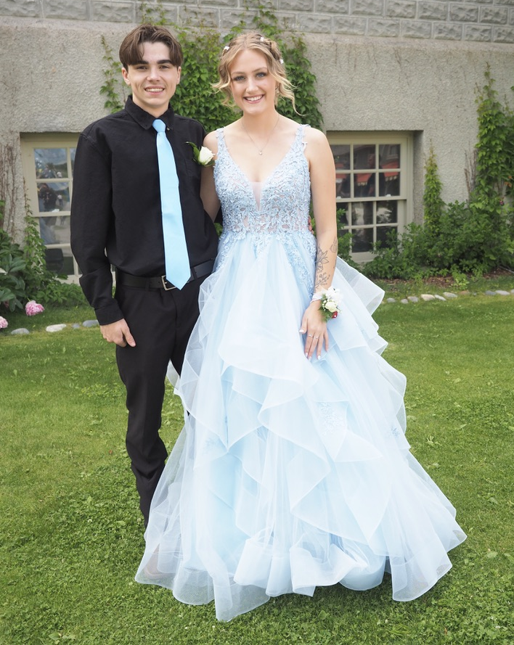
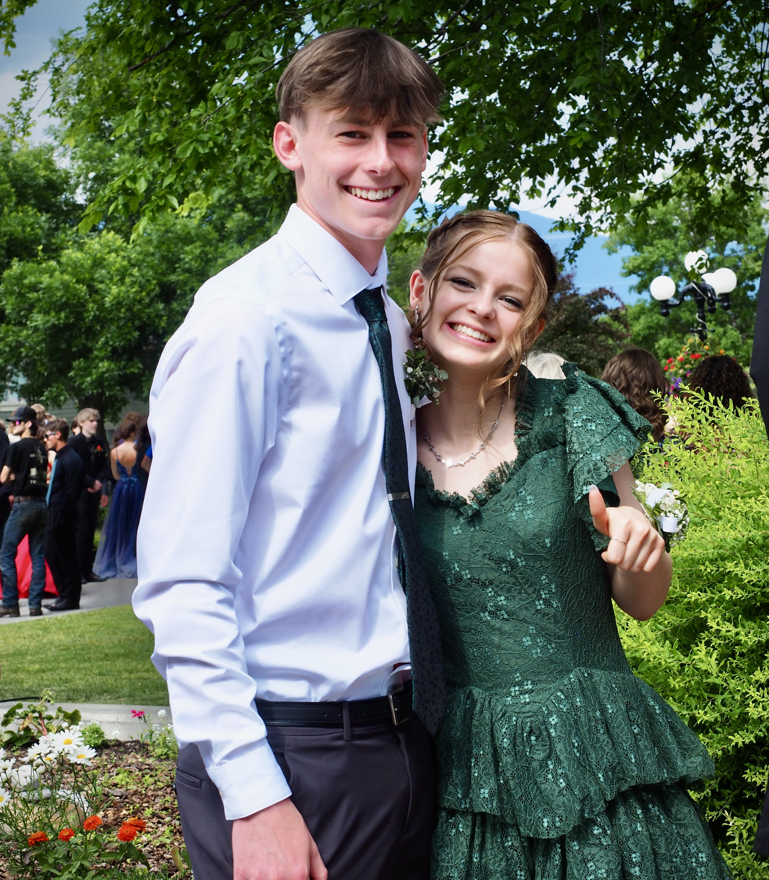
Glitz n Glam
The
2024
re Prom
St. Eugene’s

Slide 22
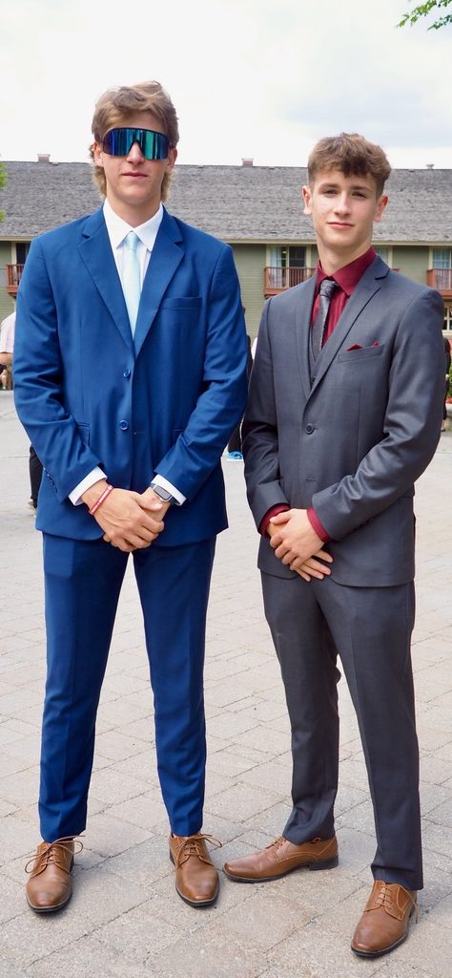
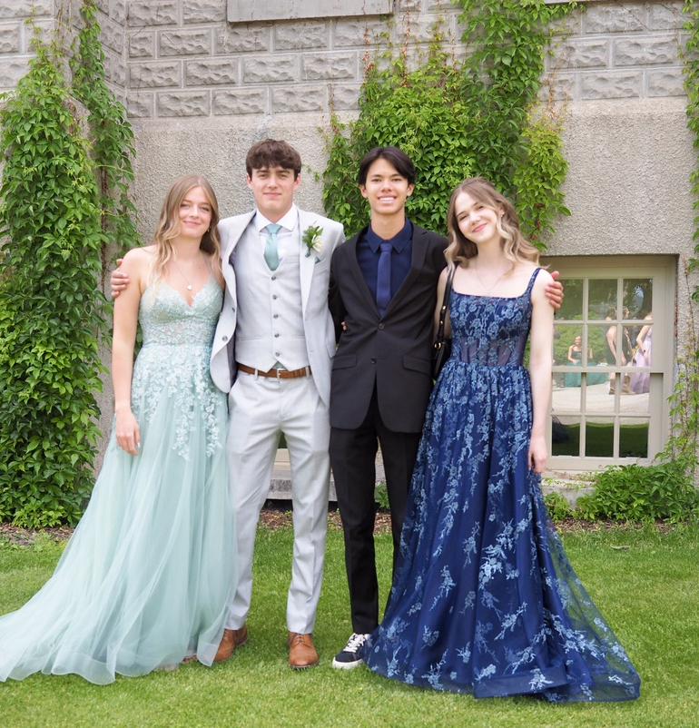
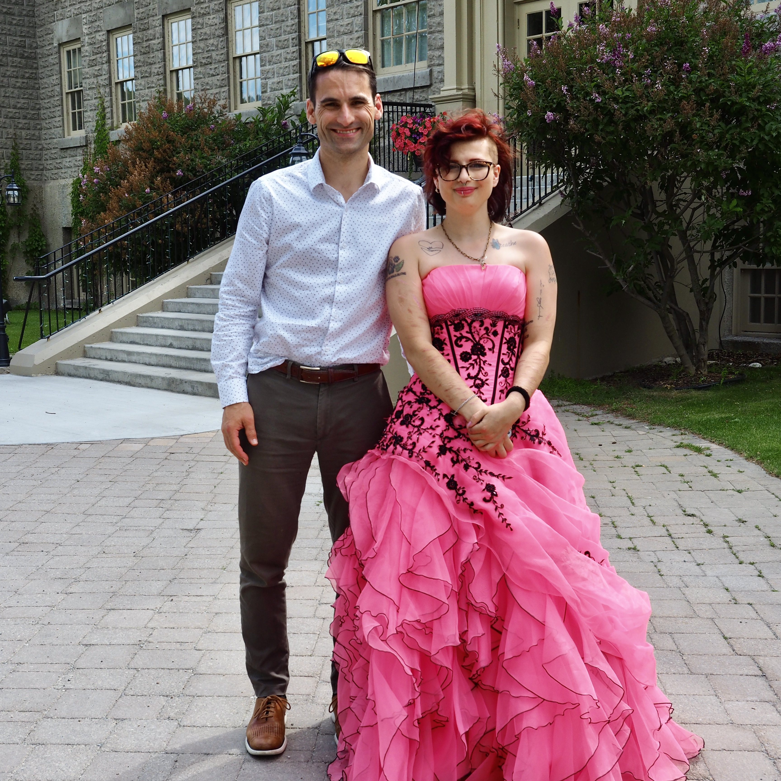
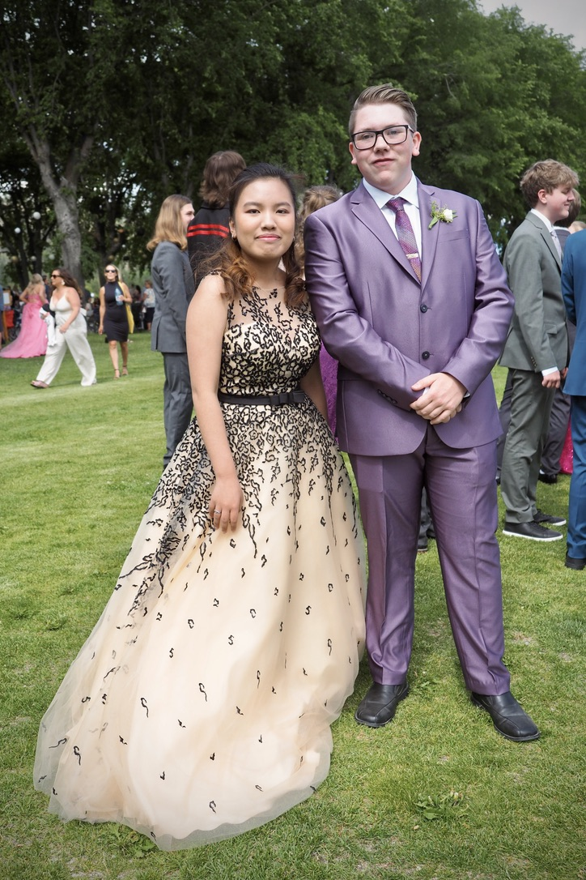
2024
Pre Prom
St. Eugene’s

Slide 23
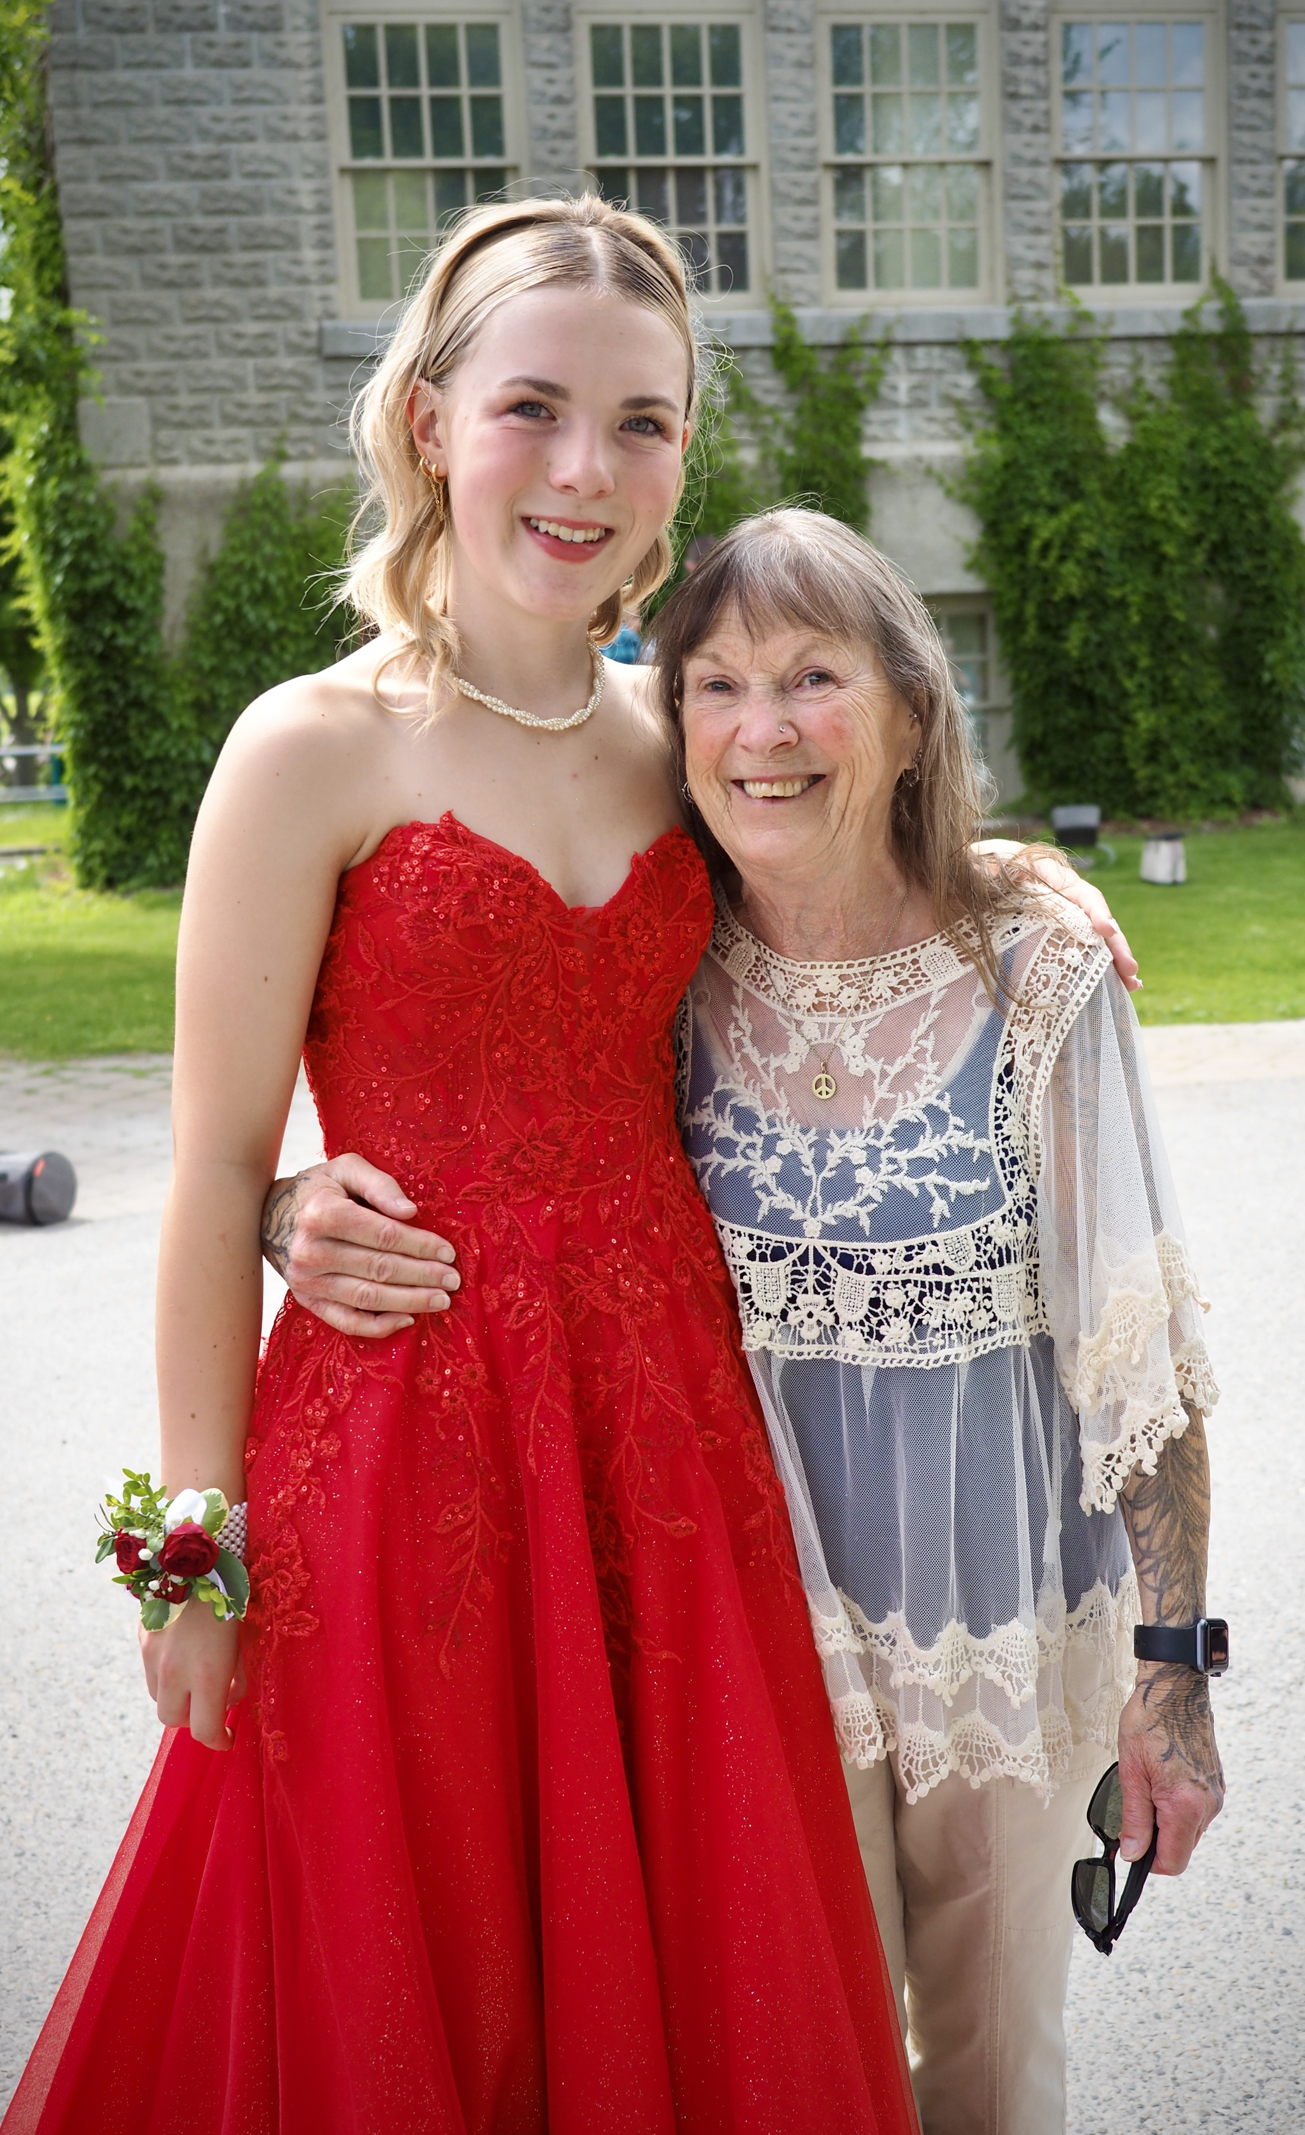
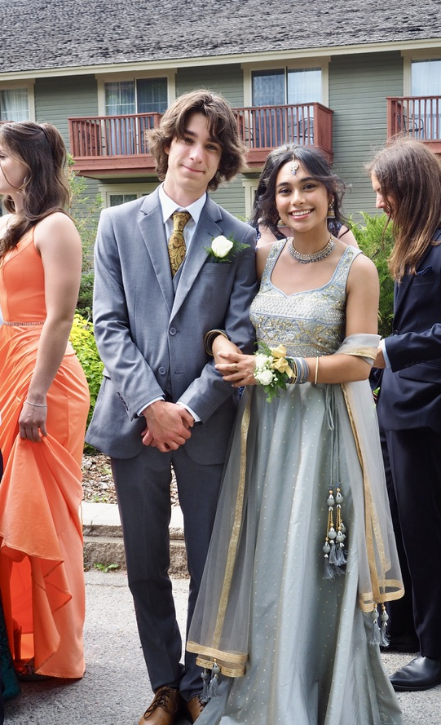
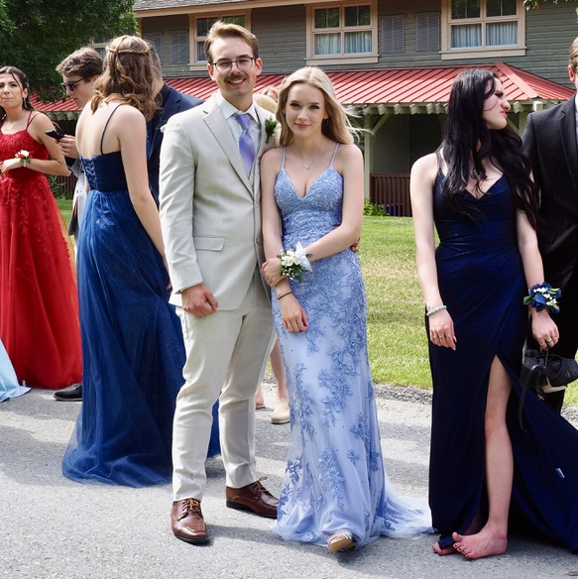
2024 St. Eugene’s
Pre Prom

