Slide 1
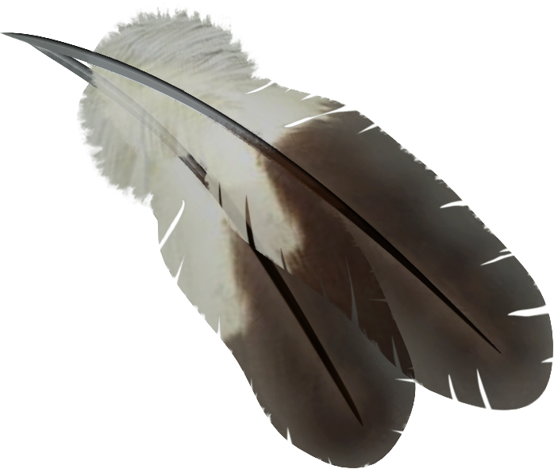
Terminology Discussion
Further to the video…
Always try to be as specific as possible to clarify your intention about whom you are speaking:
For example: Indigenous People, Indigenous Women, Indigenous Students
First Nation Communities, Ktunaxa Children, Inuit Men
Don’t say “Aboriginals” – Say Aboriginal People

Slide 2
Terminology Discussion
Other Terms - Indian
Indian – Name first given to North/South America’s Indigenous People because the first explorers thought they were in India! This term was used to broadly to describe all Indigenous People, but still has a place where it is used today in Canada.
The term Indian refers to the legal identity of a First Nations person who is registered under the Indian Act.
Indian should be used only when referring to a First Nations person with status under the Indian Act, and only within a legal context.
Pulling Together: Foundations Guide by Kory Wilson
Since First Nation Groups were “officially named” by the Federal Government, many First Nation’s still bear those “legal” names. – i.e. “St Mary’s Indian Band, has successfully legally changed to their traditional name of ʔaqam

Slide 3
Terminology Discussion
Other Terms – Native
This term is used in a similar manner to First Nations, but more specifically used in the United States.
It can be used to more specifically define their Indigenous People
Native American
Native Hawaiian
Native Alaskan
This term is generally avoided in Canada. Again, it is always more respectful to use as specific a term as possible, if you are referring to a specific group of Indigenous People

Slide 4
Terminology - Definitions
Decolonization
The action or process of a state withdrawing from a former colony, leaving it independent. Decolonization is now recognized as a long-term process involving the bureaucratic, cultural, linguistic and psychological divesting of colonial power.
Decolonization restores the Indigenous world view
Decolonization restores culture and traditional ways
Decolonization replaces Western interpretations of history with Indigenous perspectives of history
Decolonization is about shifting the way Indigenous Peoples view themselves and the way non-Indigenous people view Indigenous Peoples.

Slide 5
Terminology - Definitions
Reconciliation
Oxford: The action of restoring estranged people or parties to friendship; The action or an act of bringing a thing or things to agreement, concord, or harmony; the fact of being made consistent or compatible.
In order for the TRC to genuinely move the relationship between Aboriginal peoples and non-Aboriginal Canadians down a more respectful, just path, its understanding of reconciliation must incorporate the form of reconciliation associated with the hostile politics of interpreting the meaning and content of the Indian Act, and its repercussions.

Slide 6
Terminology - Definitions
Cultural Safety:
A manner that affirms, respects, and fosters the cultural expression of individuals. This usually requires the individual to have undertaken a process of reflection on their own cultural identity and to have learned to practice in a way that affirms the culture of others and self. Cultural safety addresses power relationships between the service provider and the people who use the service.
Cultural un-safety: What is it? A subjective sense that one’s cherished values, goals, language, identity, and ways of life are denigrated or threatened in an encounter, or that one is being asked to venture into a foreign culture without knowing how to function in it and without positive accompaniment. Unsafe cultural practice is any action which demeans, diminishes or disempowers the cultural identity and well-being of people.

Slide 7
Terminology - Definitions
Unceded Territory:
In large sections of British Columbia, crown land is unceded land, meaning that Indigenous Title has neither been surrendered nor acquired by the Crown. Under the Royal Proclamation of 1763, the King of England declared that all unceded, unsold land would be reserved to them.
Ally:
There are many ways to be an ally to Indigenous peoples. As allies, we must examine how our systems of governance and economics have been built, how our social beliefs are constructed, and explore what each one of us can do to help transform our relationships, workplaces, and communities to truly become the safe and just country we proclaim ourselves to be.

Slide 8
Acknowledgements of Territory:
To acknowledge Indigenous traditional territory is to recognize that ‘Canada’ has a long history dating back before European colonization and refers to the fact that First Nations have lived and occupied these lands since time immemorial.
An informed acknowledgement is authentic, accurate, respectful, and spoken with heartfelt sincerity.
There is no “right” or “wrong” way!

Slide 9
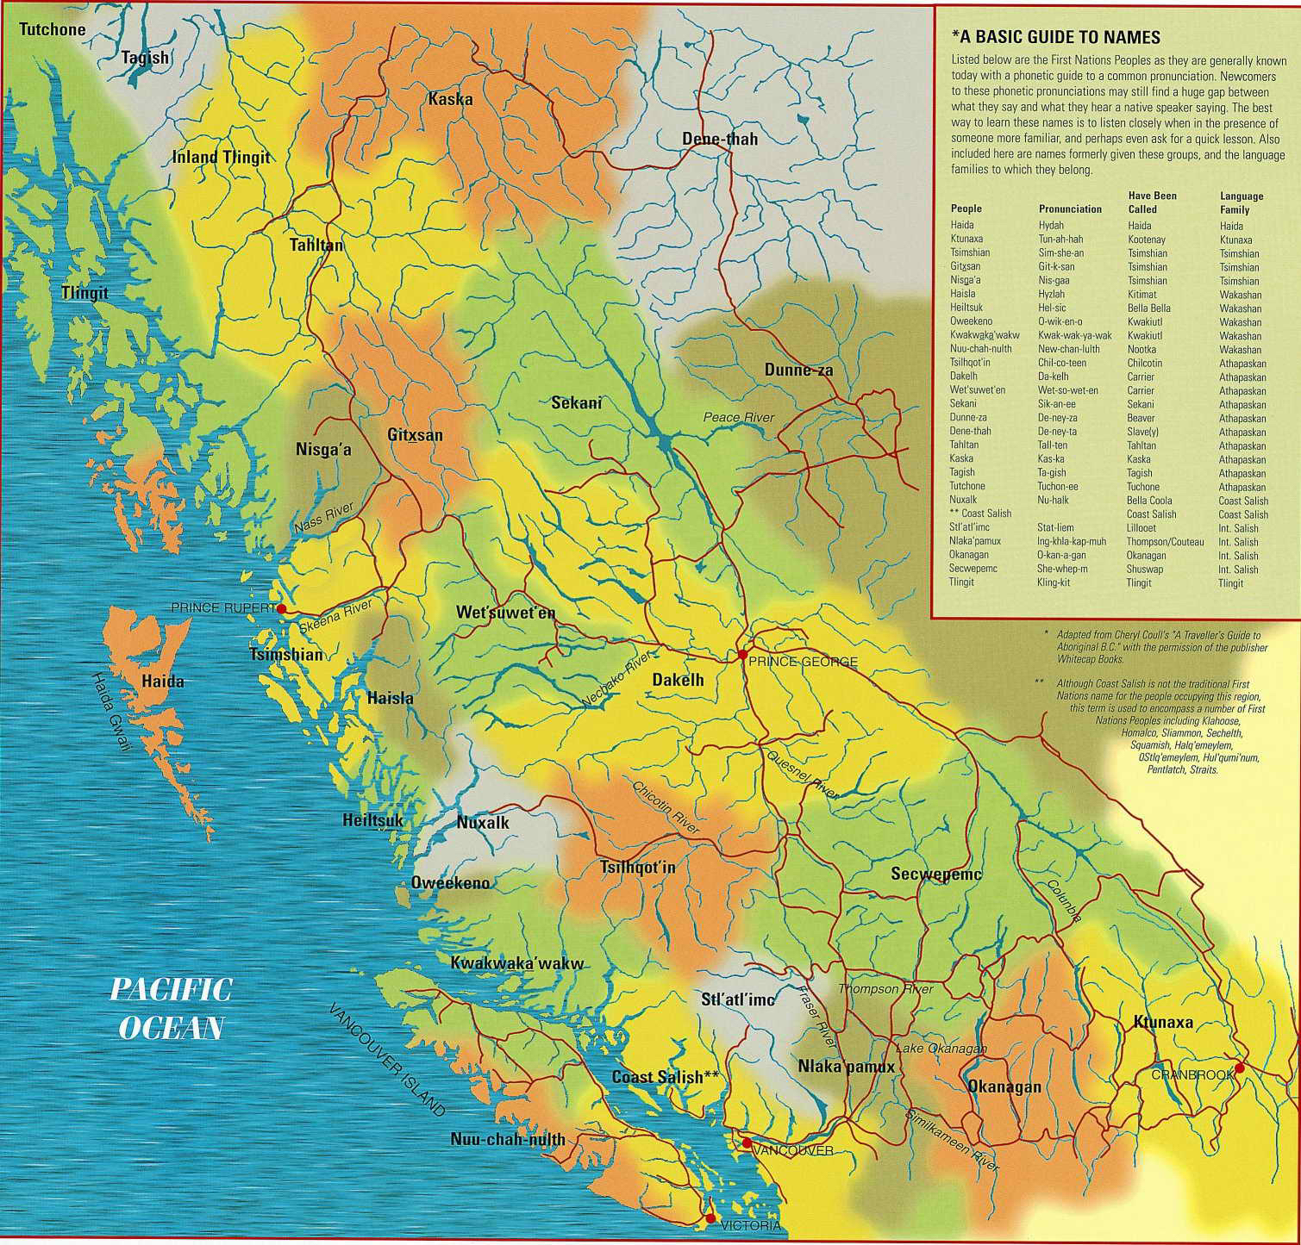
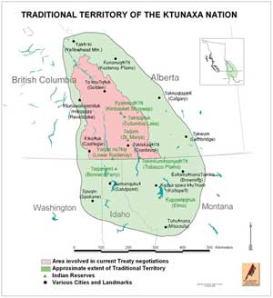

Slide 10
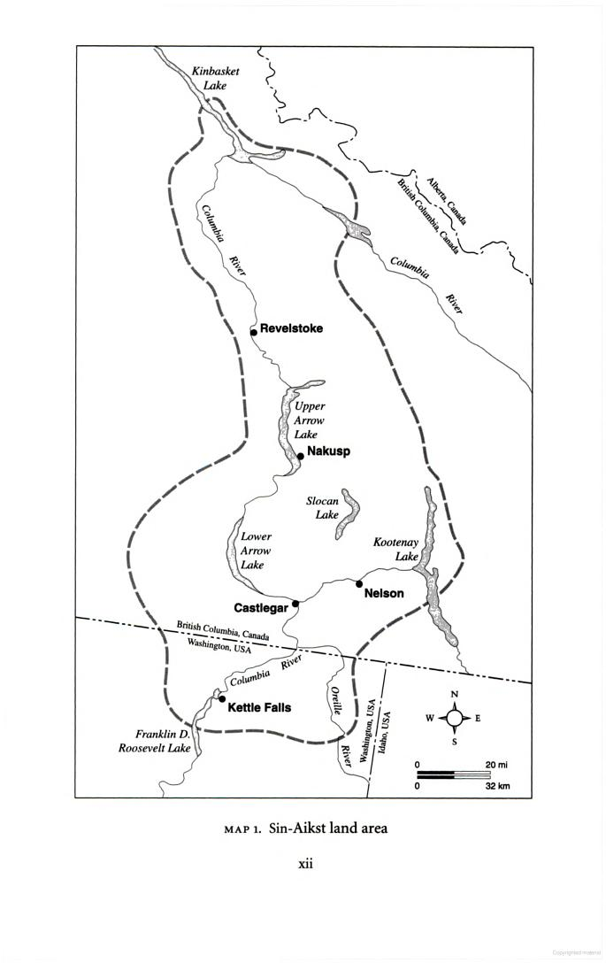
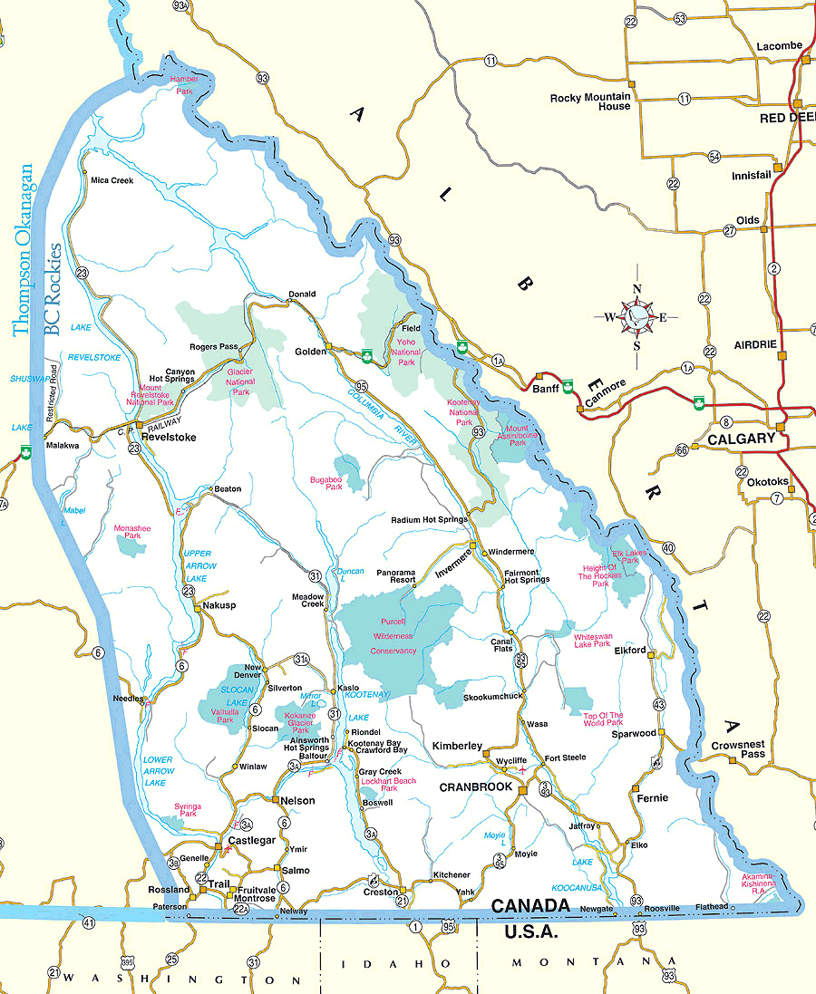

Slide 11
Acknowledgements of Territory:
For a written acknowledgement, more thought regarding details can happen
(i.e. webpage, calendar). Here is the basic idea:
College of the Rockies serves the communities of the East Kootenays, all of which are located on the unceded ancestral lands of the Ktunaxa People. We acknowledge, value and honour our partnerships with four Ktunaxa communities, as well as with the Shuswap Band, and the Kootenay Regional Office of the Métis Nation, BC.
We try to encourage that verbal acknowledgements are not scripted, but come from whatever your heart is telling you to say.
You can replace “ancestral lands” with “traditional territory”, and you can add any other details describing your relationships.

Slide 12
Acknowledgements of Territory: When, Where & How Often?
In Classrooms: As often as you want, but at minimum:
The beginning of class each term
When you are covering a topic that is Indigenous
A topic that may involve class decisions
A topic that could lead to emotional or contentious discussion.
When you feel tension among students
Often an acknowledgement at the beginning can set a calming tone and remind students that the ancestors may be listening and respect is paramount.
In Meetings: Again as often as desired, but at minimum:
Meetings with guests from outside the territory
Meetings with guests from local nation or other Indigenous Groups
As above – Indigenous topics, important decisions, tension among participants, topics that could lead to emotional or contentious discussions

Slide 13
Acknowledgements of Territory: When, Where & How Often?
At all large or public events, announcements, and celebrations.
Graduation and Awards Recognition Events
Professional Development Events
Performances, Assemblies, etc.
Email:
Add an acknowledgement to your signature! This is an easy way to incorporate respectful practise into your everyday work.
You don’t need to bring in an elder to do an acknowledgement! Everyone should feel comfortable enough to be called upon to do an acknowledgement – practise if you feel you need to. Elders are brought in sometimes to provide a welcome to the territory – this is different than an acknowledgement.

Slide 14
Indigenizing Practice includes:
Indigenous Ways of Knowing
Indigenous Perspective & Principles of Learning
Incorporating traditional knowledge & awareness of current issues

Slide 15
Indigenous Ways of Knowing
Holistic
Trust for inherited wisdom
Respect for all things
Includes physical & metaphysical world linked to moral code
Emphasis of practical application of skills & knowledge
Communication of metaphor & story connected to life, values and proper behaviour
Practical Experimentation
Qualitative oral record
Local verification
Integrated and applied to daily living & traditional sustenance practices

Slide 16
Indigenous Ways of Knowing
What the community deems worth knowing, how they come to know it and how and with whom the knowledge is shared.
Programs must consider historical, social, cultural, family and personal factors in order to be effective:
cultural identity,
gender,
family responsibilities,
geography (urban, rural, remote, on-reserve),
first language,
age and
previous educational experience.

Slide 17
Indigenous Ways of Knowing
Ktunaxa Elders say that everything you need to know about being a good Ktunaxa citizen is in the stories and the songs.
Ktunaxa children know that lying is not a good idea because it always gets coyote into trouble.
Ktunaxa children learn to never take all of the eggs out of a duck’s nest.
Ktunaxa children learn to not pick out a whole area of berries – some must be left for nupqu.

Slide 18
Indigenous Perspective
Indigenous people have had their own ways of looking at and relating to the world, the universe, and to each other (Ascher 2002; Eglash 2002). Their traditional education processes were carefully constructed around observing natural processes, adapting modes of survival, obtaining sustenance from the plant and animal world, and using natural materials to make their tools and implements. All of this was made understandable through demonstration and observation accompanied by thoughtful stories in which the lessons were imbedded (Kawagley 1995; Cajete 2000).

Slide 19
Indigenous Perspective
Ktunaxa people are valued for the skills and talents they bring to the well-being of the community, and those talents are fostered, groomed and encouraged.
Ktunaxa people had many chiefs – “duck chief”, “deer chief”, “fishing chief”, “medicine chief”.
Decisions were made by consensus, by listening to all voices, and hearing all perspectives.
Consideration for the land, the animals and the ancestors was paramount.

Slide 20
Indigenous Principles of Learning
Indigenous people have traditionally acquired their knowledge through direct experience in the natural world. For them, the particulars come to be understood in relation to the whole, and the “laws” are continually tested in the context of everyday survival.

Slide 21
Indigenous Principles of Learning
Learning ultimately supports the well-being of self, the family, the community, the land, the spirits and the ancestors.
Learning is holistic, reflective, experiential, and relational (focussed on connectedness, on reciprocal relationships, and a sense of place.
Learning involves recognizing the consequences of one’s actions.
Learning involves generational roles and responsibilities.
Learning recognizes the role of Indigenous knowledge.
Learning involves patience and time.
Learning requires exploration of one’s identity.
Learning involves recognizing that some knowledge is sacred and only shared with permission and/or in certain situations.

Slide 22
Implications for Practise
For many educators the changes needed in their classroom are not much different than many changes promoted by new teaching and learning literature (e.g., student-centered teaching, experiential learning, critical reflection, consensus building, land-based learning, active listening, etc.).
Indigenizing our teaching is also about supporting Indigenous peoples and communities goals for their self-determination and sovereignty.
Decolonization can be understood as dismantling of barriers, intentional or otherwise, that prevent Indigenous people and their ideas from prospering in Canadian society independently. Indigenization is the integration of Indigenous people and their ideas into institutions and society in a manner that supports their visions and aspirations for self-determination, well-being, growth and prosperity.

Slide 23
Implications for Practise
Consider moving away from lecture style course delivery to classroom design that encourages dialogue (circle format; small table groupings; and other approaches).
Consider arts based and non-dominant forms of demonstrating understanding, including re-storying, photo essay, performance, reflective writing, etc.
Be flexible enough to take up emerging local Indigenous issues as they arise.
View your classroom and your institution (co-workers) as an extended family, where everyone brings a unique skill, talent or perspective. Foster those skills!
Implement land-based learning and experiential learning opportunities whenever possible.
Indigenizing our teaching aims to challenge the dominant narratives about our collective histories, contemporary aspirations and challenges.

Slide 24
Implications for Practise
Learn some Ktunaxa language – this shows honour to the nation.
kiʔsuk kyukyit – Good Day
ʔanwunikit – until a later time
What do our signs mean? Let’s find out!
ya·kiⱡ hawiȼkpayamki – Dental Reception
ya·kiⱡ kqsumunaⱡiⱡki niʔkȼxaⱡ kȼi·kat k̓ituq̓ⱡiⱡqaⱡʔis – Student Services
Acknowledge the traditional territory of the Ktunaxa Nation
At meetings
Minimum of once per term in class, and whenever covering Indigenous topics

Slide 25
Implications for Practise
If an Indigenous Person approaches you and/or your workspace
Don’t make assumptions, while at the same time, be prepared:
Indigenous people have varying experiences with institutions (racism is real)– they may not feel at ease asking questions, asking for help, etc. Be aware of this history and be friendly & patient.
Keep learning – Canada’s history and keep up with Indigenous current events and issues affecting the Ktunaxa Nation. Share knowledge with friends and family.
If you hear racist or derogatory comments about Indigenous People, start a conversation, share some knowledge, or at the very least, let the person know you don’t appreciate the remark.

Slide 26
Implications for Practise
Reflect:
On a particularly cold and bitter winter day, reflect on what it must have been like for Ktunaxa People – living in tipis, no central heat….
When you do your weekly shopping, buying fresh fruit out of season, butchered meat in packages, and a wide variety of prepared foods and snacks… Think about how Ktunaxa people had to collect and dry enough food to get their entire family through the winter.
Have conversations about this….

Slide 27
Incorporating Indigenous Content
Incorporate Indigenous Authors
Current Events – Indigenous Issues
Research Topics – Encourage Indigenous Issues
Bring in an elder to give perspective to issues
Business/Office Admin/Accounting
Create excel charts, spreadsheets, surveys
Sciences
Chemistry – traditional plant dyes, brain hide-processing, traditional medicines
Biology – Traditional medicines,
Health/Social Work
Use Case Studies, Cultural Sensitivity, Traditional Medicine, Indigenous Health Statistics
Trades/Engineering/Physics
Traditional technology of fish trap, snowshoes, bows, arrows, tipis, travois, tools, canoe

Slide 28
Incorporating Indigenous Content
Professional Cook
Traditional foods and cooking methods, food drying, pit ovens
Sustainable Business Practices
Compare trade or fur-trade economy with today’s
Look at what First Nations are currently doing – partner for projects.
Recreation Management / Adventure Tourism
Land-based learning!!
Traditional Land Management/Sustainability Practices
Leadership/Administrative
Compare Traditional with Current Indigenous Governing Structures and westernized/colonialized Government Structures

Slide 29
Cultural Appropriation
Taking intellectual property, traditional knowledge, cultural expressions, or artifacts from someone else's culture without permission.
This is a real concern, along with being afraid of offering incorrect information, but don’t let it be an excuse not to Indigenize instruction or practice! It is easily avoided by:
Using Reliable Sources – preferably published by or endorsed by the nation you are studying/discussing
Verify information with the nation
Be prepared to state your sources
Give credit to where or from whom information has been obtained from (don’t represent as your own).

Slide 30
Recognize Cultural Differences
All Indigenous People are not the same!!
Don’t Generalize!
Although there may be similarities, Indigenous cultures do not share the same history, art, music, stories, beliefs, traditional practices, or present-day struggles.
Make sure you acknowledge the correct origins of concepts taught.

Slide 31
Recognize Cultural Differences
Some common concepts or artifacts that are often generalized:
Totem Poles - specific to Pacific Northwest Coast & Alaskan Peoples
Dream Catchers – Ojibwa Chippewa
The term “Turtle Island” - Algonquian and Iroquoian
Types of housing, clothing, regalia – differs greatly among Indigenous people, even within some nations
Beadwork – Beadwork of today has evolved post-contact, Ktunaxa people mainly used fringe or quillwork for ornamentation
Pow Wows – Multi-tribal Pow Wows are a post-contact activity, although protocols specific to the host nation are observed
Medicine Wheels – (Sacred Circles) – Origin of Medicine Wheels is generally attributed to Plains Cultures, but various forms are used by many
Fry Bread – Fry Bread can be traced back to Indigenous people but also many western cultures for centuries

Slide 32
Myths and Mythbusters
Myth: Indigenous People Get Free Post-Secondary Education
Mythbuster: Some Indigenous People receive funding for Post-Secondary Education, under very limited and prescribed terms.
There is a great deal of misinformation regarding Indigenous peoples’ access to financial aid when studying at the post-secondary level. Métis, non-status and Bill C-31 Indigenous peoples have historically not been eligible to access any financial support.

Slide 33
Myths and Mythbusters
Indigenous People Get Free Education
Funding was allocated to First Nations Bands from the sale of land or mineral rights, by First Nations peoples. The money is distributed by an Aboriginal Trust Fund established by the federal government. Eligible people (‘Status Indians’ with Band membership) may apply to their Bands for post-secondary funding. However, the financial aid that Status First Nations students may receive is rarely enough to cover the ever growing expense of post-secondary attendance and cost of living (Doran et al., 2015).
Demand for funding far exceeds the money that communities receive for post-secondary education.

Slide 34
Myths and Mythbusters
Indigenous People Get Free Education
Students have to apply for funding for school from their home community.
Most often, the demand for funding far exceeds the money that bands receive for post-secondary education.
Strict conditions apply
Funding is limited to “eligible programs” and “eligible institutions”. For those who do receive funding, the money often comes with strict conditions.
Many students must reapply to their band every year, uphold a certain grade point average, have a career outline, not miss classes and take a minimum of four courses per semester.
Students who have their funding pulled because they have missed or failed classes often have to wait a minimum of two years before they can reapply, or repay band for failed classes.
Most reserves have funding priorities
The number 1 priority is often newly graduated high school students. Next are people continuing their undergraduate studies, then masters students and then people who have been out of school for a while.
Some communities also place priority on people who actually live on-reserve.

Slide 35
Myths and Mythbusters
Indigenous People Get Free Education
It is important to understand WHY “paid-for” education came into effect.
The goal was toward assimilation and disenfranchisement. Only since the 1970s have First Nations peoples been allowed to pursue post-secondary education without the fear of disenfranchisement. Until this compulsory enfranchisement provision was removed from the Indian Act, Indians who received a college or university education were required to give up their status.
And HOW “paid for” education came into effect.
Funding was allocated to First Nations Bands from the sale of land or mineral rights, by First Nations peoples. The money is distributed by an Aboriginal Trust Fund established by the federal government.

Slide 36
Myths and Mythbusters
Indigenous People Get Free Housing

Slide 37
Myths and Mythbusters
Indigenous People Get Free Housing

Slide 38
Myths and Mythbusters
Indigenous People Get Free Housing

Slide 39
Myths and Mythbusters
Indigenous People Get Free Housing

Slide 40
Retention & Success
Indigenous People Get Free Education
Post-secondary institutions will have to allocate both physical and human resources to support students’ adjustment to campus (Smith et al. 2011). The completed needs assessment, recommended previously when defining the target student population, will guide access program staff to find or develop the appropriate support for incoming students. These supports may already exist within the faculty of engineering, the post-secondary institution or the community and should be identified. However, some may be unique and will require innovative solutions and partnerships. The importance of these services will continue over the students’ time at post-secondary, but will likely be most acute during their transition to post-secondary. Support services are key to Indigenous students’ persistence through the engineering program, to student morale and to performance (R.A. Malatest & Associates Ltd. & The Council of Ministers of Education Canada (CMEC), 2002).

Slide 41
Retention & Success
Students may need support in different facets of their lives, but example areas include: daycare, locating housing, accessing transportation, academic counselling, personal counselling, professional development, career planning or tutoring (Environics Institute, 2010; Herrmann, 2012; R.A. Malatest & Associates Ltd. & The Council of Ministers of Education Canada (CMEC), 2002). For urban Indigenous students, family support has been shown as central to their success at post-secondary (Environics Institute, 2010).
Labun (2002) suggests support personnel, including faculty, counselors and support staff, meet regularly to discuss each student, with greater frequency early in the students’ time at post-secondary. More frequent meetings occur with students who require extra assistance, as deemed by personnel or the individual. Behaviours that solicit more frequent meetings include missing class, falling below a certain grade limit or behaviour indicative of a student not managing the transition well.

Slide 42
Retention & Success
Only since the 1970s have First Nations peoples been allowed to pursue post-secondary education without the fear of losing Status and disenfranchisement (Anonson, Desjarlais, Nixon, Whiteman, & Bird, 2008; Doran et al., 2015; Prince Albert Grand Council, 2005). As Goldfinch & Kennedy state, “a long history of institutionally driven dispossession of lands, language, culture and identity have led to varying degrees of mistrust of institutions” (2013, p.5), especially considering the history of residential schools, which ended in the 1990s, and other practices of assimilation (R.A. Malatest & Associates Ltd. & The Council of Ministers of Education Canada (CMEC), 2002).
Unemployment, poverty, insufficient high school education—particularly in remote communities where prerequisite science and math courses may not be offered—and sparse information on career options, are all factors restricting access to post-secondary engineering education for Indigenous learners (Adams et al., 2005; R.A. Malatest & Associates Ltd. & The Council of Ministers of Education Canada (CMEC), 2002; D. Smith, McAlister, Tedford Gold, & Sullivan-Bentz, 2011). Specifically, 29 per cent of Indigenous peoples in Canada have not completed high school. For those with Status, this number grows to 35 per cent (Statistics Canada, 2013).

Slide 43
Establishing Support Services
Establishing Support Services
1. Pair needs identified in assessment of student population with supports (existing or those that can be established).
2. Identify if these supports are significantly culturally appropriate, revise accordingly.
3. Establish a communication plan to inform students of support services.
4. Measure if students are sufficiently aware of support services. (Curran et al., 2008)
a. Student services and supports were identified and effort was made to offer appropriate level of services and programming to address needs.
b. Students are aware of available support services.
c. Students are comfortable accessing support services.
d. Students are satisfied with support.
e. Available student support is promoted.

Slide 44
Establishing Support Services
Bridge Programs/Alternative Orientation
Bridge programs allow students to take a step to upgrade skills, begin first-year courses or acclimate to post-secondary culture before entering an engineering program. They range in scope from years-long to multi-week orientation programs. Bridge programs can be implemented within a student’s home community, at an associated college, at the post-secondary institution where the student has been admitted or a combination of these
Bridge programs may function simply as an academic upgrade program. Assuring students are prepared for calculus, physics or chemistry can introduce post-secondary class style, alleviate the need for those courses in admissions policies and help students step into their other classes feeling prepared (Herrmann, 2012; Labun, 2002). Other course topics include professionalism, student responsibilities, career planning or language training (Labun, 2002). Bridge programs may also help mature students return to the routine of school.

Slide 45
Establishing Support Services
1. Based on needs assessment, establish what professional and academic skills students require refreshers.
2. Determine feasibility and appropriate scale for delivery (community based, on campus, alternative orientation, etc.)
3. Determine consequences of bridge program / orientation completion (compulsory for entry, course credit, information only)
4. Measure students' confidence, anxiety and feelings of preparedness for "first week".
5. Ensure introduction of supports available to students.

Slide 46
Establishing Support Services
Orientation Programs
In some instances, specialized orientations, rather than complete bridge programs, may be more suitable. Alternative or additional programming to the post-secondary institution’s first-year orientation may provide Indigenous students an important introduction to post-secondary. The orientation familiarizes students with important support services, assists in transitioning to post-secondary and introduces them to their future colleagues. ENGAP at the University of Manitoba introduces students to the University’s electronic systems, including registration and email, as well as its library system. Students participate in a short course to assess and refresh key academic skills. Academic, personal, social and financial supports that are available to the students are introduced. Students are also familiarized with the city of Winnipeg, the rules of the University and student roles (personal communication with ENGAP director, 2015).

