Slide 1
Welcome to highlands elementary school

Slide 2
Highlands Elementary school
Highlands School opened in November 1977.
The school is located at 3300 7th St S. Cranbrook, British Columbia.
The schools phone number is 250-489-4391.

Slide 3
We would like to acknowledge that we are teaching and learning on the ancestral and unceded territory of the Ktunaxa people. In particular, we honour the ?Aq’ am and Tobacco Plains communities. We thank them for this privilege.

Slide 4
Highland Huskies
Highlands Huskies Cheer
Highlands Huskies say it loud.
Highlands Huskies say it proud.
Highlands Huskies hear us shout,
We will help each other out!
Highlands Huskies we believe,
Watch how much we can achieve!
GO HUSKIES!

Slide 5
Meet our Principal
This is Mr. Johnson, he is the leader of the huskies pack.
Mr. Johnson has been our principal here at Highlands for just over three years.
DID YOU KNOW?- Mr. Johnson has three sons, they all play hockey and Mr. Johnson loves coaching hockey.

Slide 6
Meet our Vice Principal
Mrs. Johnson has been at Highlands for one year.
Along with her duties as Vice Principal, she is also one of our grade six teachers.
DID YOU KNOW? - Mrs. Johnson loves to run, garden, and play floor hockey.

Slide 7
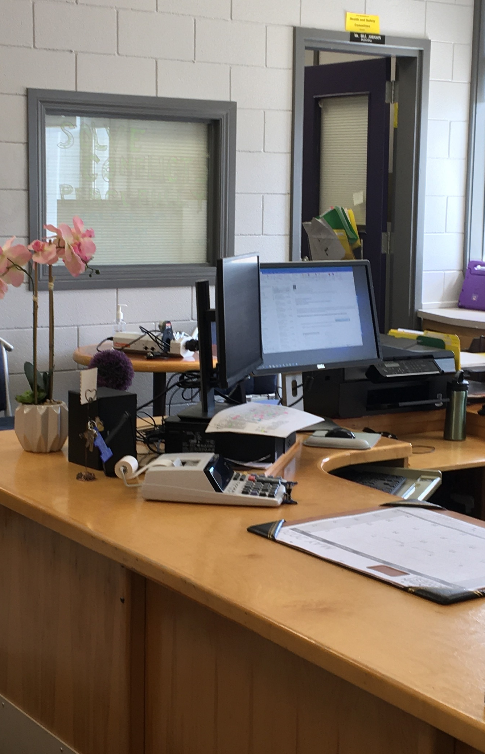
The Office
The office is were you can go to ask for help. Mrs. Pearson is our school secretary. She will answer any of your questions.

Slide 8
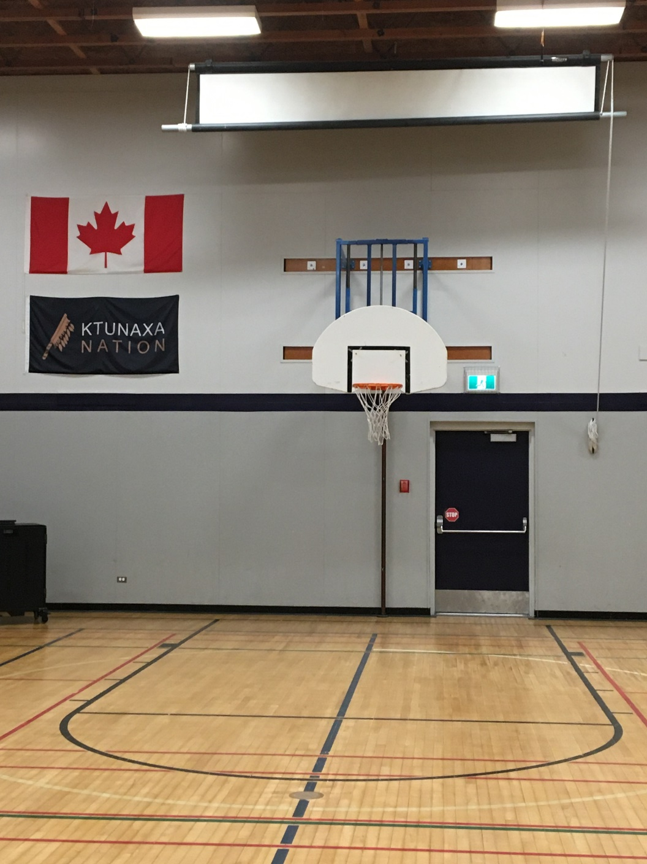
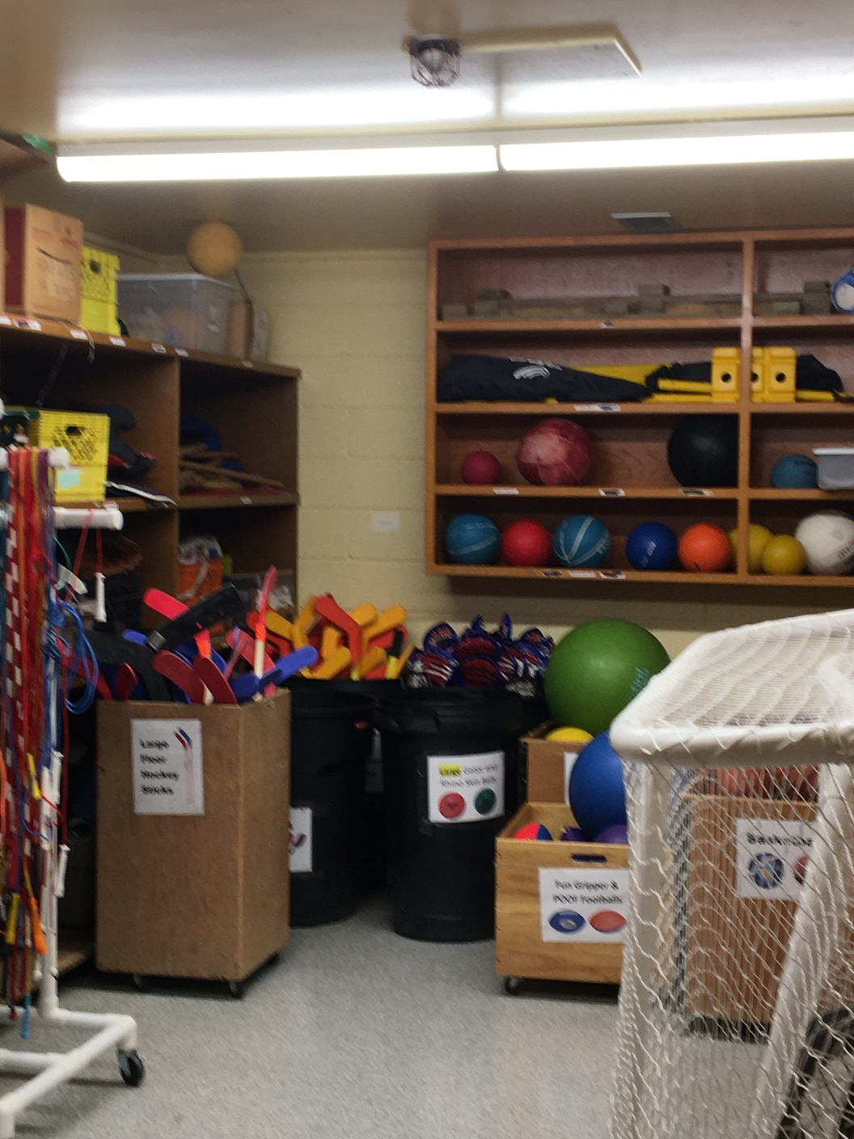
The Gymnasium
The gym is a large space where students get to be active and learn new games, sports, and movements. Check out the equipment room. Look at all the different types of equipment you will get a chance to explore while you’re here at Highlands.
We also use the gym for special events through out the year. Some of these events include assemblies, the Heart 2 Heart market and fair, and Huskies sports games.
Go HUSKIES Go!

Slide 9
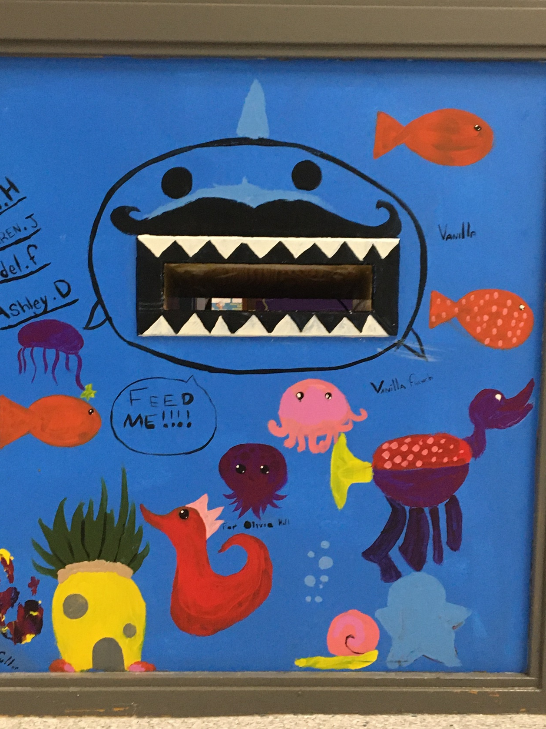
THE LIBRARY
WOW! There are so many books to explore. Here in the library you will find a book sure to spark your interest. We have books for everyone. Don’t forget to feed Mr. Shark. He will keep your book safe and make sure that it gets delivered back to the shelf safely.

Slide 10
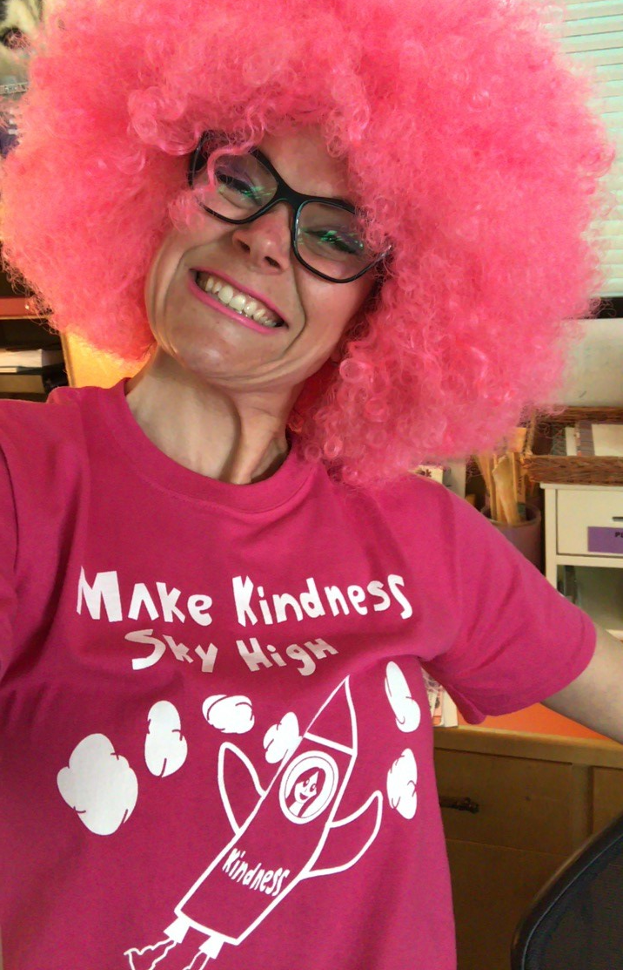
Mrs. Merkel
Mrs. Merkel has been at Highlands for many years. You will find her in the library or teaching students. She also runs our leadership club for grade six students.
Mrs. Merkel is the lady who organizes our Heart 2 Heart market and our anti bullying t-shirt/button contest.
Merkel is always ready to show her fantastic school spirit.

Slide 11
The Library
Mrs. Lawrence works in our library. She will help you find a book and sign it out.
Did you Know? – Mrs. Lawrence has 2 grown up children and a grandson. She likes to garden and hike. Her favorite book is “Fish in a Tree.”

Slide 12
The Music Room
DO, RE, MI, FA, SOL, LA, TI, DO. Here in the music room you will get to explore many different instruments, while reading/writing music, learning the different notes and exploring sound.

Slide 13
Mrs. BAin
Mrs. Bain is our music teacher. She has only been with us for a short time but in that time she has organized some absolutely moving Remembrance Day and Christmas Concerts.
Lyndsey’s main instrument is piano, she has played it for over 20 years. She has also played many other band instruments.

Slide 14
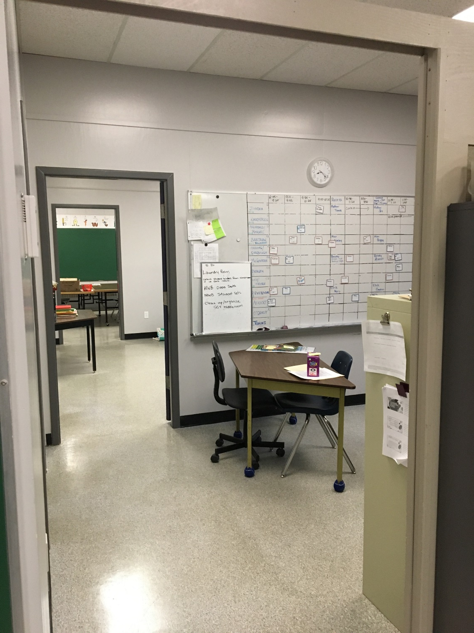
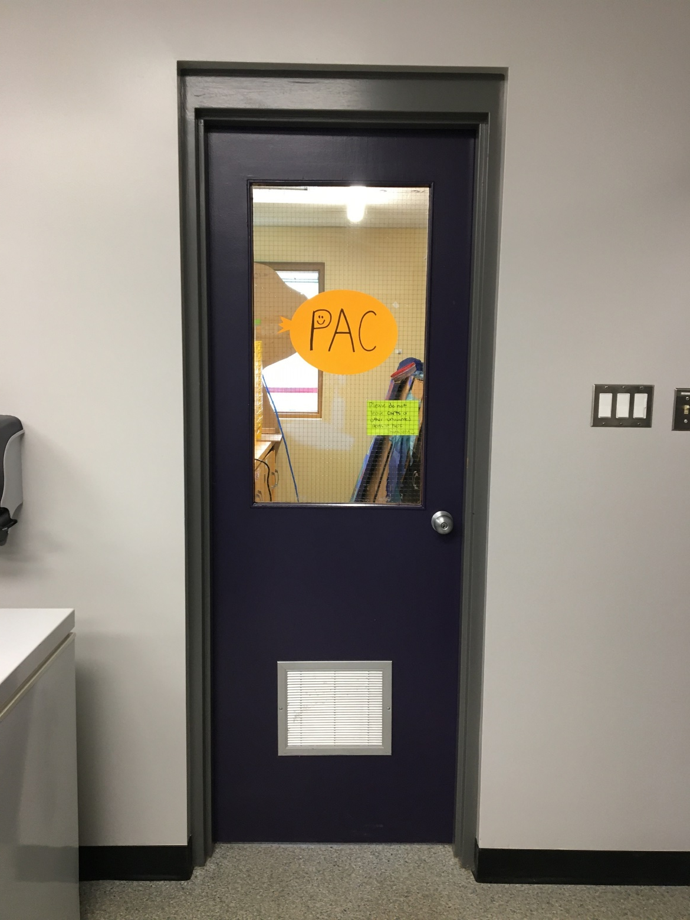
Student Services
This is a very important area at Highlands. Many different services take place in this area. For example, the breakfast club meets here every morning, so kids can come visit with friends/staff while enjoying some delicious breakfast. Also in this area there are multiple offices that house our Students Services Teacher, School Counsellor, Youth Care Worker, and Aboriginal Education Support Worker. Other programs that utilize this area are the Highlands Parent Advisory Committee (PAC) for the weekly hot lunch program, and Highlands Running Club.

Slide 15
Student Services Teacher
Mrs. Damant is our Student Services Teacher. She coordinates our Educational Assistants, organizes programs, and supports students in a variety of different ways.
DID YOU KNOW? – Mrs. Damant likes birds and reading stories to kids. She especially likes reading stories about birds to kids. Maybe she even likes reading to birds.

Slide 16
School Counsellor
Emily Popoff is our school counsellor who works out of our student services area.
She loves working with kids and families in the school and in the community as a registered clinical counsellor.
Emily believes that talking can be a big help for kids (and all people who are going through difficulties).
Counselling is meant to help people work through emotional problems and challenges that are troubling their day to day lives.

Slide 17
Youth Care Worker
Ms. Reid is our Youth Care Worker. She helps students learn how be kind and work with others. She leads programs in the classrooms and friendship groups to help students feel connected to their school.
DID YOU KNOW? – Ms. Reid has had many different pets in her life. Some included a Tarantula named Sparky (she lived 25yrs), an iguana, a monkey, guinea pigs, a rabbit, dogs, cats, turtles and much more!

Slide 18
ABORIGINAL EDUCATION SUPPORT WORKER
Ms. Palmer supports many of the students in our school. She provides many Aboriginal based experiences for all our students.
Ms. Palmer’s favorite part of her job is bringing Aboriginal Elders and Artists into our school to share their knowledge with our students.
She also loves being a grandma and farm mom in her free time.

Slide 19
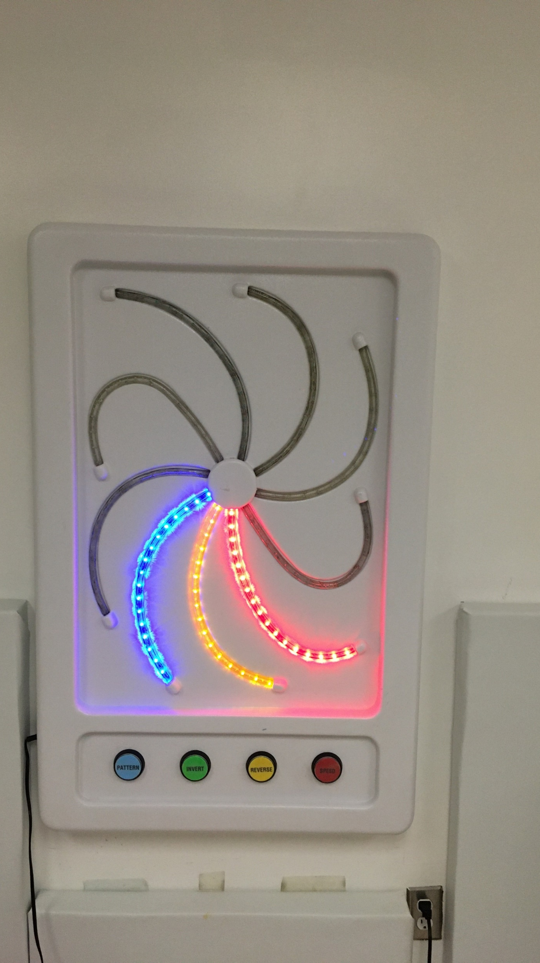
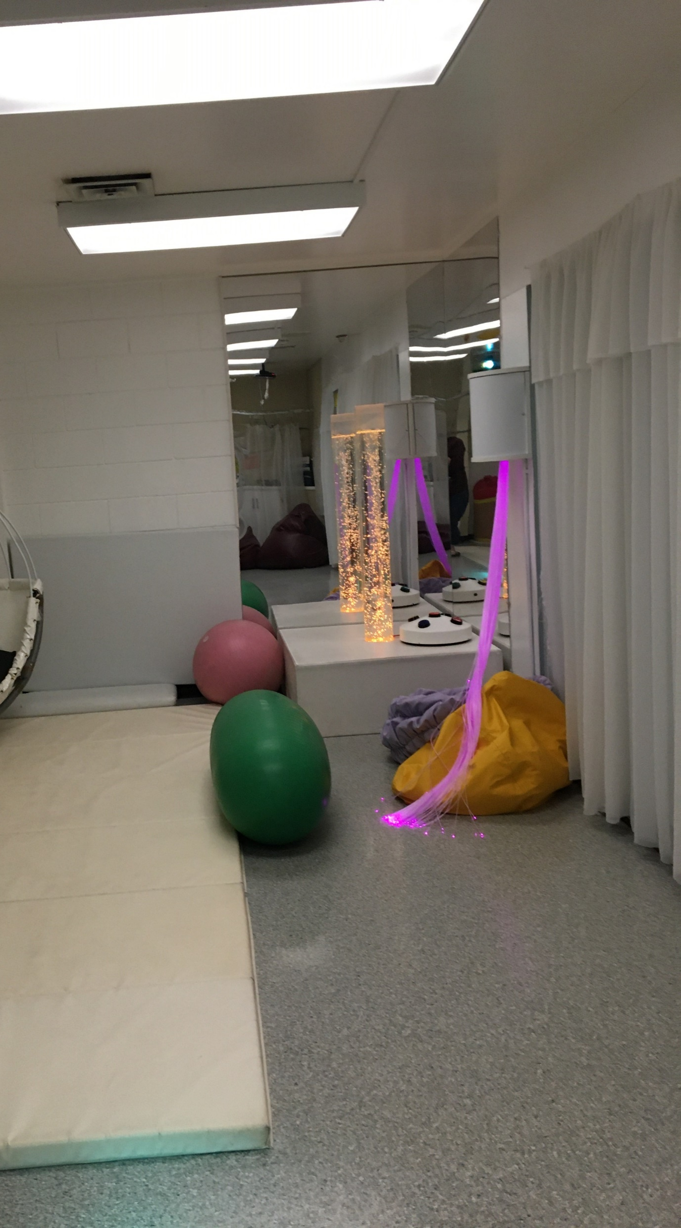
The Sensory Room
Our Sensory Room has specialized equipment that helps some of our students build on their Self regulation skills, fine/ Gross motor skills and focus.

Slide 20
The Courtyard
Highlands classrooms follow hallways that encase a special little area. The courtyard is a special outdoor space in which our students/classes can go and play, explore nature, or even just sit and visit or read their favorite book.

Slide 21
The WORM Hut
The Worm Hut is a just one of the special clubs your child could be apart of. This club ran by our very own Mrs. Ackert. The children learn about composting and how to become a special keeper of the earth.
Do you like Wiggly Worms? If so you could help us in the Worm Hut.

Slide 22
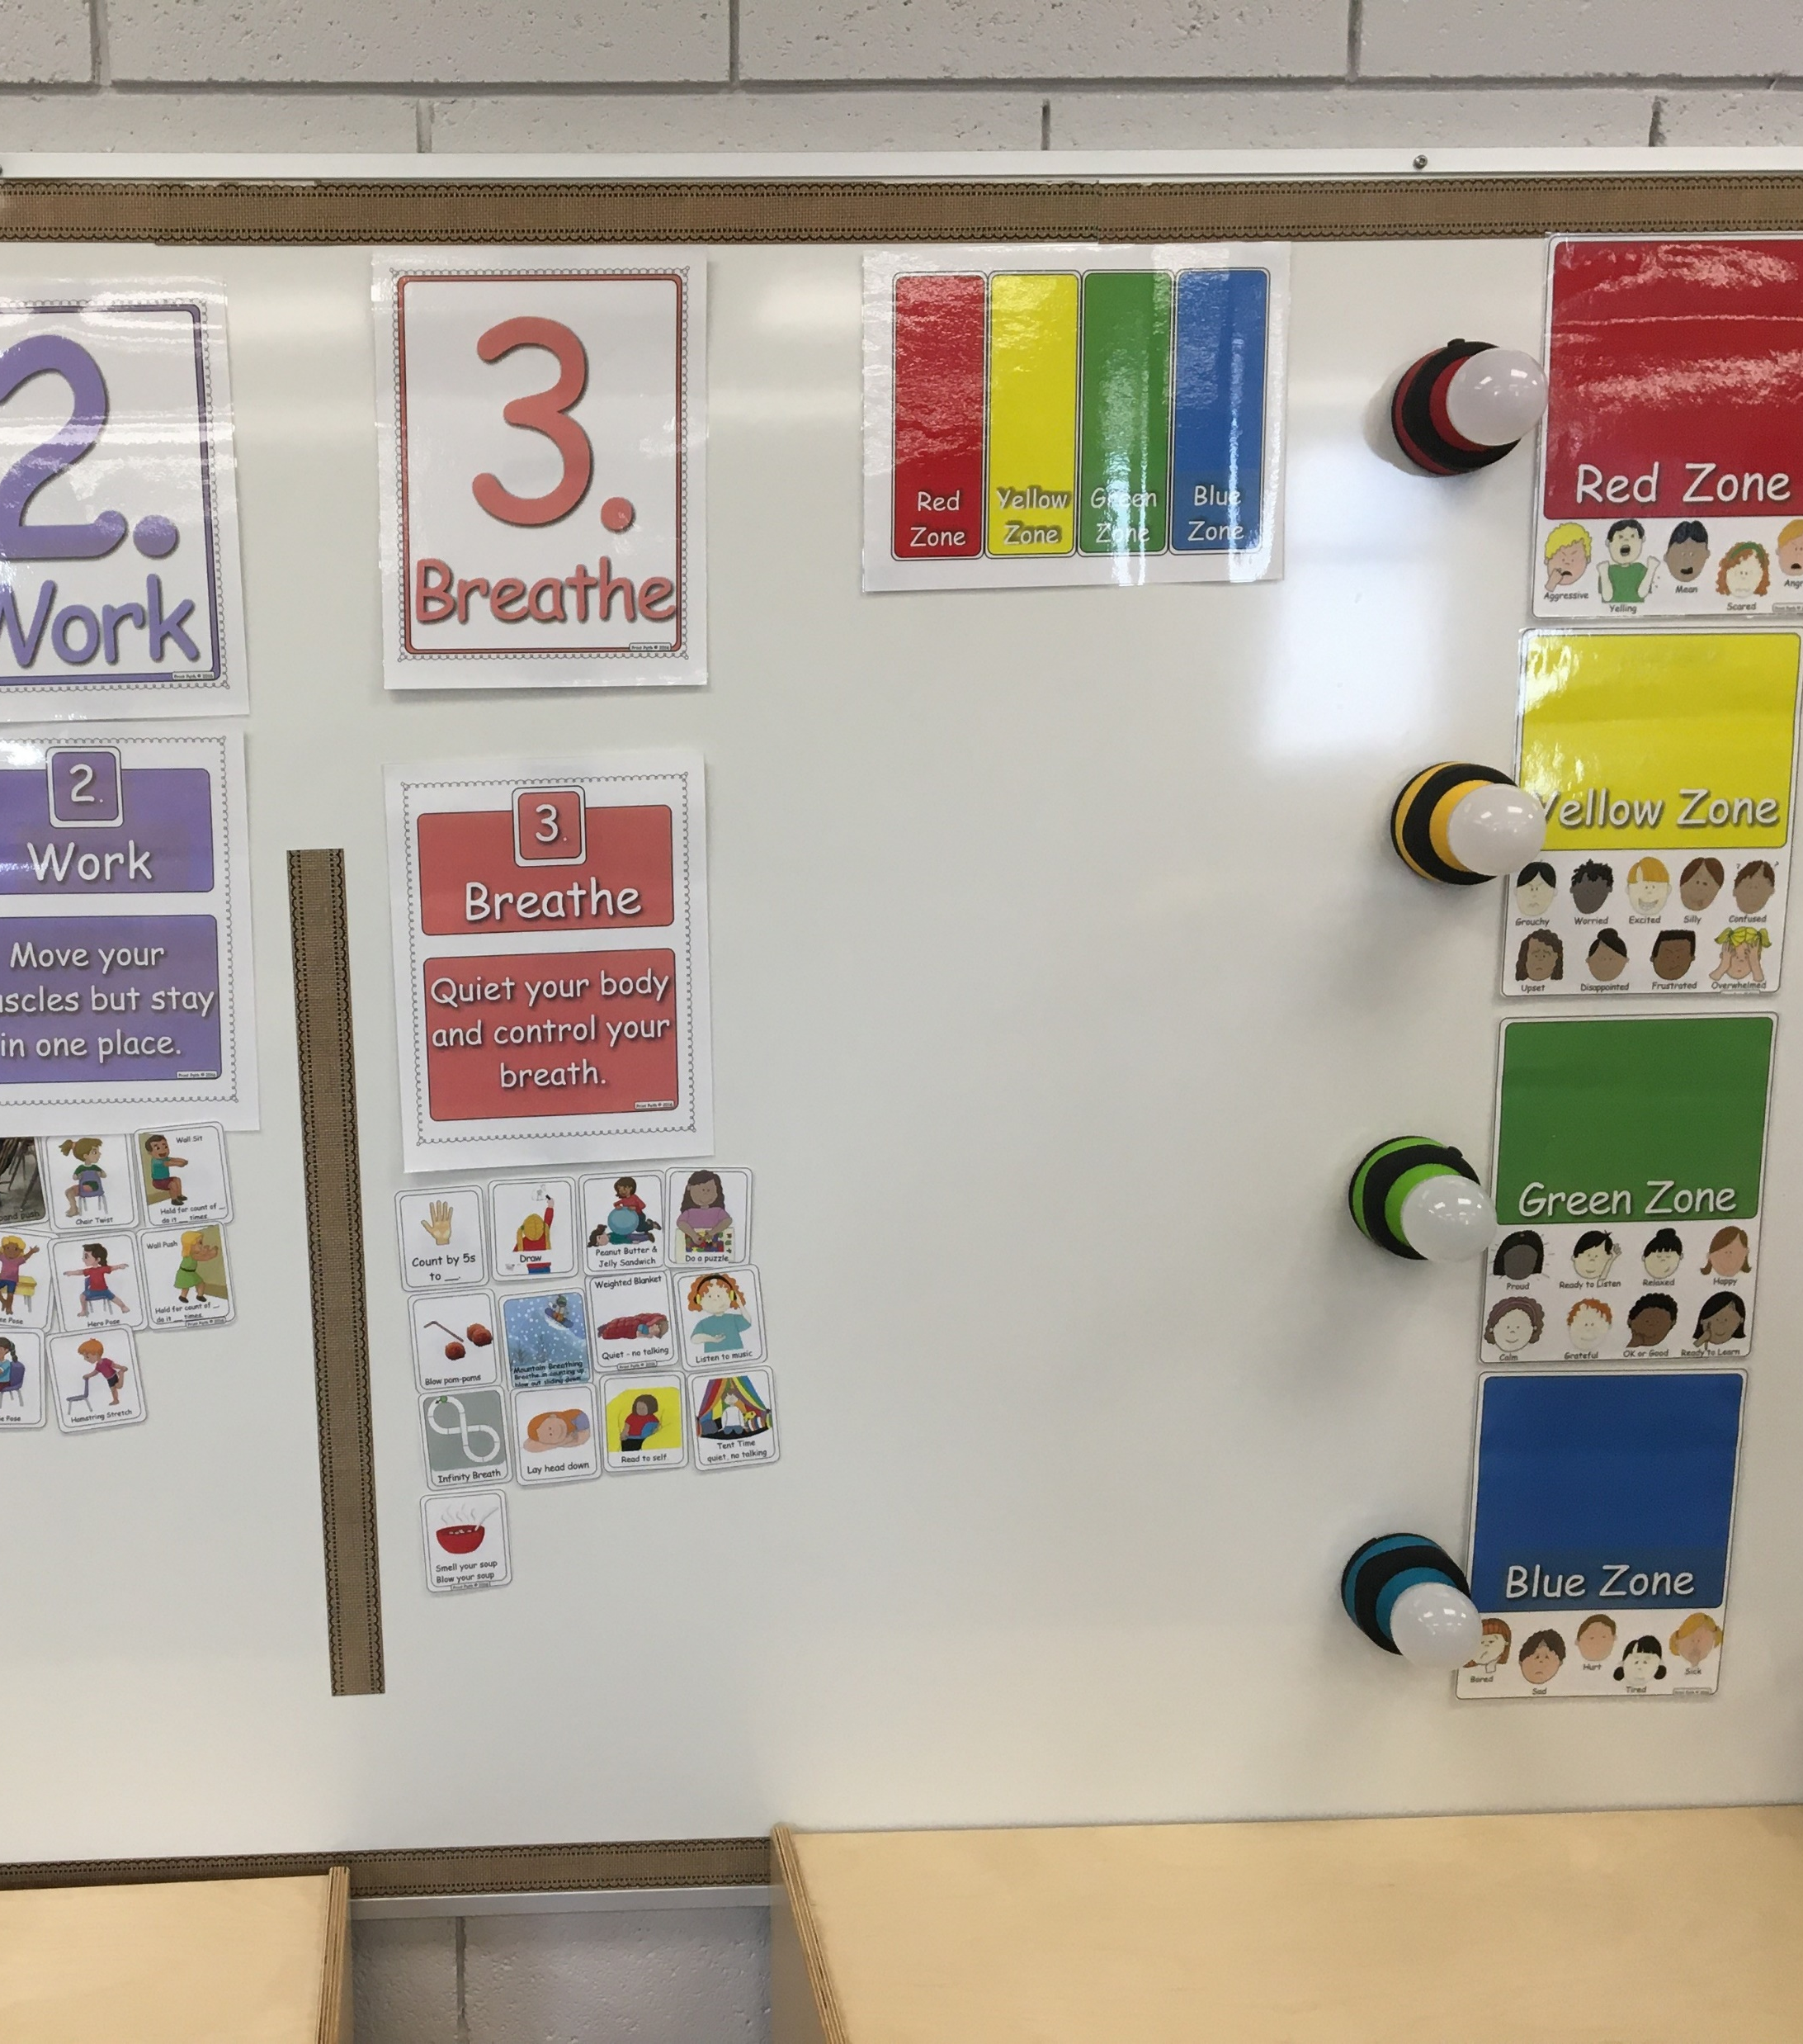
Social Emotional learning centre (SELC)
SELC fosters an inclusive learning environment that embraces the developmental needs of primary students who require social emotional support in elementary schools throughout School District 5.
SELC enables students to learn valuable social emotional skills while maintaining daily connections with their home schools. Primary students from various elementary schools to participate in afternoon social emotional learning in a Highlands classroom. Students are supported in transferring their newly acquired skills back to their home classroom by the SELC team.

Slide 23
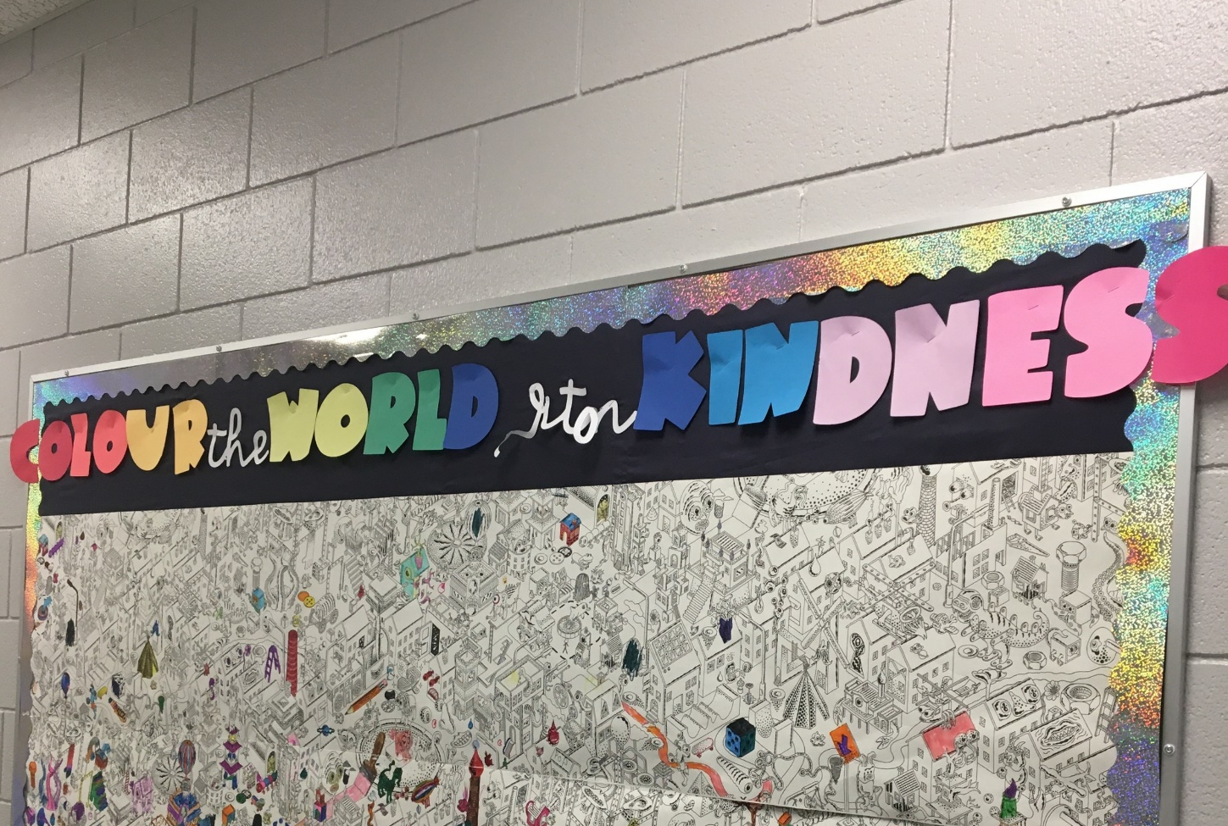
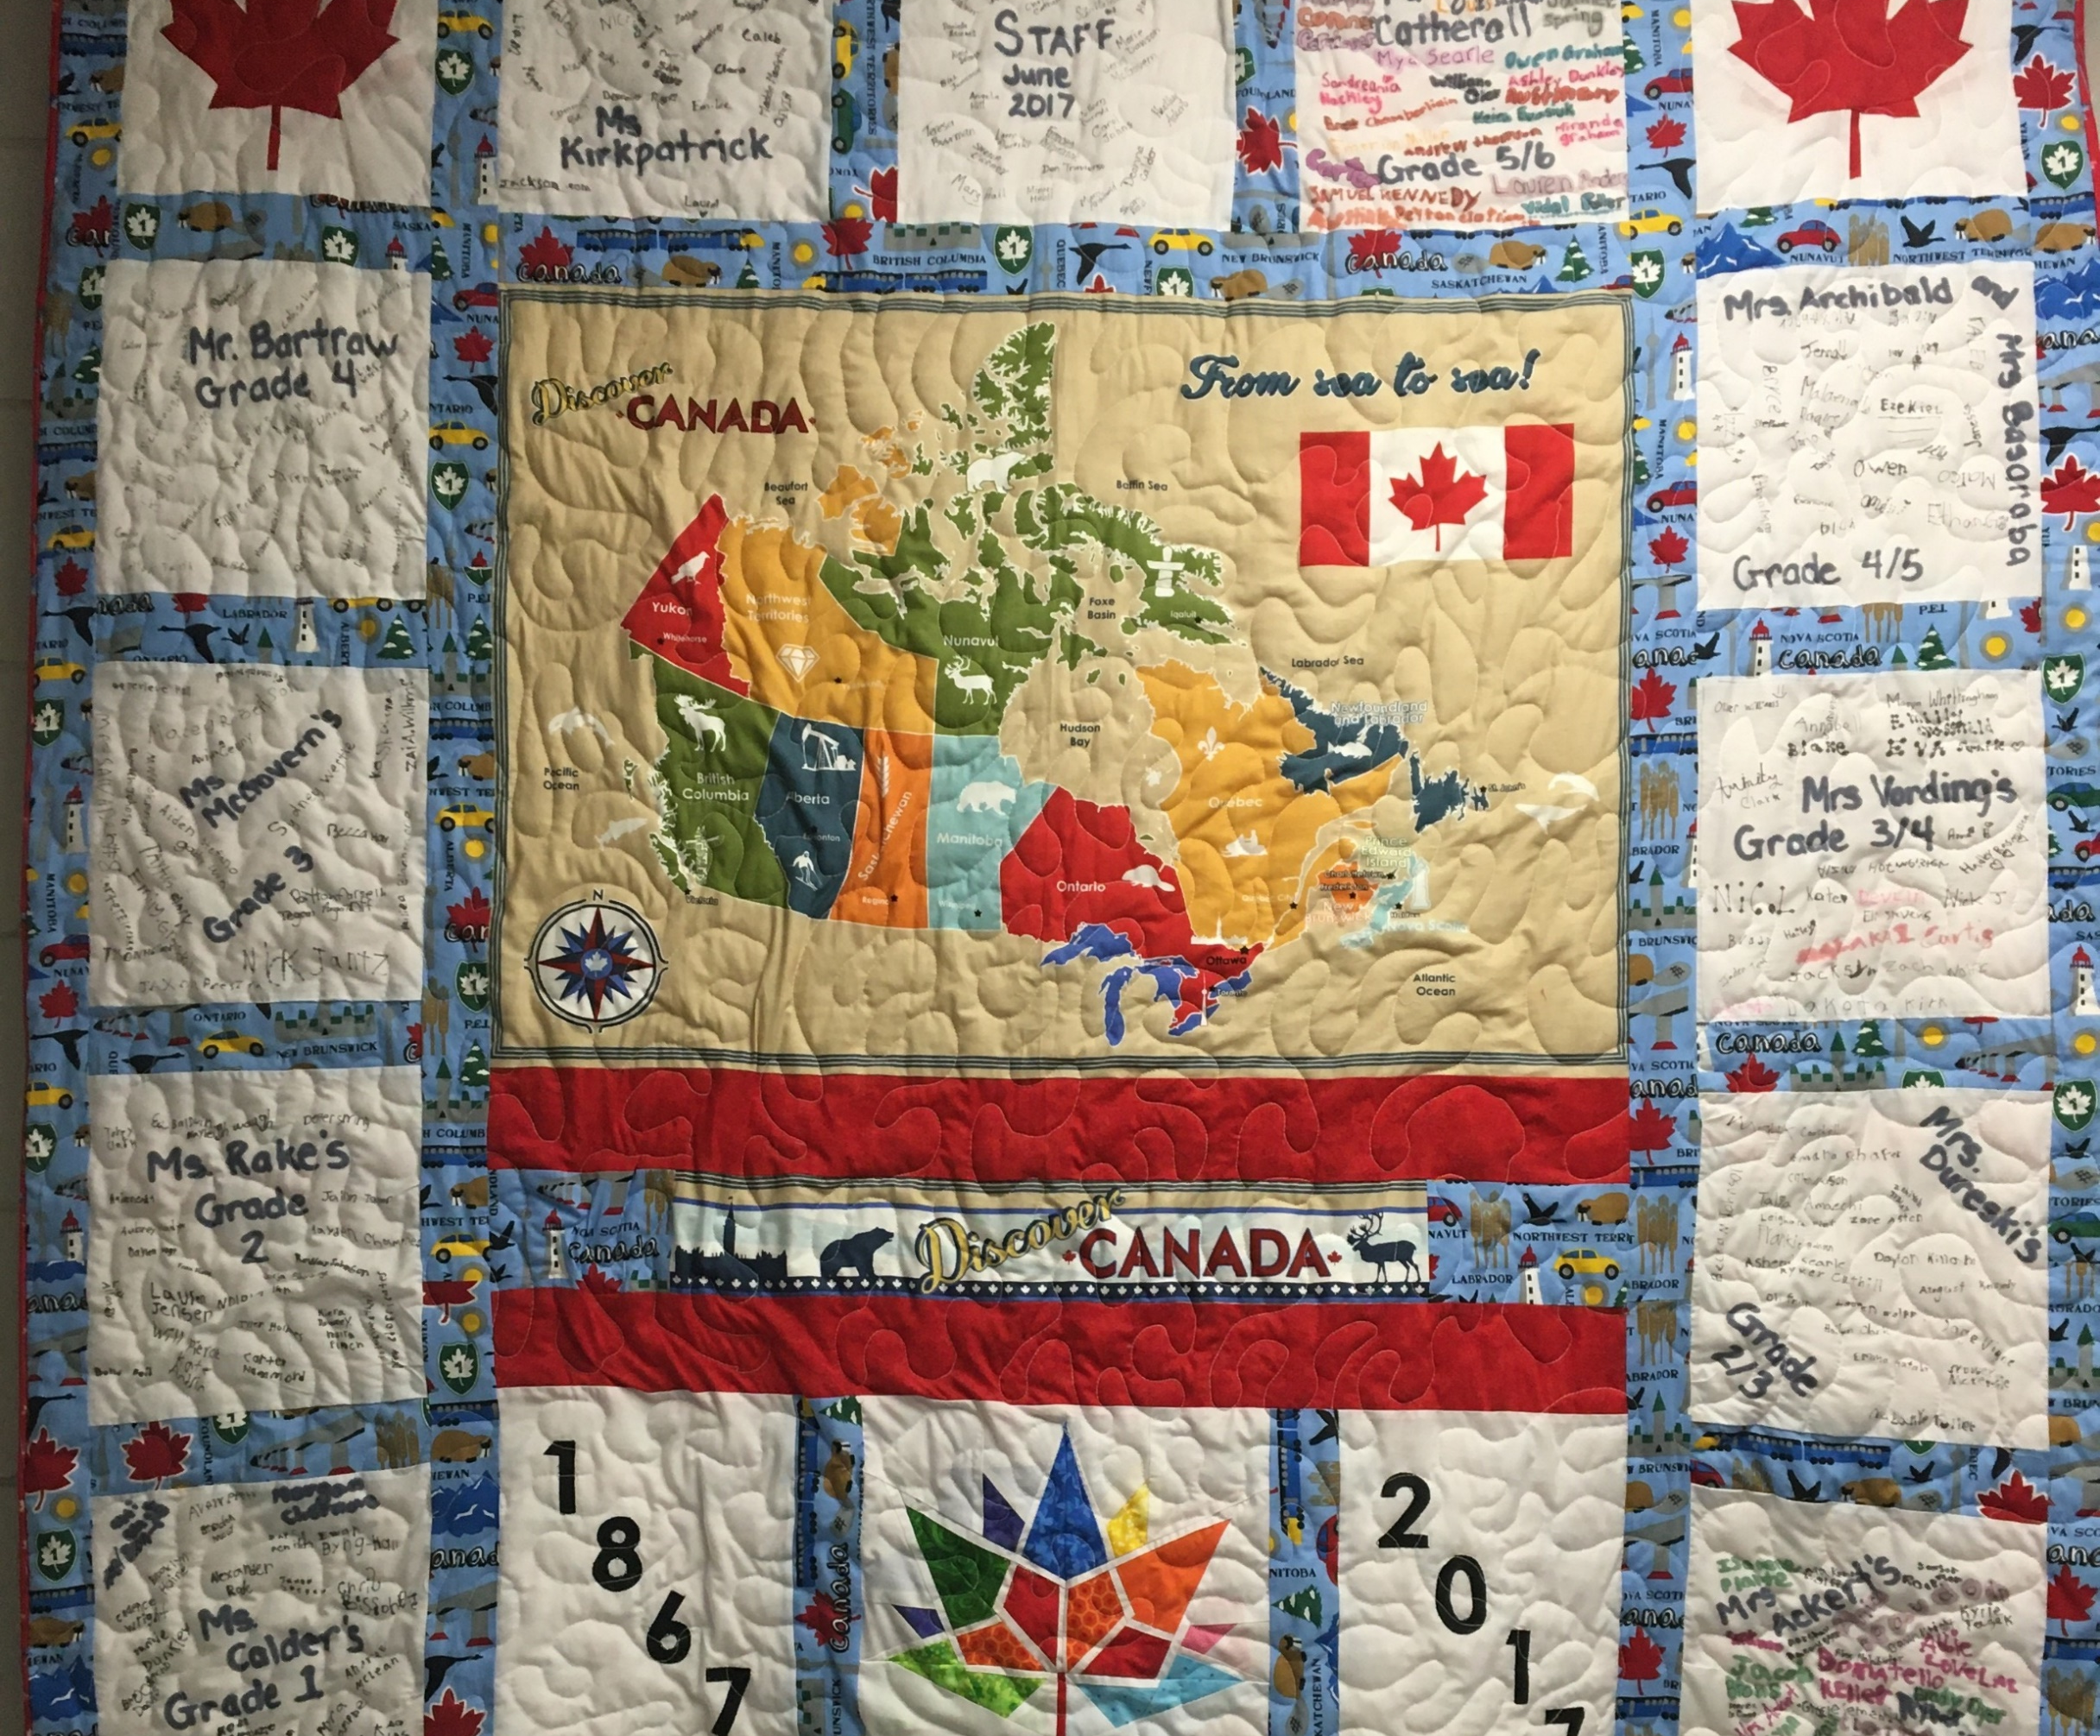
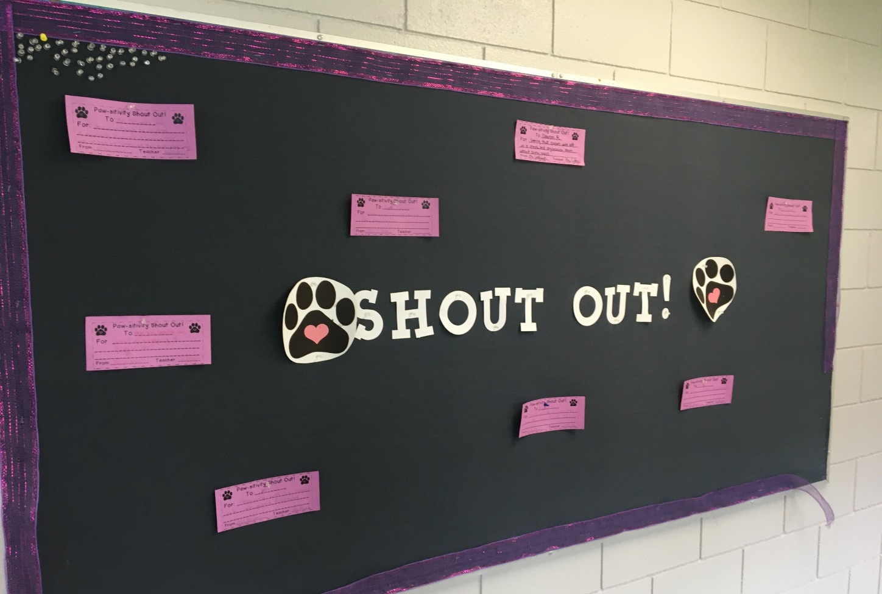
SHOW YOUR HIGHLANDS PRIDE!

Slide 24
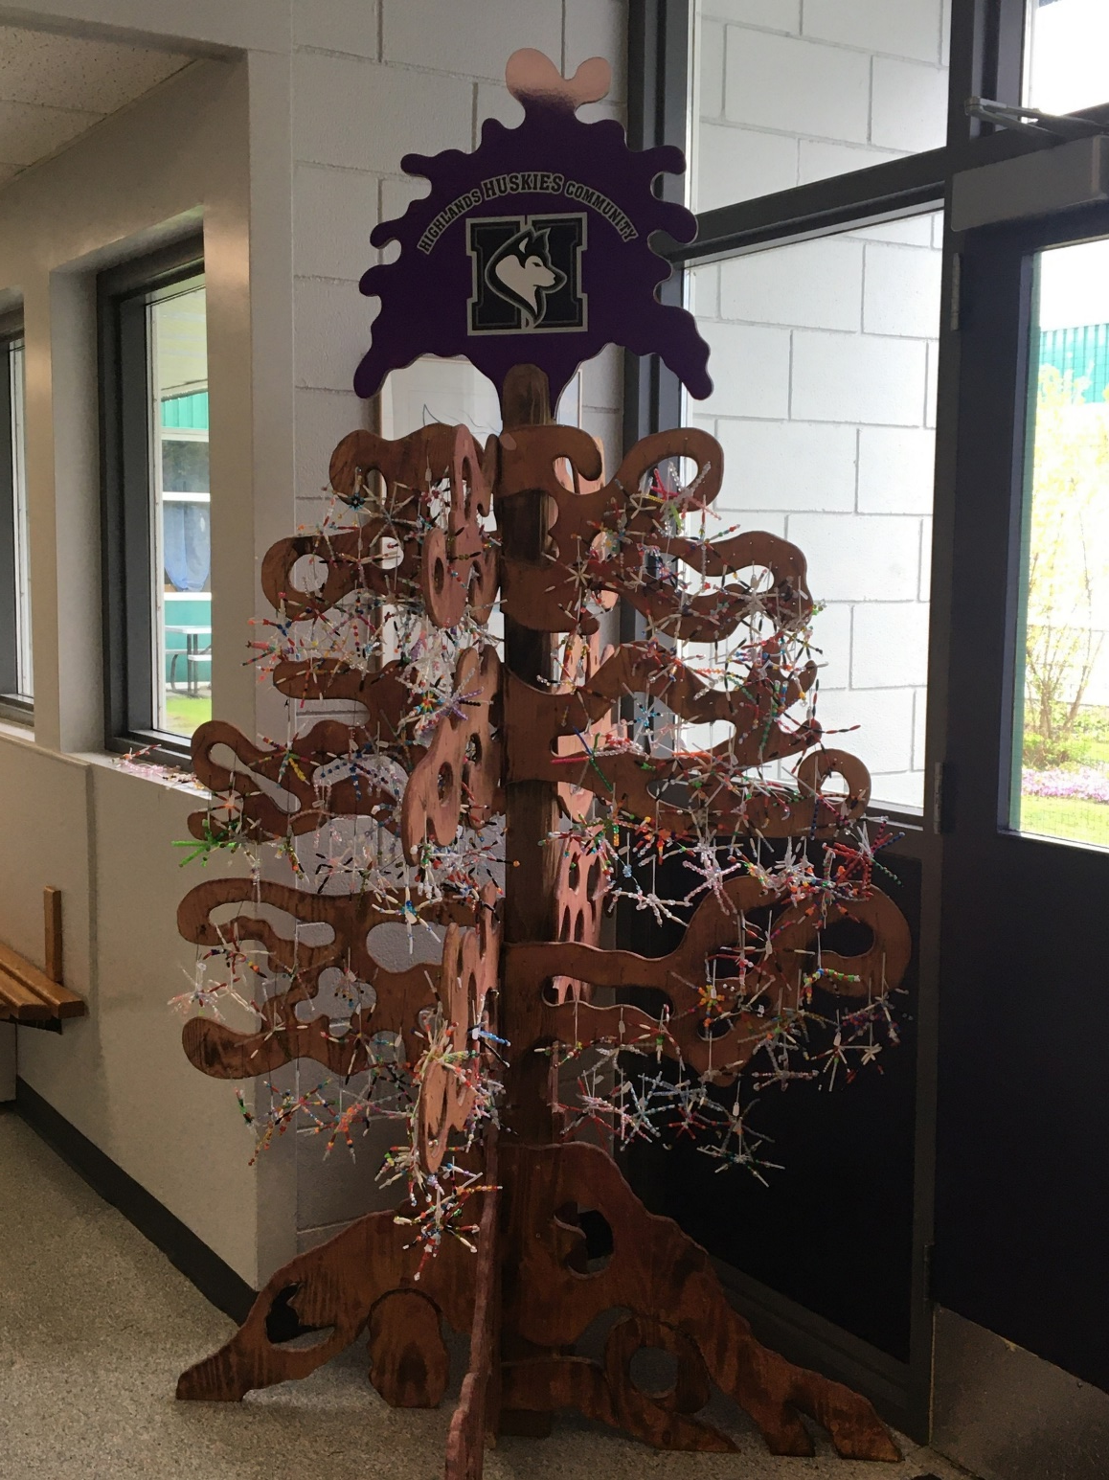
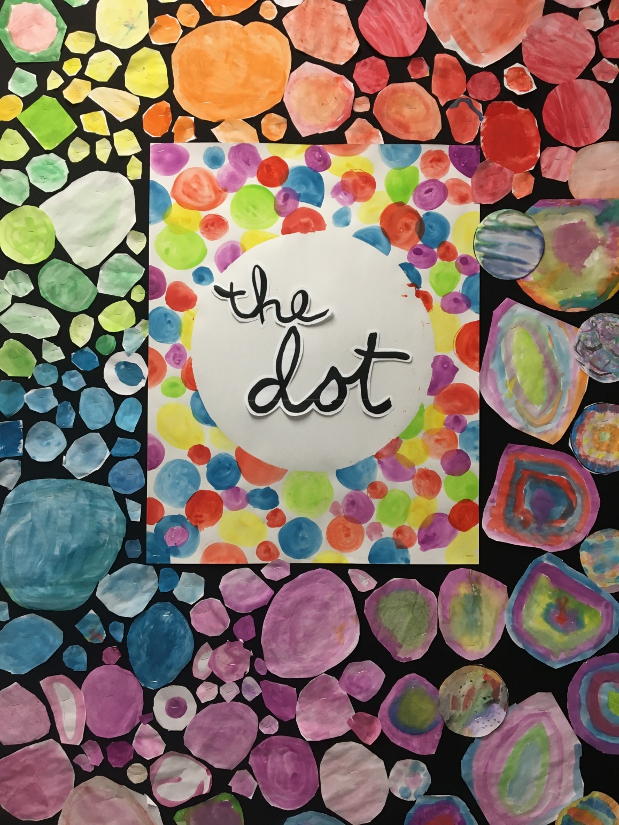
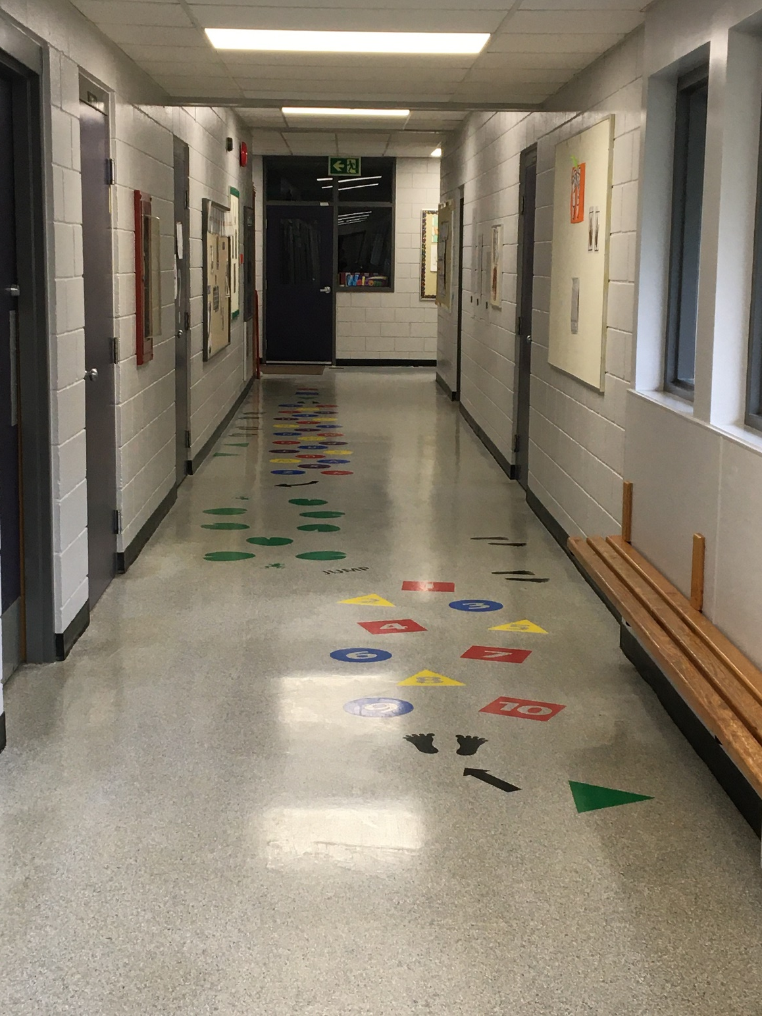
HIGHLANDS FUN!

