Slide 1
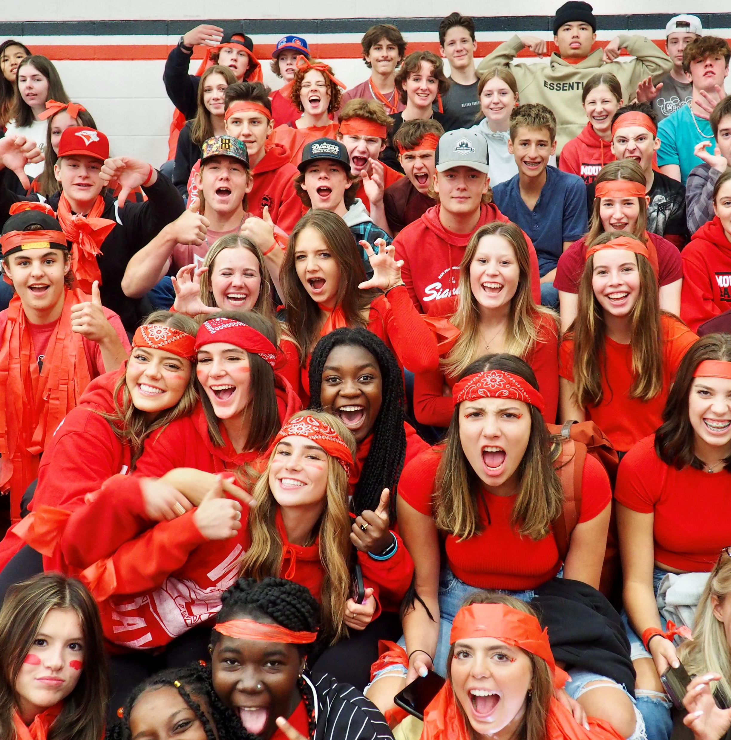

Welcome to Mount Baker Secondary!

Slide 2
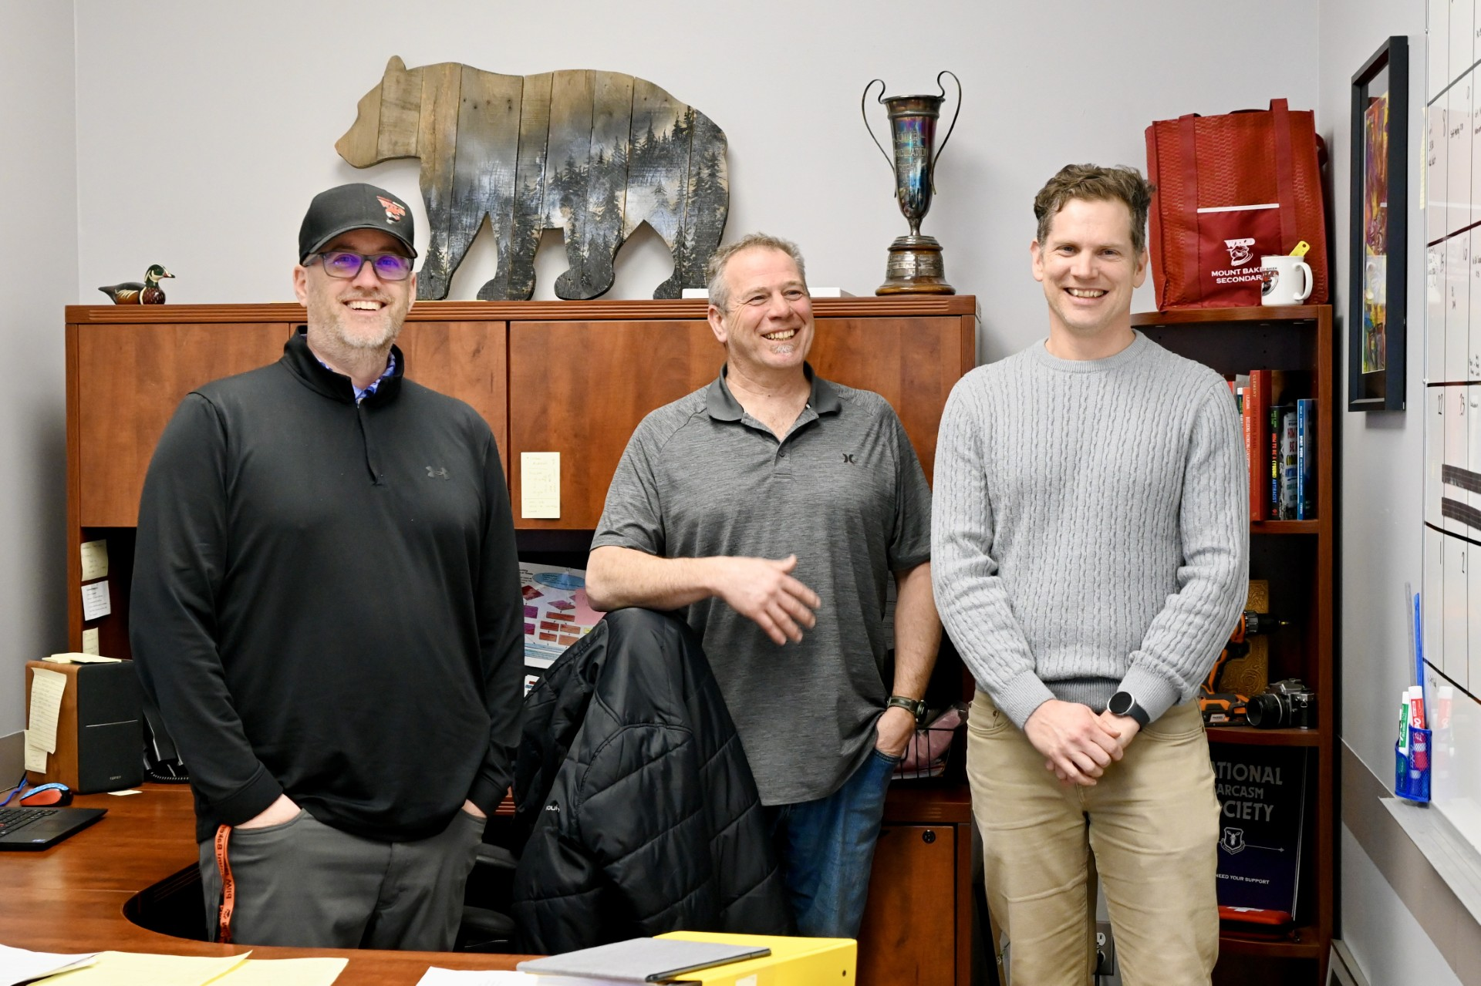
MBSS Administration team
Principal:
Mr. Aaron Thorn
Vice Principal:
Mr. Shane Fifield
Vice Principal:
Mr. Sean Sinclair

Slide 3
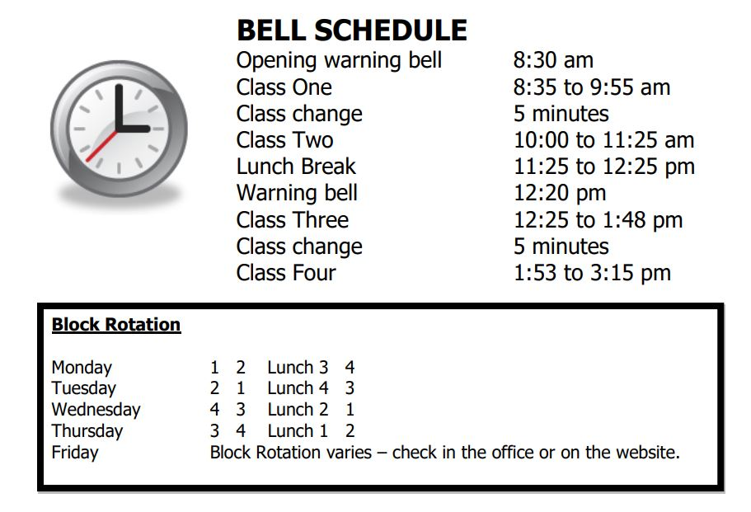
Class run on a block rotation…
2 semesters:
4 classes each semester
8 classes total in the timetable each year

Slide 4
How many classes are in each semester?
4
You can, however, take additional courses outside of the timetable to get extra credits!

Slide 5
Each course is worth 4 credits:
8 classes in one year = 32 credits
You need 80 credits to grad = (20 courses)
At least one Fine Arts or Applied Skills course
At least one Indigenous focused course
3 Assessments (Literacy 10, Numeracy 10, Literacy 12)

Slide 6
Graduation: a 3 Year Plan
Grade 10 | Grade 11 | Grade 12
6 required courses Math English Science Socials Careers 10 P.E. + 2 Electives | 4 required courses Math English Science Socials + 4 Electives | 2 Required courses An English 12 Career Life Conn. 12 + 6 Electives
If you do not pass a required course, you will need to repeat it.

Slide 7
How many required courses are there in grade 10?
6
Math, English, Science, Socials, P.E., & Careers
(plus 2 electives)

Slide 8
What is the minimum number of credits required to graduate?
80
(20 courses)

Slide 9
GRADE 10: Course selection
8 Courses Total:
6 Required Courses:
An English 10
A Math 10
Social Studies 10
Science 10
PE 10
Career Life 10 (In or Out of Timetable)
Plus :
2 Elective choices
or
1 Elective if you are taking Band
or
1 Elective if you are French Immersion
or
0 Electives if you are in Band and F.I.
If you do not pass a required course…You will need to repeat it before moving on.
Notes:
Social Studies:
Explorations 11 is a non-academic course, but counts toward grad credits.
All grade 12 Socials Studies are academic (Comparrative Cultures/BC First Peoples/Contemporary Indigenous Studies/20th Century World History)
Law and Philosophy are academic, but do not count as a Social Studies entrance course into universities in Alberta.
See your counsellor for clarification.
Math:
(Pre-Calculus, Foundations, OR Computer Science)
Science:
Science for Citizens is a non-academic course, but counts toward grad credits.
Academic options for university: Chemistry/Physics/Life Sciences (Biology)
**any extra core classes you choose count as electives.)

Slide 10
What happens if you fail a required course?
You do it again!

Slide 11
English and MATh options:
English 10:
English Composition 10
or
English First Peoples Writing 10
or
English Spoken Language 10
or
English First Peoples Spoken Language 10
Math 10:
Workplace Math 10
or
Foundations of Math and Pre-Calculus 10
Take the hardest option you can be successful at!
Not sure? Talk to your Math 9 teacher.
*New Media (English) is not being offered next year.

Slide 12
Which math class should you take?
The hardest one you think you can pass!
(Ask your math teacher if you aren’t sure.)

Slide 13
Grade 10 Elective OPtions…
Beginner Chess Intermediate Chess 11 Art Studio 10 Media Arts 10 Photography 11 Yoga & Mindfulness 12 Guitar 10 Child Development/Caregiving 12 Food Studies 10 | Drama 10 Film & Television 11 Puppetry 10 Accounting 11 Entrepreneurship & Marketing 10 Computer Information Systems 11 Computer Programming 11 Computer Science 11 (Counts as Math 11) Drafting 11 | Electronics 11 Woodwork 11 Robotics 11 Metalwork 11 Art Metal & Jewelry 12 Power Tech 10 Core French 10 Spanish – Introductory 11
Inside timetable:
within the school day →
Concert Choir 10 Vocal Jazz 10 Jazz Band 10 Musical Theatre 10 Theatre Company 10 Theatre Production 10 | Studio Sports 11 Nature-Based Wellness 11 Warriors 10 (Indigenous Leadership) Leadership 10 Yearbook 10 Film & Television: Movie Studio 10
Outside timetable:
At lunch/after school etc.

Slide 14
What does ‘outside the timetable’ mean?
These 4-credit electives
take place at lunch, or
before/after school.

Slide 15
Trying to get ahead?
Take Careers 10 out of Timetable in Grade 10
Enrol in 4-credit out of Timetable courses (Music, theatre, yearbook, leadership, etc.)
Complete an online KDS course not offered at Baker (Fashion Industry 12, Interpersonal Relationships 11, etc.)
Work hard & attend in grade 9. It will make life easier next year.

Slide 16
Support blocks & Spares…
Support Block:
Not worth credit (Save them for later!)
Block to receive support with courses
Attendance is mandatory
Based on an Application
Priority to Grade 11/12 students
Spare:
Not worth credit
Must leave school property
Not given in Grade 10
Will impact eligibility for scholarships

Slide 17
TRAIN in Trades Programs (TRNE)
Interested in a Career in Trades?…
Electrician
Industrial Mechanic
Hairstylist
Carpenter
Heavy Duty Mechanic
Welder
Cook
Auto Technician
Dual credit: Receive high school elective credit as well as Foundations apprenticeship credit while attending the College of the Rockies
Application required – available in counselling (September of grade 11)
There is a selection process that looks at conduct, attendance, work habits, from Grade 10 & 11.

Slide 18
When can you apply for the trades programs?
Early in grade 11 (September)

Slide 19
You may be interested in KES if:
You haven’t been successful in middle school
You have attendance struggles
You need something more self-paced
Interested? Contact your school counsellor or administrator
Kootenay Educational Services (KES) – our alternate school

Slide 20
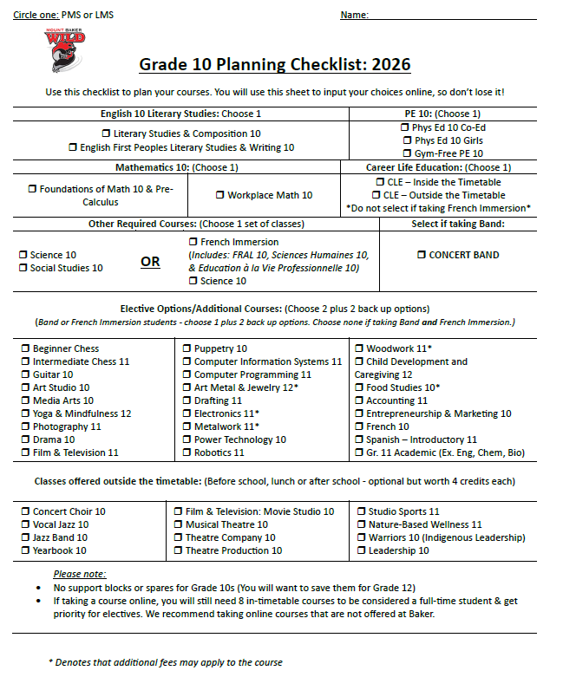
Grade 10 Course selection:
←This is a planning guide to help you prepare.
Important Dates:
MARCH 10th: Grade 9 Parent Night (MBSS Library)
APRIL 8th: Laurie Course Selection
APRIL 9th: Parkland Course Selection
JUNE 5th: Grade 9 MBSS Visitation Day
(Counsellors will return in Spring to make changes.)
Jodi Lode (Last name A-L): jodi.lode@sd5.bc.ca
Leah Draper (Last name M-Z): leah.draper@sd5.bc.ca

Slide 21
When are we coming back to help you complete course selection?
April 8th (Laurie)
April 9th (Parkland)
(Hang on to your sheet!)

Slide 22
When is grade 9 visitation day?
June 5th

Slide 23
For more information, directions &
Course Selection Guide
(lists all elective options with video links):
https://www.sd5.bc.ca/mbss/registration-course-selection

Slide 24
Where can you find descriptions of all the classes baker offers?
In the course selection guide
(Use the QR Code on your sheet!)

