Slide 1
Highlands Grade 6 Send Off
Highlands Huskies say it loud,
Highlands Huskies say it proud,
Highlands Huskies hear us shout,
We will help each other out!
Highlands Huskies we believe,
Watch how much we can achieve!
GO HUSKIES!!!
Celebrating who I am and what WE are together!
Notes:
NOTE: To change images on this slide, select a picture and delete it. Then click the Insert Picture icon
in the placeholder to insert your own image.

Slide 3
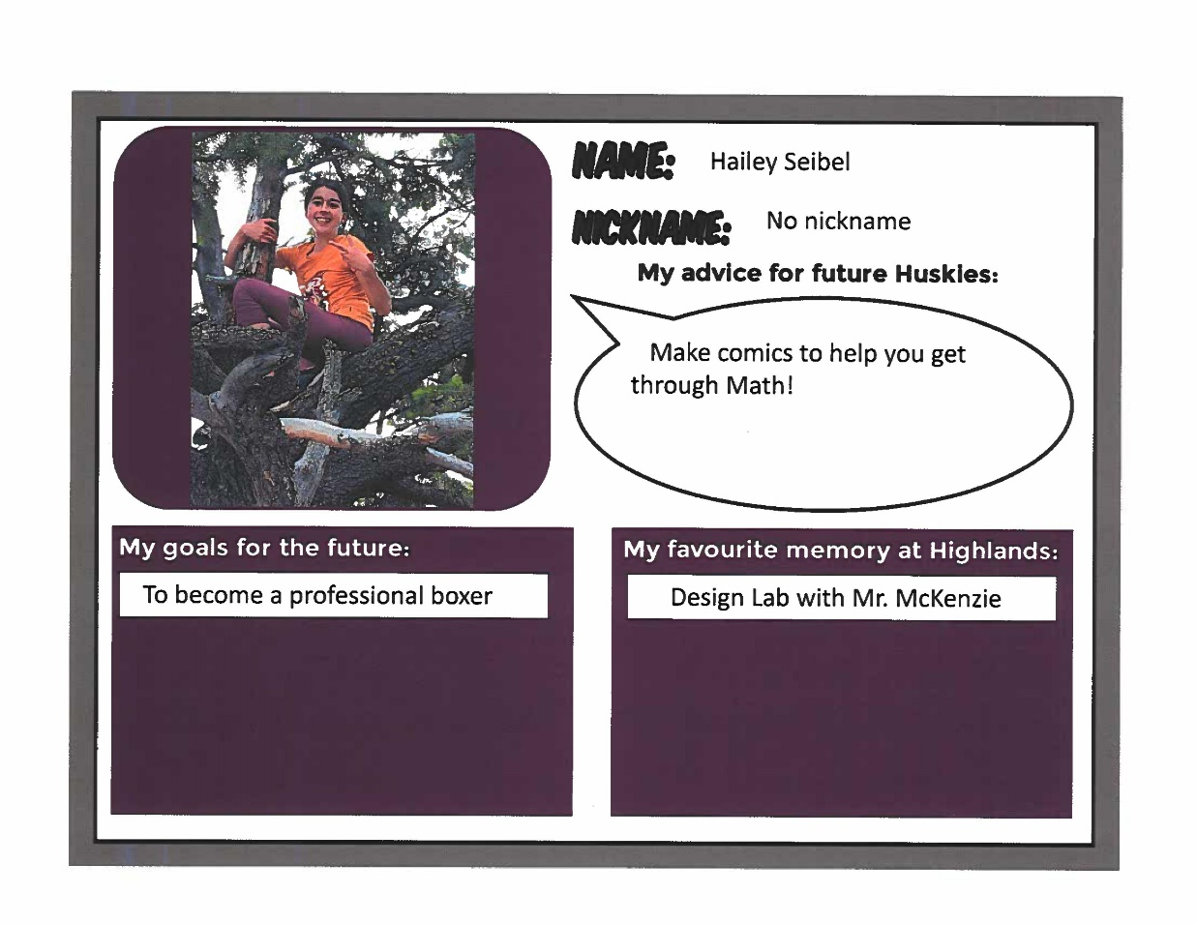

Slide 7
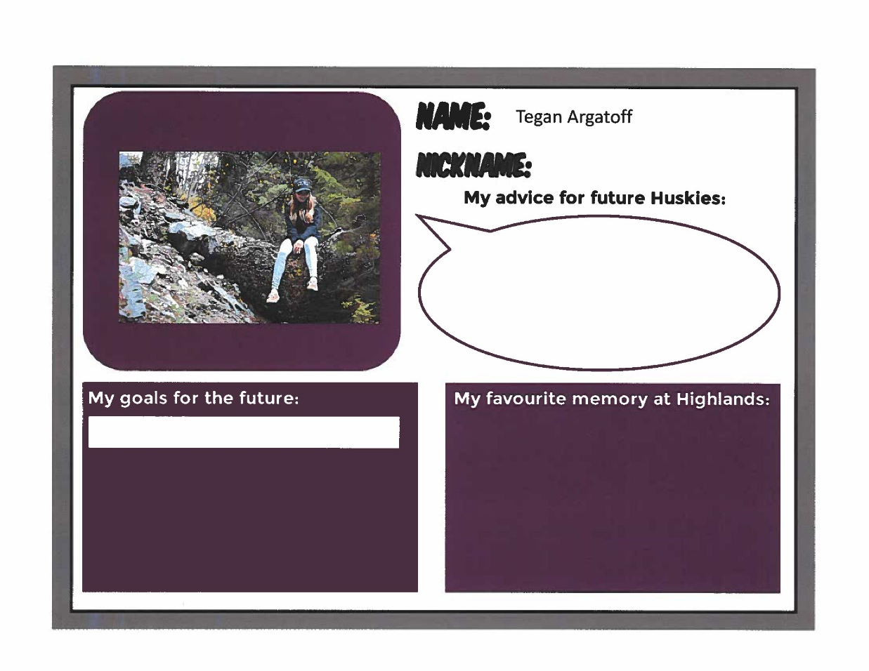
Go Huskies Go!

Slide 8
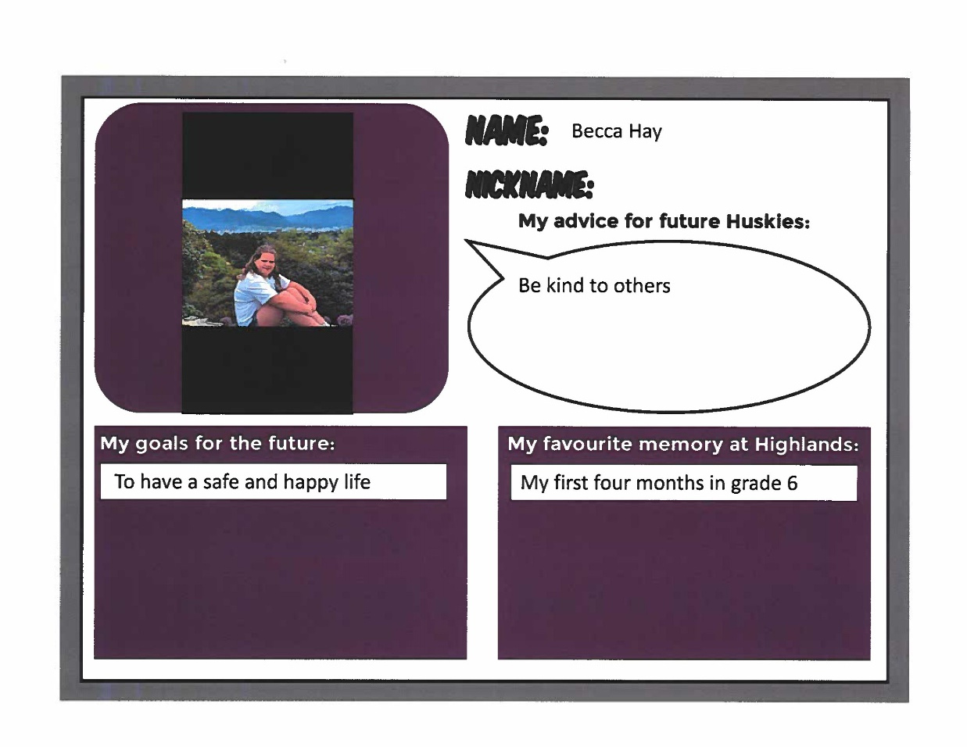

Slide 9
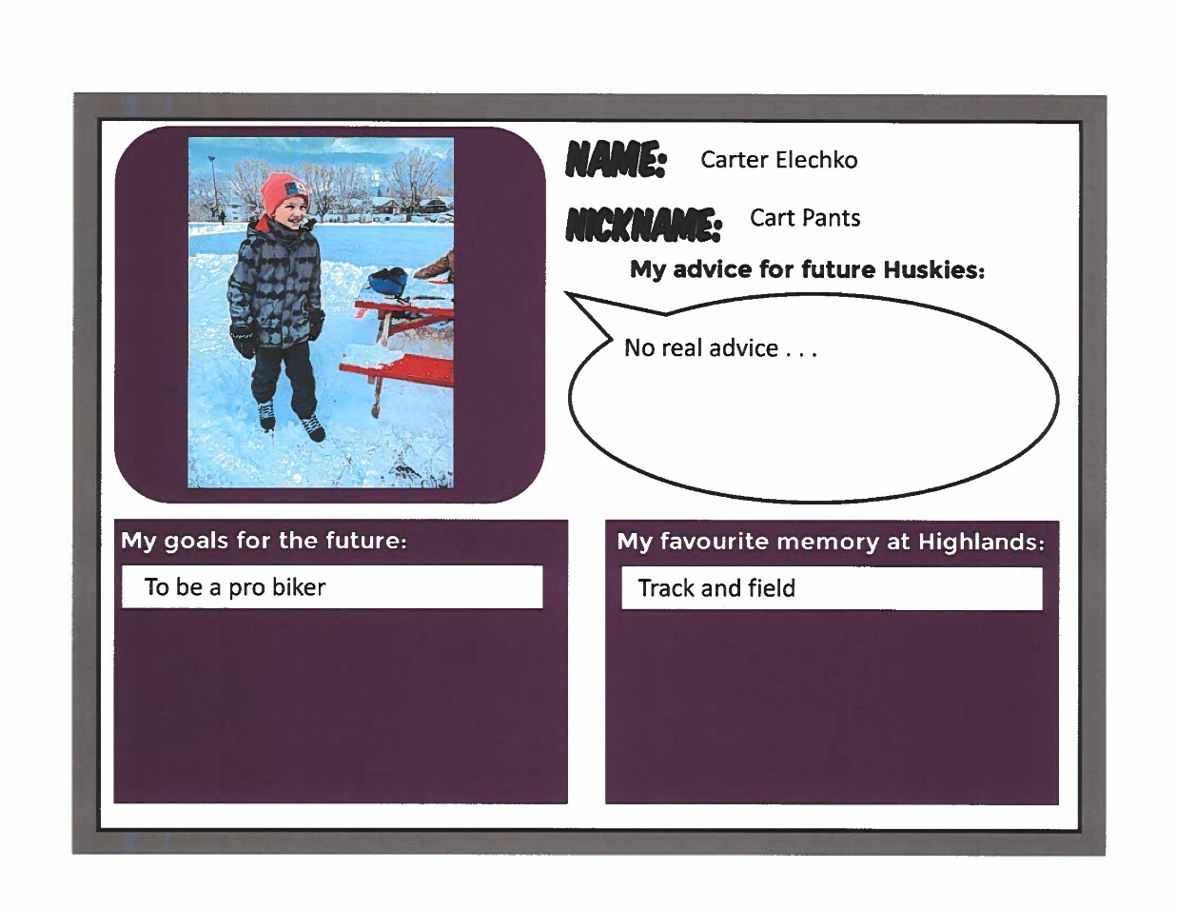

Slide 11
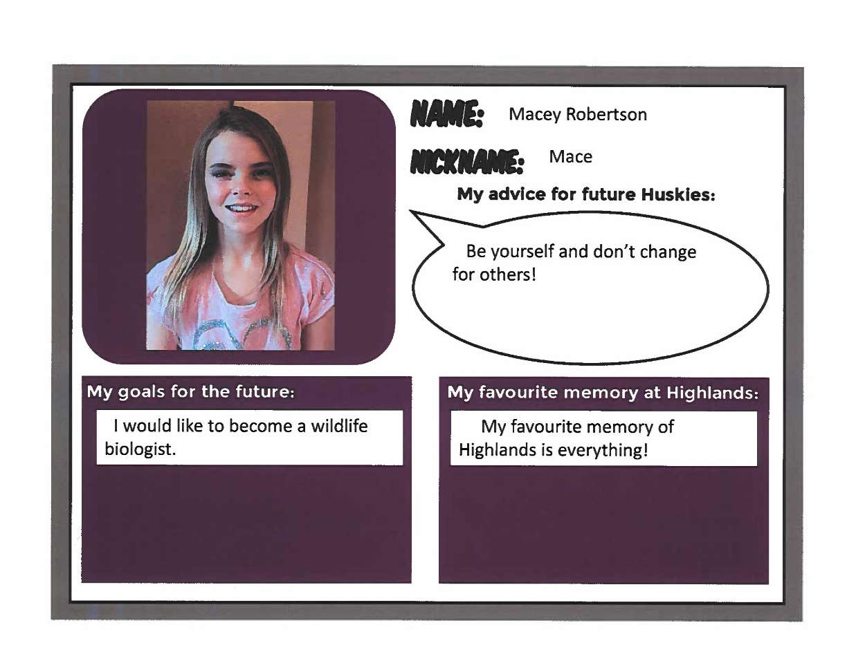

Slide 15
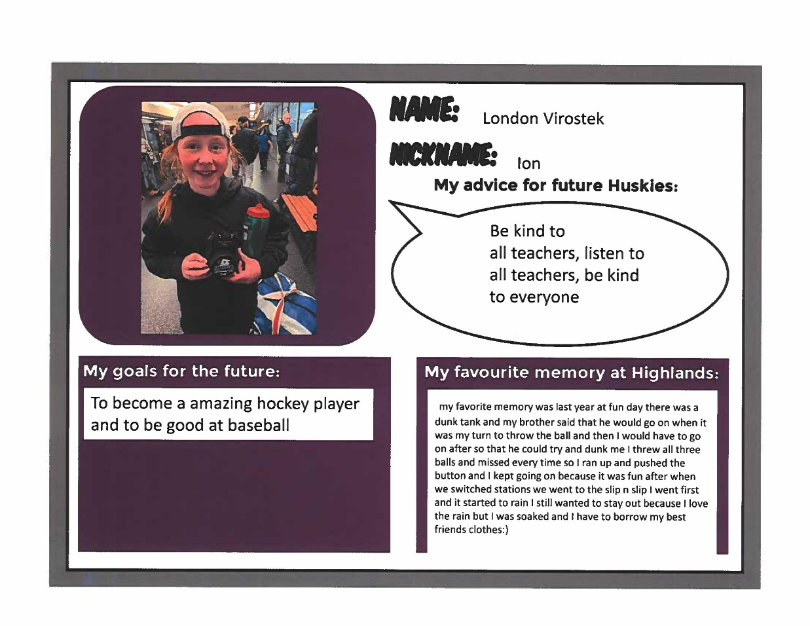

Slide 17
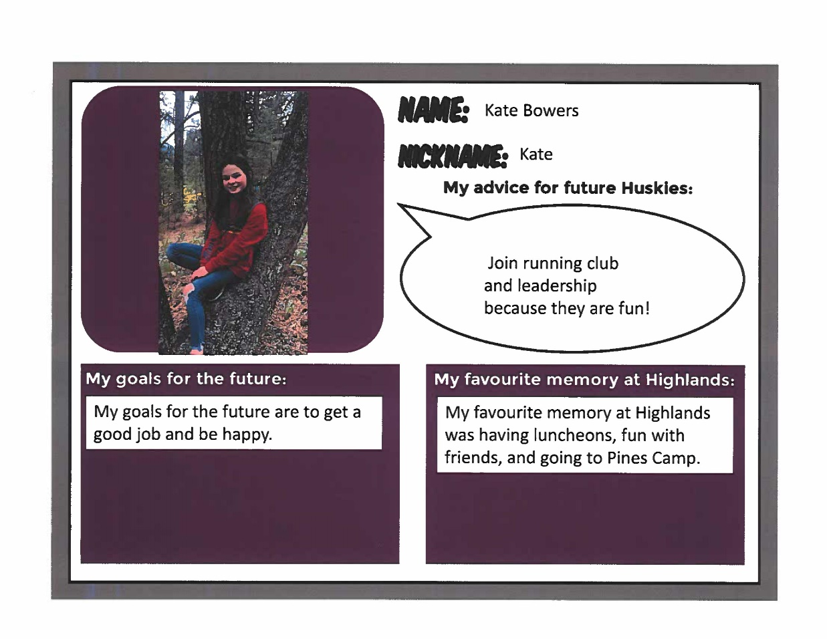

Slide 19
Go Huskies GO!

Slide 20
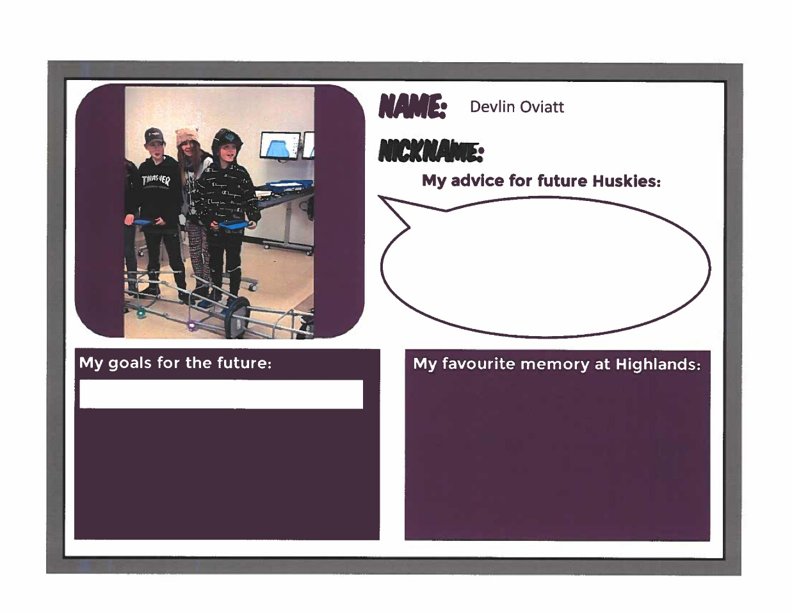
Go Huskies Go!

Slide 21
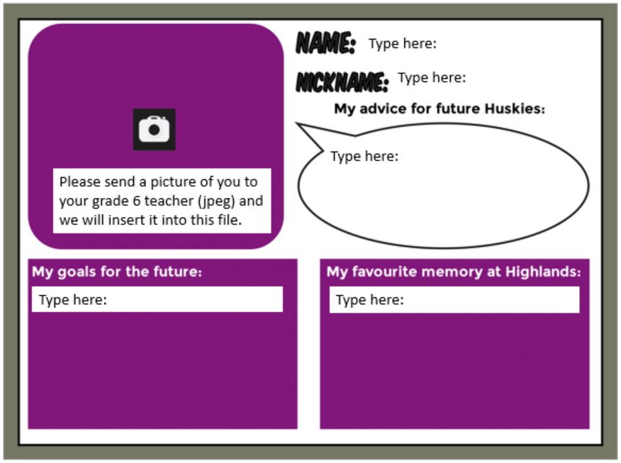
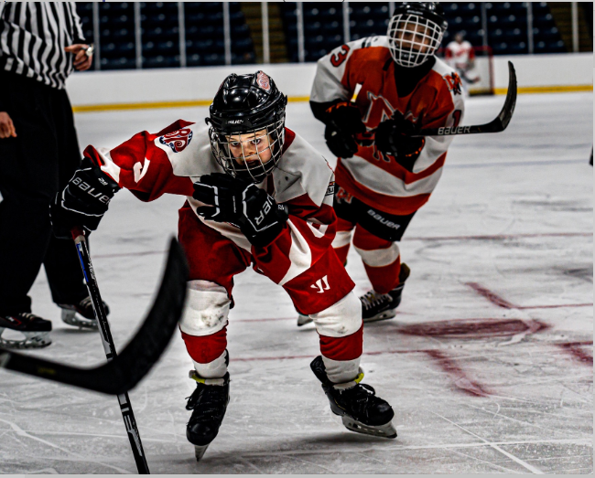
Aiden Stefano
AJ
Work hard & Just have fun. (Oh and try the basketball game called bump)
In the future, I would like to be a radiologist because I like reading x-rays and that kind of stuff.
My favourite memory at Highlands School was doing fun day every year, and doing Halloween events every year. Thanks to all of my previous teachers and my recent teachers.

Slide 22
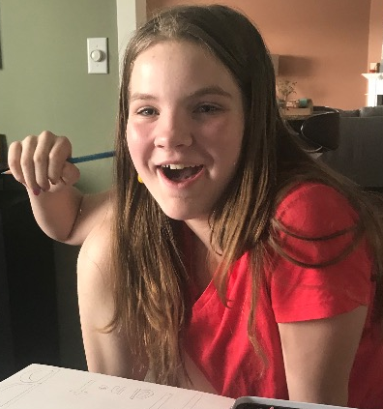
Amanda
Mandy
If you work hard and meaningful your dreams can come true.
My goals for the future are to be someone who changes the world or stands up for people.
My favorite memory at Highlands is my first day. Everyone was so nice and accepting to me.

Slide 23
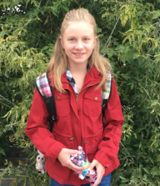
Amara
Mar Mar or Amara Pear
Be kind.
My goal for the future is to become a Youtuber and be famous for animations.
My favourite memory is meeting friends like Annabell.

Slide 24
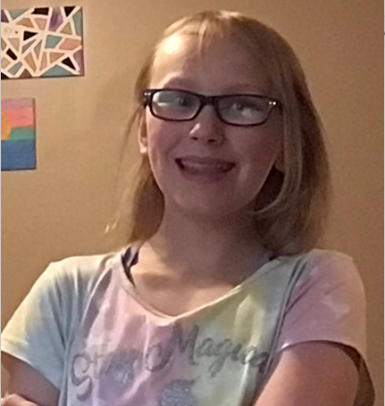
Annabell.J
Be kind and always help and include others.
My goals for the future are to:
-be a You-tuber
-be an App designer
-get a good job
-get a house
My favourite memories at Highlands are hanging out with my friends and
English class ( all of the stories).

Slide 25
Aviya Cerny
I was scared of grade 6 but it’s not that cool. Just remember to keep positive in the hardest times and cherish the good ones.
My goal is to try my best even through the toughest times.
My favourite memory is coming to Highlands in grade 1 and meeting the most kindest people!

Slide 26
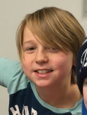
Beckam
Listen to your teacher.
My goal is to play more lacrosse and get really good so I can get a scholarship.
One of my favourite memories is going to Pines Camp and the games we played there.

Slide 27
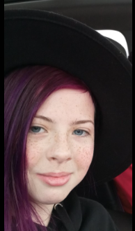
Emma Brown
Bear
Don’t judge others. Accept them for who they are.
My goals are to become more confident and to get better at math. I want to travel to Japan, and I want to become famous on YouTube for making people laugh.
My favourite memory at Highlands is going kayaking with Mrs. Archie in Creston.

Slide 28
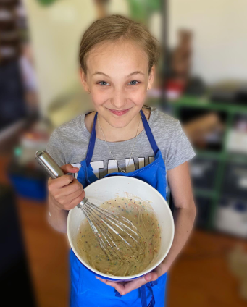
Gabby Wik
Lil Dribble
Try out for basketball in grade 6 because it will be your last year.
My goal is to make it through middle school.
My favourite memory was going to district track and getting sprayed with the fire hose.

Slide 29
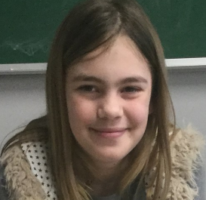
Hailyn Clark
When you are in grade 6, I suggest you to join leader ship.
My goals are to travel around the world, and to be a good chef.
My favourite memory is going to Pines Camp in Mr. Bartraw’s class.

Slide 30
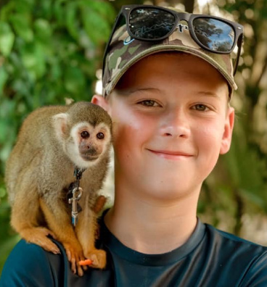
Isaiah
Stay out of trouble and always include others.
My future goal is to be a professional hockey player and to be overall successful.
My favourite memory at Highlands is in grade 4 having a mini stick tournament with all of the grade 6 and grade 5s and they won obviously.

Slide 31
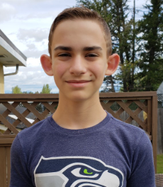
Jaxon Preston
J
Always be nice to everyone and let other people play with you.
In the future I want to have a good job and live some where tropical.
My favourite memory is going camping with Mr. Bartraw at the end of school.

Slide 32
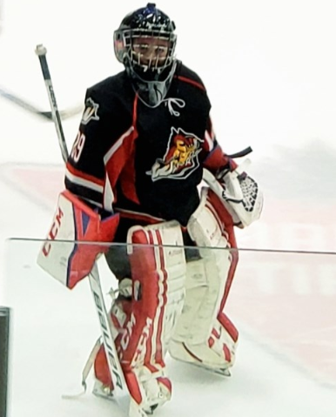
Jonah White
Jo
Always have fun because elementary goes by very fast!
My best memories are basketball/volleyball games and also when Beckham sled down the hill, hit the jump and broke his shoulder... OUCH!
My goal is to be successful in whatever I choose to do and have fun doing it!

Slide 33
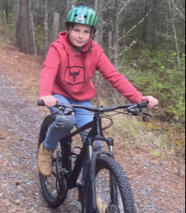
Kash Coleman
Kashos
Make new friends and have fun doing the announcements.
My goal is to be a professional dirt biker because I like going out and exploring the forest.
My favorite memory is Pines Camp in grade 5. It was fun because I went with my dad

Slide 34
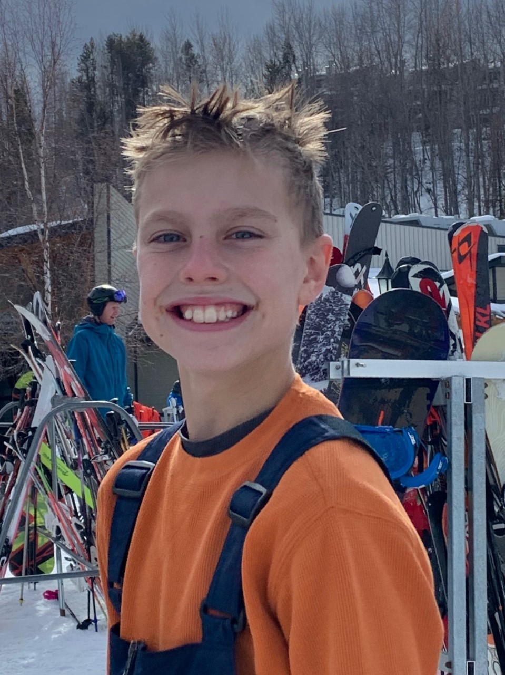
Mac
Live life to the fullest you don't live forever
v
My goal is to become an architect or an engineer.
My favorite memory at Highlands is parlauf.

Slide 35
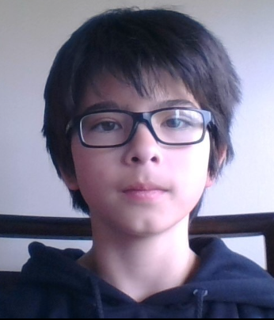
Maddex
Mad Max
Do your best, work hard and be open to new ideas.
My goal is to learn more tricks on skis and back at Fernie try Polar Peak and hike my first mountain to the summit!
My favourite memory at Highlands was when I did my first backflip on ground and it felt like a miracle because I thought I couldn't do it but I was wrong.

Slide 36
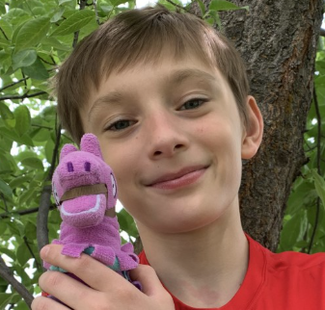
Micah Stevenson
Mitch
Stay strong when its tough:)
My goal for the future is to complete more work.
My favourite memory is playing with my friends and meeting new kids.

Slide 37
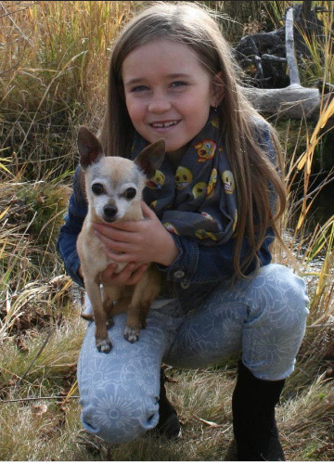
Payton
Pmoney
Get good sleep.
My goal is to be a flight attendant and travel the world or be a baker.
It would be
leadership and hot lunch.

Slide 38
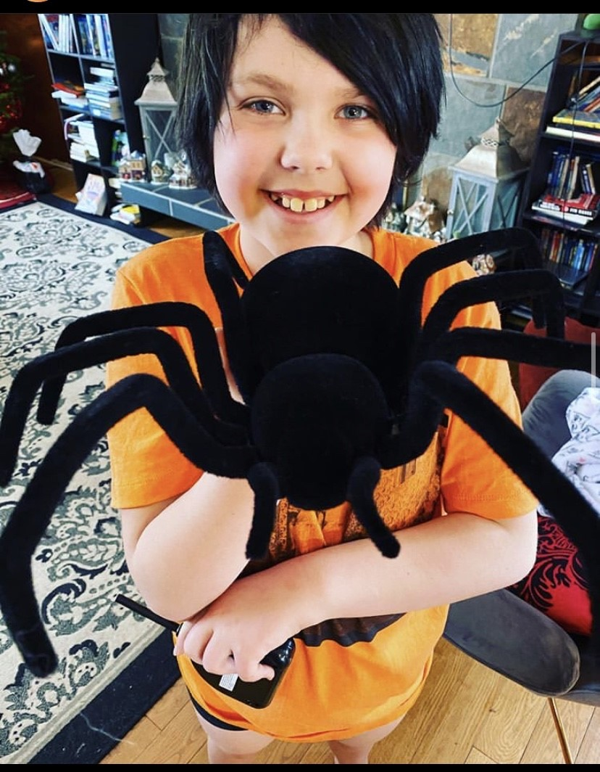
Sage Vigne
Baby Girl
If you are bullied,
never give up. Show them that you are strong and impenetrable. When you get to Laurie, hang out with the right people. Keep your friends close. Do not kill spiders! (or you will wake up with one in your bed!)
I want to finish high school and become an arachnologist (someone who studies spiders). I want to travel to Germany, learn German and live there.
My favourite memory is meeting different kinds of people and all the school staff. Shout out to everyone who helped me. Another favourite memory is being on the best (basketball) team anyone who could ask for.

Slide 39
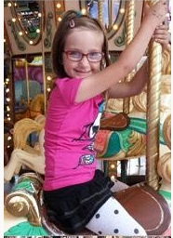
Taytum
Tay or Nay Nay
Sometimes trying new things isn't always the worst.
I would like to become a criminal prosecutor lawyer.
My favourite memories at Highlands is my volley ball tournament this year.

Slide 40
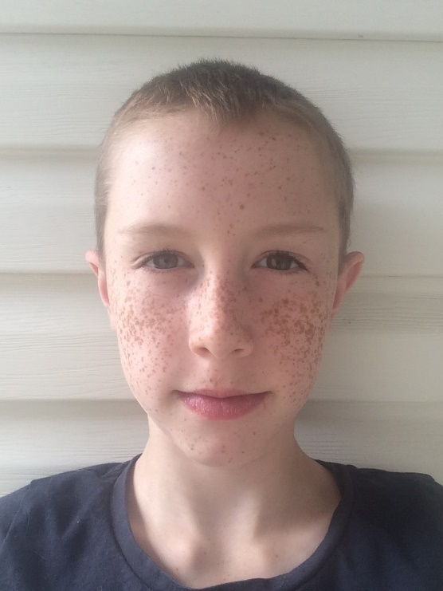
ZACHARY
ZACH
STAY COOL, DON'T DROP OUT OF SCHOOL!
MY GOAL FOR THE FUTURE IS TO BECOME A PROFFESIONAL BASKETBALL PLAYER!!!
MY FAVOURITE MEMORY IS MAKING THE FISHING GAME FOR THE HEART TO HEART FAIR!!!

Slide 41
