Slide 1
Grade Four Opportunities at ÉIDES
English or French Immersion?

Slide 2
English and French Immersion Classes:
Follow the Ministry of Education Curriculum
Follow the same Communicating Student Learning (reporting) format
Students have access to school and district support services (Counsellors, Youth Care Workers, Aboriginal Education Support Workers, Student Services)
Have access to French and English resources in the library and online
Have access to technology (iPads in the classroom, access to cart of laptops or iPads)
All equipped with Smart Board technology and document cameras to enhance student learning
Grade 6 classes (and sometimes 5/6 blends) take Band at Fernie Secondary School

Slide 3
English and French Immersion Classes:
Participate in curricular, extra curricular and special events at school: ski days, skating, school sports, field trips, presentations, performances, etc.
Follow the same contractual guidelines for class size and composition
Have a diverse range of learners with their own unique learning styles, strengths and challenges

Slide 4
Grade Four Curricular Areas
ENGLISH
English Language Arts
Mathematics
Science
Social Studies
Physical and Health Education
Arts Education
Applied Design, Skills and Technology
Career Education
Gr 5-8 French As A Second Language
FRENCH IMMERSION
Français Langue Seconde-Immersion
Mathématiques
Sciences
Science Humaines
Éducation Physique Et Santé
Éducation Artistique
Conception Compétences Pratiques et Technologies
Éducation À La Carrière
English Language Arts

Slide 5
What is French Immersion?
An education program that parallels the regular English program in structure and content but focuses on developing French language and thus instruction and communication is mostly in French
An opportunity for non-francophone students to become bilingual in English and French and to graduate with a Dual Dogwood: BC Certificate of graduation (Dogwood Diploma) and Diplome de fin d’etudes en Colombie-Britannique
Begins in grade 4 and continues through to grade 12

Slide 6
What Does French Immersion Instruction Look Like?
Grade: | % of French Instruction | % of English Instruction
4-7 | 75-80 | 20-25
8-10 | 50-75 | 25-50
11-12 | No less than 25 | No more than 75

Slide 7
French Immersion Expectations (gr 4-6)
Grade 4 | Grade 5 | Grade 6 and up
By the end of grade 4 students will be able to express orally basic needs and some of what they are doing Students will need to spend much time developing an understanding of the French language and increasing their vocabulary | By the end of grade 5, children are able to express themselves in French though English words may be heard in a sentence where the French word isn’t known. Students will be comfortable reading basic French text and will be able to express simple ideas orally as well as in written form | In grade 6 most students are quite comfortable speaking, listening, reading and writing in French. Students have the basic communication skills to enable them to function in French. Throughout the rest of the school years, greater fluency is achieved in their oral and written language development.

Slide 8
What Does Instruction Look Like?
The gift of time:
To delve deeper into curricular concepts in all subject areas (Science, Social Studies, Careers, Health etc.)
60-90 minutes of daily Language Arts instruction
60-90 minutes of daily Math instruction

Slide 9
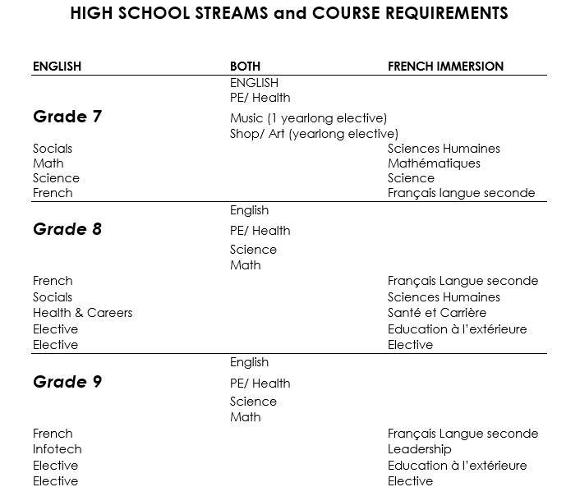
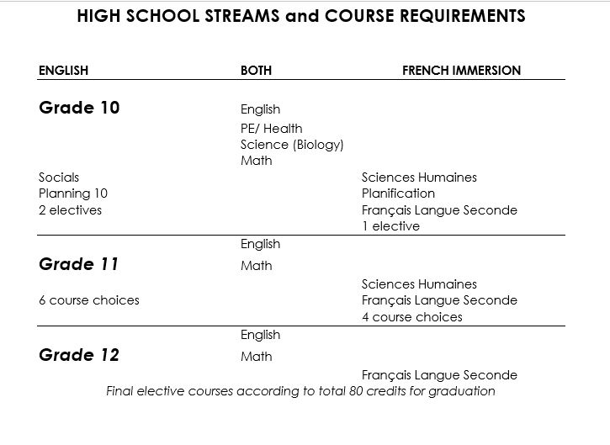
Looking Ahead to High School

Slide 10
How Do You Decide?
Talk to your child
Consider your child’s interests, strengths, challenges
Canadian Parents For French (great resource for FI)
Contact ANY of our English or French Immersion Intermediate teachers to get more information
Speak with your child’s grade 3 teacher
Grade 4 is the entry level for Late French Immersion at EIDES. Registration into French Immersion should be viewed as a long term commitment. Return to English programming can be possible with consultation of the teacher and principal.

Slide 11
Late French Immersion Availability
Spaces available each year are based on our school’s configuration, staffing and class size contractual requirements.
School District 5 Enrollment and Placement Policy 3.1 will be used if the number of students wishing to enter French Immersion exceeds the spaces available.
Registration Bands according to policy 3.1.
Students who have a sibling currently in FI in SD 5 will be given first priority and placed directly on the roster.
The SD 5 Director of Student Learning and Innovation will draw the remainder of student names in order of the band they are in, with the Principal/Vice Principal and a PAC representative present.
Clerical staff will record names for registration and continued monitoring of spaces.
Students/parents will be contacted by ÉIDES to inform them of lottery results.

