Slide 1

Expectations at STEEPLES
Respectful, Safe and Responsible

Slide 2
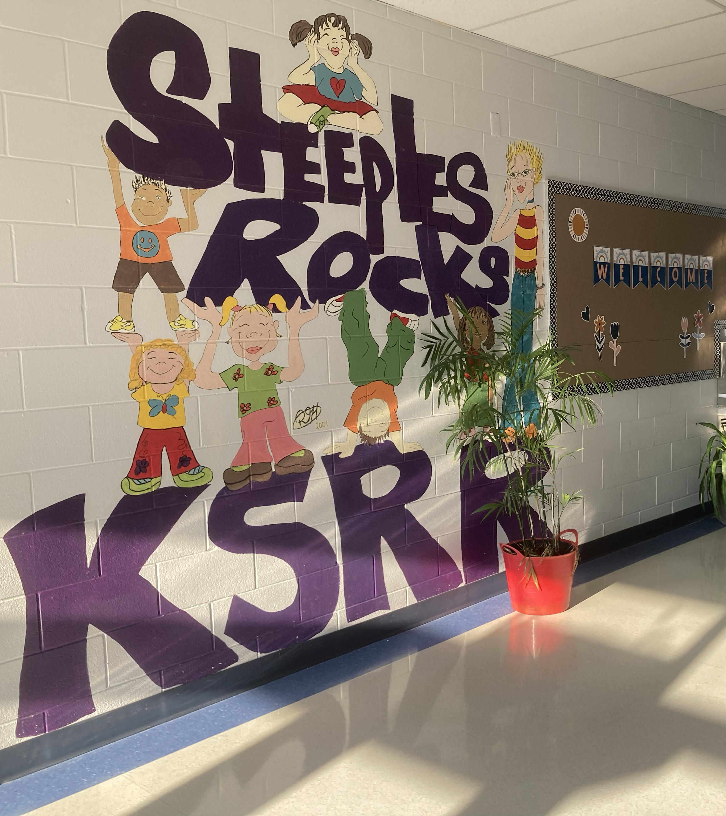
Be Respectful
Use inside voices.
Be mindful of others' needs.
Recognize that everyone has different needs.
Be Safe
Walking feet while indoors.
Use kind words.
Wear inside shoes.
Be Responsible
Take care of school property: Computers, desks, chairs, pencils, supplies, artwork, art supplies, etc.
Have a Growth Mindset.
Try your best.
Lock up your scooter and bikes when you arrive to school.

Slide 3
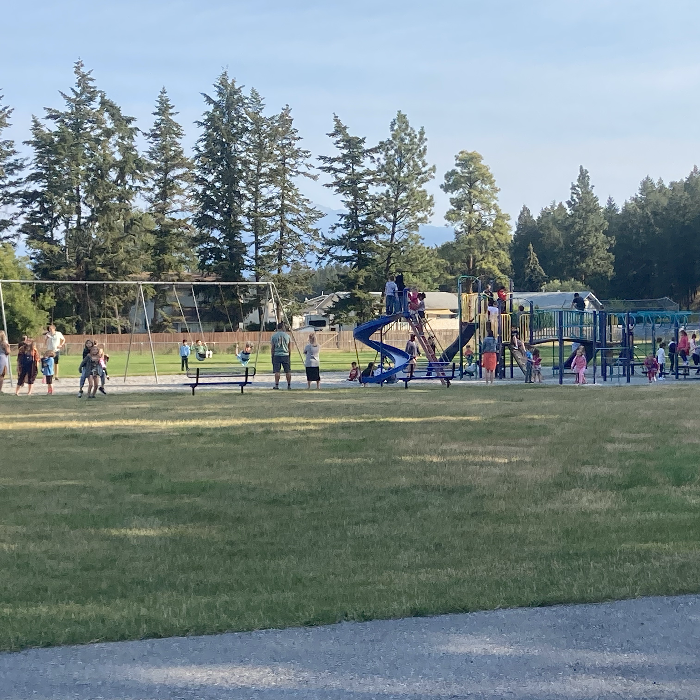
Playground
Be respectful
Respect the growing trees by not climbing them or hanging off the branches.
Keep the rocks on the ground, and off the slides.
Be safe
Hands and feet to yourself.
Keep shoes on your feet at all times.
Stay off the icy snow hills.
Slide down slide one at a time, feet first.
Be responsible
Put your garbage in the right bin.
Finish your food before going outside
Wash your hands before eating and when entering the school.

Slide 4
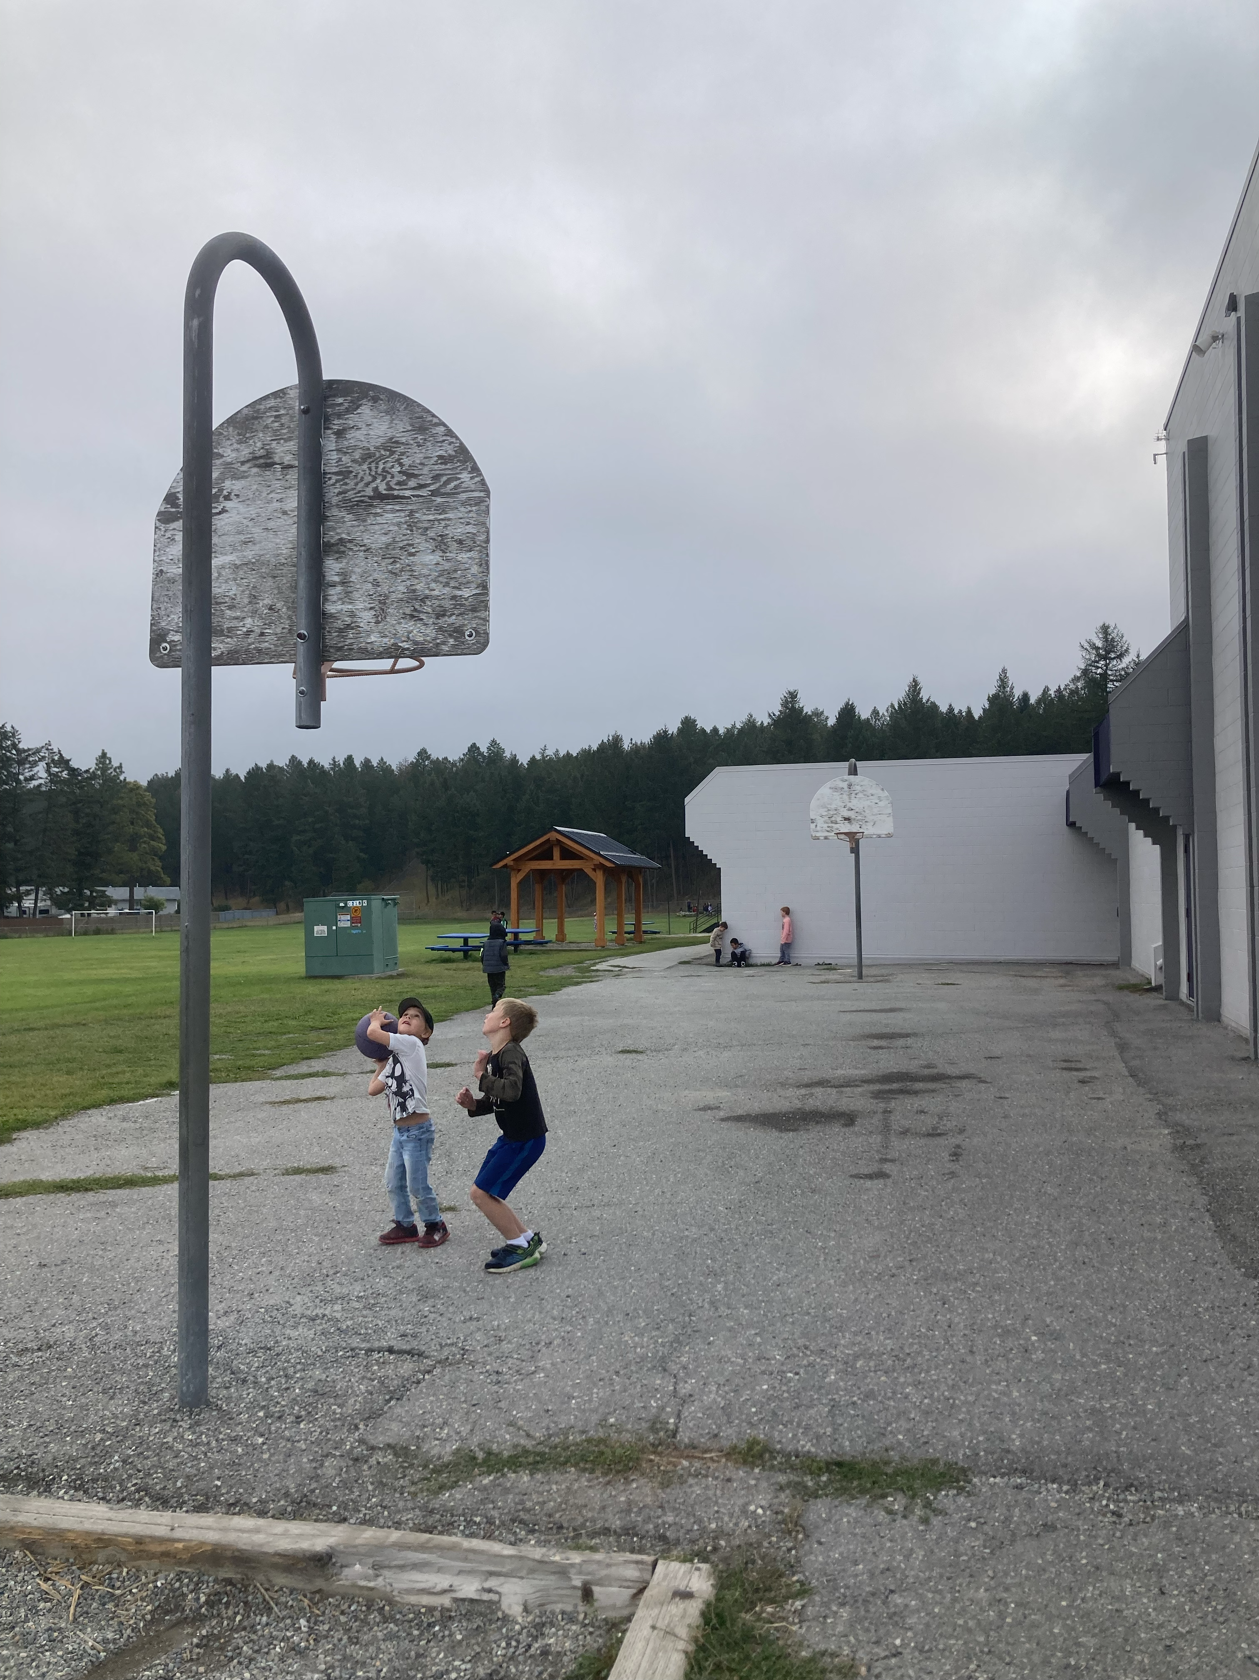
Lunch Recess
Be respectful
Sit down while eating in your classroom.
Bring extra food home, not in the garbage.
Play outside at recess times.
Be safe
Dress for the weather.
Keep hands to yourself.
Use school-appropriate language.
Be responsible
Keep your area clean.
Take care of your garbage and recycling.
Be prepared for the weather.

Slide 5
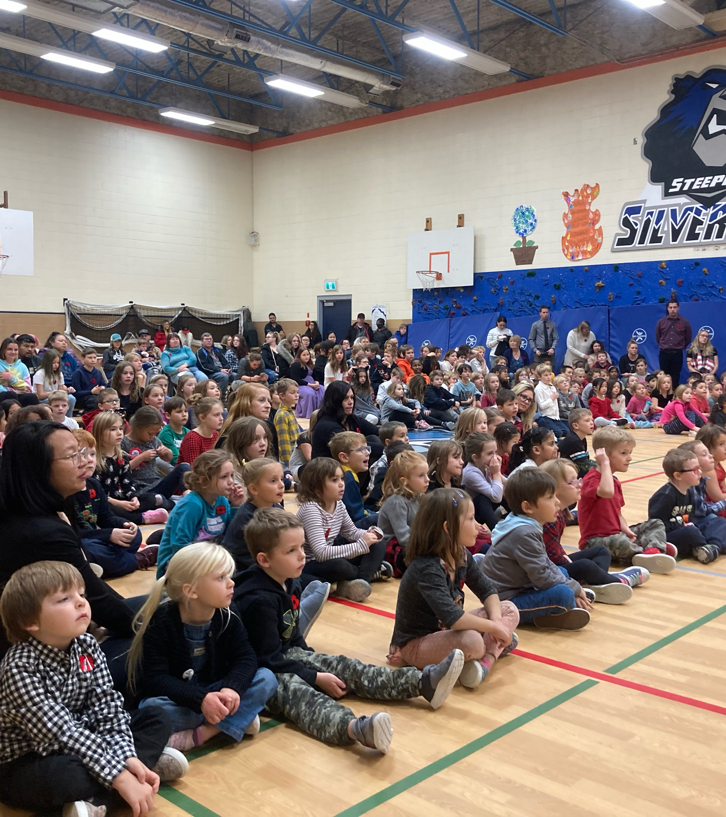
Assemblies
Be Respectful
Applaud when appropriate.
Be quiet when appropriate.
Silence phones.
Be Safe
Give space to the row in front of you.
Sanitize before and after.
Be Responsible
Hands to self.
Eyes on the speaker.

