Slide 1

Entering Gr.11 & Gr. 12 Course Selection
Mount Baker Secondary School

Slide 2
GRADE 11: Required Courses
4 required courses:
English 11
Social Studies 11 or 12
Math 11 or 12
Science 11 or 12
PLUS 4 elective courses
Including those not successfully passed in gr.10
Notes:
Social Studies:
Explorations 11 is a non-academic course, but counts toward grad credits.
All grade 12 Socials Studies are academic (Comparrative Cultures/BC First Peoples/Contemporary Indigenous Studies/20th Century World History)
Law and Philosophy are academic, but do not count as a Social Studies entrance course into universities in Alberta.
See your counsellor for clarification.
Math:
(Pre-Calculus, Foundations, OR Computer Science)
Science:
Science for Citizens is a non-academic course, but counts toward grad credits.
Academic options for university: Chemistry/Physics/Life Sciences (Biology)
**any extra core classes you choose count as electives.)

Slide 3
GRADE 12: Required Courses
2 required courses:
English 12
Career Life Connections 12
PLUS 6 elective courses
Including those not successfully passed in gr. 10 / gr.11
* 5 Grade 12 level courses required for academic scholarships
* Preference will be given to students with a full timetable at MBSS (8 courses)
Notes:
Many students opt for extra social studies 12 classes as higher marks equals more scholarship opportunities. If math or science is your strength, choose more of those at the grade 12 level.

Slide 4

Career Life Connections 12 (CLC-A)
Two ways to take it:
1. In-timetable as a block in grade 12 (4.0 credits).
OR
2. In two halves outside the timetable (on your own time):
CLC-A (Assignments = 2.0 credits)
&
CLC-B (Capstone = 2.0 credits)
Current GRADE 11s…
If you haven’t done at least half of CLC-A, you need to chose it as a class (CLC-12) for next year to save yourself a seat.
If you are planning to apply for a spare, it is expected that CLC-A is done.

Slide 5
Other Grad Requirements:
Numeracy 10 & Literacy 10 Assessments
Literacy 12 Assessment
A fine arts or applied skills/design course
ONE INDIGENOUS FOCUSED COURSE
(Could be within English or Social Studies course)

Slide 6
Train in Trades (TRNE)
To enter the program in Grade 12, all required courses must be completed in Grade 11 (Including English 12 & Career Life Connections 12).
Grade 11 Timetable:
Semester 1:
English 11
Math 11
Science 11
Elective
Semester 2:
CLC-12
English 12
Socials 11 or 12
Elective
PLUS: All 3 assessments completed
Work at College of the Rockies during Grade 12 (Instead of Mount Baker) towards one of these trades:
Industrial Mechanic/Millwright (Needs Physics 11)
Electrician (Needs Pre-Calc 11)
Hairstylist
Cook (Professional Cook 1)
Carpenter
Welder
Auto Service Technician
Heavy Duty Equipment Technician
Expressions of Interest (application) due October 17th of your grade 11 year.
Grade 12s- Do not select “Train in Trades” on course selection unless you have a letter of acceptance.
Interested?
Contact Tristan Taylor
College Transitions Coordinator
ttaylor@cotr.bc.ca
Notes:
Suggested Courses:
Hardest course you can do and be successful in
Trades: Workplace Math 11 and Explorations in Social Studies 11 meets requirements
Exceptions:
Electrical: Suggests Pre-Calculus 11
Industrial Mechanic: Suggests Physics 11 and hardest math you can handle
Child, Youth, and Family Studies: 65% in English 12

Slide 7
ECE Dual Credit The Child, Youth and Family Studies Dual Credit Semester is being offered to high school students who would like to get a jump-start on a career in the health and human services field.
Next program intake: February 2027
Program Overview:
Participants of the program will be eligible to apply for licensure to work as ECE Assistants.
Online delivery, once working, students can build onto the 13 credits in the Child, Youth, and Family studies academic stream to pursue full certification in Early Childhood Education, Education Assistant or Human Service Work.
Pre-requisites:
65% minimum in English 12
What you will gain:
16 high school credits
Qualification for work as an Early Childhood Education Assistant
13 post-secondary credits
7 of these credits are applicable in any one of the CYFS certificate programs

Slide 8
University/College Bound? PLAN AHEAD.
Consider the following in Grade 11:
Every University has unique requirements- They are not all the same!
SURPRISE: Applications open early October, close as early as March 1st of Grade your grade12 year.
Many require final grades in specific courses after 1st Semester (FEBRUARY)…
Plan Schedule Accordingly!!!
Hoping for early admission? ALL REQUIRED COURSES COMPLETE BY APPLICATION DEADLINE.
Examples
UBC looks at Literacy 12 assessment mark
Alberta Universities want specific Social Studies 12. Ask and know!!
COTR nursing: Needs Biology 12 & English 12 with specific marks in First Semester of Grade 12
Notes:
If Biology 12 is required for your program, and you want early admissions, consider Socials to grade 12 and complete the required courses in grade 11. It may take juggling.

Slide 9
Other Ways to Earn Credits:
1. External or Sport Credit: Check Ministry of Education BC website
2. Out of Timetable courses: Yearbook/Choir/Band/Theatre, etc…
3. Dual Credit at College of the Rockies (COTR):
(many have prerequisite of English 12 with a specific grade of 65% or 73%)
- Plan your courses accordingly so this can be done.
- Expression of Interest (available in counselling office) due September 22nd
- Each Dual Credit course has specific requirements to enroll.
Notes:
Example: almost all courses require English 12 to be completed with a specific mark
Child/Youth/Family studies requires a 65% in English 12 ahead of time

Slide 10
Thinking about Support blocks or Spares…?
Are you Grad requirements in order? (e.g. CLC-A)
Full-time students receive priority for electives
Full-time students prioritized for local scholarships
Spares: off school property
Application required for support block (1 per year)

Slide 11
Why didn’t I get the courses I requested? - Not enough people chose that course - Too many people chose that course - Priority may be given to grade 12’s
What happens if I
fail a grade
10 course?
You need to choose it as one of your electives or you WILL NOT graduate.
*If you have a blank course, see counsellor right away or we will place you in a random class (Example: Contemporary Dance Physics 11)*
Notes:
Make the changes when you get your timetable. You might get English 12 in first semester, 11 in second.
You need to change that right away.
You may need to add in classes that you fail.
The number of sections of each class is dependent on the what is chosen in March. If you think you want a class, choose it early to guarantee a spot. We only create enough blocks for the number of students who choose them in march.

Slide 12
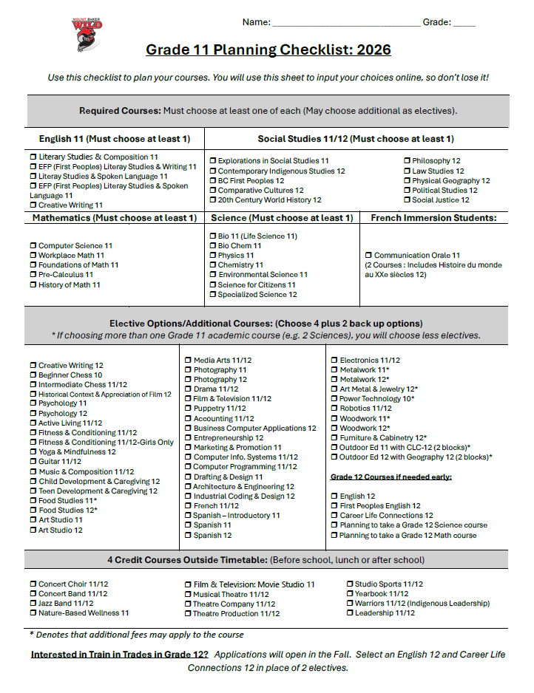
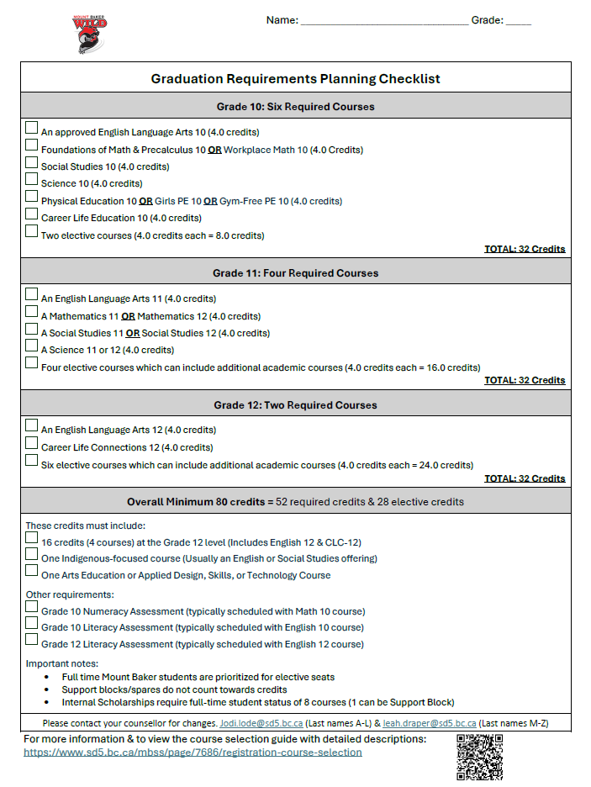

Slide 13
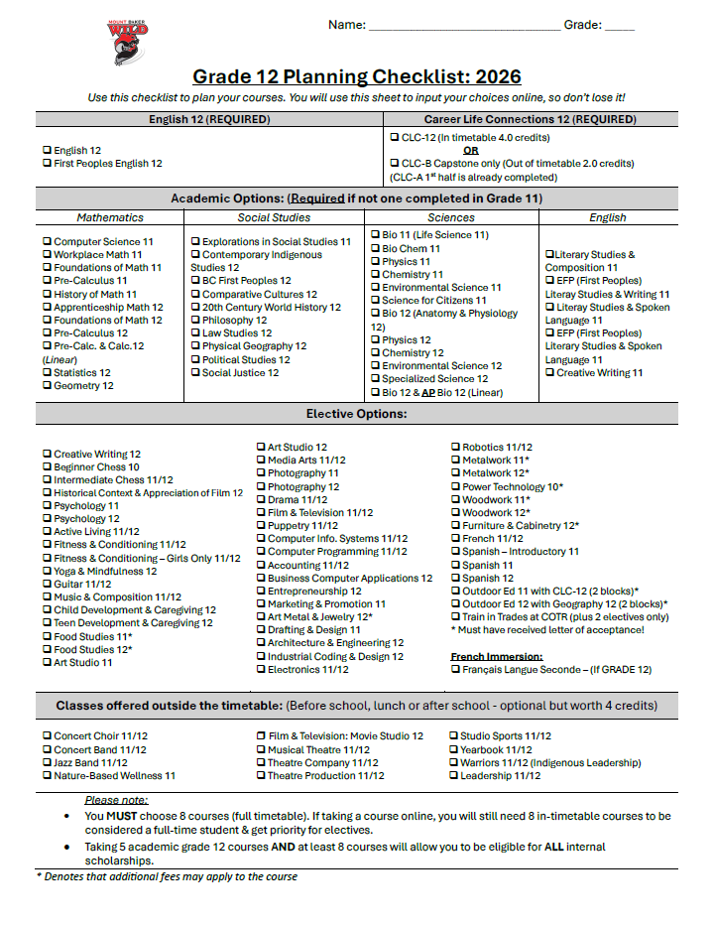
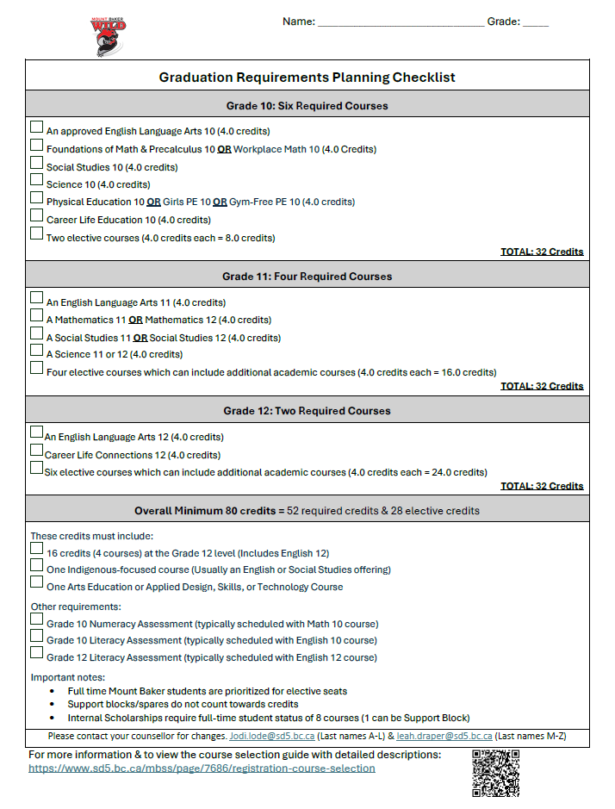

Slide 14
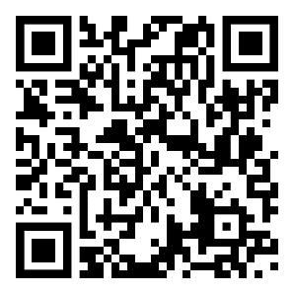
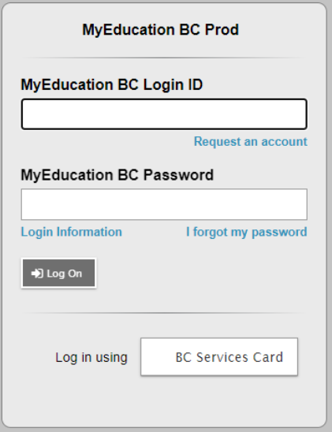
MyEducation BC Portal Information:
Scan QR Code or visit myeducation.gov.bc.ca
Your Login ID will always be the same: sd5stu-firstinitallastname **Your login ID is NOT your student number**
Example: John Smith would be sd5stu-jsmith Forgot your password?
Click here before your account is locked to reset your password!
After 5 attempts, your account will be locked.
***The system will ask for your Login ID and Primary email.
Your Primary Email is your school email account***
If your account is locked, please go to the office to have it reset.
**Passwords are case sensitive!!**
If you reset your password, an easy password is: Baker2026$

