Slide 1
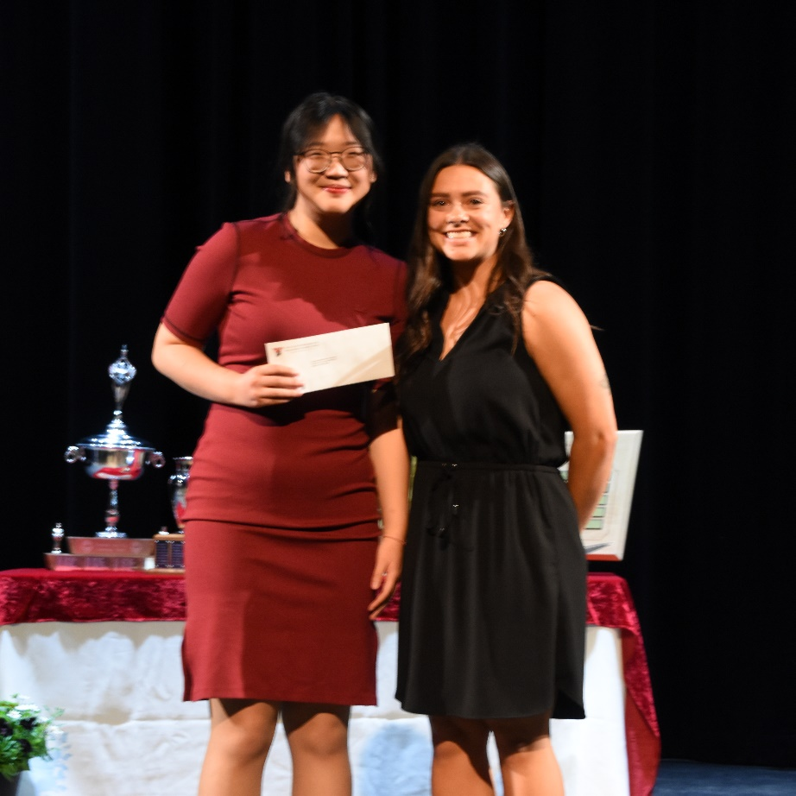
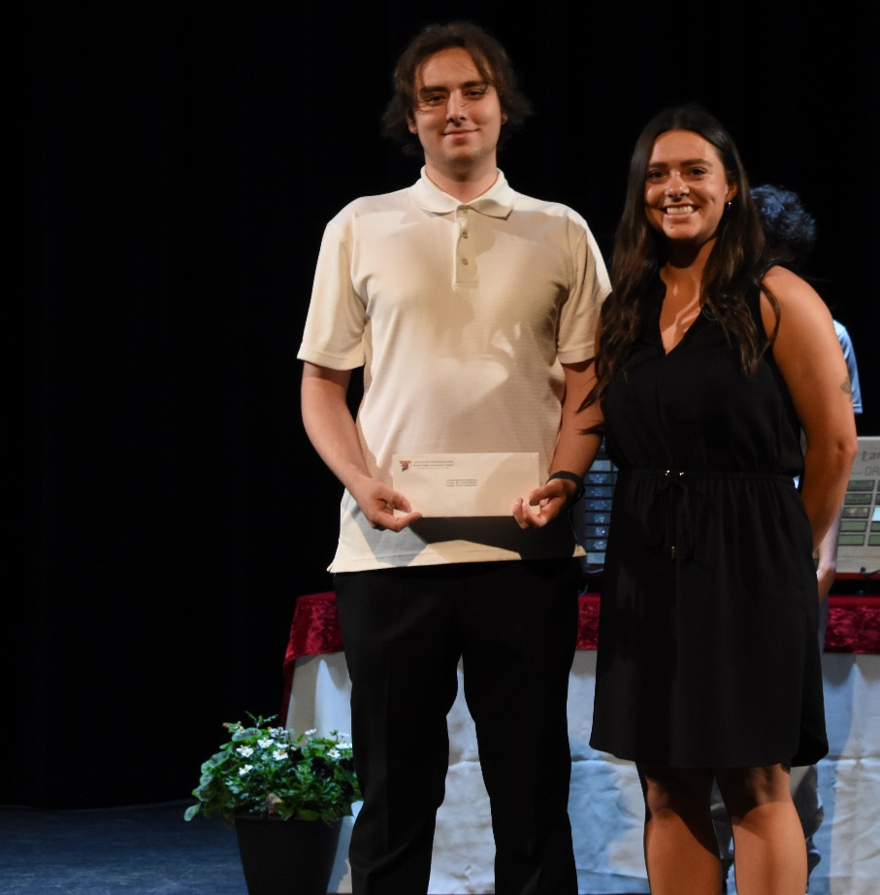
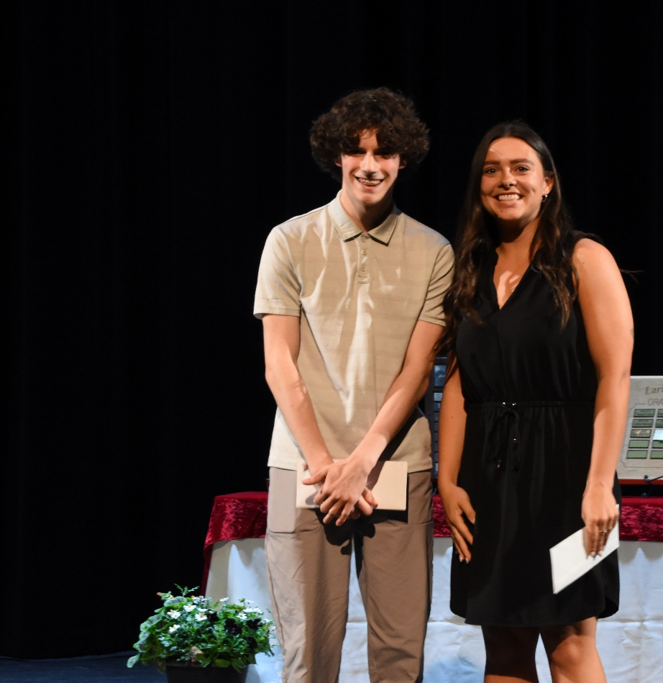
THIS AWARD GOES TO
Chenia Weng
Dion Georgeopolous
Talon Ackerman
Cranbrook Badminton Club Bursaries

Slide 2
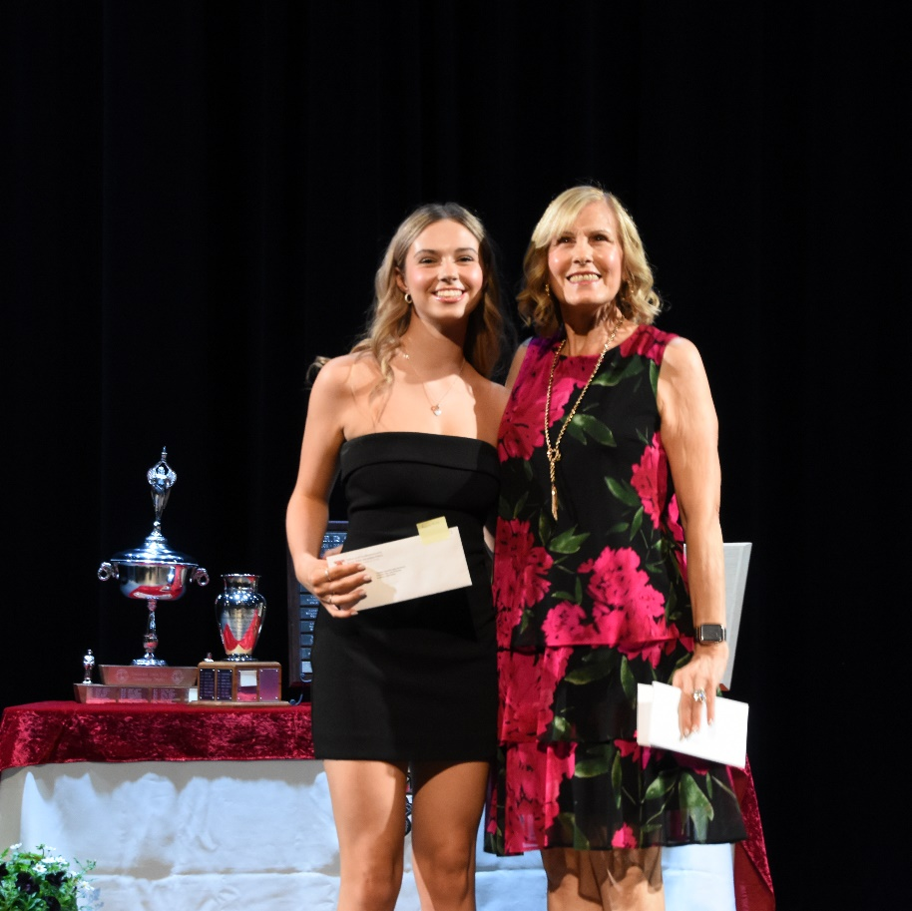
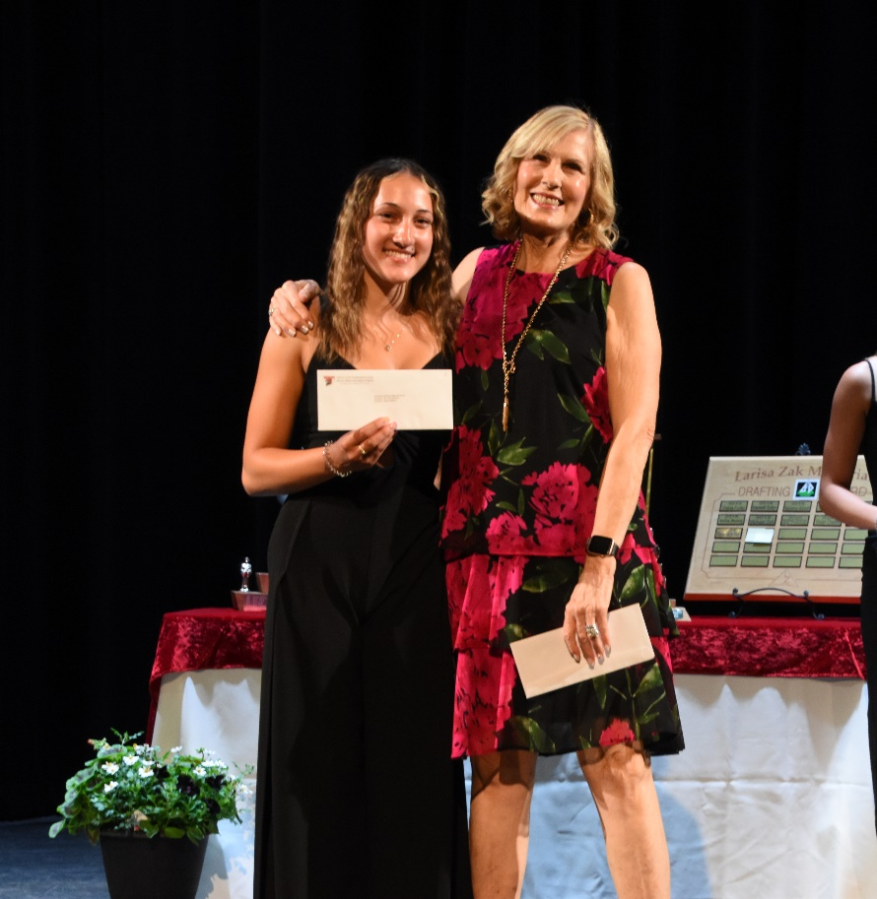
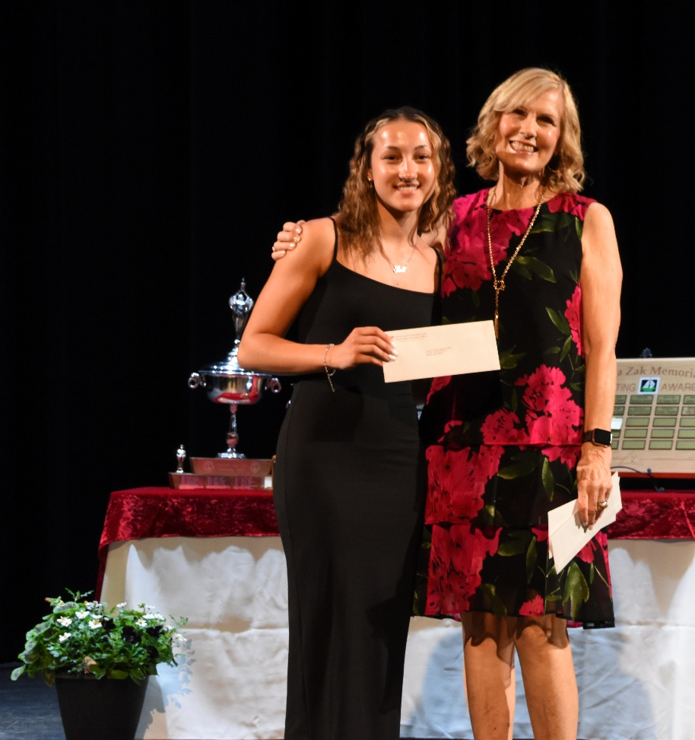
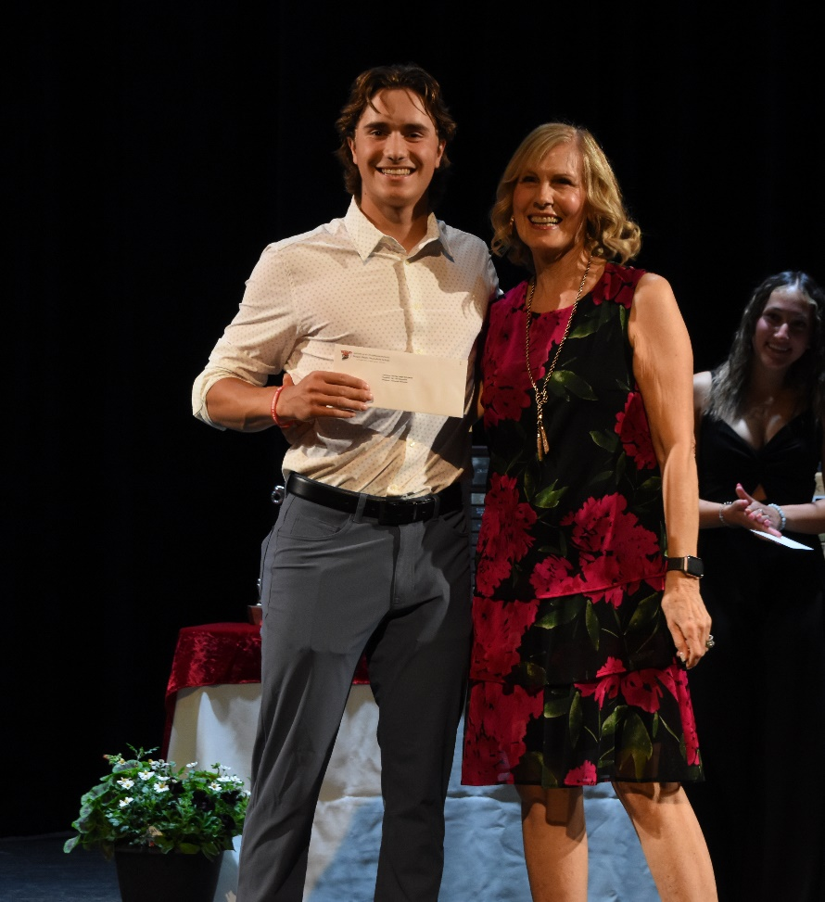
THIS AWARD GOES TO
Callie Bohan
Ashley Williams
Sara Williams
Donnovin Fiorentino
CRISTOFORO COLOMBO LODGE SCHOLARSHIP (1980)

Slide 3
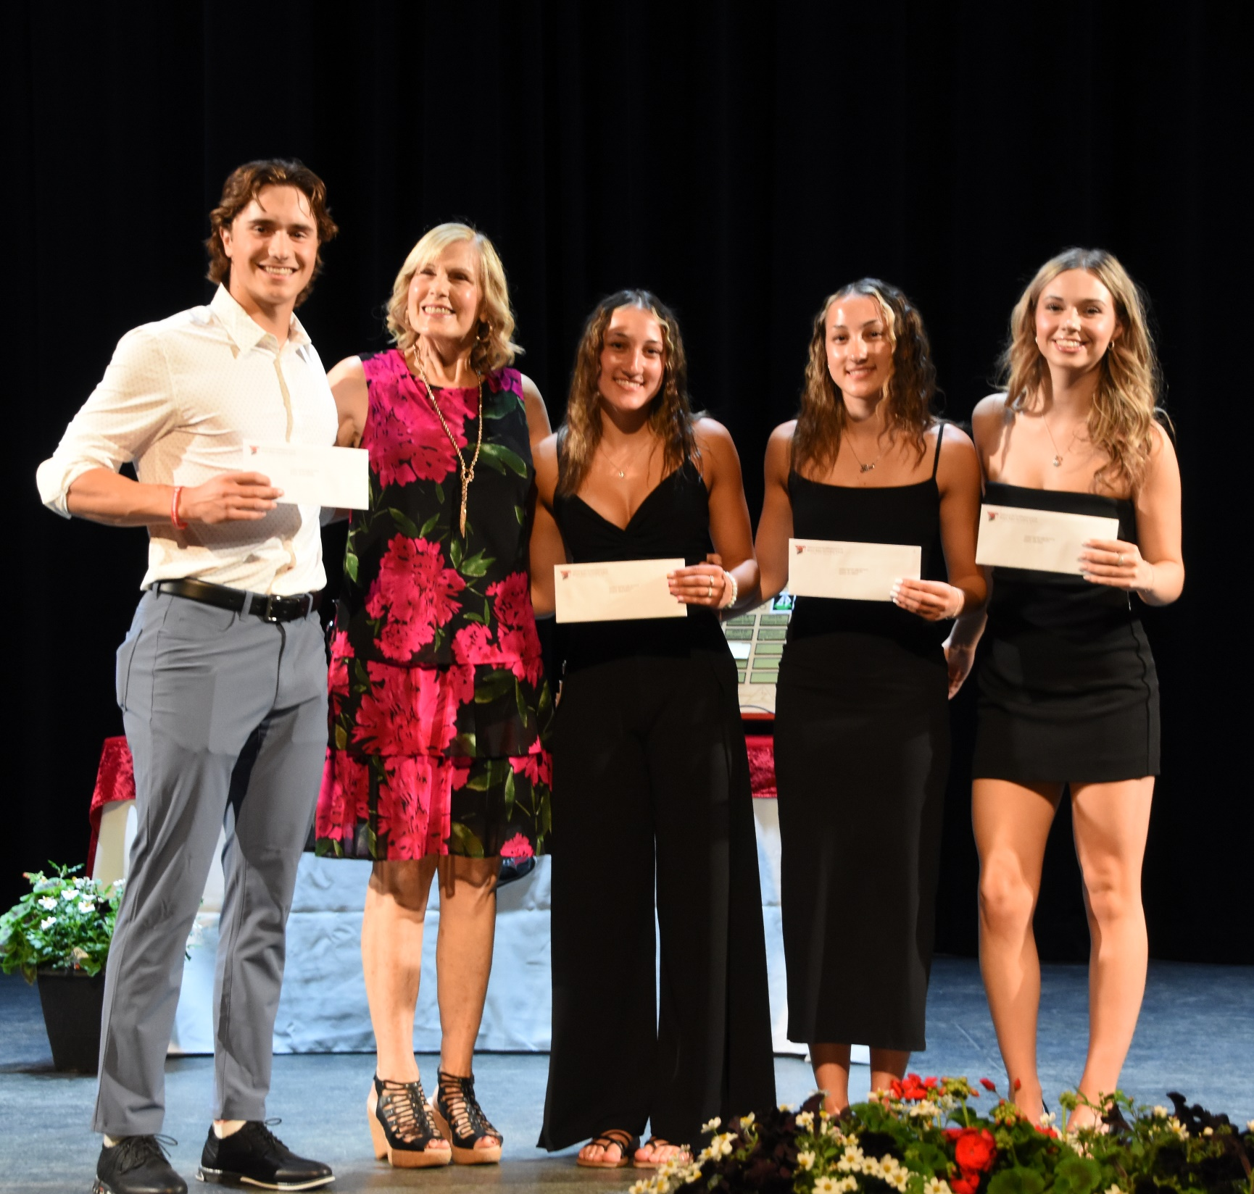
THIS AWARD GOES TO
Callie Bohan
Ashley Williams
Sara Williams
Donnovin Fiorentino
CRISTOFORO COLOMBO LODGE SCHOLARSHIP (1980)

Slide 4
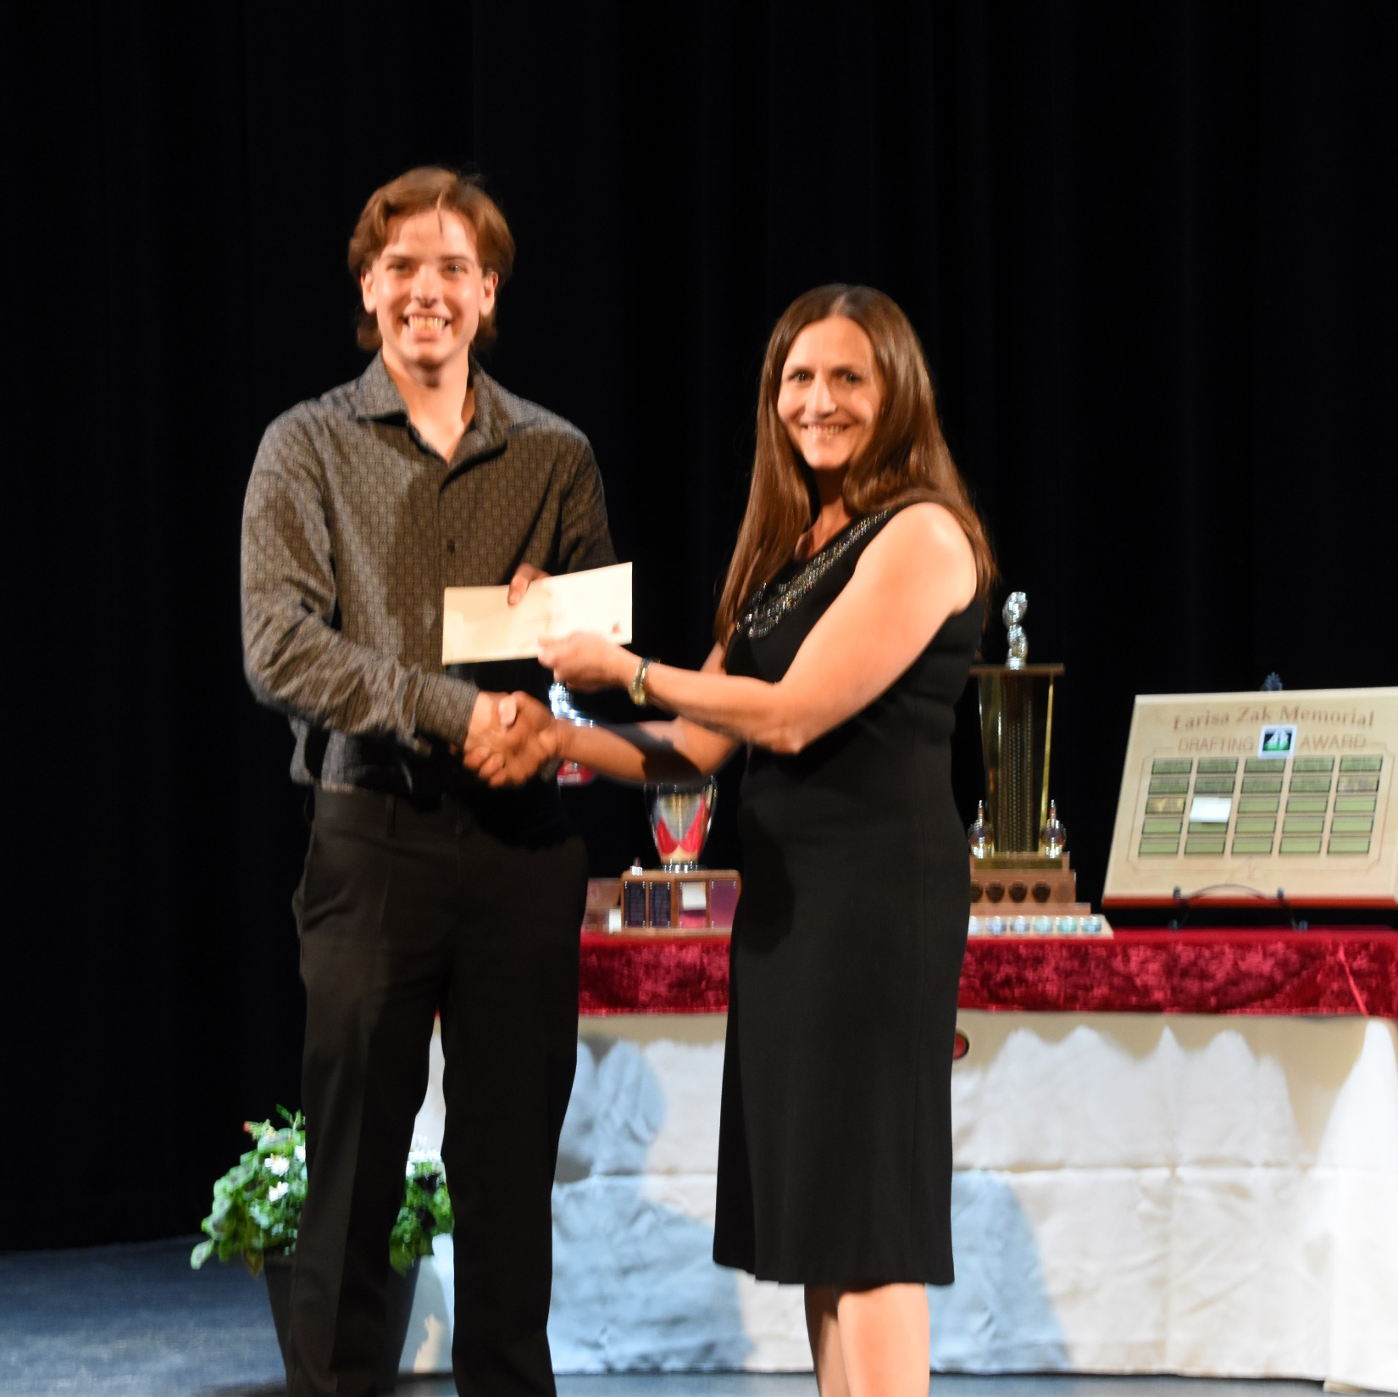
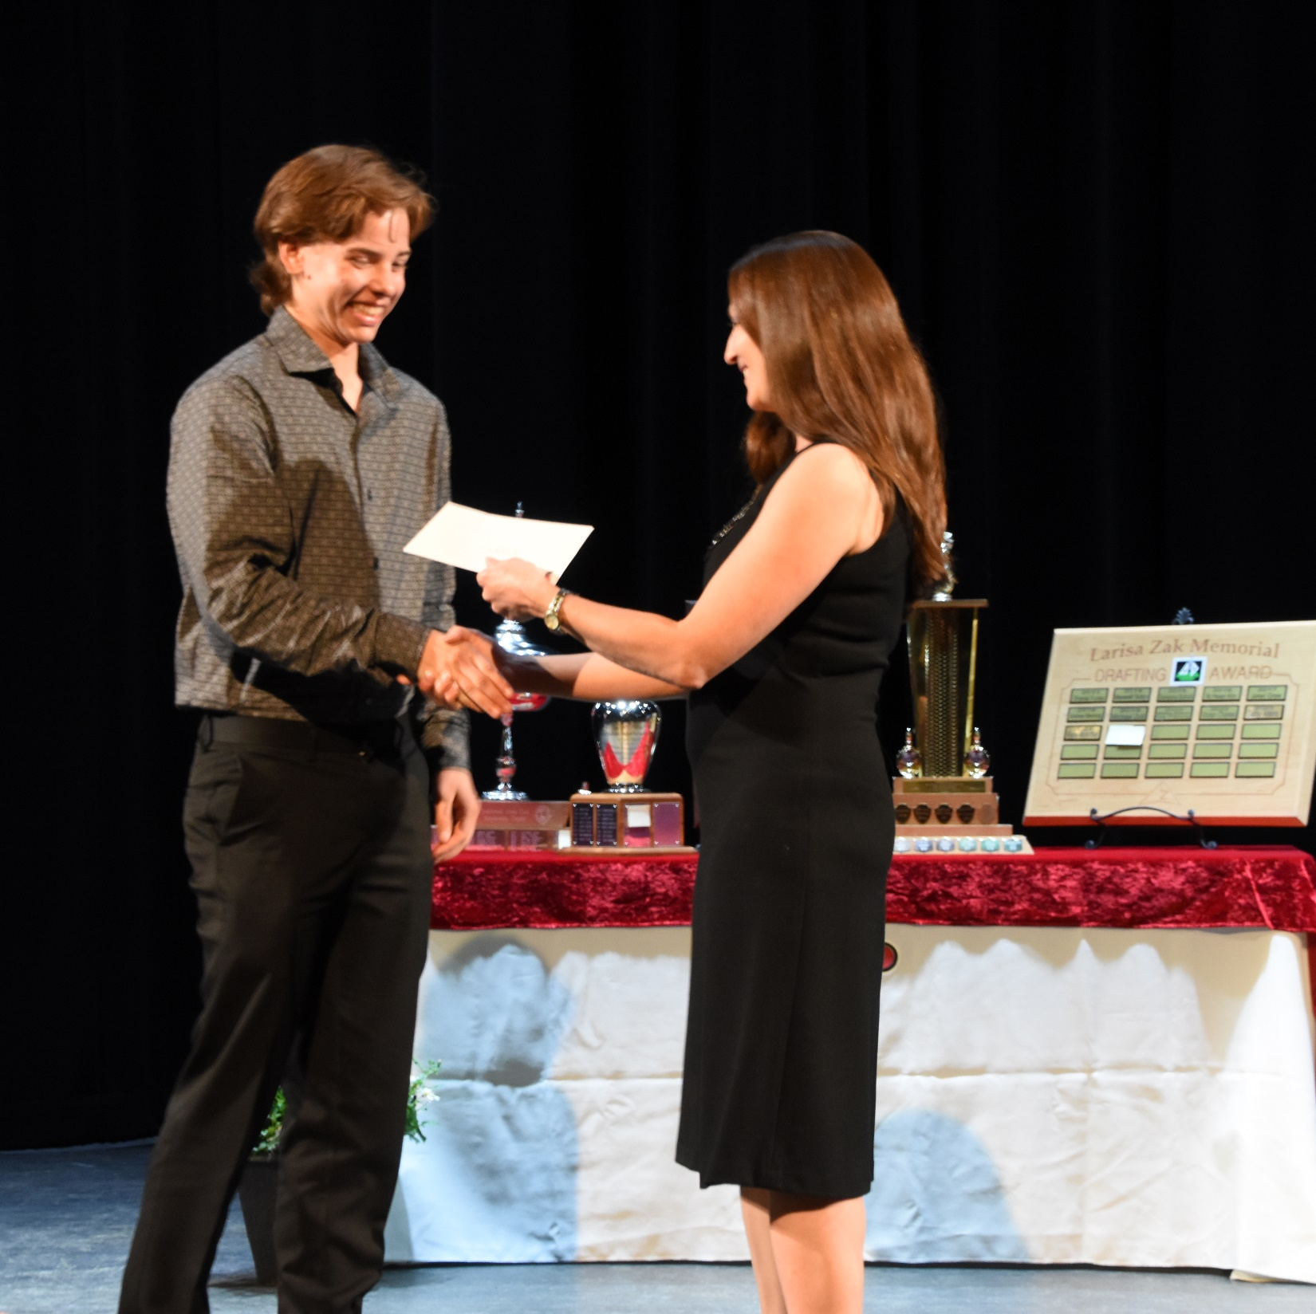
Slide 3 title
Canadian Parents for French Award
Jake Wishart

Slide 5
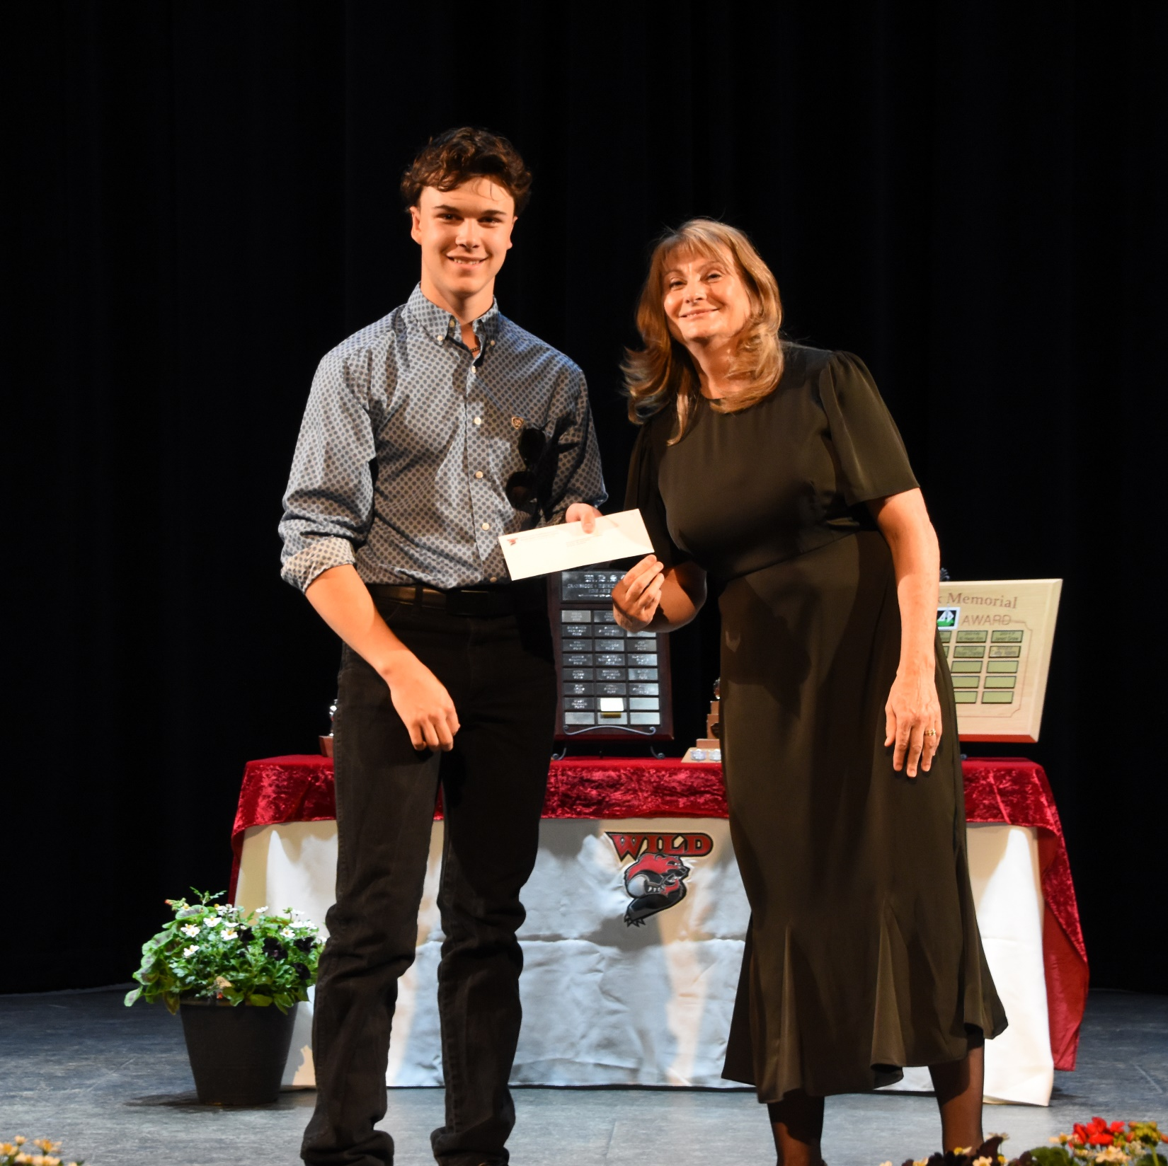
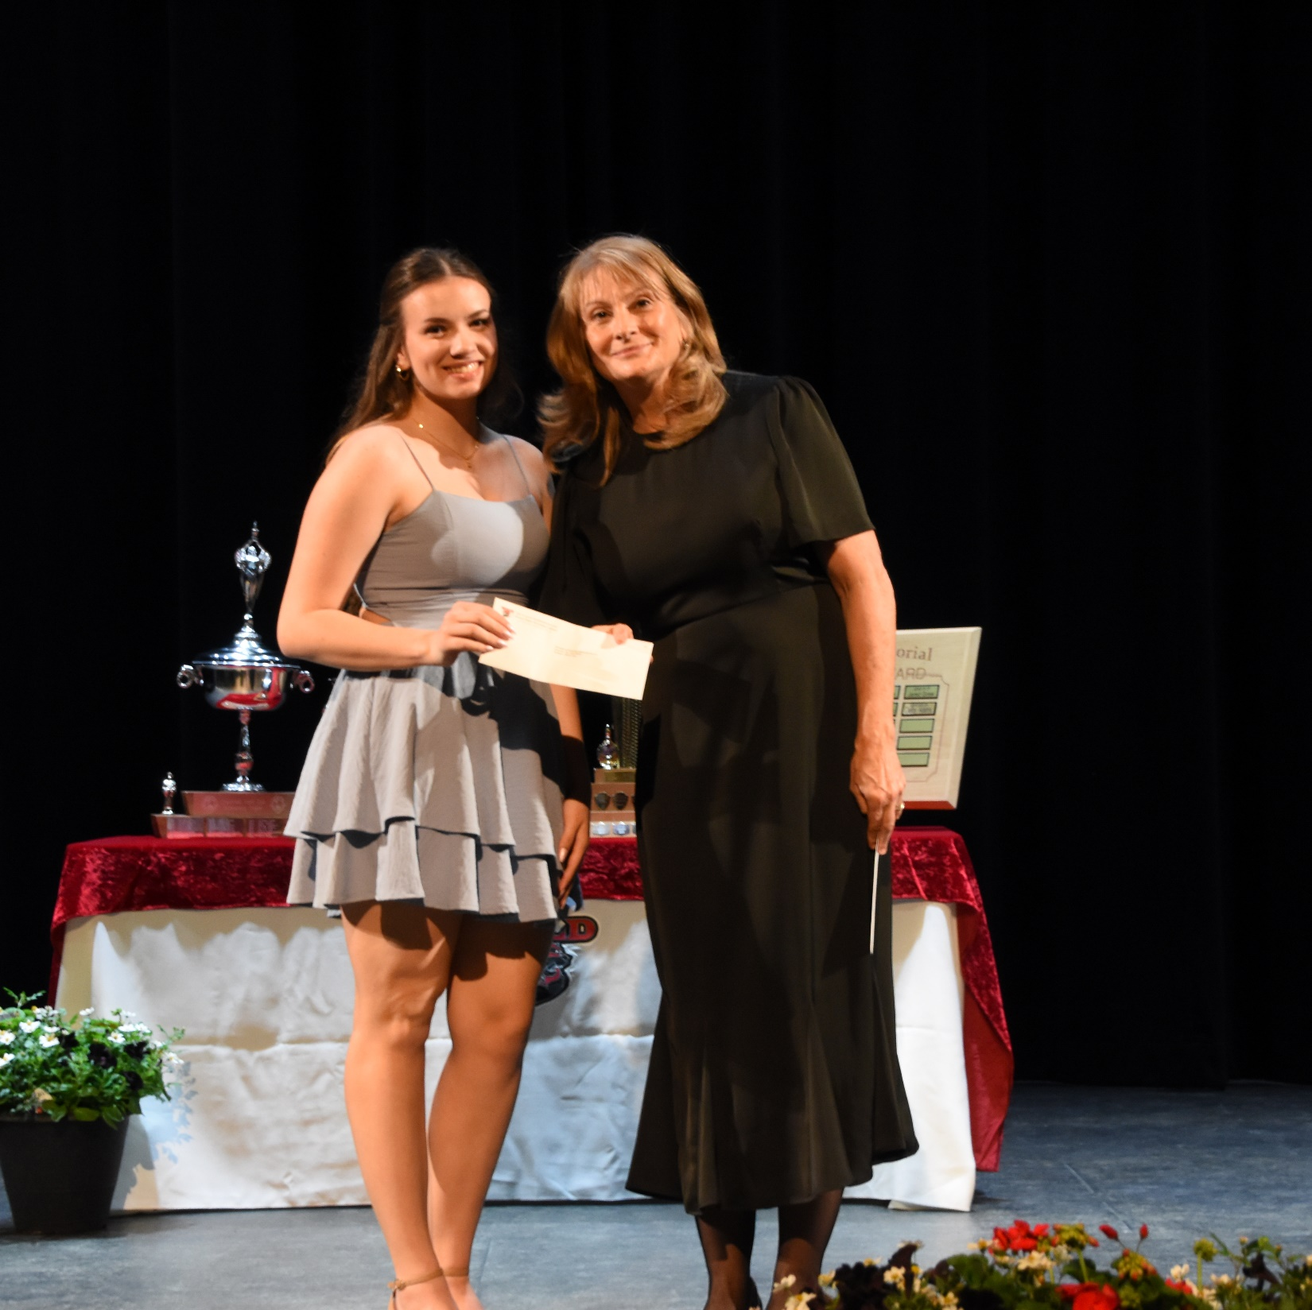
Slide 4 title
TM Roberts Elem. School PAC Scholarship English
Jack Spring
TM Roberts
Elem. School PAC Scholarship
French
Allison Cote

Slide 6
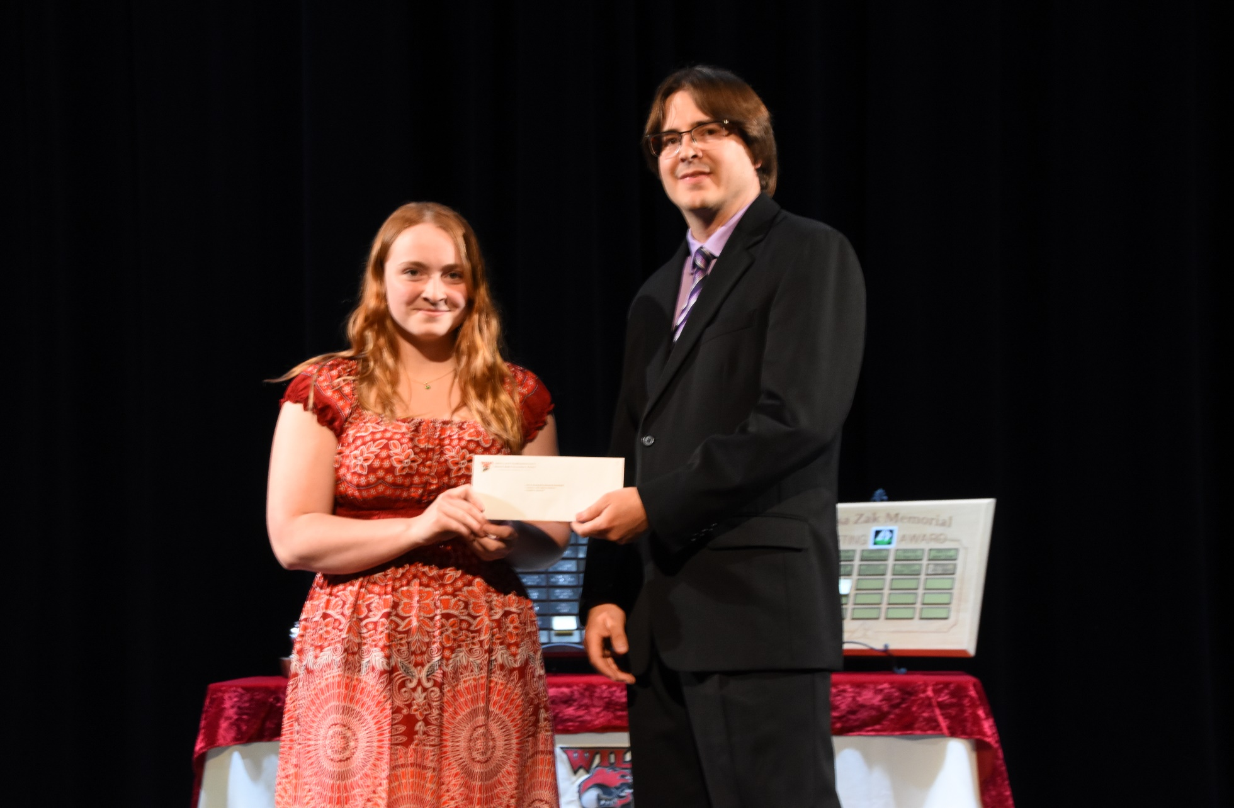
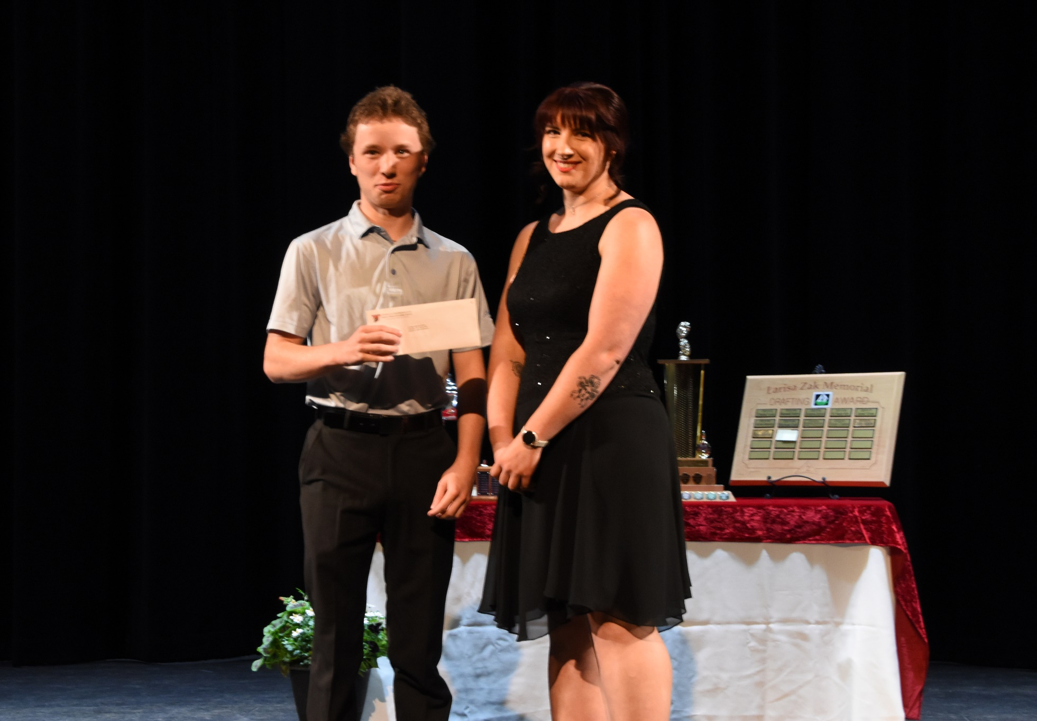
Slide 5 title
CST KATIE FERGERON AWARD
Garrett Bevilacqua
MELVIN & JEAN BAIN MEMORIAL SCHOLARSHIP
Nova Bell

Slide 7
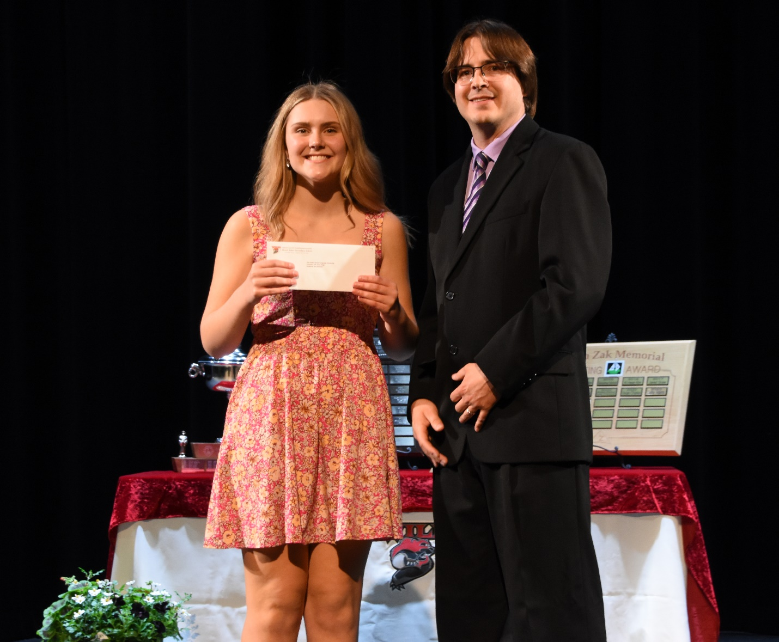
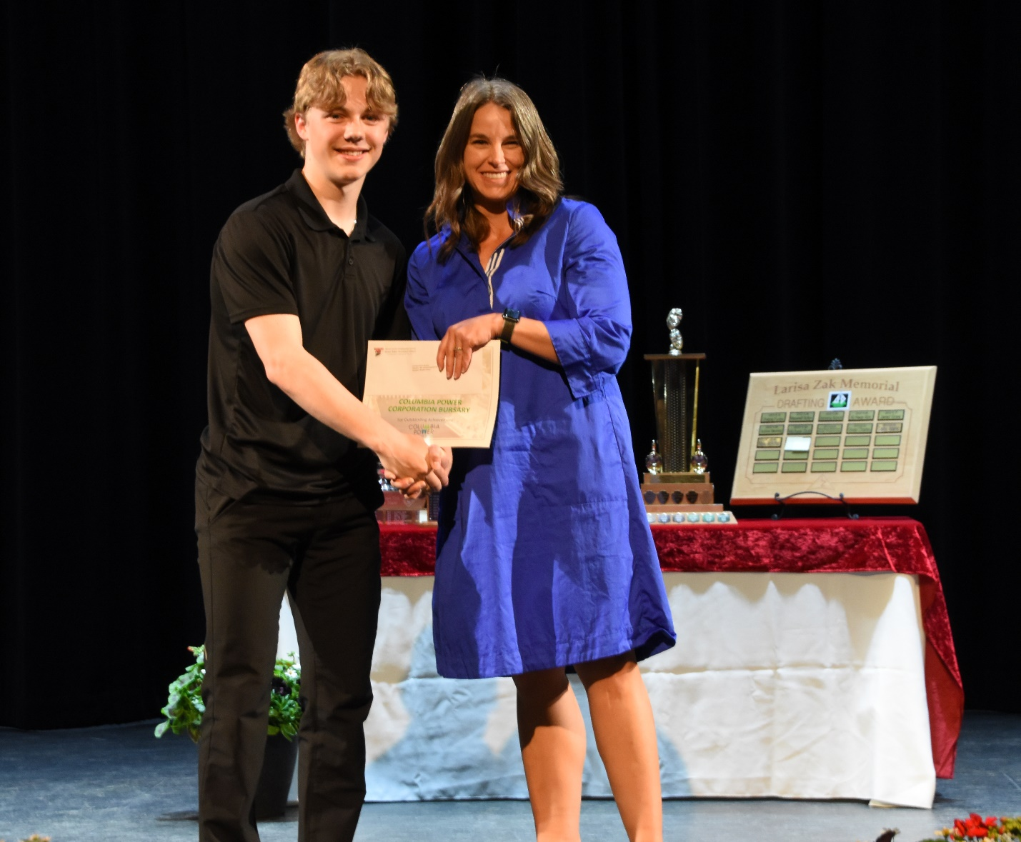
Slide 6 title
ALAN BODEN SECOND LANGUAGE SCHOLARSHIP
Ava Zantiotis
COLUMBIA POWER BURSARY
Brayden Conroy

Slide 8
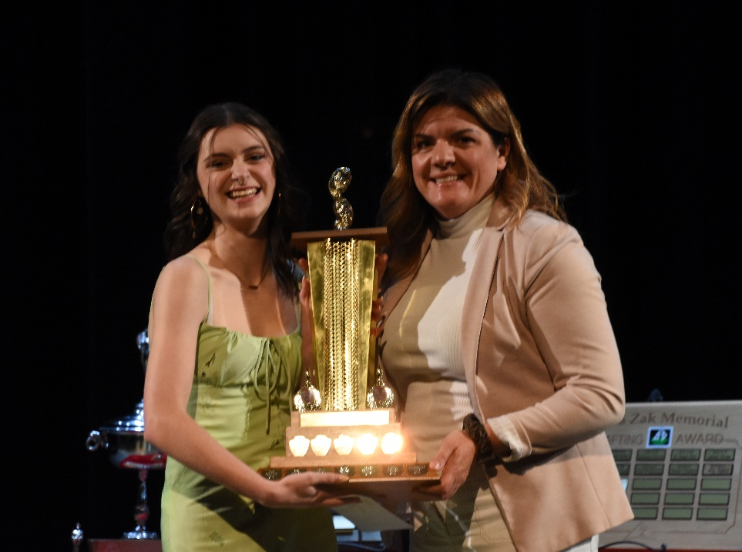
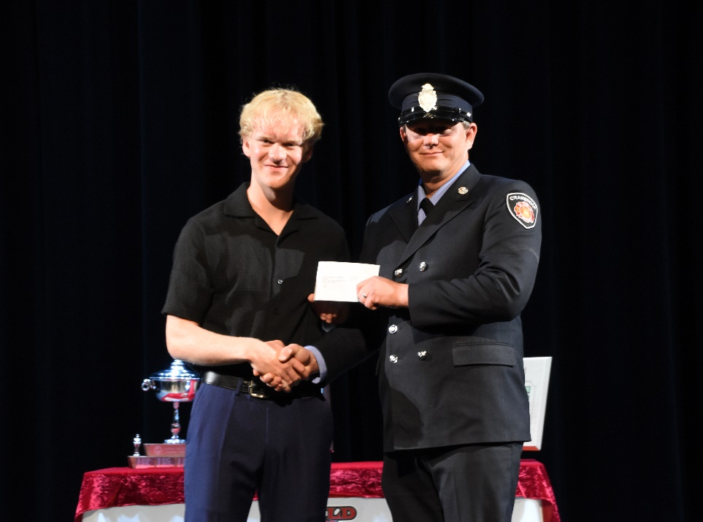
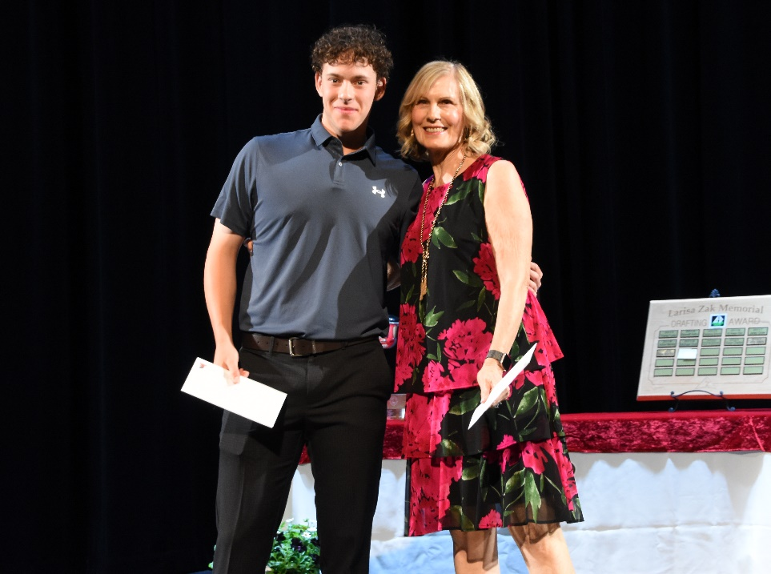
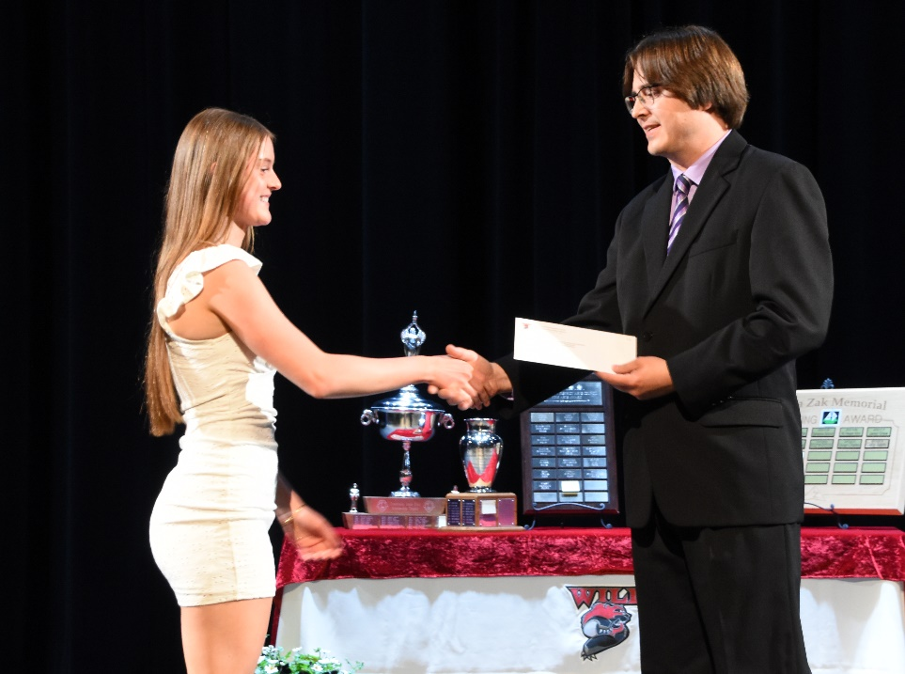
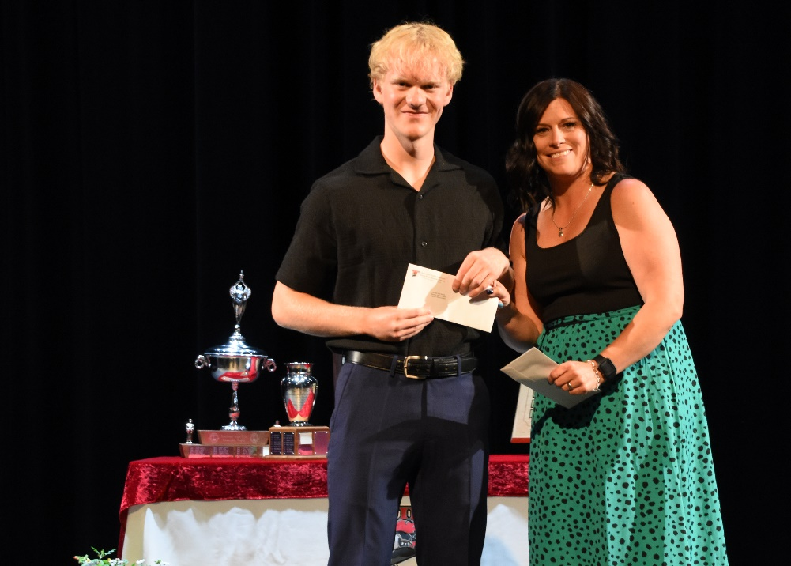
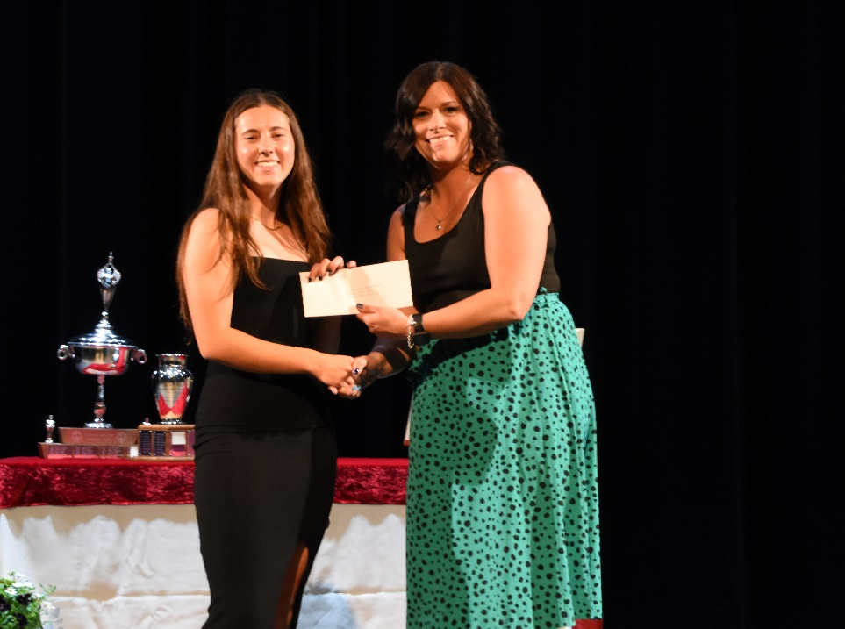
Scholarship goes to
Cranbrook Community Theatre Award
Charlee Organ
Cranbrook Firefighters I.A.F.F Local 1253
Nathan Lockhart
Cranbrook Garden Club Scholarships
Josh Pighin (Echo Heidt not pictured)
Cranbrook Rotary Interact Club Scholarship
Natalie Bradshaw
CUPE 4165 Bursary
Nathan Lockhart
CUPE 4165 Indigenous Bursary
Abbie Pasowisty

Slide 9
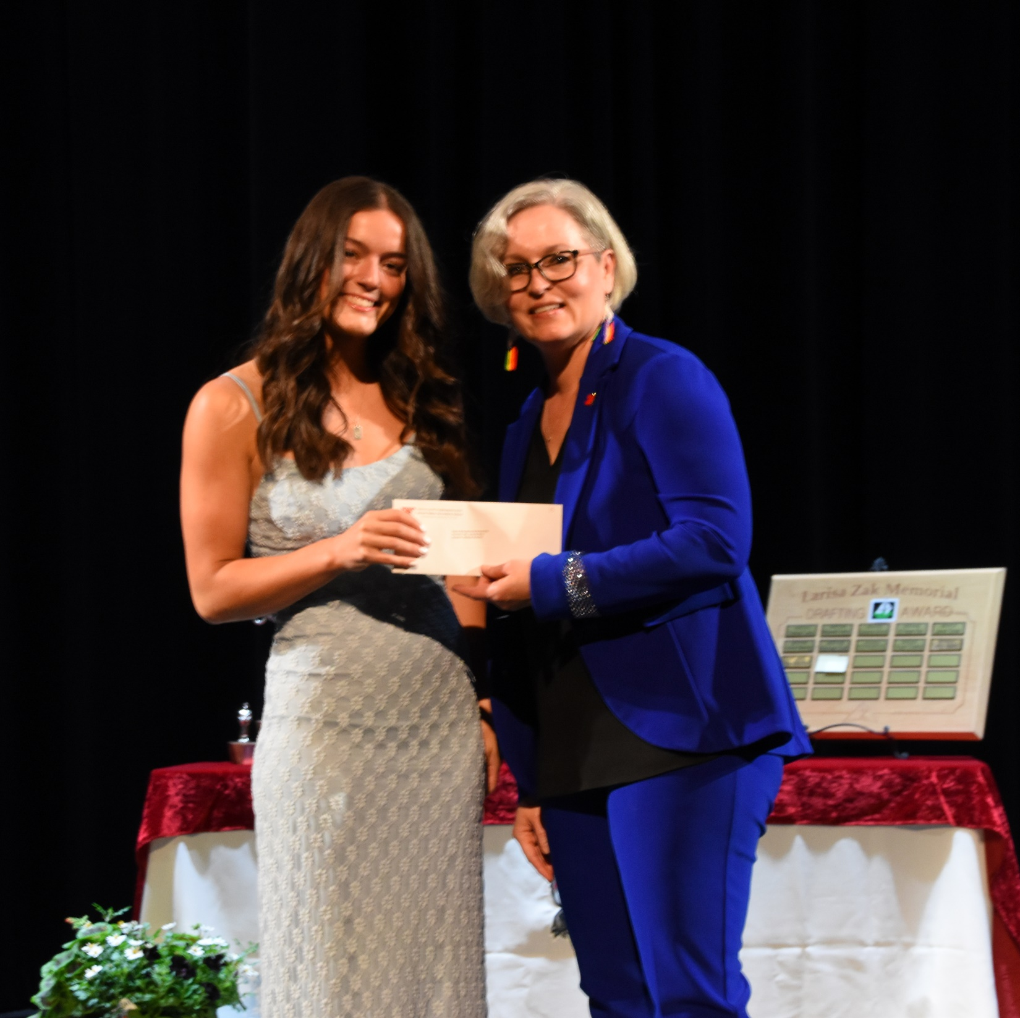
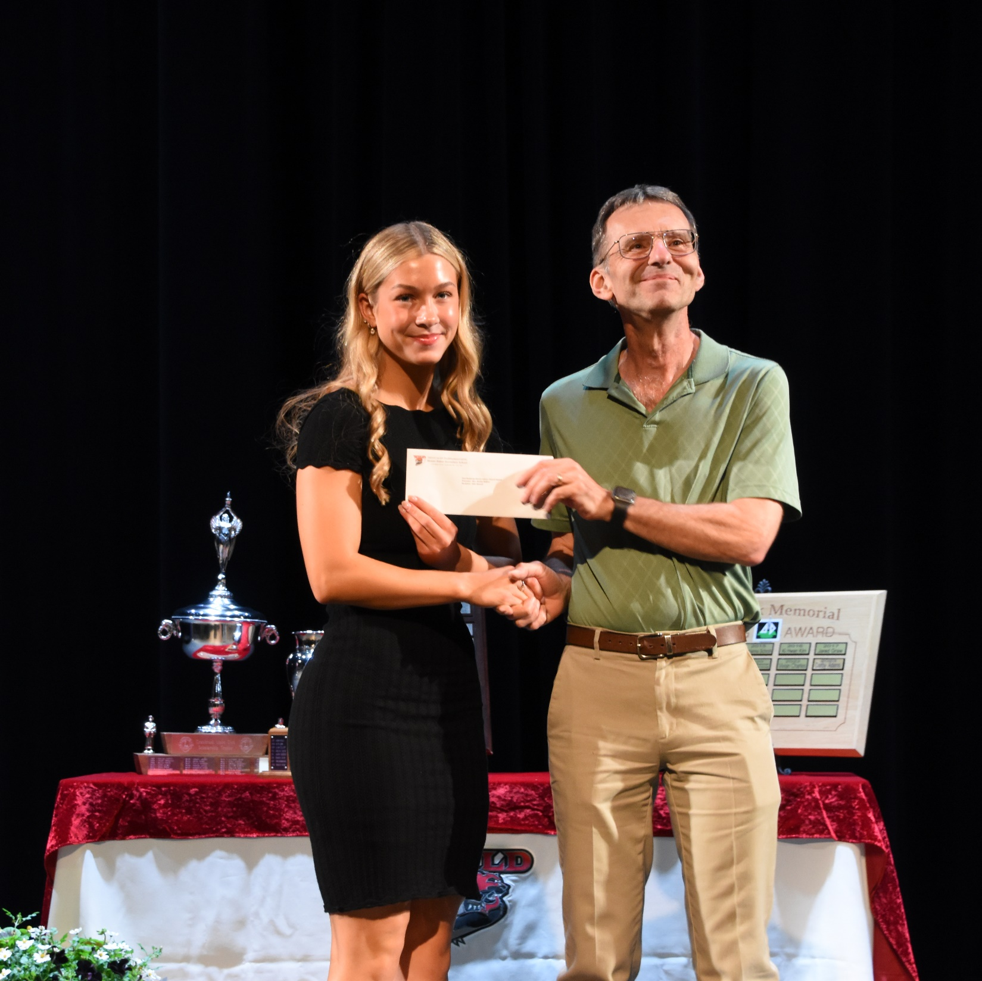
Slide 3 title
Dianne Wray Memorial Scholarship
East Kootenay District Labour Council Award
Malayah McArthur
Eden Bassett

Slide 10
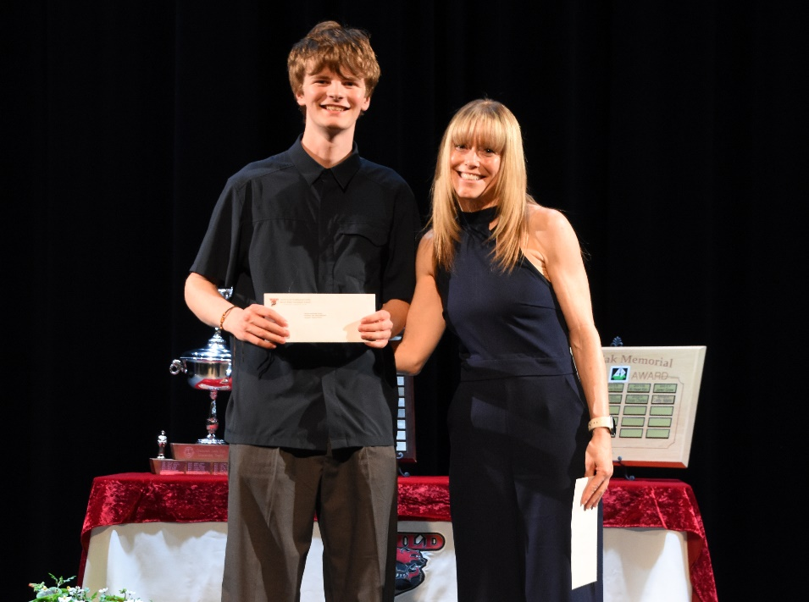
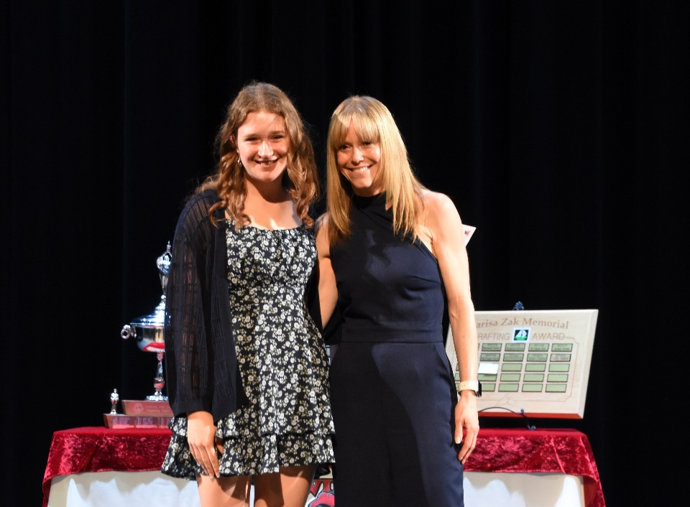
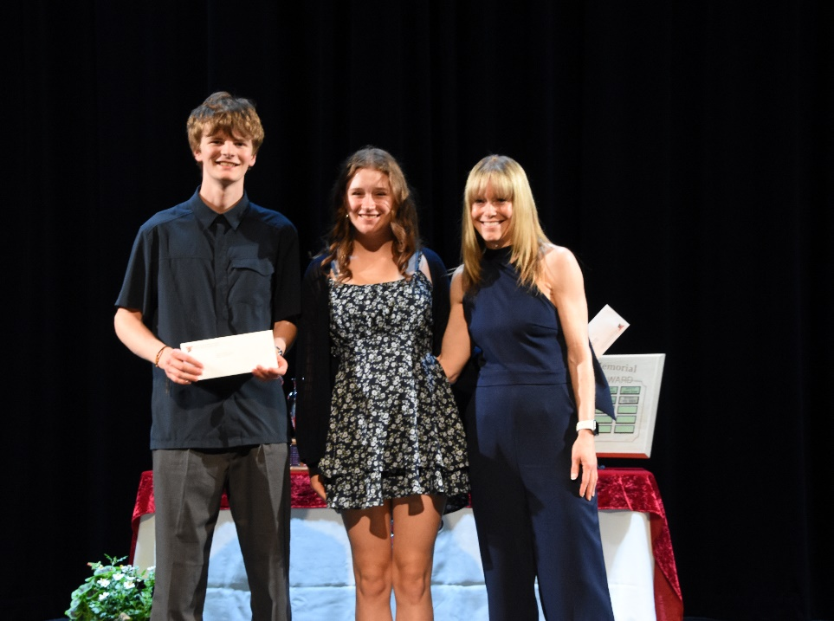
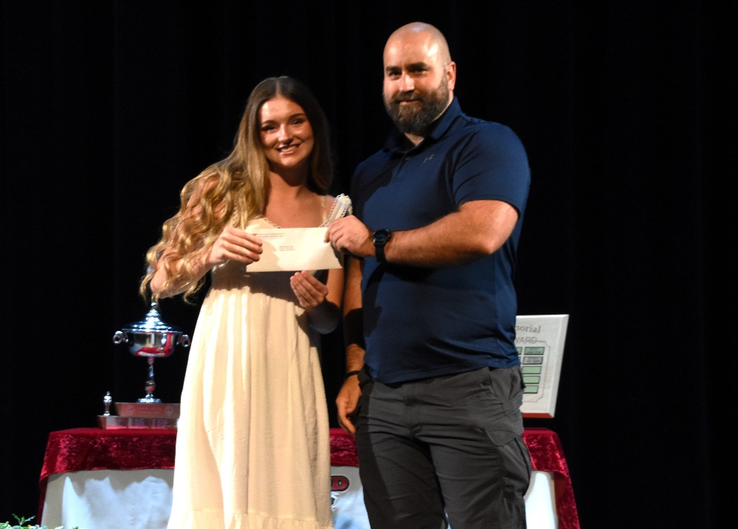
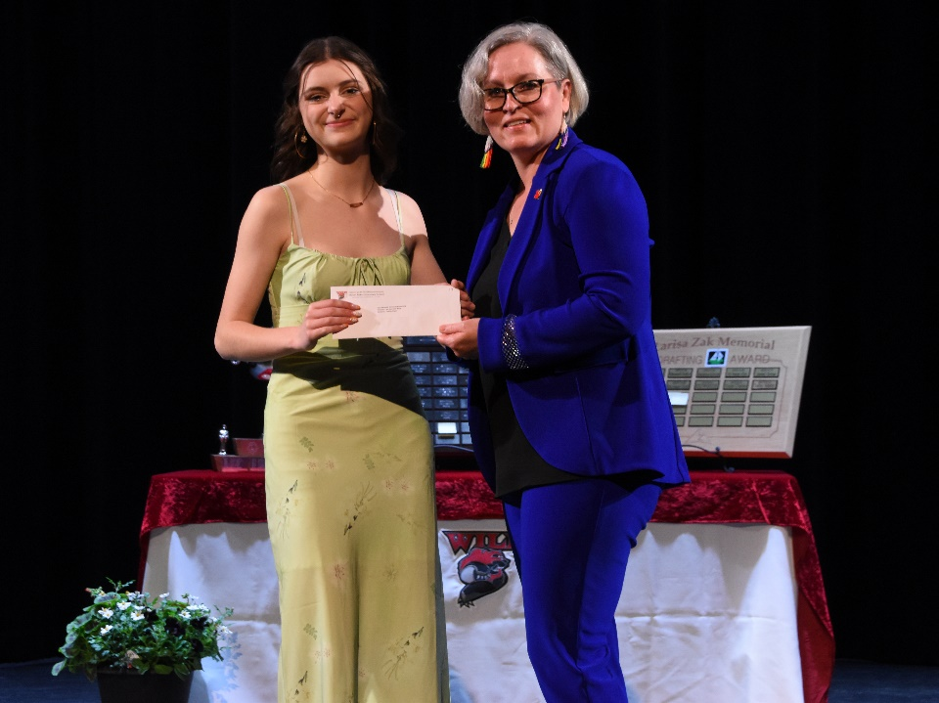
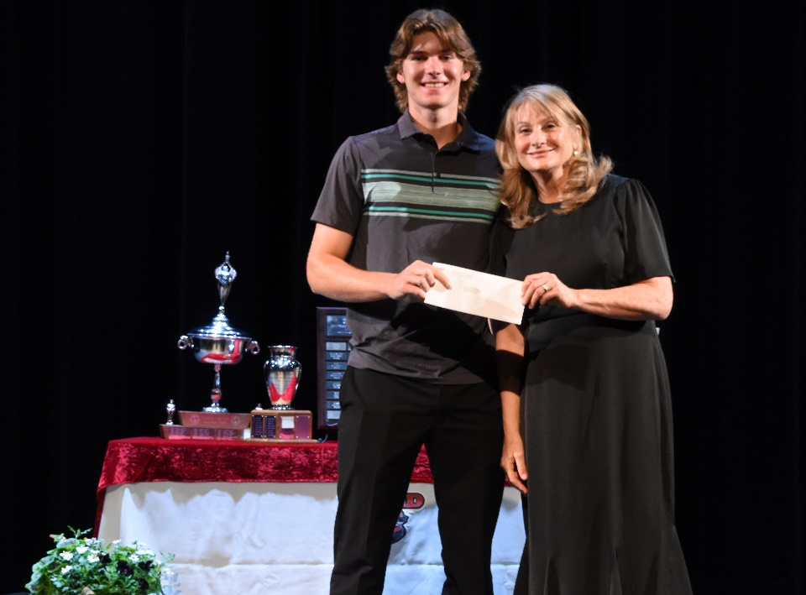
Awards & Scholarships
Fashion and Design Award
Payton Hansen
Fashion and Design Award
Kendal Frenette
Fashion and Design Award
Highlands School Award
Kendell Downey
Joyce Metcalfe Memorial Award
Charlee Organ
Kenton Barber Memorial Award
Clark Reimer

Slide 11
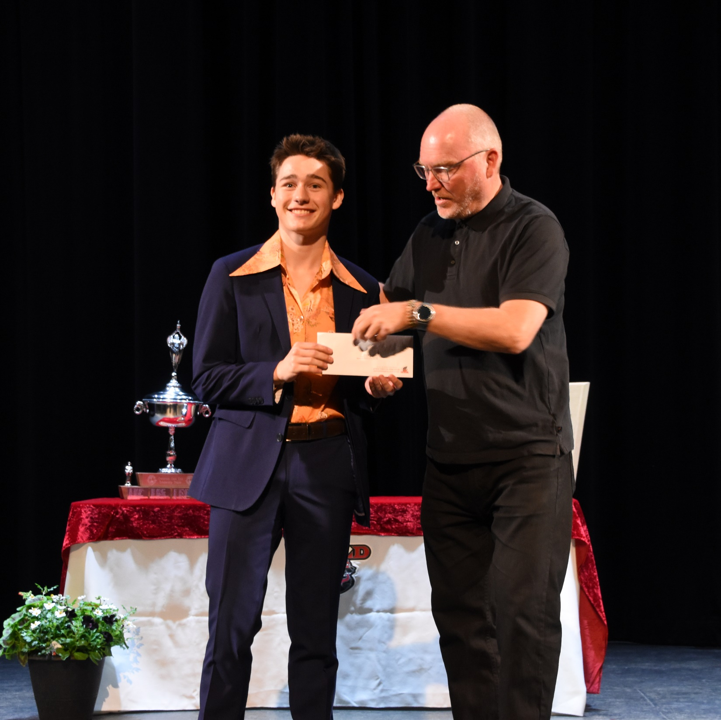
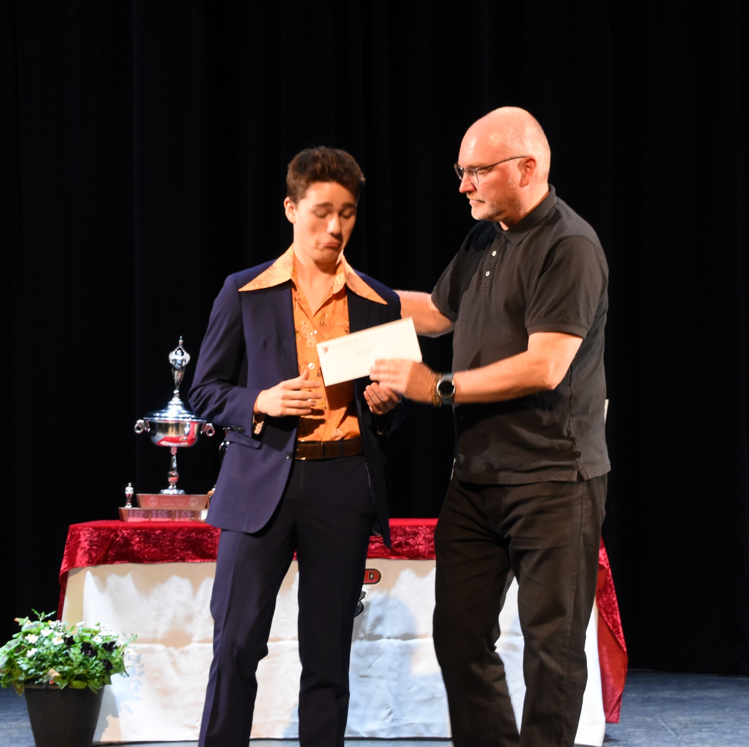
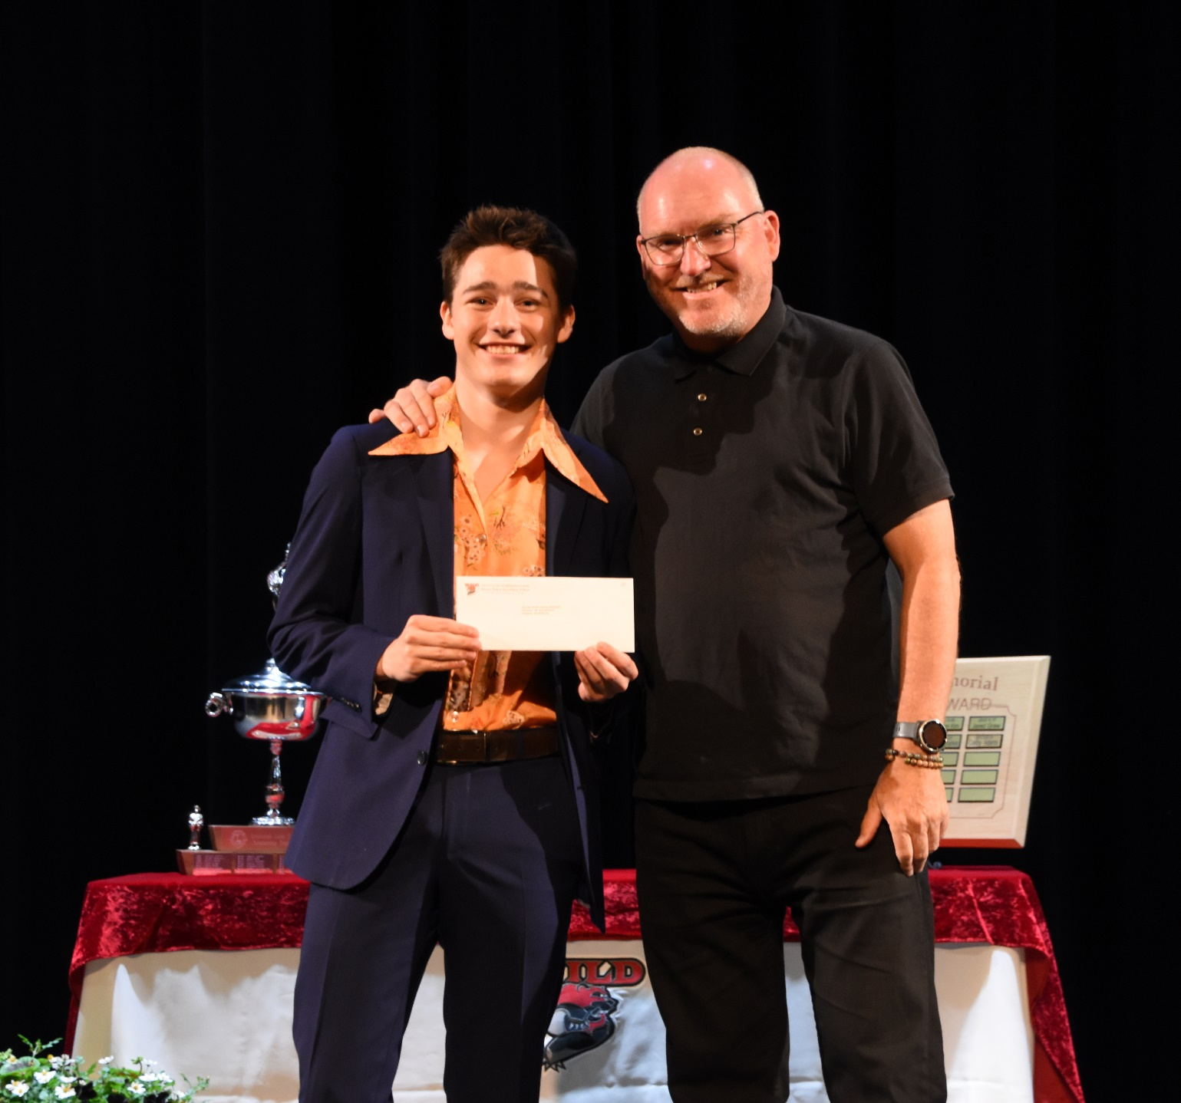
Slide 3 title
Key City Theatre Society Scholarship
Finn McBurney

Slide 12
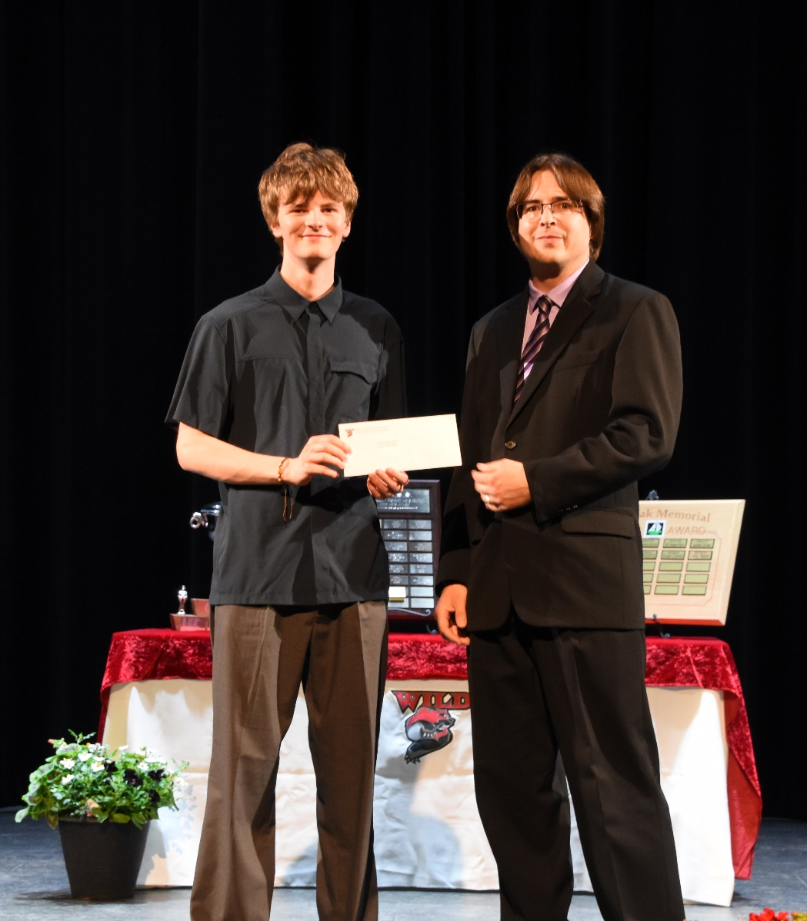
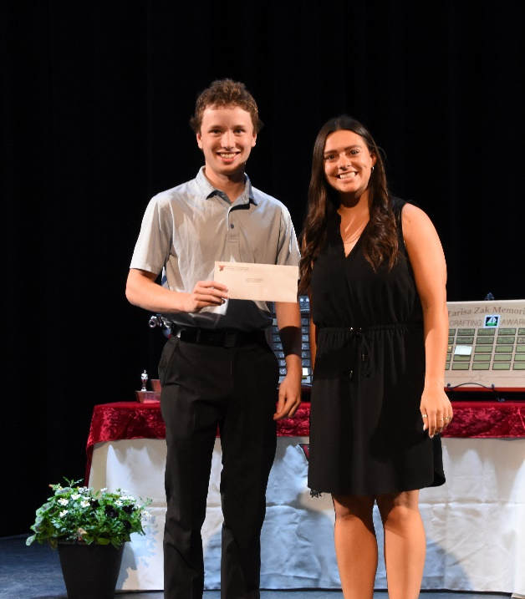
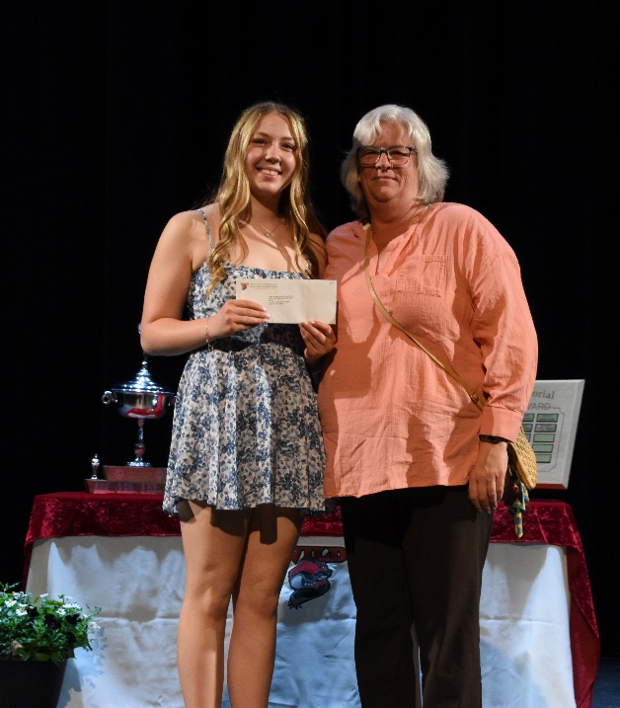
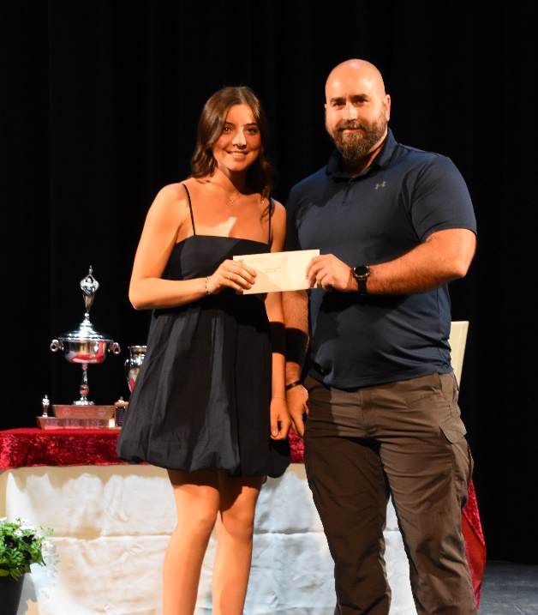
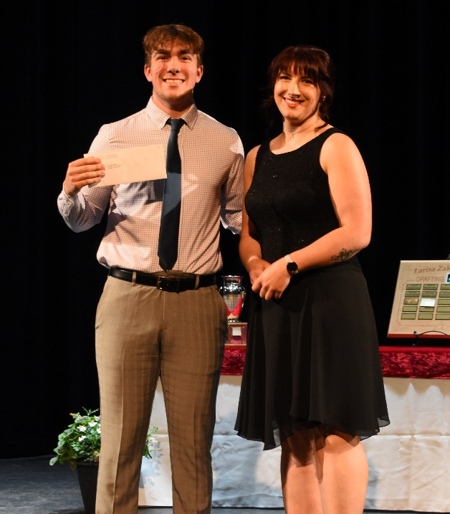
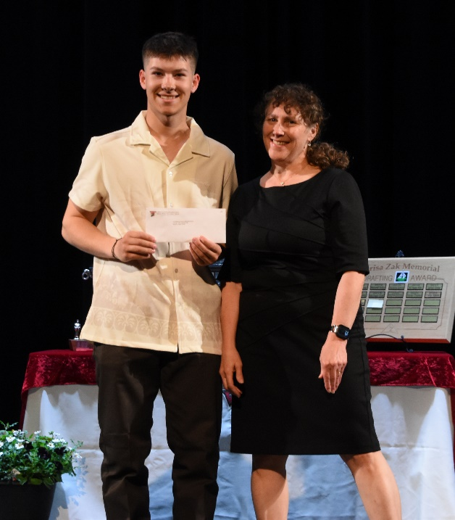
Bursaries & Scholarships
Kootenay Tax Services Scholarship
Garrett Bevilacqua
Ladies Auxiliary to FOE #3032 Regis Jacobson Memorial Bursary
Abby Ackison
Laurie Middle School Scholarship
Molly Cain
Kootenay Country Fair Bursary
Payton Hansen
Lifetouch Canada Scholarship
Jackson Rose
N.W. (Wayne) Morrison Memorial Forestry Award
Dagen Duczek

Slide 13
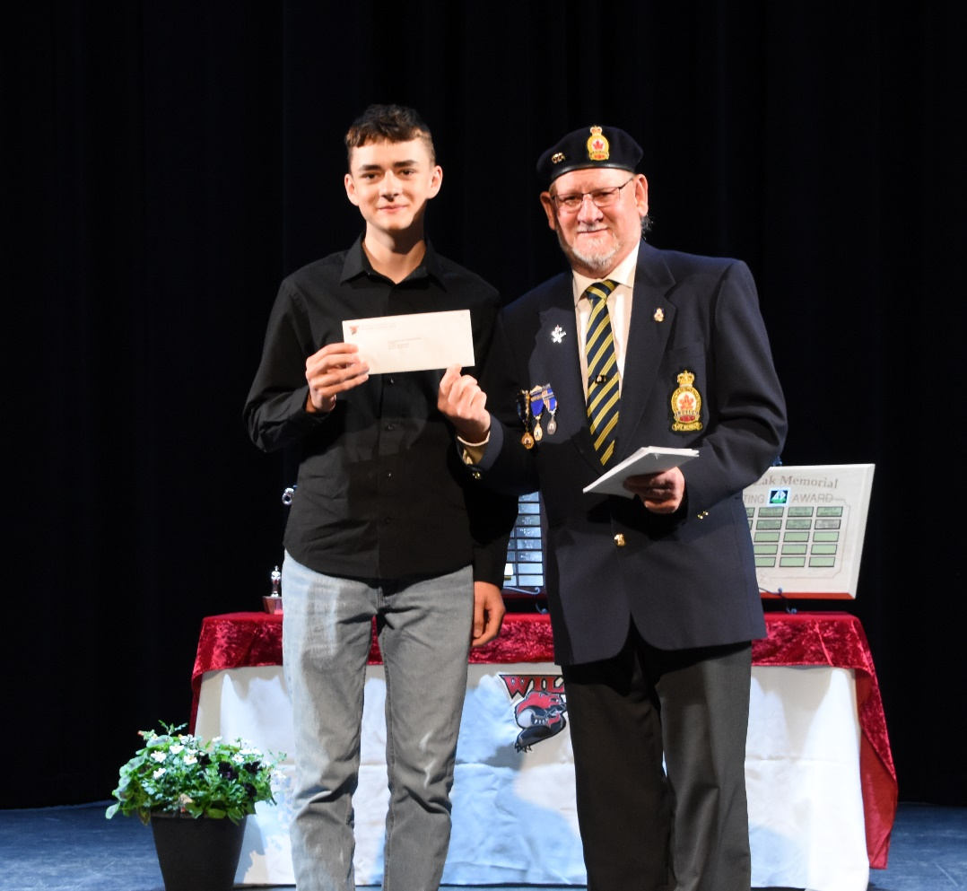
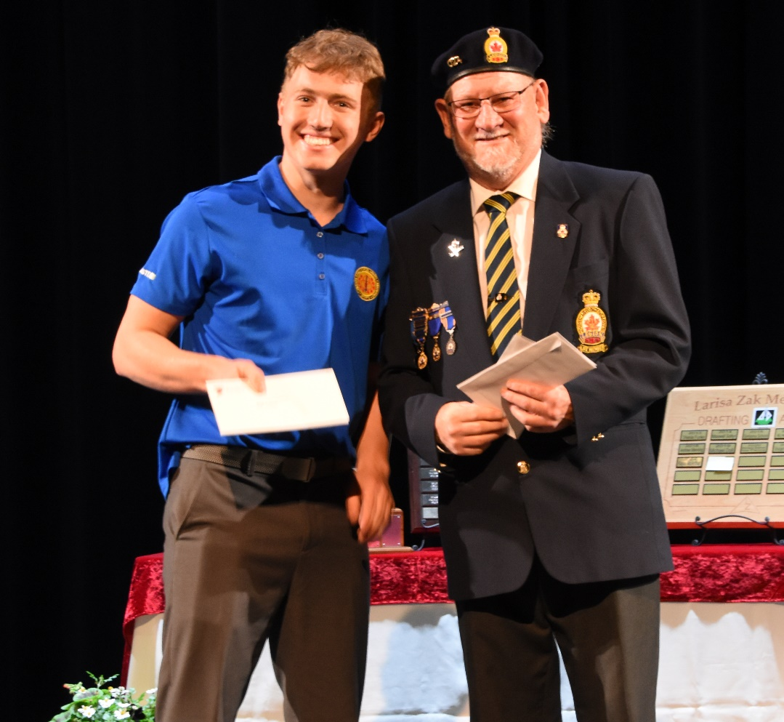
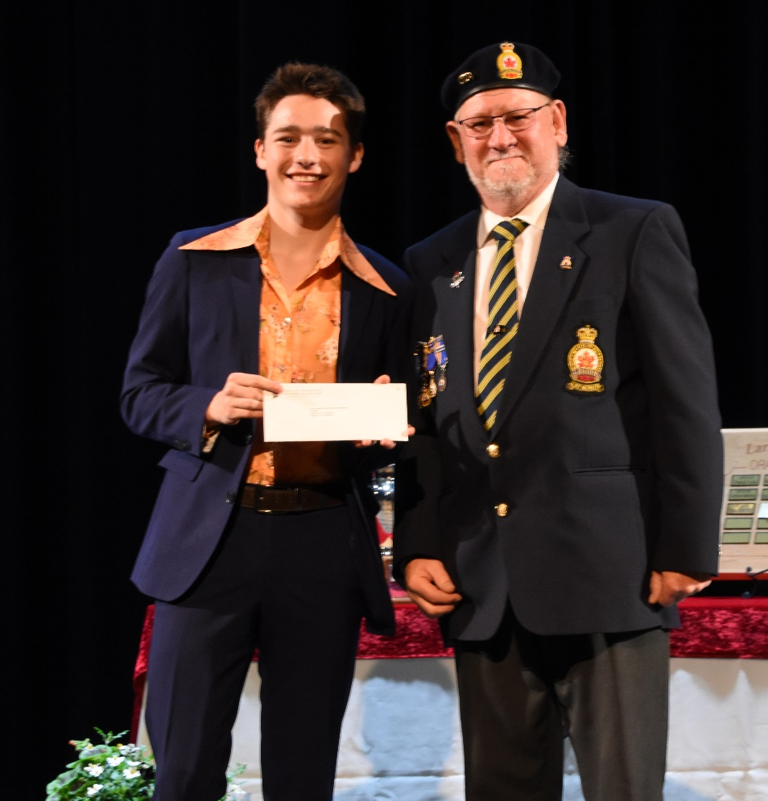
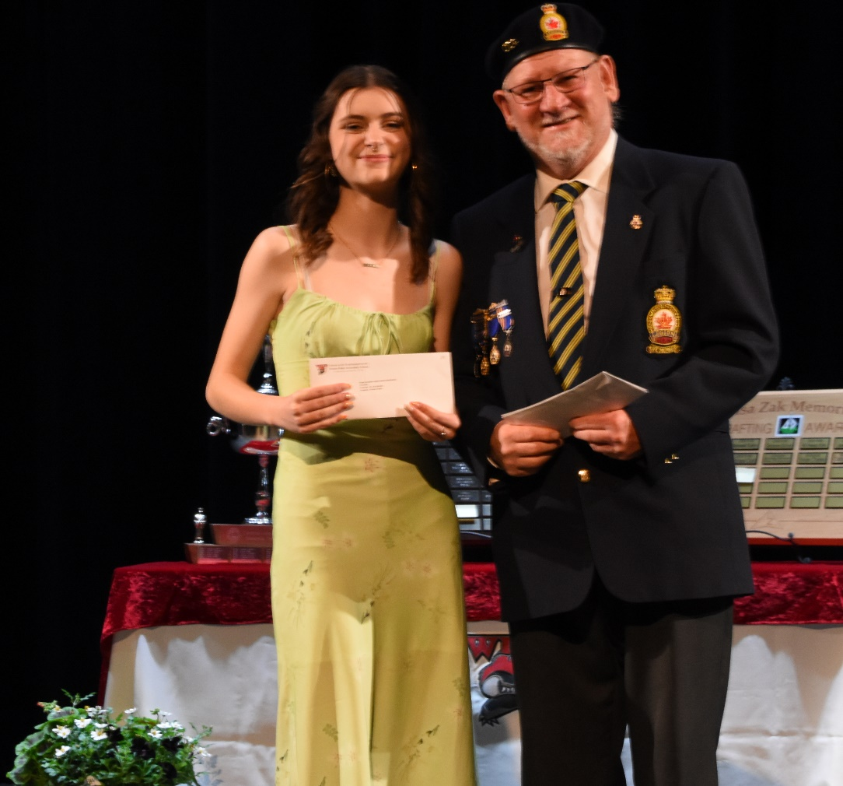
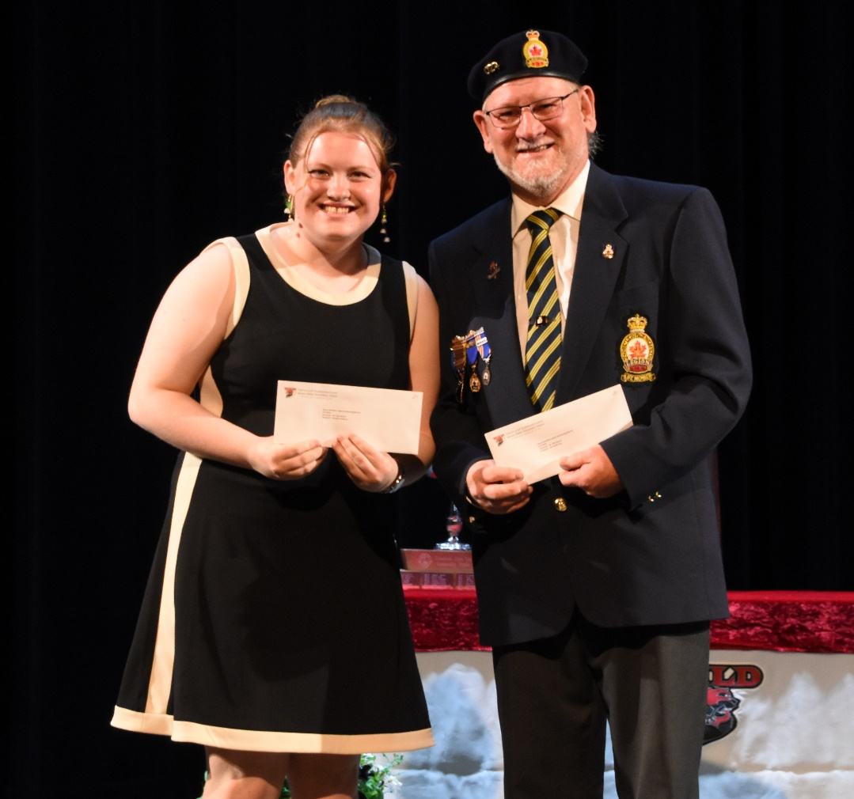
Royal Canadian Legion Scholarship Branch 24
Nic Lucas
Aiden Morrison
DREAMER
Adrian King
Finn McBurney
Serafina Veldman
Charlee Organ

Slide 14
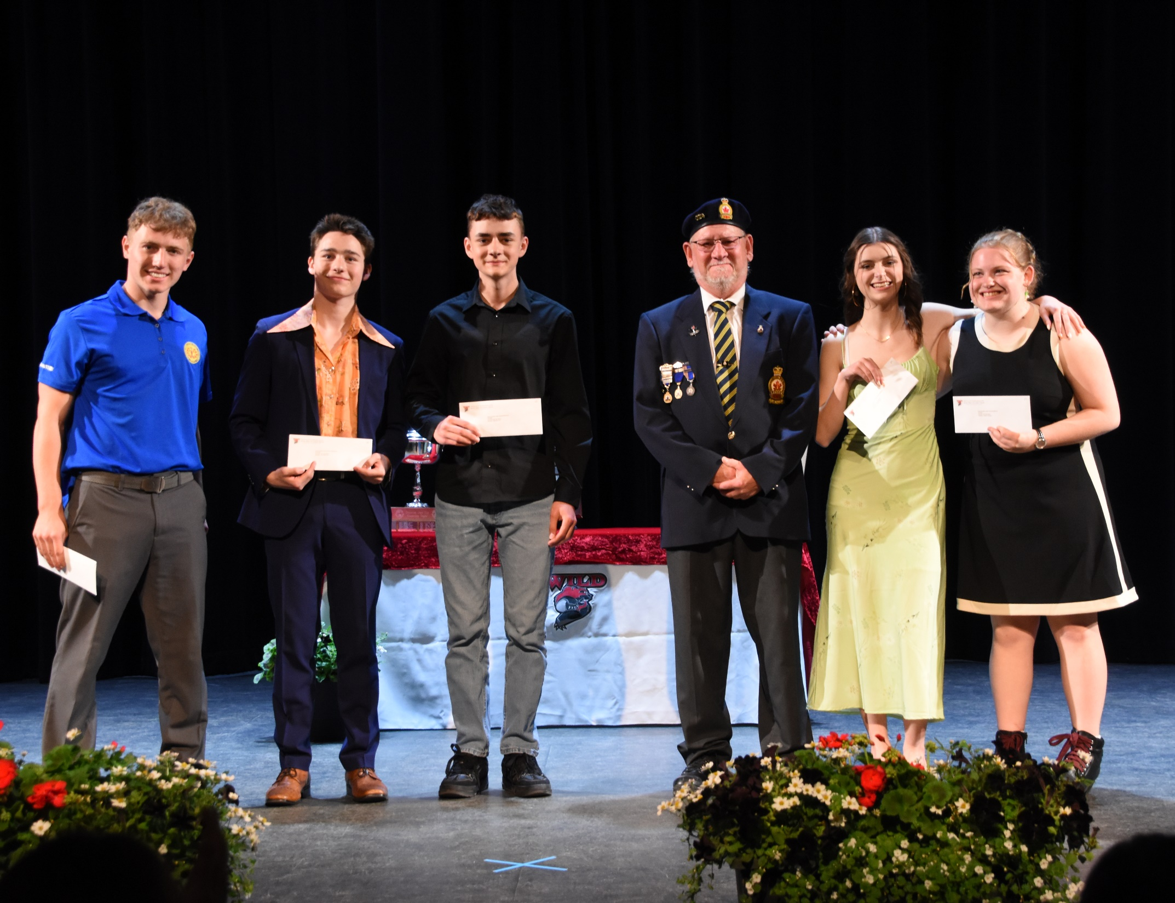
THe Royal Canadian legion scholarships, branch 24

Slide 15
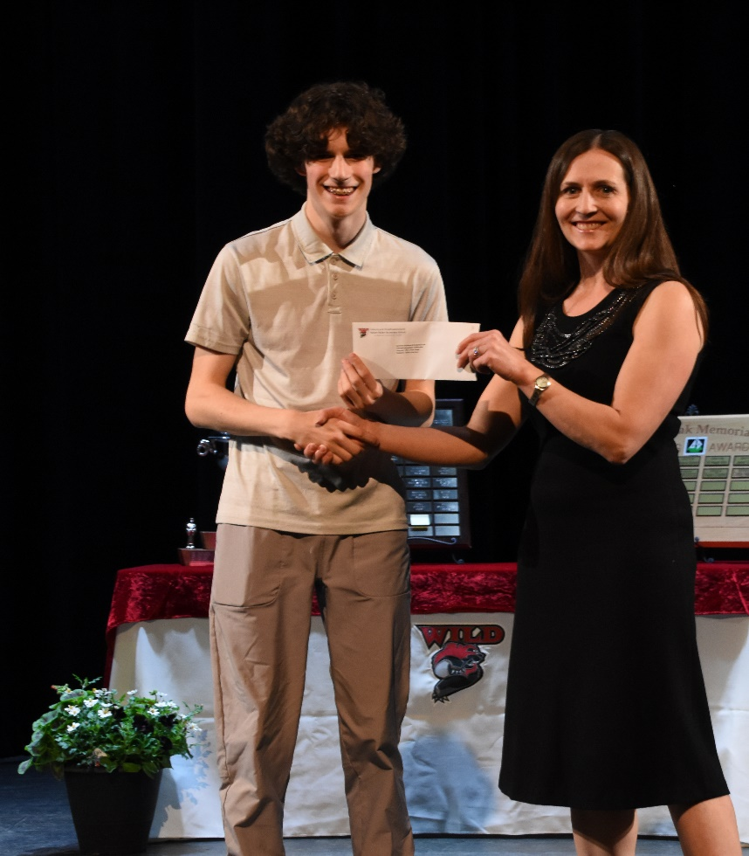
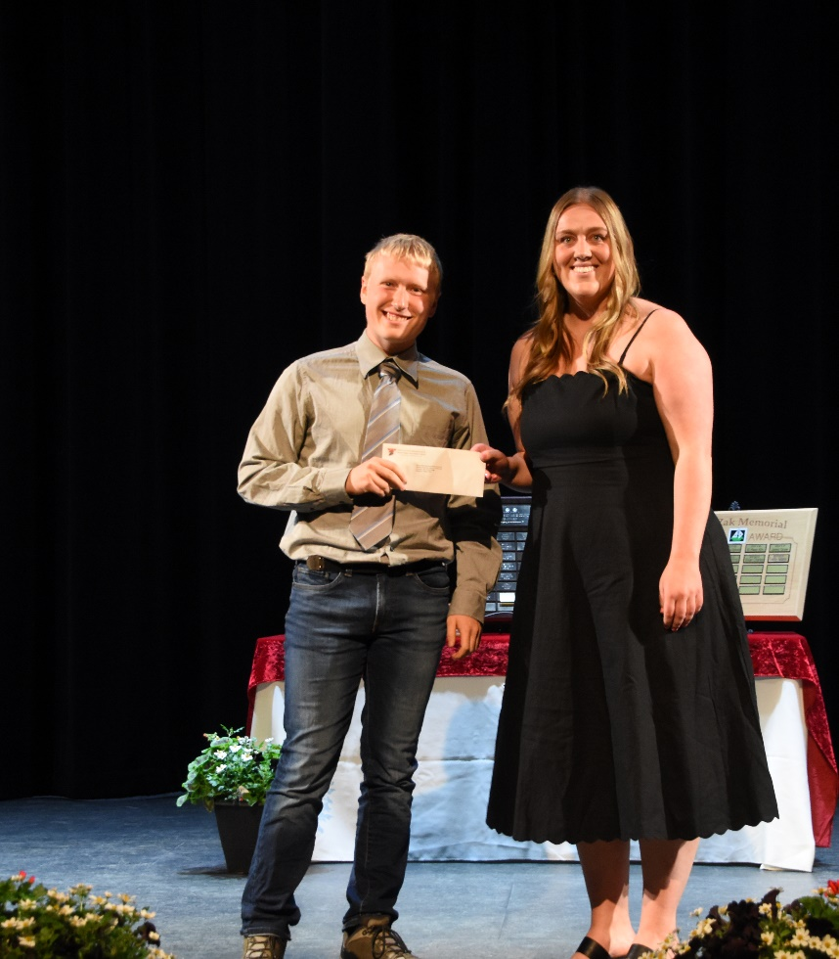
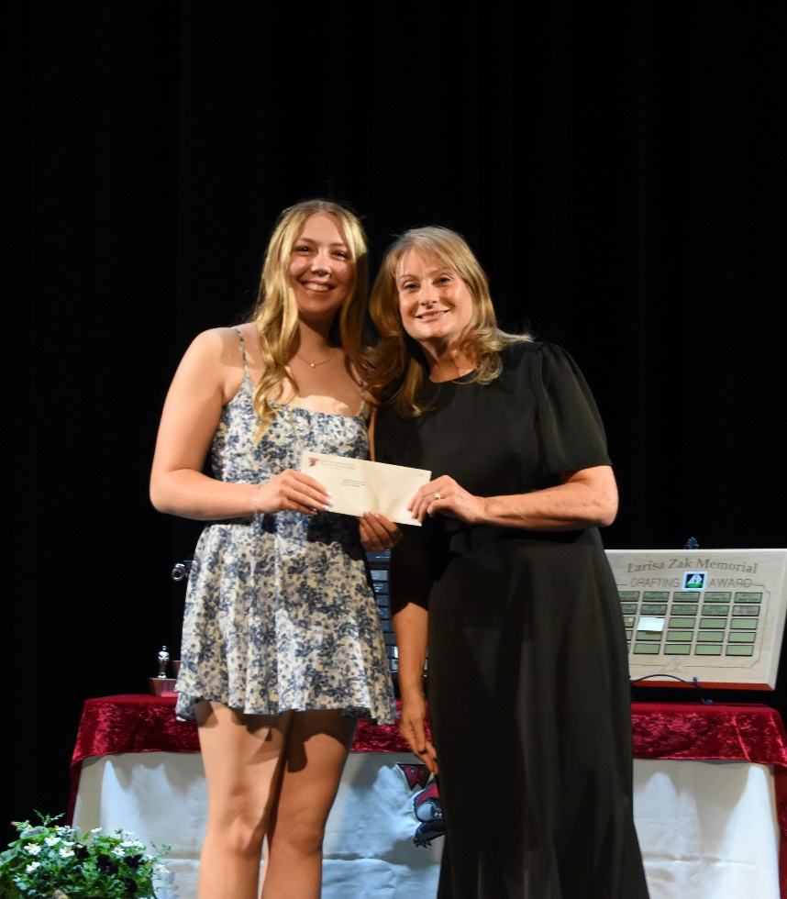
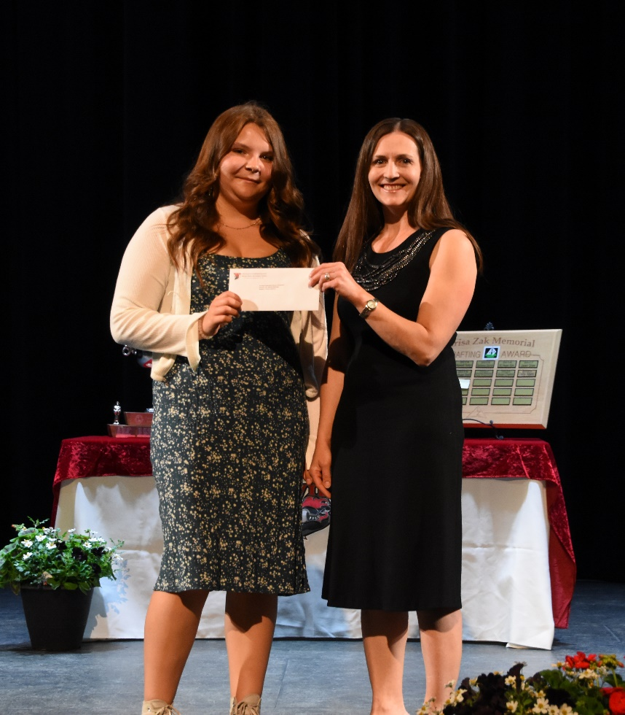
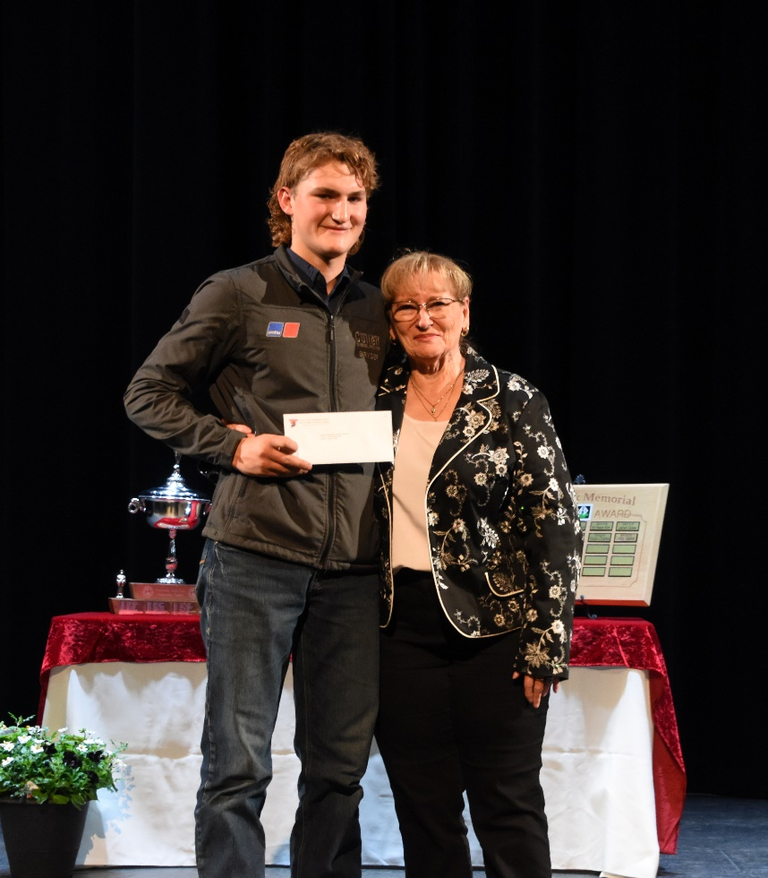



Sevilla Clark Memorial Bursary- Abby Ackison
Terralogic Exploration-Discovery Scholarship- Treasure Salomons
Southeast Kootenay Principals and Vice Princpals’ Award- Talon Ackerman
Steve Corbett Memorial Public & Private- Trapper Pillet
William Henderson Scholarship- Erica Godsave
Abreast in the Rockies Scholarship- Jillian Perry
Waldo Stockbreeders Livestock Scholarship- Bryder Quaife
Yoo Deserve this Scholarship of International Heritage- Ame Pieterse

Slide 16



Bob Necombe Memorial Scholarship- Nicholas Jensen
Larissa Zak Memorial Drafting Award- Kennedy Emsland

Slide 17




Slide 3 title
Western Inspirational Award
Dion Georgopolous

Slide 18

The Award goes to:
Seeley Willems
Apex Accounting Scholarship

Slide 19





CANFOR SCHOLARSHIPS
Nicholas Jensen
Seeley Willems
Calissa Haine
Natalie Bradshaw

Slide 20






Awards & Scholarships
Cranbrook & District Ambulance Association Award
Fatima Patterson
Cranbrook & District Arts Council Fine Arts Award
Tesa Reutgen
Cranbrook Ministerial Scholarships
Autumn Ewaskow Shemi Ajayi

Slide 21




THIS AWARD GOES TO Clockwise:
Garrett Bevilacqua Olly Williams
Finn McBurney
Heinrich Brink
Cranbrook Sunrise Rotary Covational Bursary
Erin Beaulac Memorial Bursary
Ermin Alexander Award
F.W. Green Clinic Scholarship

Slide 22

The Award goes to:
Rachel McDonaugh
Frank & Teresa Torozzo Memorial Award

Slide 23




The Gyro Open Scholarships go to: Ashley and Sara Williams
Seeley Willems
Apex Accounting Scholarship

Slide 24






More awards
Mark Mahovlic Memorial Scholarship
Aydan Rohbock
Signal Collision Cranbrook Award
Bryder Quaife
Terus Contruction Award
Donnovin Fiorentino
Walker Willis Memorial Award on behalf of Jubilee Chapter 64 Order of the Eastern Star
Alex Graff
Westlund Industries Trades Pathway Scholarship
Prince Dube
Yoo Deserve This Bursary of Technology
Aydan Rohbock

Slide 25






Great Smiles!
Yoo Deserve This Scholarship of Technology
Mathew Berg
KeyCity Oldtimers Hockey League Scholarship
Lu Hadford
Key City Oldtimers Hockey League Trade Scholarship
Aiden Morrison
Cranbrook Teachers Association
Jake Wishart
Cranbrook Teachers Association
Jorja Wills

Slide 26



CUPE BURSARY LOCAL 2090 CITY OF CRANBROOK EMPLOYEES
Tesa Reutgen
Hadley Rasmussen

Slide 27




Friends of the Library Award
Evelyn Lonergan
Kin Club of Cranbrook Bursary
Maria Pequero
Kin Club of Cranbrook Scholarship
Ella Kneblewski
Pidoca Construction Group Memorial Scholarship
Imman Vito

Slide 28




Skookumchuck Pulp Incorporated
Charlee Organ
Yoo Deserve This Scholarship Of Excellence
Lara Van Wyk
Cranbrook Rotary Club Local Bursaries
Roisin Britner & Kaitlyn Gauthier- not pictured
Cranbrook Lions Lloyd Wilson Memorial Bursary
Kurt Lalach

Slide 29




Columbia Basin Trust Youth Community Service Awards
Sophia Claude
Fatima Patterson
Lara Van Wyk

Slide 30


Fraternal Order of Eagles (Terry Warden Memorial) Award
Sawyer Scott

Slide 31



Rick and Marg Jensen Family Award
Janessa Caron
Zoe Veg

Slide 32


Cranbrook Health Care Auxiliary Scholarship
Abbie Pasowisty (Bursary- Fin Le not pictured)
Cranbrook Lions Club Scholarship
Ty Lehmann

Slide 33


Floyd and Mary Hall Memorial Bursary and Scholarship
Adele Stahl
Natalia Deutsch

Slide 34

The Award goes to
Chenia Weng
Cranbrook Rotary Club Scholarship

Slide 35

The Bursary Goes to
Evelyn Lonergan
Stanley and Gracie McNeil Student Aid Memorial Bursary

Slide 36

The Scholarship Goes to
Ava Zantiotis
City of Cranbrook Memorial Scholarship

