Slide 1
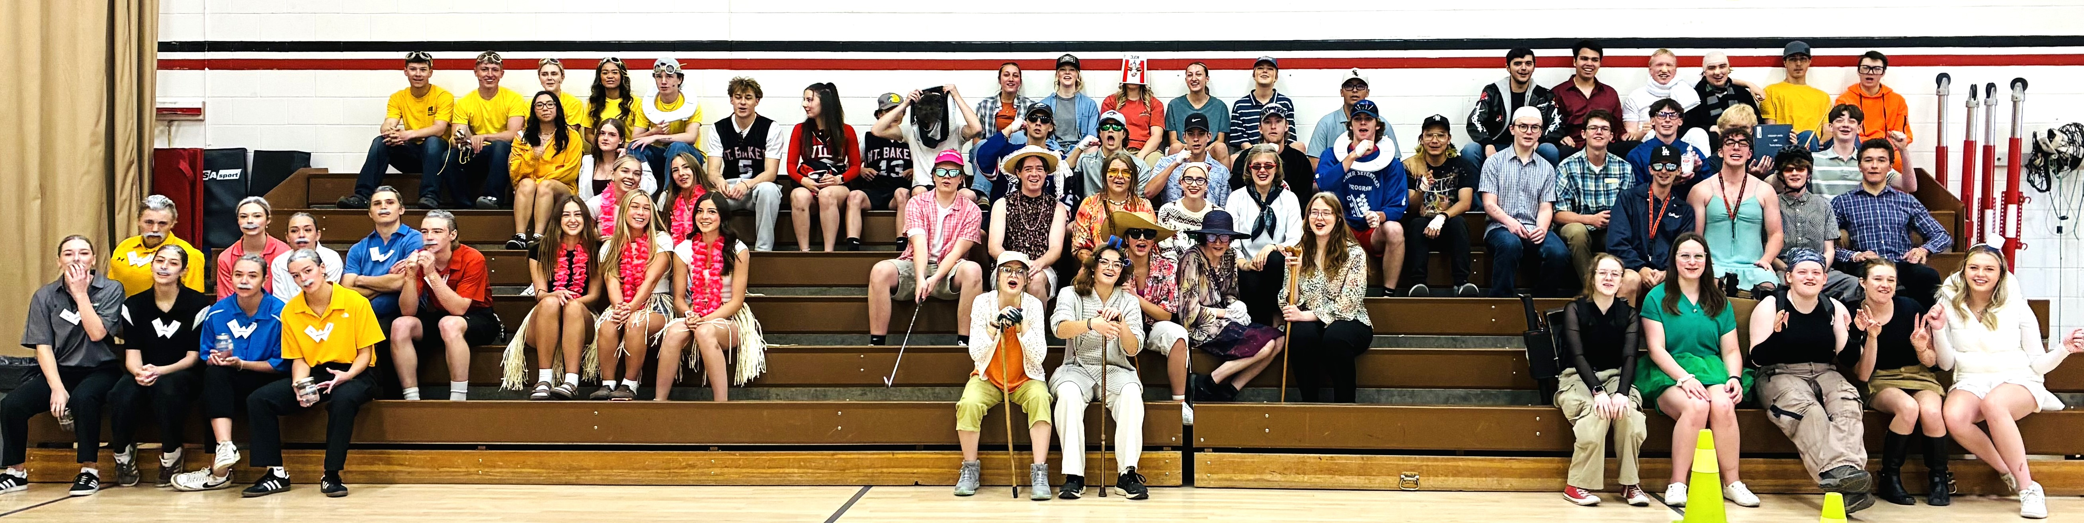
Slide 3
Grad Amazing Race Teams!

Slide 2
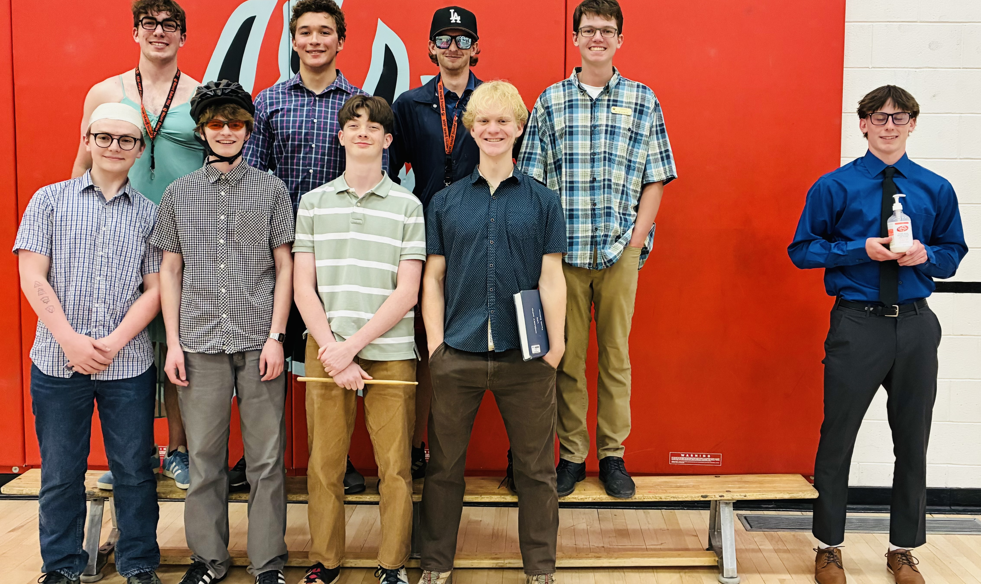
Slide 1
All Stars with Mr. Hogg

Slide 3
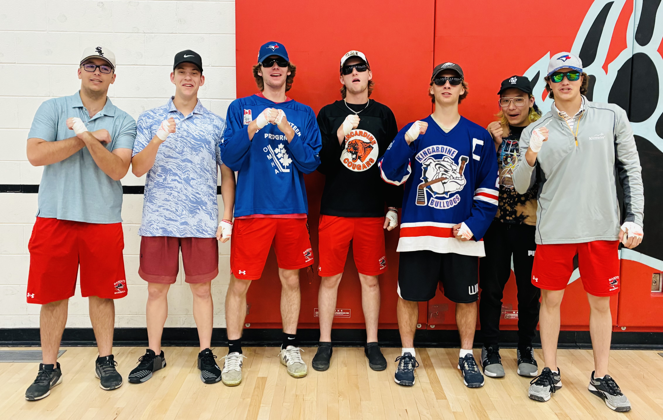
EADIE GROUP

Slide 4
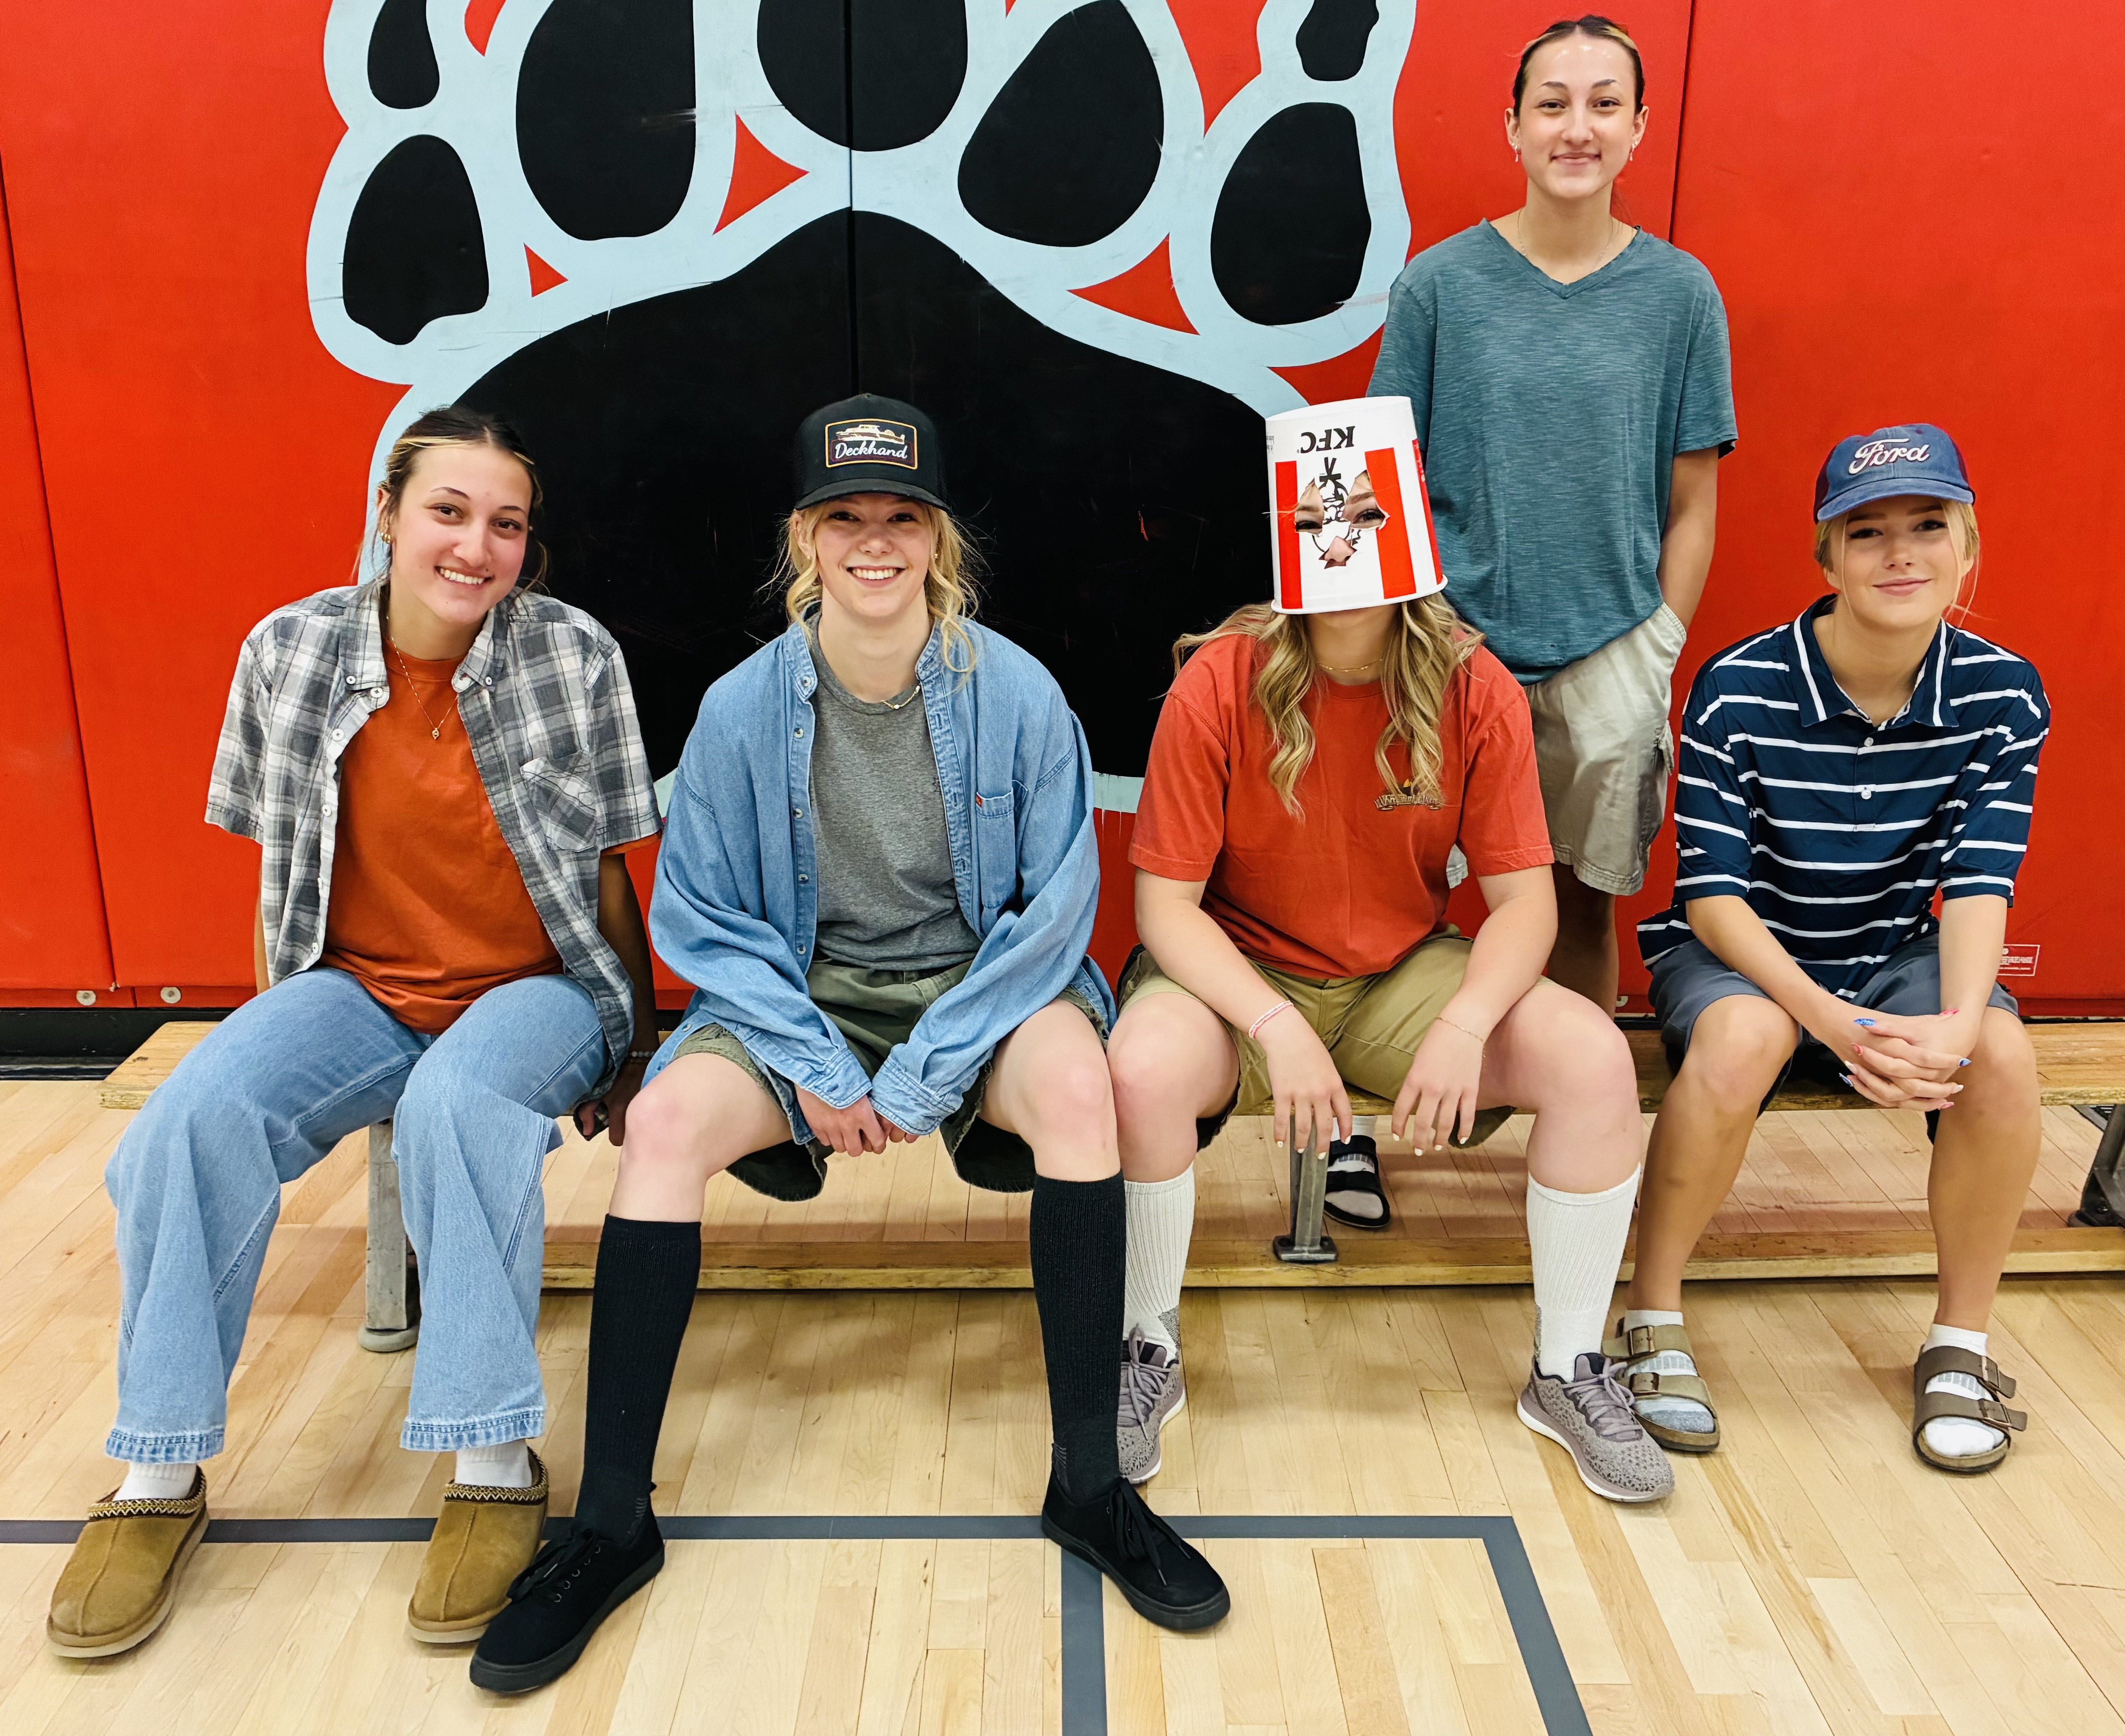
Slide 2
BIG GIRLS

Slide 5
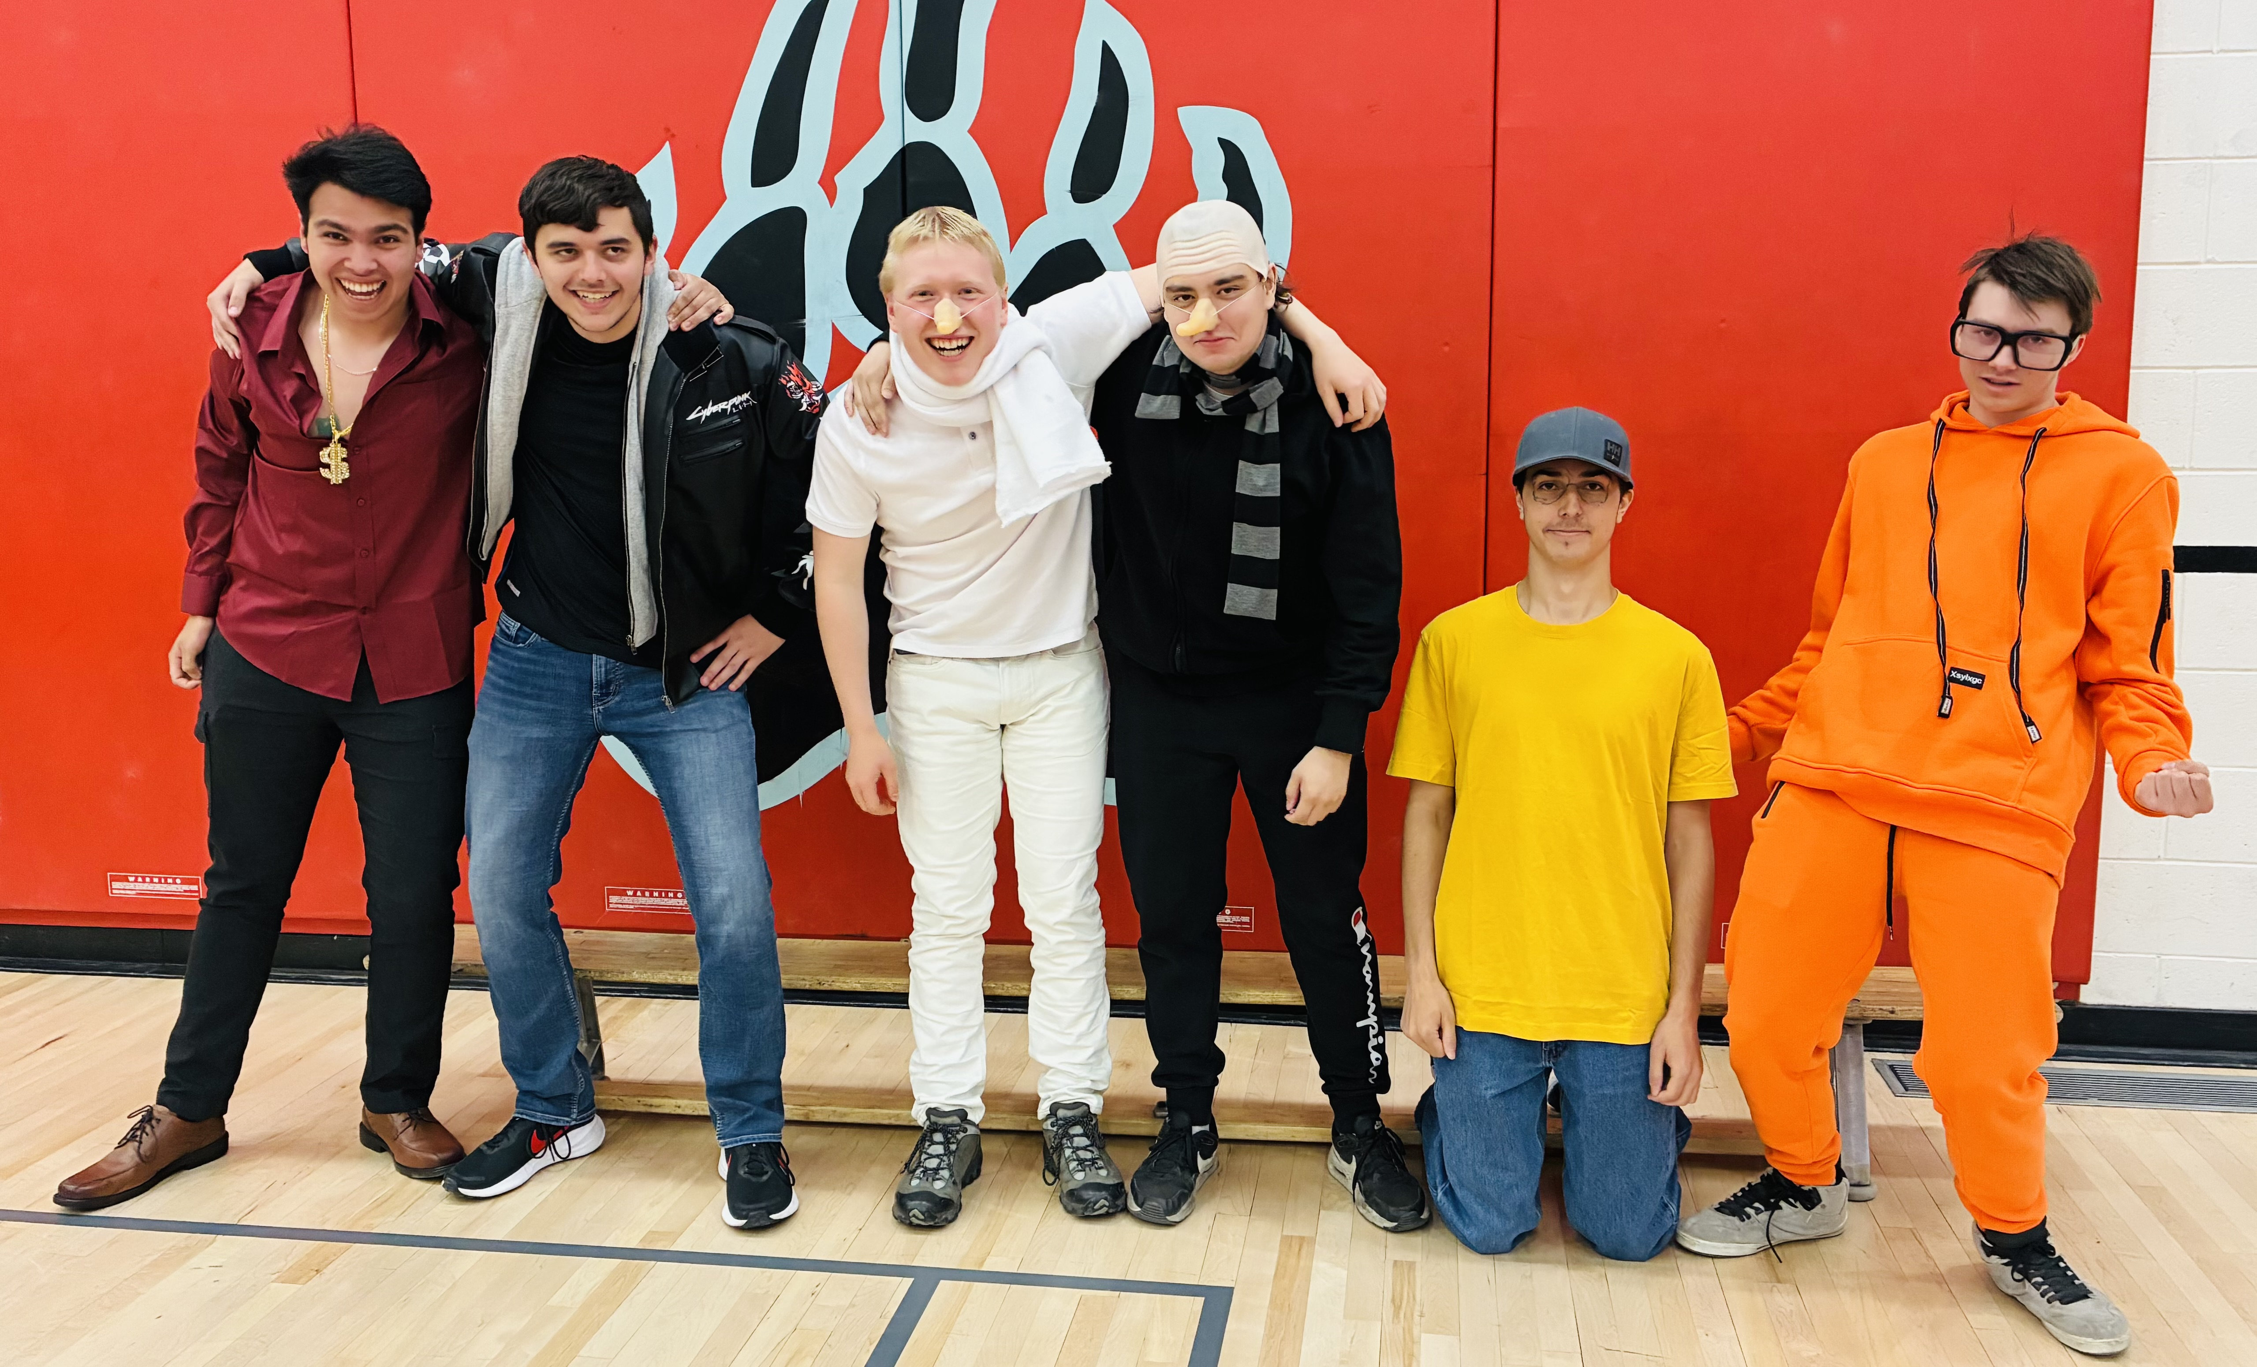
Slide 5
DESPICABLES

Slide 6
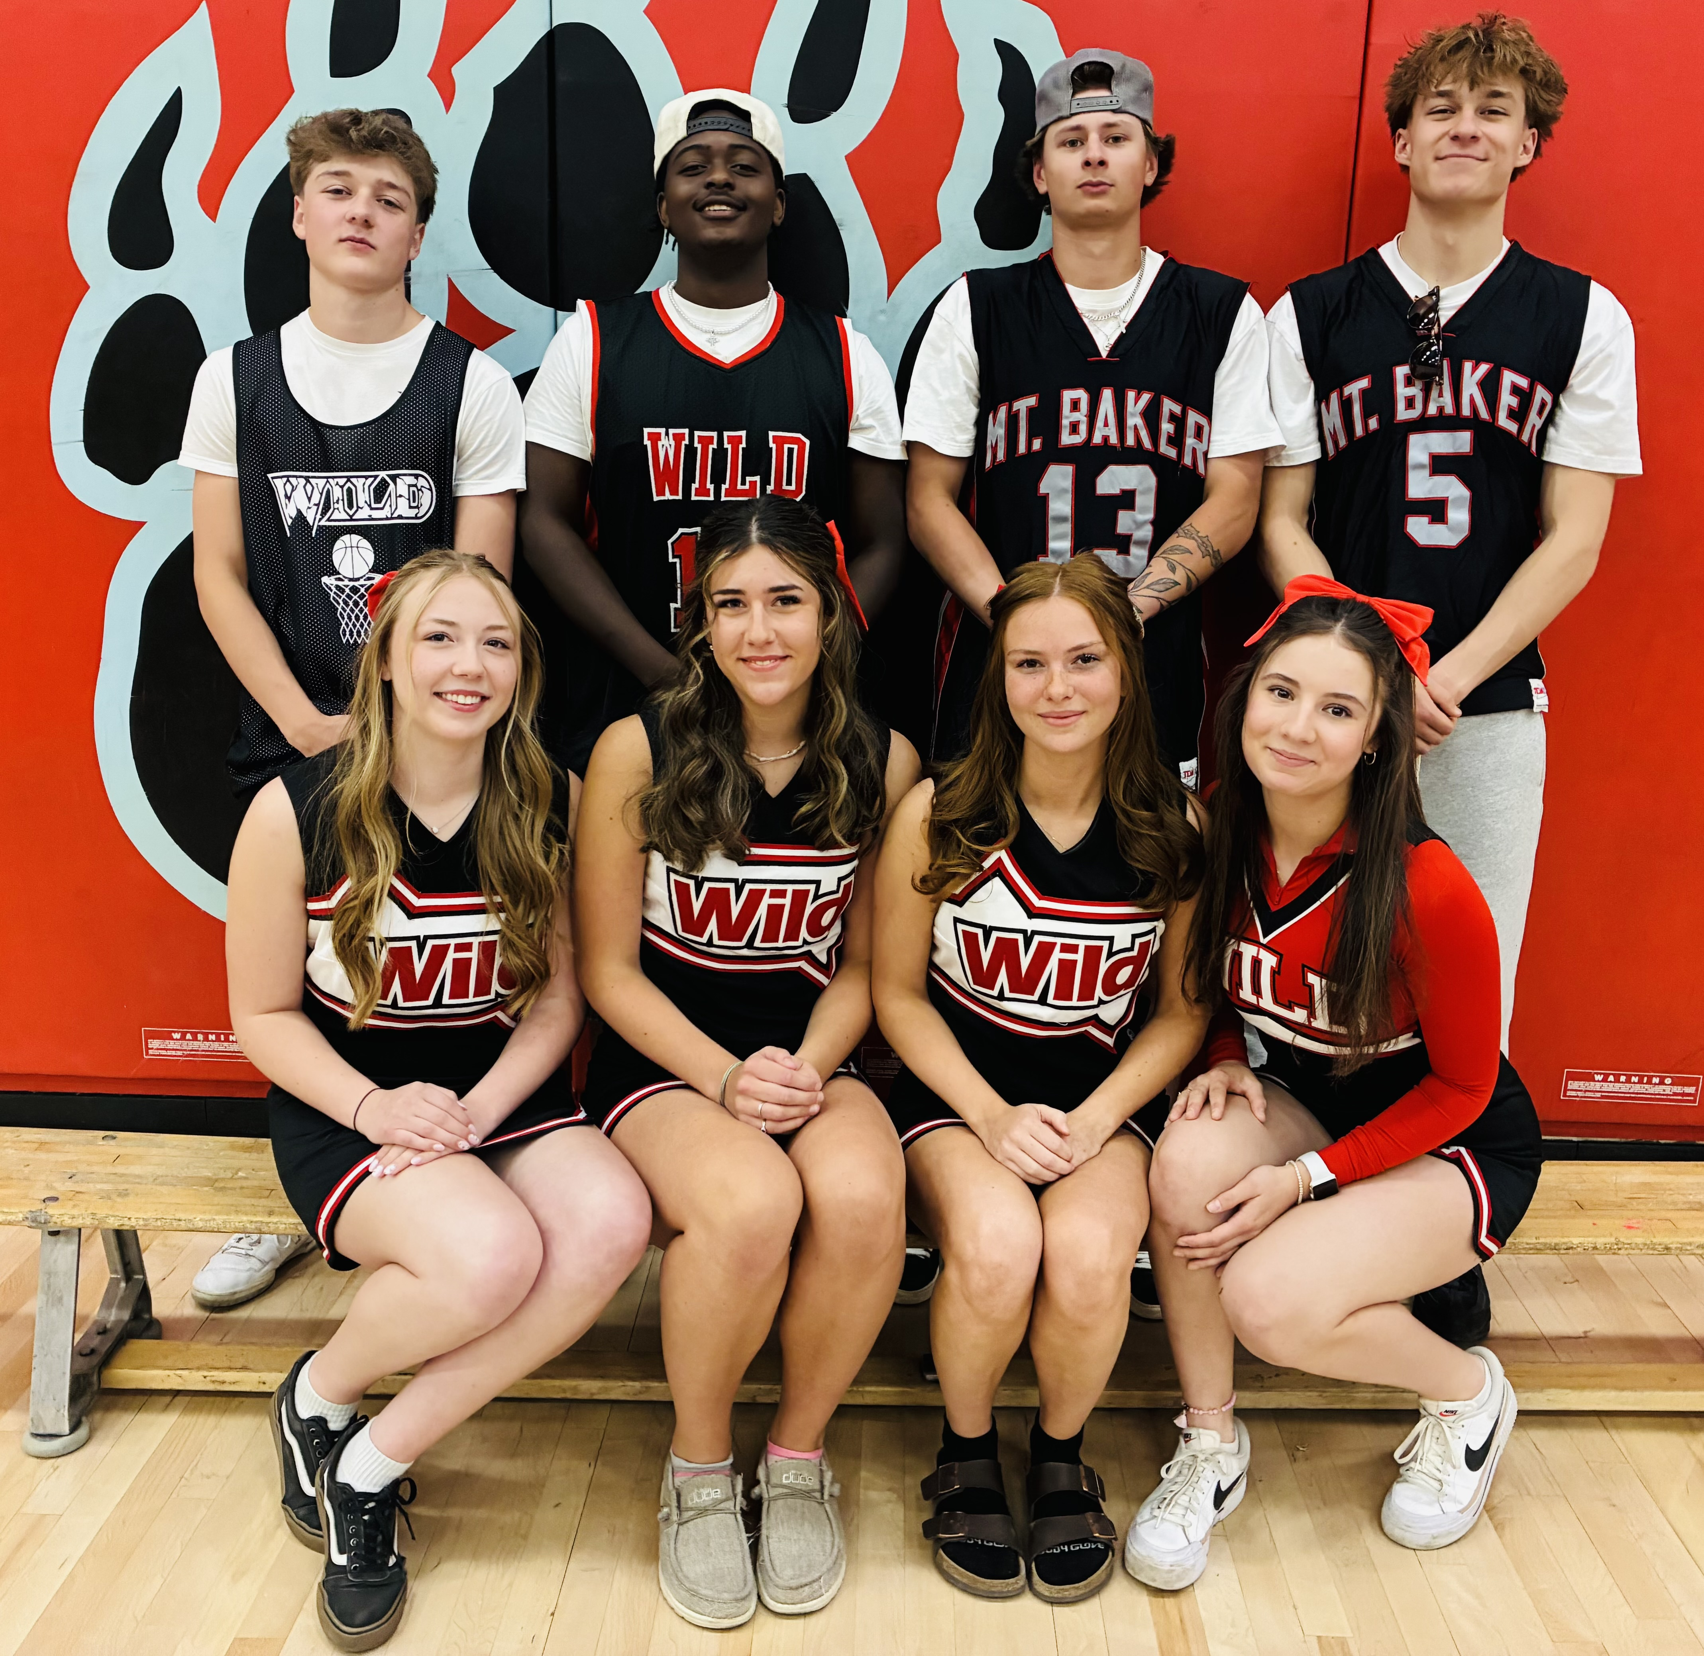
Slide 6
DTB or Whatever!

Slide 7
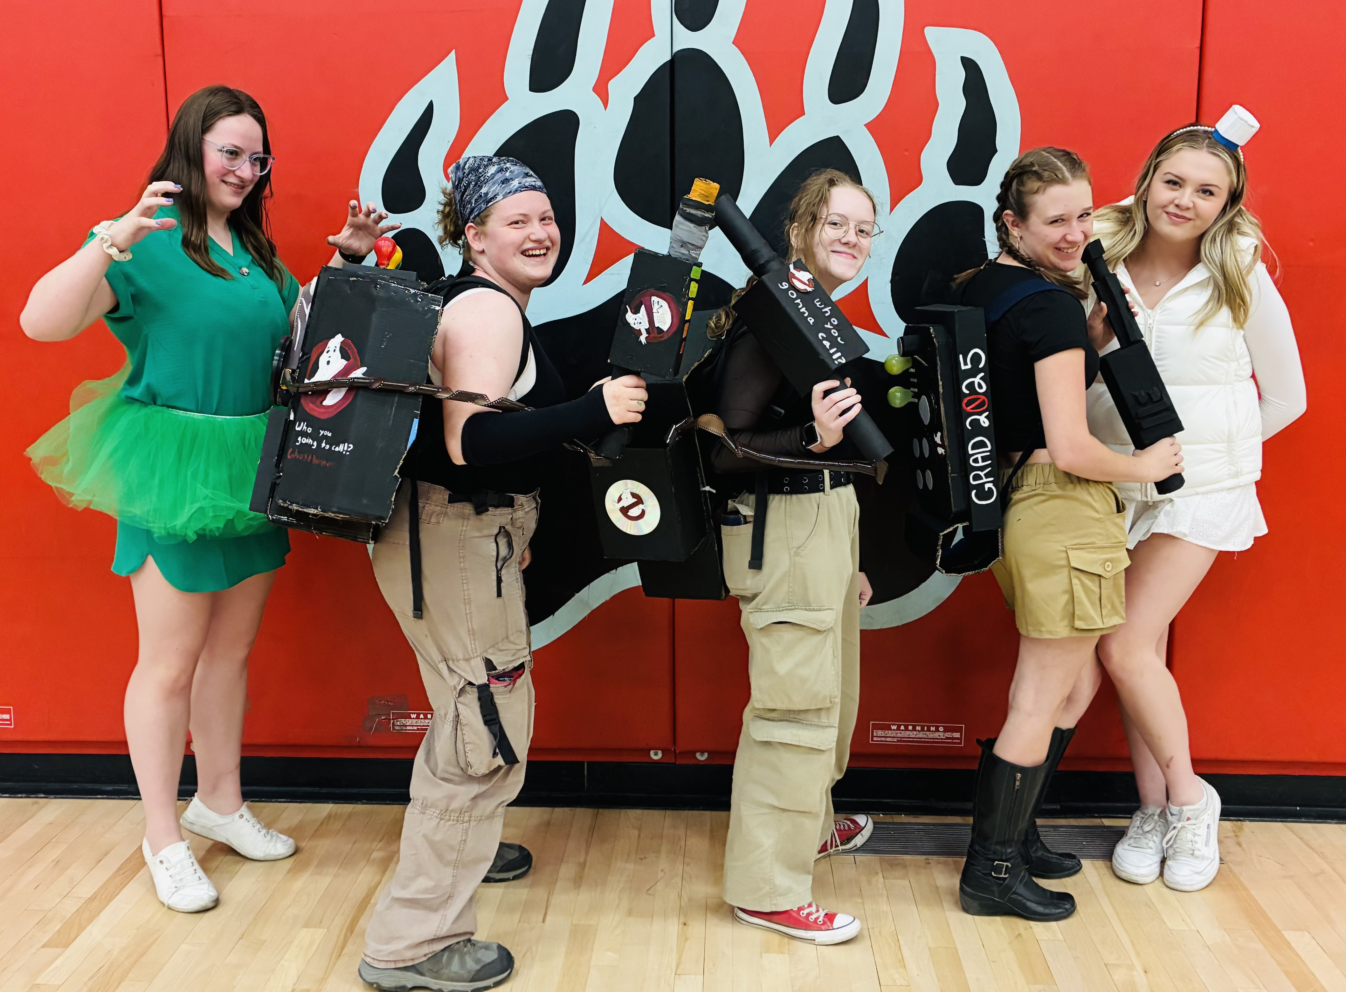
Ghost Busters!

Slide 8
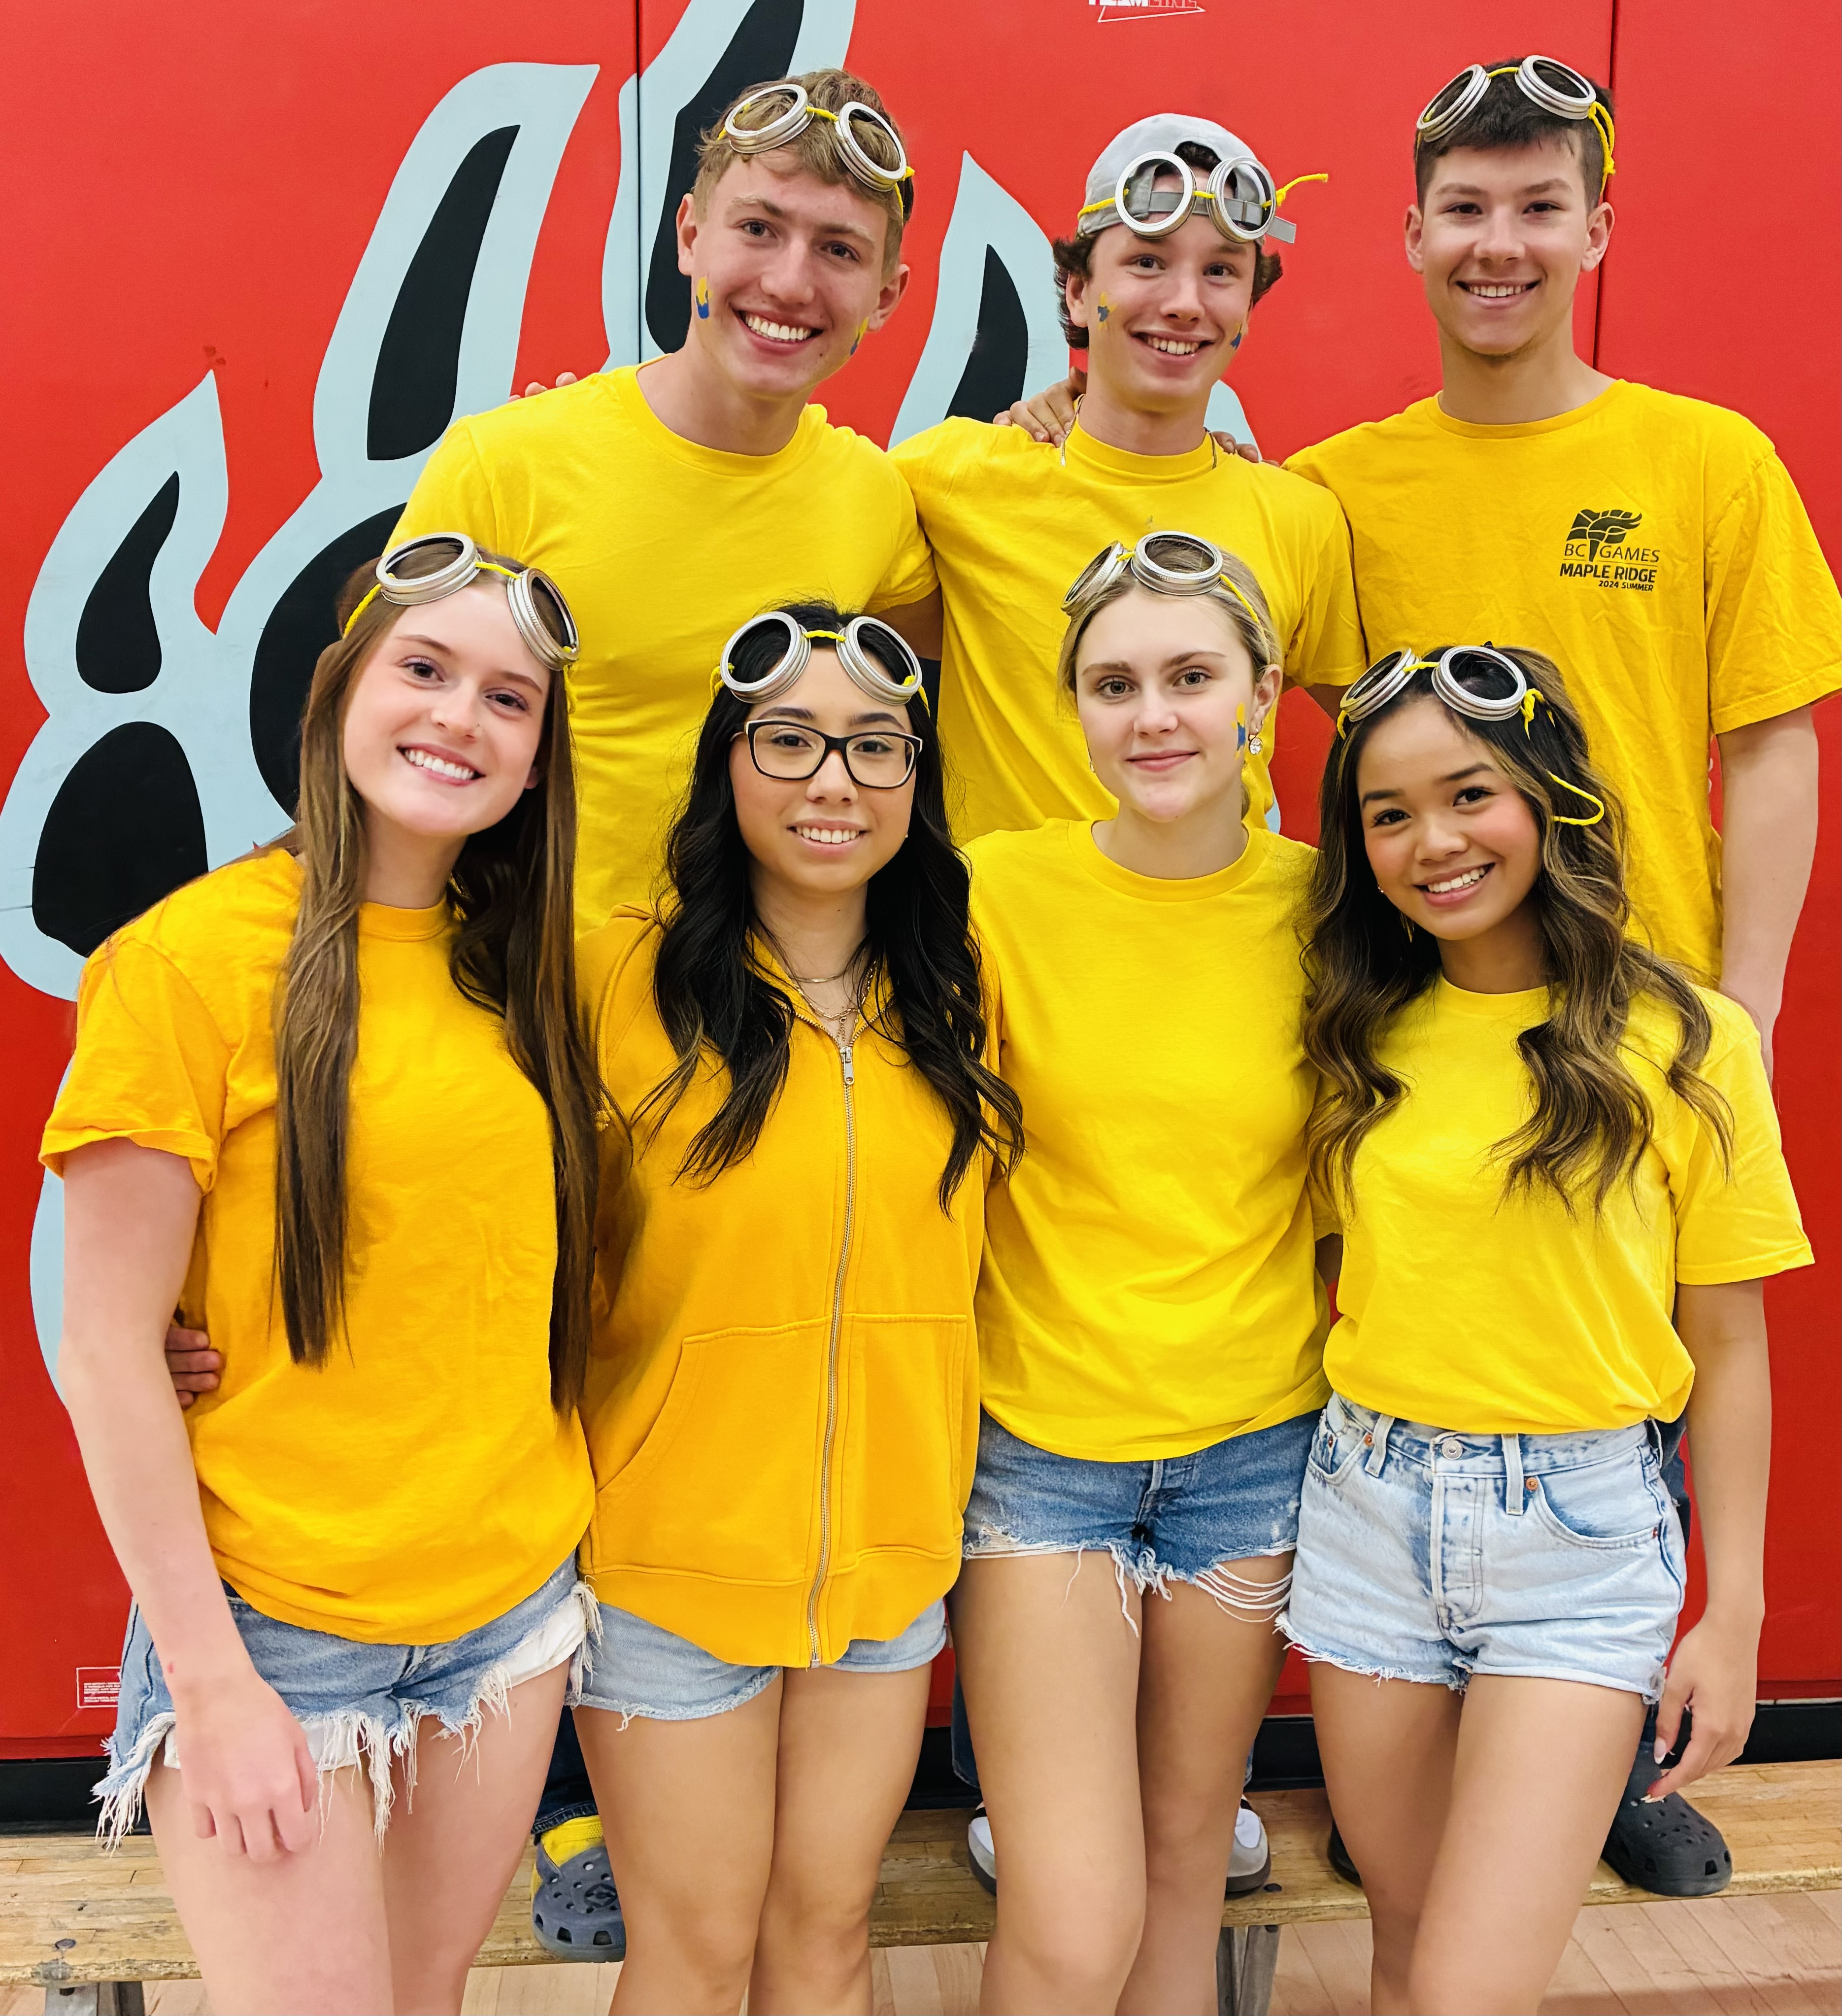
Minions

Slide 9
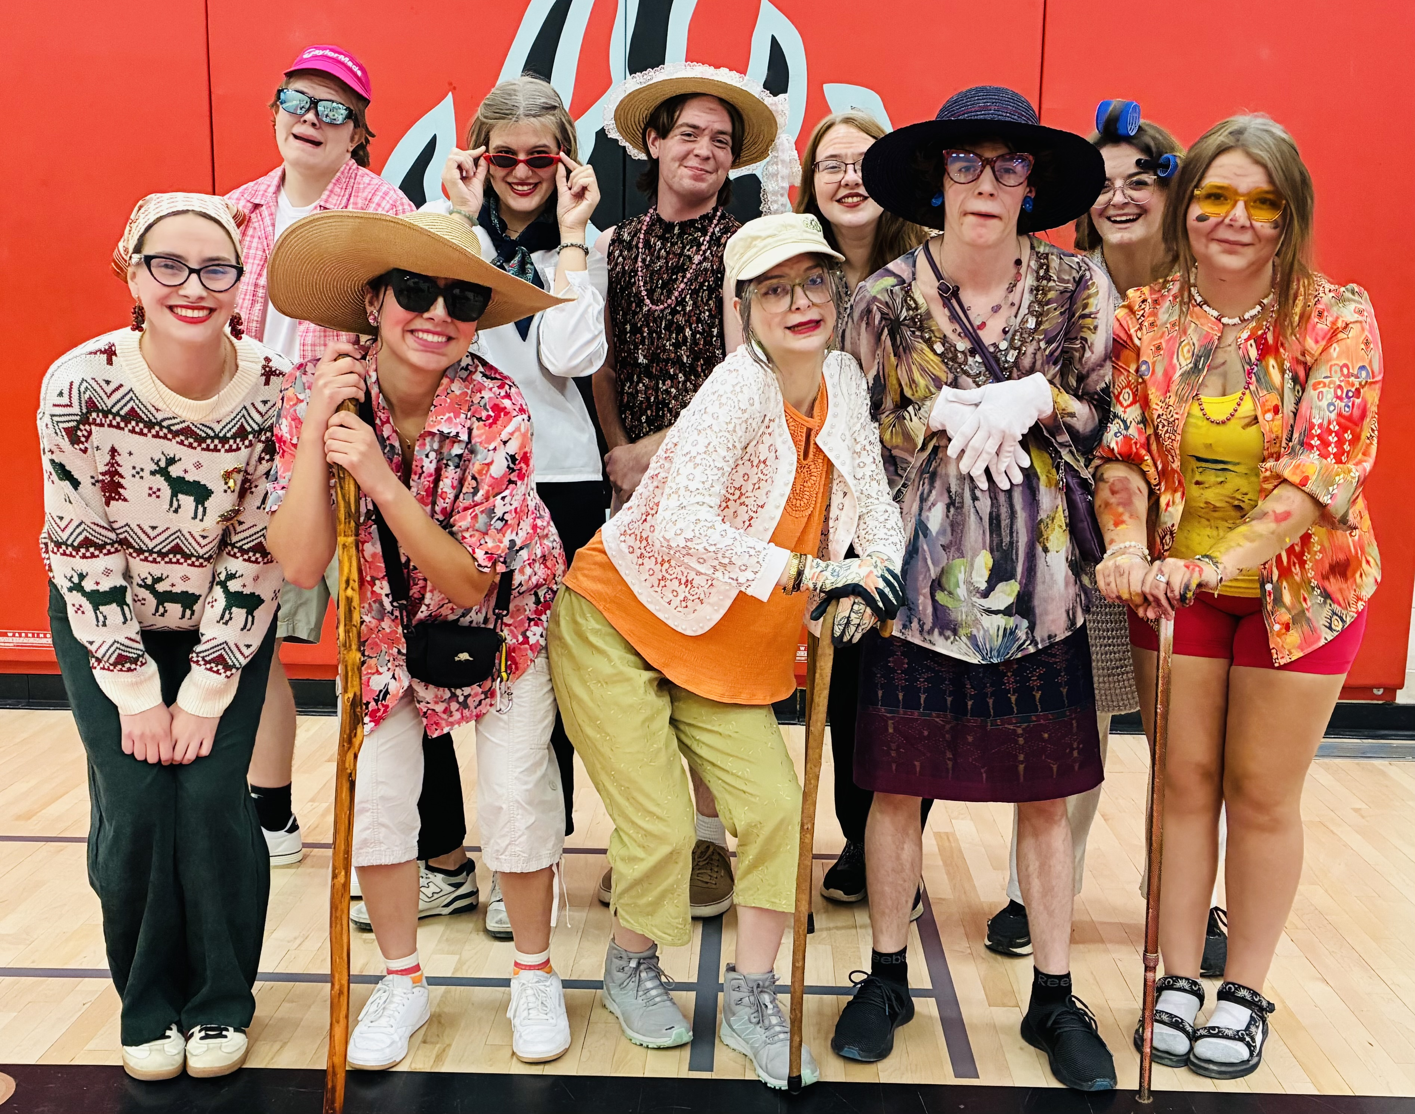
SUPER SENIORS

Slide 10
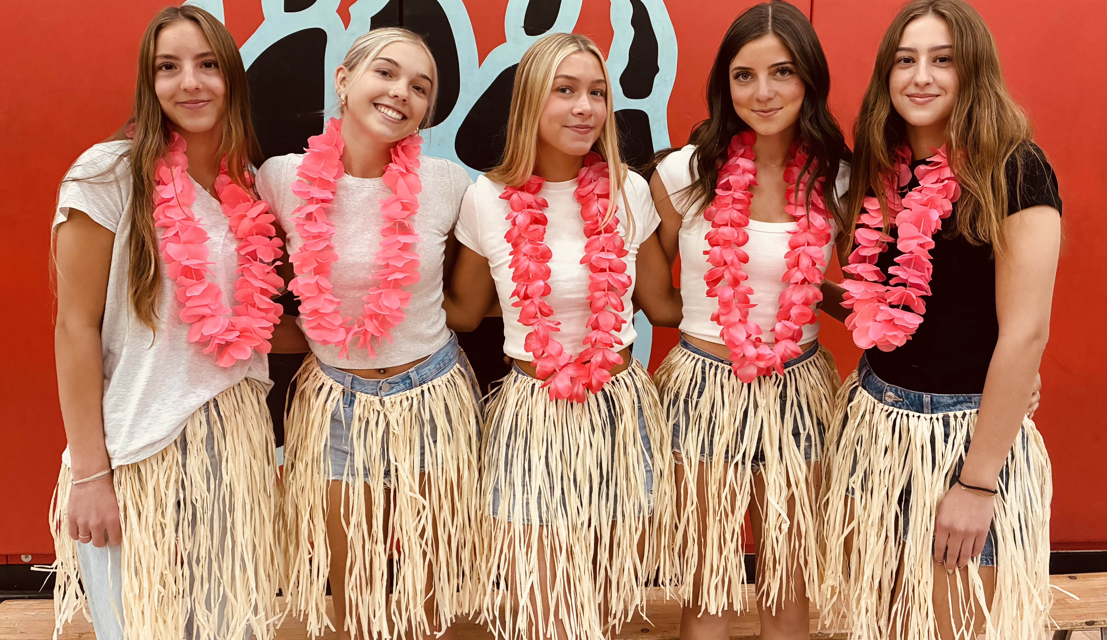
Tropical Ladies

Slide 11
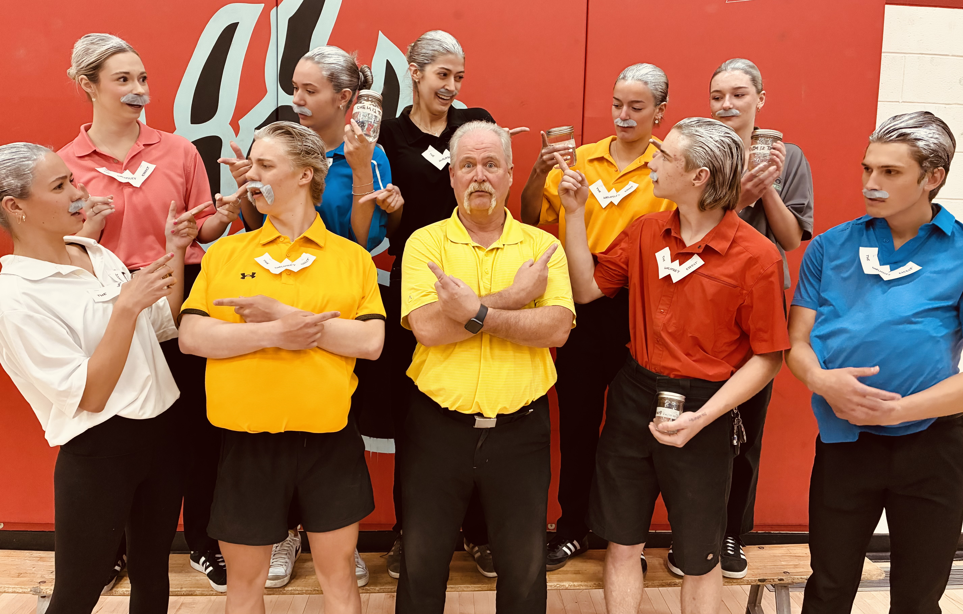
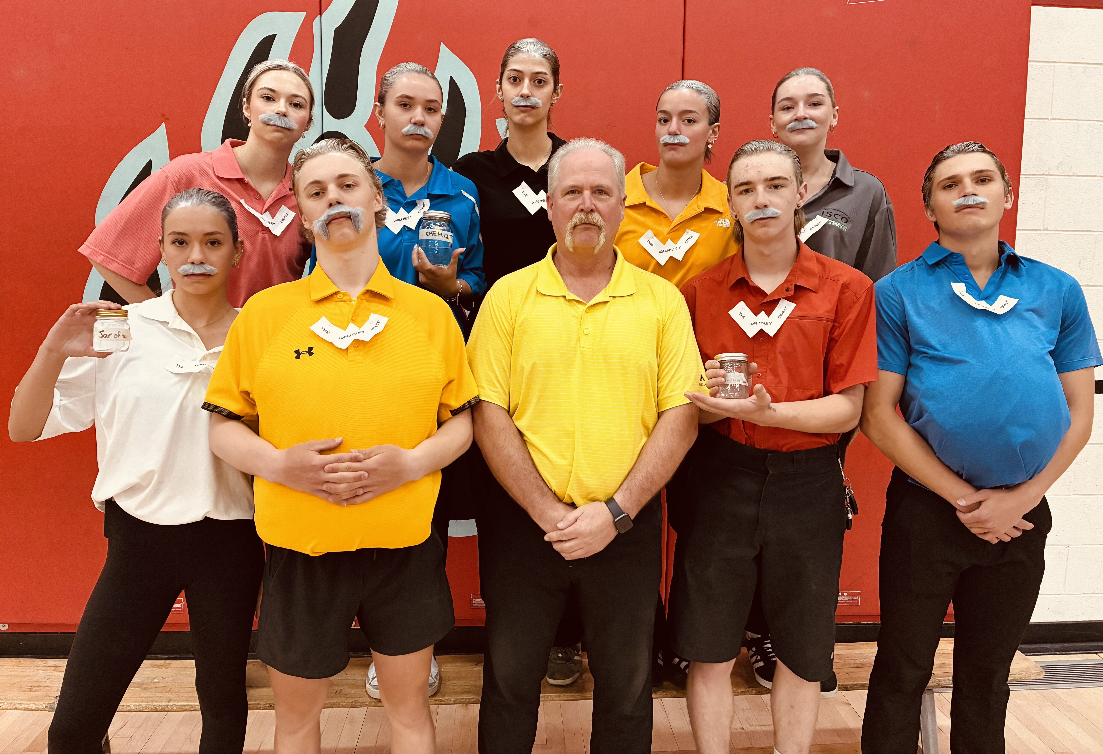
The Walmsleys

