Slide 1
Amy Woodland Catchment Boundary Revisions November 28, 2024
School District No. 5
(Southeast Kootenay)

Slide 2
Agenda
Housekeeping from February 2024
Background Information
Purpose
Goals
Internal Process for Amending Catchment Boundary Areas
Proposed Timeline
School Utilizations
Proposed Short-Term Revisions
Questions and Answers

Slide 3
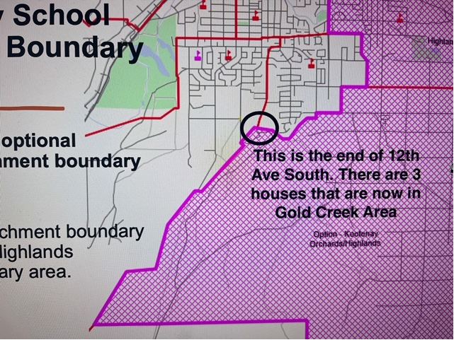
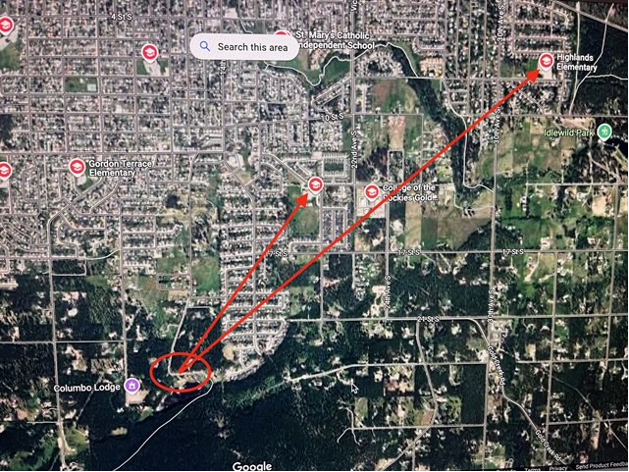
Housekeeping from February 2024
A small pocket was overlooked with the boundary changes in February 2024.
The address is 2404-12 Avenue South which is a dead-end road.
The catchment change only affects the last 3 houses on this road.
The District has reviewed this change and has realized it was an oversight.

Slide 4
Background
On June 30, 2024, Amy Woodland Elementary experienced a fire that resulted in significant damage to the building and, as a result, will not be available for K-12 operations for the foreseeable future.
The District anticipates this problem will persist for at least the next three to five years which creates the immediate need to revise the Amy Woodland catchment boundary to best support the displaced students with the goal of providing stability for their elementary tenure.

Slide 5
Purpose
The District was approved by the School Protection Program (SPP) to engage a consultant for the catchment boundary review process, funded through insurance.
The goal is to find immediate short-term solutions to ensure displaced students have consistency over the next three to five years while advocating for a replacement school.

Slide 6
Goals
A proposed revision will consider the following key criteria:
Current students allowed to stay at their current school (e.g. Grade 1 will stay in Highlands for Grade 2)
Walkability
No crossing railroads
Consideration for main roads
Consideration for natural obstructions (e.g. rivers)
No changes to Middle School catchment areas
Providing transportation where criteria cannot be met

Slide 7
Internal Process for Decision Making
Legislation – School Act
Excerpt 75.1
A board must establish for each school in its school district, except for a Provincial resource program, a catchment area consisting of a geographical area around the school that includes all or part of the school district.
A board may amend the catchment area established for a school under subsection (1).

Slide 8
Internal Process for Decision Making
Board Policy 2 - Role of the Board
AP 305 – School Catchment Areas
“Students who are resident within the District are generally expected to attend their neighbourhood school according to catchment areas defined by the Board.”
“Space permitting, students may attend a school outside their catchment area.”
Long Range Facility Plan
Used in conjunction with Baragar software for updated school capacity analysis and long-term school enrolment projections.
The Board can “approve changes to catchment areas for schools and District programs.”

Slide 9
Proposed Timeline
September 2024
Internal discussions
October 2024
November 2024
Host public information meeting
Discussion with Baragar
December 2024
Report back from public information nights to the Board of Education for additional discussion
January 2025
Additional public consultation, if necessary
Early 2025 Regular Board Meeting
Regular Board Meeting for final approval and adoption of new boundary catchment areas
Board of Education initial approval of draft plan for amended catchment

Slide 10
School Utilizations (2024/2025)
School | Official Capacity | Functional Capacity (Occupied by K-12 Students) | 2024/25 Enrolment | % of Official Capacity
Amy Woodland | 295 | 273 | - | 0.00%
Gordon Terrace | 265 | 247 | 287.000 | 108.30%
Highlands | 265 | 247 | 255.000 | 96.23%
Kootenay Orchards | 240 | 224 | 240.000 | 100.00%
Pinewood | 145 | 135 | 147.000 | 101.38%
Steeples | 240 | 224 | 220.000 | 91.67%
TM Roberts | 385 | 359 | 349.000 | 90.65%
Parkland Middle | 600 | 600 | 442.000 | 73.67%
Laurie Middle | 500 | 500 | 412.000 (42 G6) | 82.40%
Mount Baker | 850 | 850 | 889.338 | 104.63%
Information Source: School District No. 5 (Southeast Kootenay) Internal Data

Slide 11
Proposed Short-Term Revisions for New Kindergarten Students

Slide 12
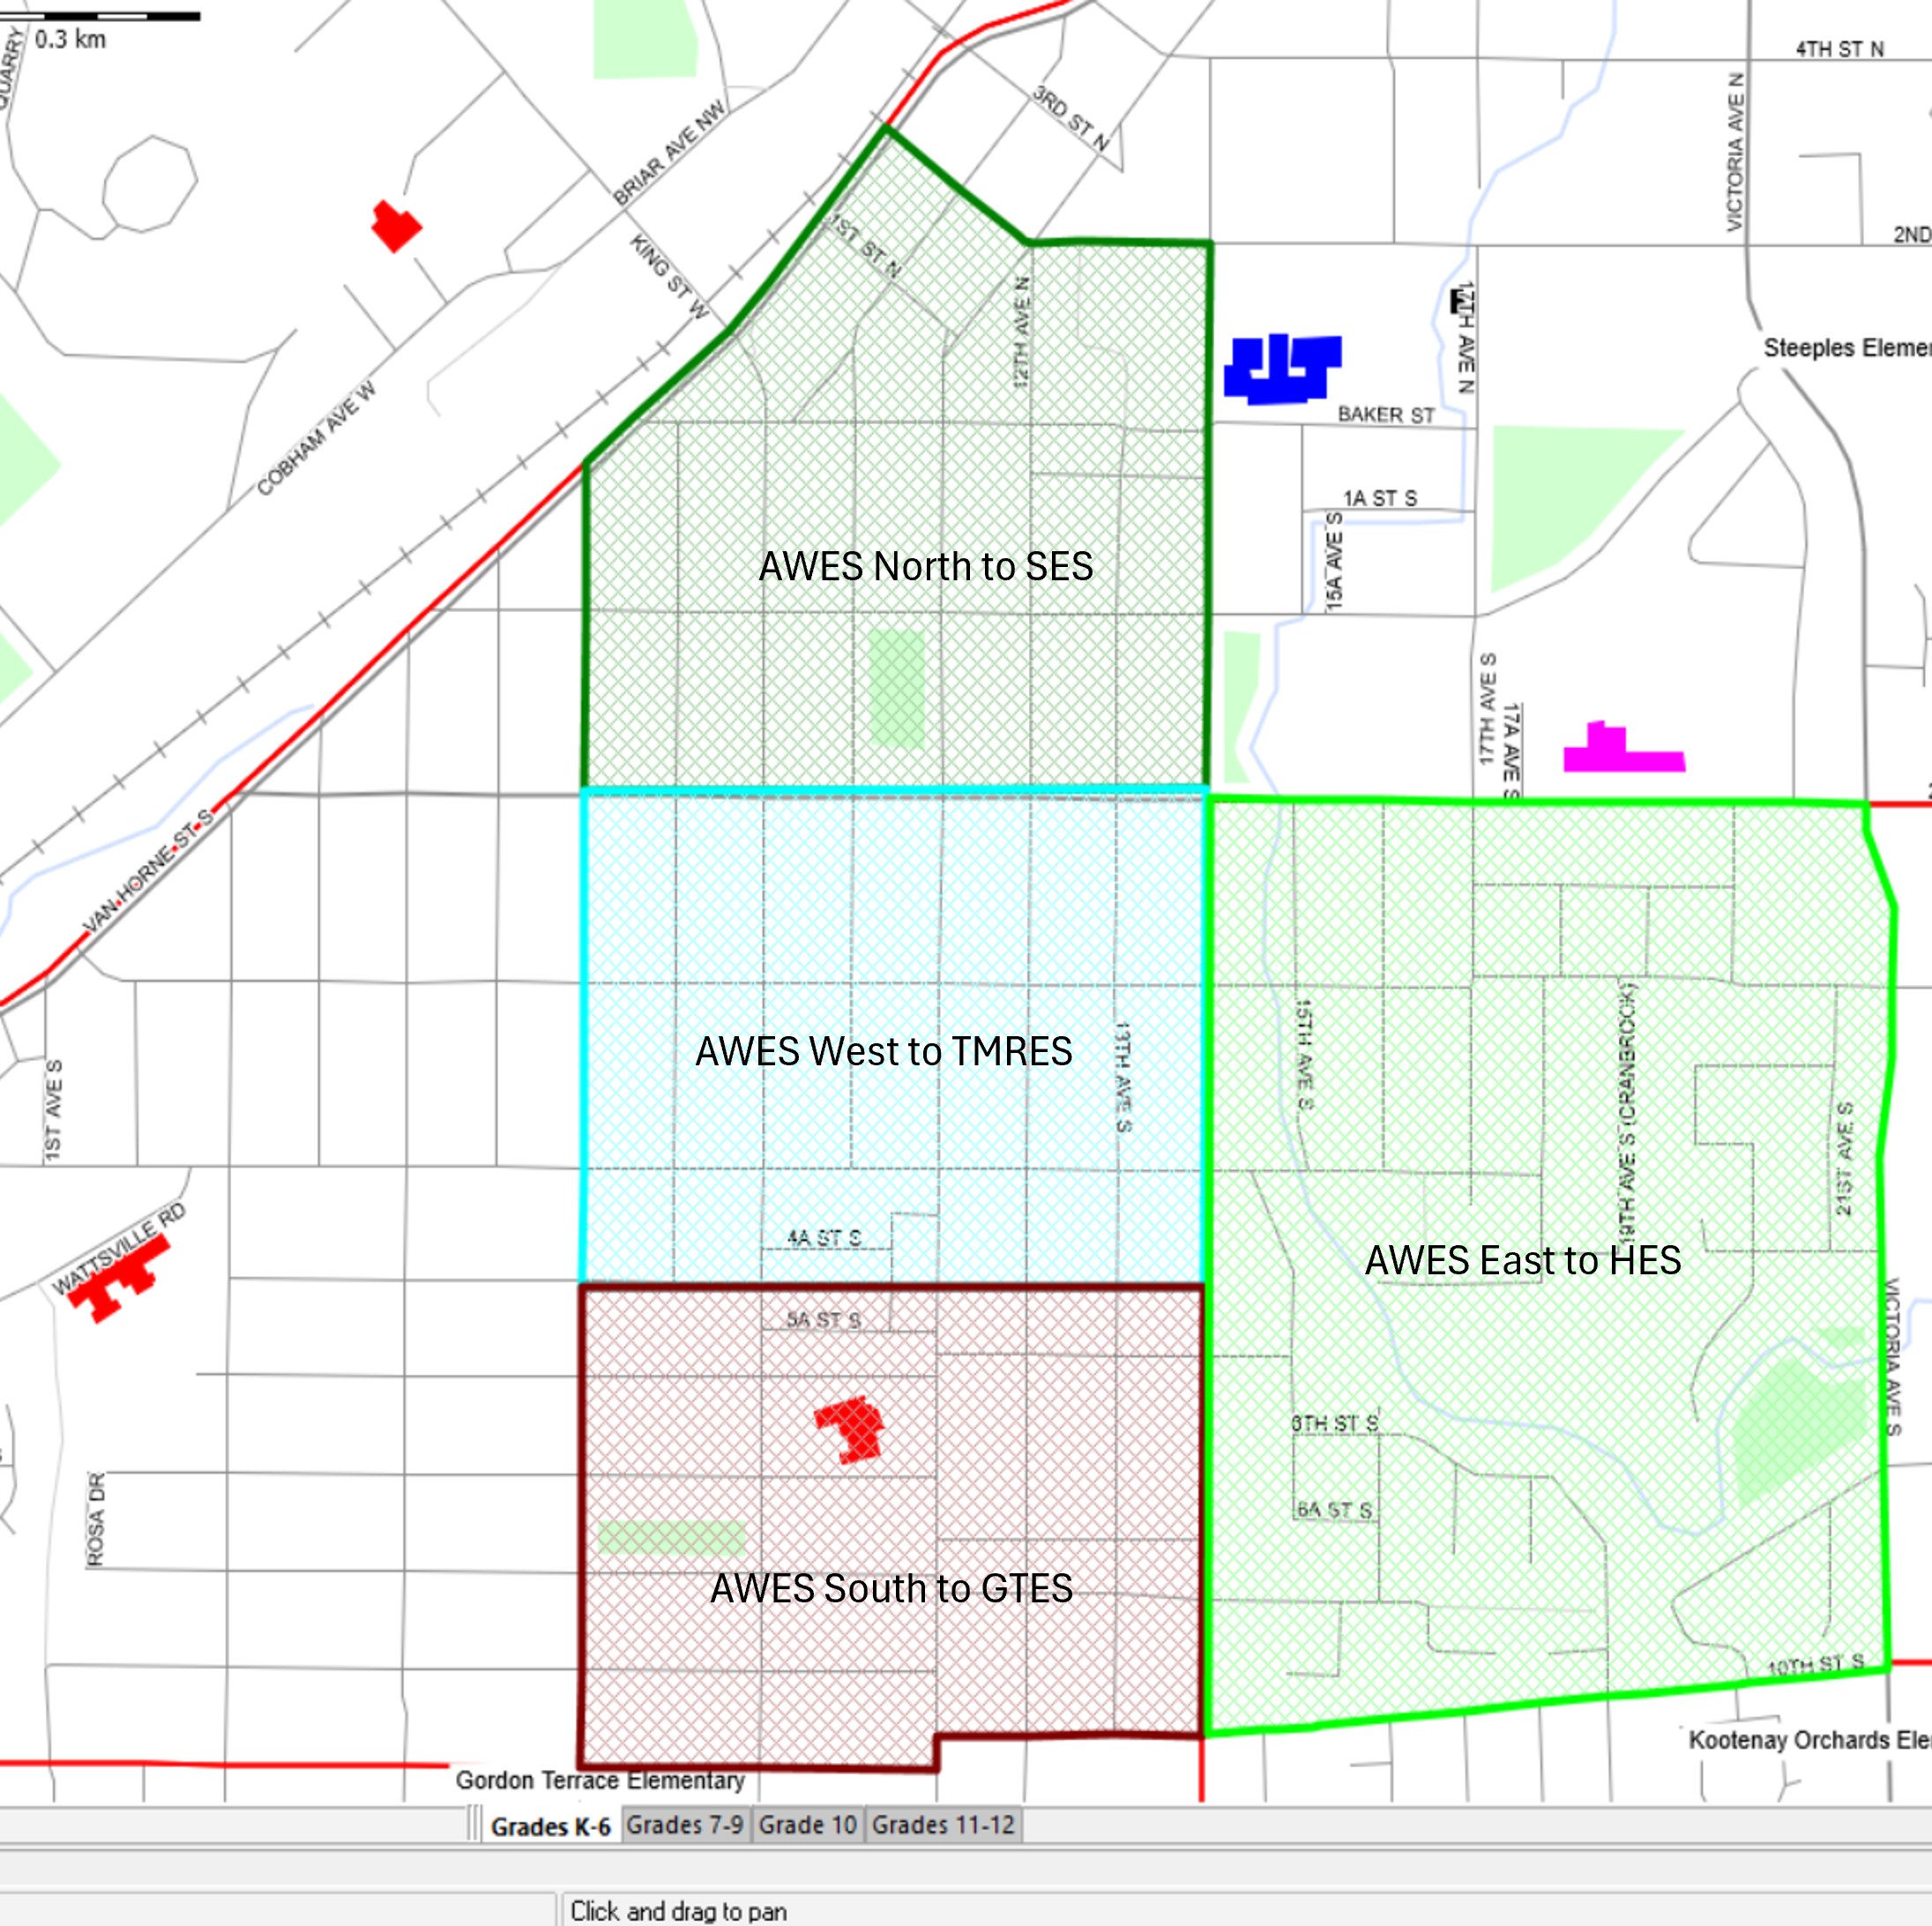
Amend Existing Amy Woodland Catchment Down 14 Avenue South
Proposed option for catchment boundary amendment would see the original Amy Woodland boundary amended to include 5 zones:
AWES Rural to PES
AWES East to HES
AWES South to GTES
AWES West to TMRES
AWES North to SES with the East Zone divided along 14 Avenue S.

Slide 14
Summary of Proposed Catchment Revision Divided Along 14 Avenue S
School | New Catchment Zone | 5-year Enrolment Increase from Boundary Change | Total Expected Enrolment | Functional Capacity | Official Capacity | Comments
Pinewood | AWES Rural to PES | 10 | 133 | 135 | 145 | 2 students per grade
Highlands | AWES East to HES | 40 | 257 | 247 | 265 | 8 students per grade
Steeples | AWES North to SES | 5 | 245 | 274 | 290 | <1 student per grade Childcare building complete 09/2025
TM Roberts | AWES West to TMRES | 25 | 367 | 359 | 385 | 5 students per grade
Gordon Terrace | AWES South to GTES | 40 | 300 | 247 | 265 | 8 students per grade
Kootenay Orchards | No change | 0 | 229 | 224 | 240 | No change
Total |  | 120 | 1,531 | 1,486 | 1,590

Slide 16
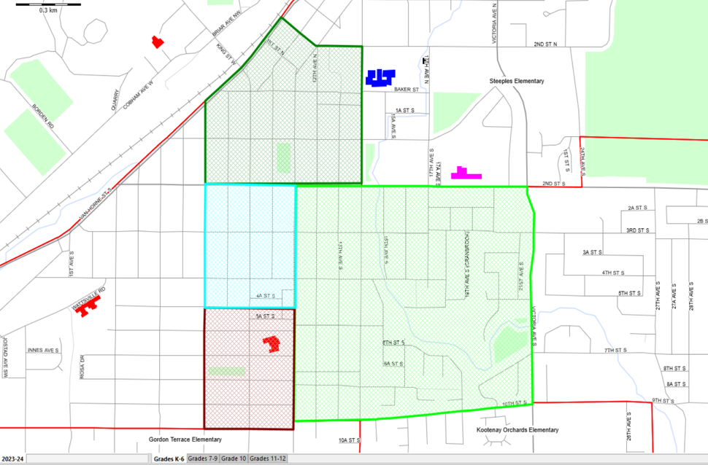
Split Existing Amy Woodland Catchment Down 11 Avenue South
This proposed option for catchment boundary amendment would see the original Amy Woodland boundary amended to include 5 zones:
AWES Rural to PES
AWES East to HES
AWES South to GTES
AWES West to TMRES
AWES North to SES with the East Zone divided along 11 Avenue S.

Slide 18
Summary of Proposed Catchment Revision Divided Along 11 Avenue S
School | New Catchment Zone | 5-Year Enrolment from Boundary Change | Total Expected Enrolment | Functional Capacity | Official Capacity | Comments
Pinewood | AWES Rural to PES | 10 | 135 | 135 | 145 | 2 students per grade
Highlands | AWES East to HES | 70 | 269 | 247 | 265 | 14 students per grade
Steeples | AWES North to SES | 5 | 252 | 274 | 290 | <1 student per grade Childcare building complete 09/2025
TM Roberts | AWES West to TMRES | 15 | 358 | 359 | 385 | 3 students per grade
Gordon Terrace | AWES South to GTES | 20 | 281 | 247 | 265 | 4 students per grade
Kootenay Orchards | No change | 0 | 229 | 224 | 240 | No change
Total |  | 120 | 1,524 | 1,486 | 1,590

Slide 20
Conclusion
Amending the existing Amy Woodland Catchment down 11 Avenue South would meet the school's functional capacities for a short-term solution, creating the least disruption for existing students.
This option is less likely that the District would require portables in the short-term and would create the least amount of disruption for existing students in the fact that we can continue to accommodate the AWES cohorts in their current schools.

Slide 21
Question and Answer Period

Slide 22
School Utilizations (2038/2039) without boundary revisions
School | Official Capacity | Functional Capacity (Occupied by K-12 Students) | 2038/39 Enrolment | % of Functional Capacity
Amy Woodland | 295 | 273 | 211.000 | 77.29%
Gordon Terrace | 265 | 247 | 223.000 | 90.28%
Highlands | 265 | 247 | 146.000 | 59.11%
Kootenay Orchards | 240 | 224 | 215.000 | 95.98%
Pinewood | 145 | 135 | 93.000 | 68.89%
Steeples | 240 | 224 | 241.000 | 107.59%
TM Roberts | 385 | 359 | 349.000 | 97.21%
Parkland Middle | 600 | 600 | 416.000 | 69.33%
Laurie Middle | 500 | 500 | 321.000 | 64.20%
Mount Baker | 850 | 850 | 808.000 | 95.06%
Information Source: Baragar Systems

Slide 23
Revised School Utilizations (2038/2039) with boundary revisions
School | Official Capacity | Functional Capacity (Occupied by K-12 Students) | 2038/39 Enrolment | % of Functional Capacity
Amy Woodland | 295 | 273 | 211 | 77.29%
Gordon Terrace | 265 | 247 | 223 | 90.28%
Highlands | 265 | 247 | 230 | 93.12%
Kootenay Orchards | 240 | 224 | 166 | 74.11%
Pinewood | 145 | 135 | 93 | 68.89%
Steeples | 240 | 224 | 206 | 91.96%
TM Roberts | 385 | 359 | 349 | 97.21%
Parkland Middle | 600 | 600 | 377 | 63.83%
Laurie Middle | 500 | 500 | 360 | 72.00%
Mount Baker | 850 | 850 | 808 | 95.06%
Information Source: Baragar Systems

Slide 24
Summary of Proposed Catchment Revision Divided Along 14 Avenue S
School | New Catchment Zone | Enrolment from Boundary Change | Enrolment from Out of Catchment Transfers | Total | Total Expected Enrolment | Functional Capacity | Comments
Pinewood | AWES Rural to PES | 12 | 11 | 23 | 139 | 160 | 2 students per grade
Highlands | AWES East to HES | 60 | 10 | 70 | 257 | 272 | 8 students per grade
Steeples | AWES North to SES | 6 | 20 | 26 | 255 | 274 | <1 student per grade
TM Roberts | AWES West to TMRES | 35 | 15 | 50 | 377 | 359 | 5 students per grade
Gordon Terrace | AWES South to GTES | 57 | 14 | 71 | 316 | 247 | 8 students per grade
Kootenay Orchards | No change | 0 | 12 | 12 | 229 | 224 | No change
Total |  | 170 | 82 | 252 | 1,573 | 1,536

Slide 25
Summary of Proposed Catchment Revision Divided Along 11 Avenue S
School | New Catchment Zone | Enrolment from Boundary Change | Enrolment from Out of Catchment Transfers | Total | Total Expected Enrolment | Functional Capacity | Comments
Pinewood | AWES Rural to PES | 12 | 11 | 23 | 139 | 160 | 2 students per grade
Highlands | AWES East to HES | 100 | 10 | 110 | 297 | 272 | 8 students per grade
Steeples | AWES North to SES | 6 | 20 | 26 | 255 | 274 | <1 student per grade
TM Roberts | AWES West to TMRES | 22 | 15 | 37 | 364 | 359 | 5 students per grade
Gordon Terrace | AWES South to GTES | 30 | 14 | 44 | 289 | 247 | 8 students per grade
Kootenay Orchards | No change | 0 | 12 | 12 | 229 | 224 | No change
Total |  | 170 | 82 | 252 | 1,573 | 1,536

Slide 26
School Utilizations (2029/2030)
School | Official Capacity | Functional Capacity (Occupied by K-12 Students) | 2030/31 Enrolment | % of Functional Capacity
Amy Woodland | - | - | - | 0.00%
Gordon Terrace | 265 | 247 | 289.000 | 90.28%
Highlands | 265 | 247 | 146.000 | 59.11%
Kootenay Orchards | 240 | 224 | 215.000 | 95.98%
Pinewood | 145 | 135 | 139.000 | 68.89%
Steeples | 240 | 224 | 241.000 | 107.59%
TM Roberts | 385 | 359 | 349.000 | 97.21%
Parkland Middle | 600 | 600 | 416.000 | 69.33%
Laurie Middle | 500 | 500 | 321.000 | 64.20%
Mount Baker | 850 | 850 | 808.000 | 95.06%
Information Source: Baragar Systems

