Slide 1
2026 Awards Night
by MBSS office

Slide 2
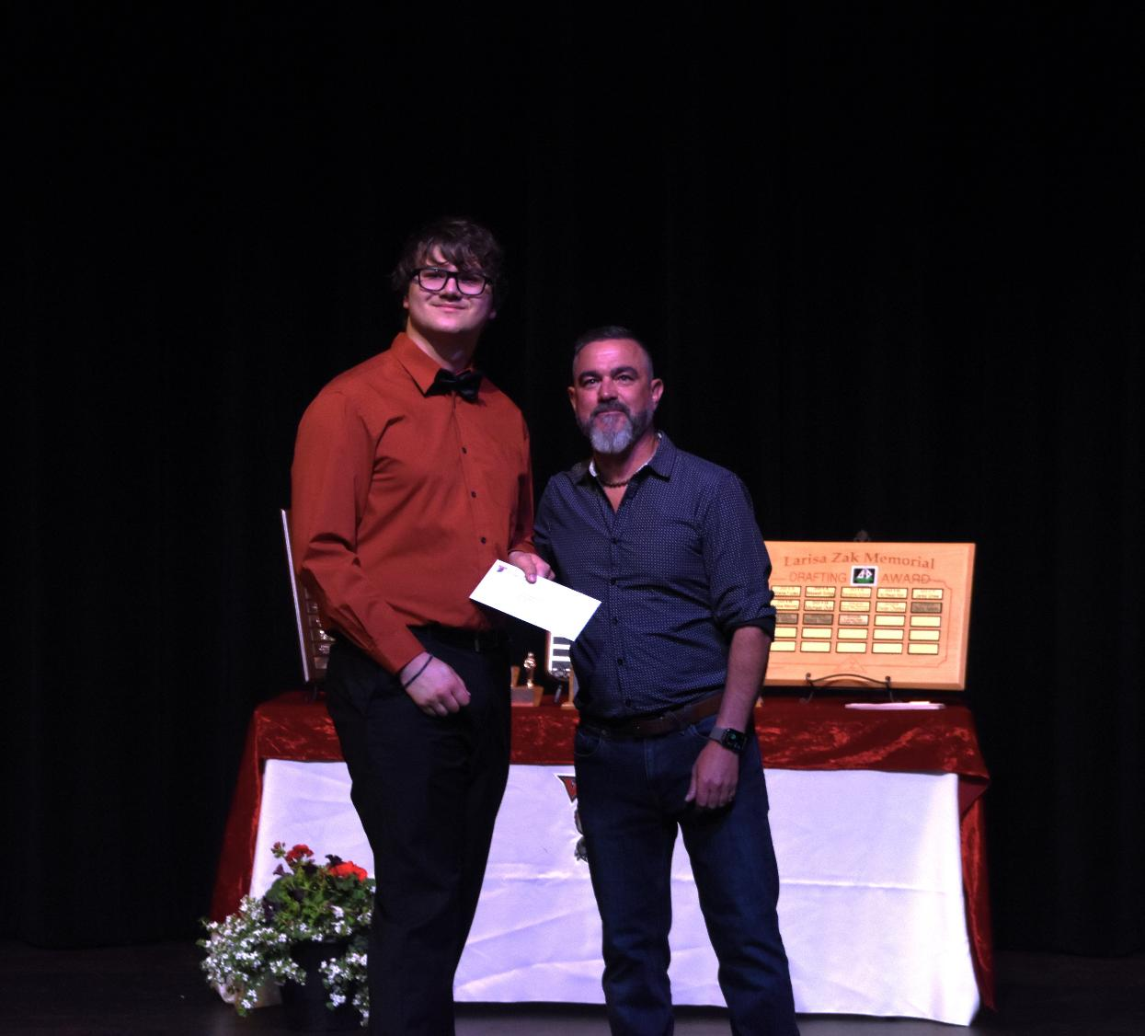
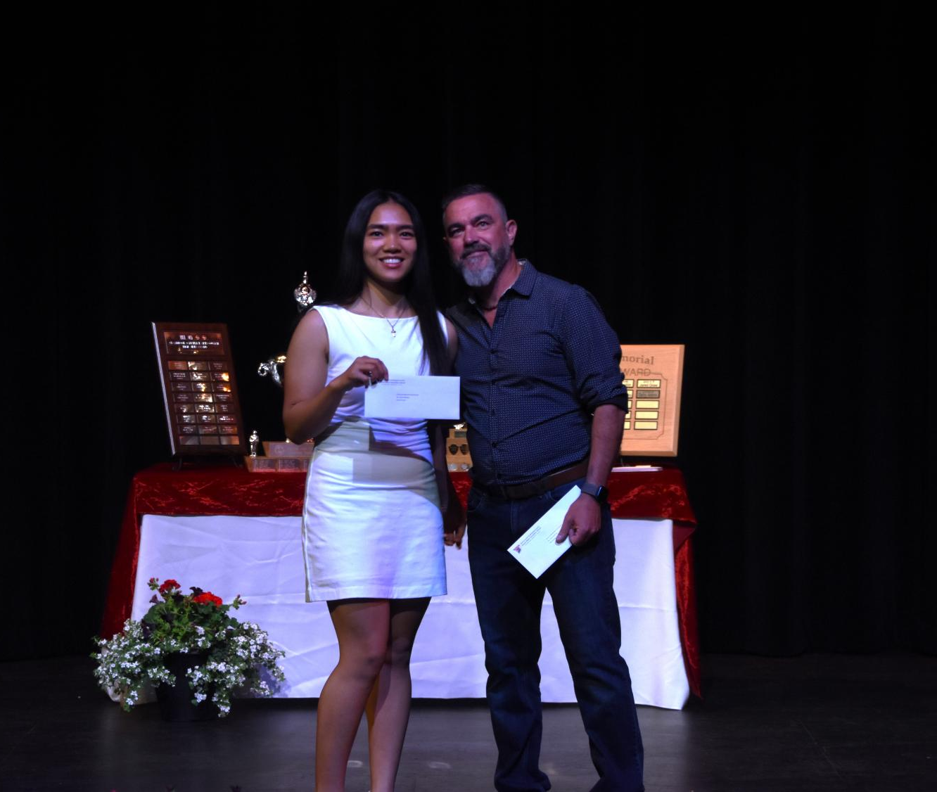
Cranbrook Badminton Club Bursaries
Rhys Denyes
Cyrene Pecpec

Slide 3
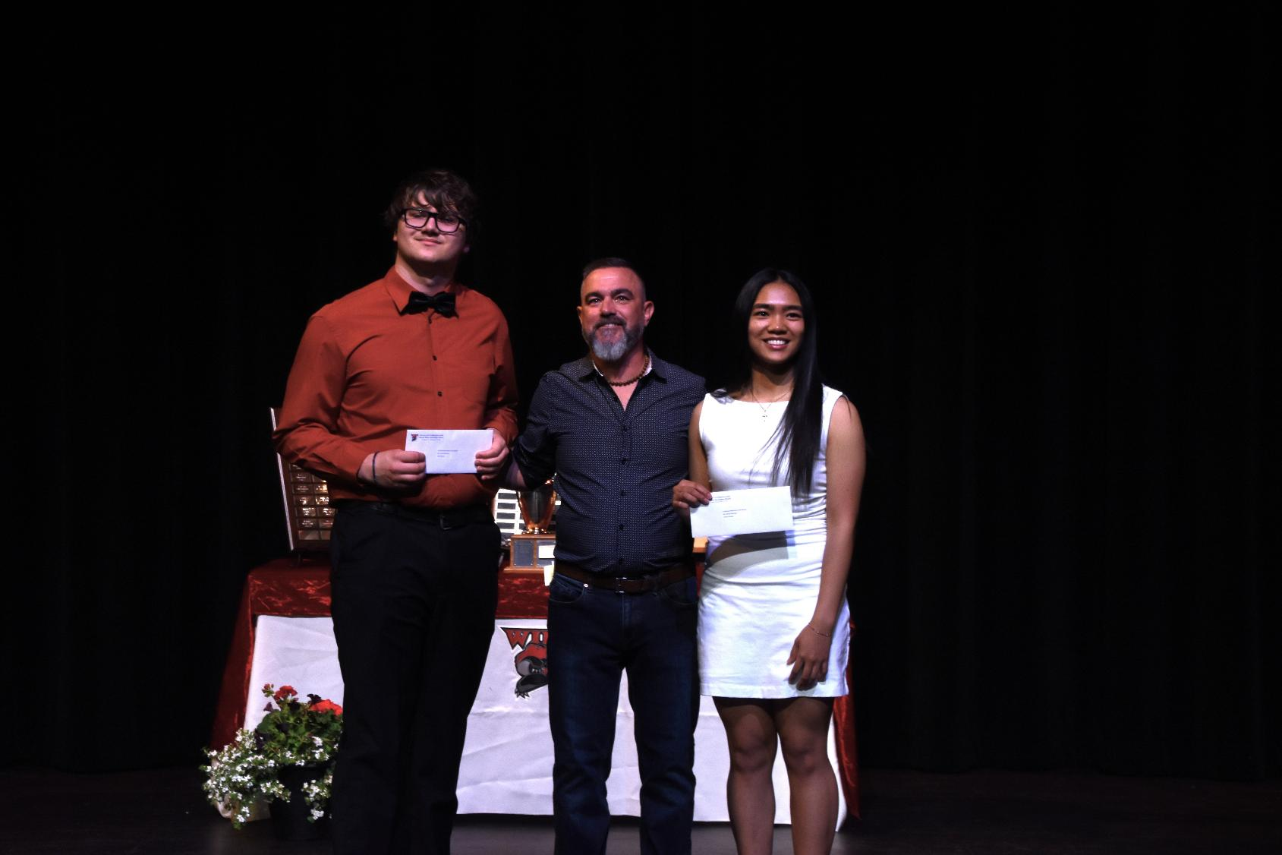

Slide 4
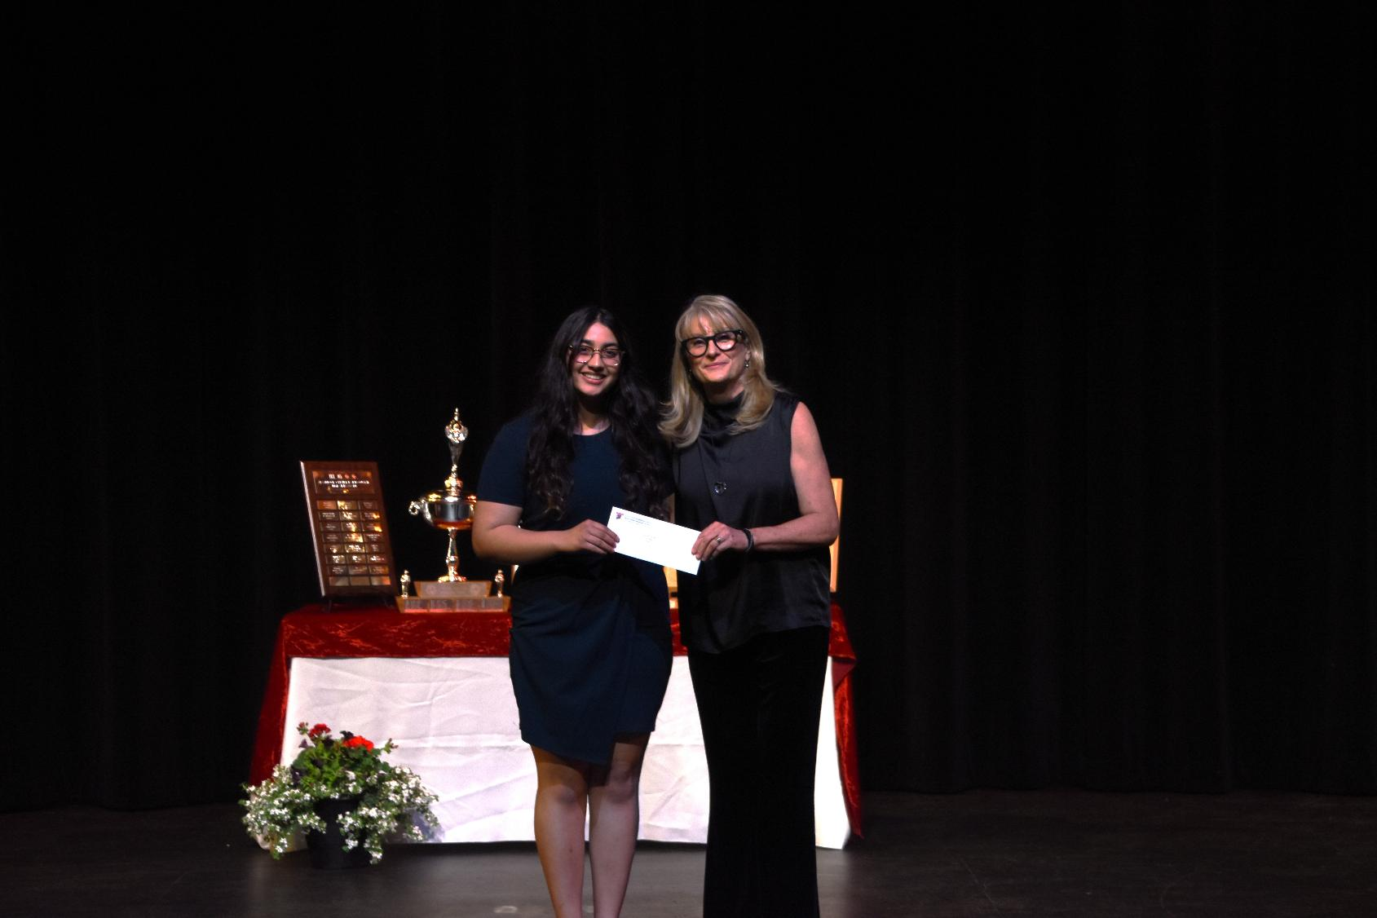
Fraser Valley Vending
Simran Parmar

Slide 5
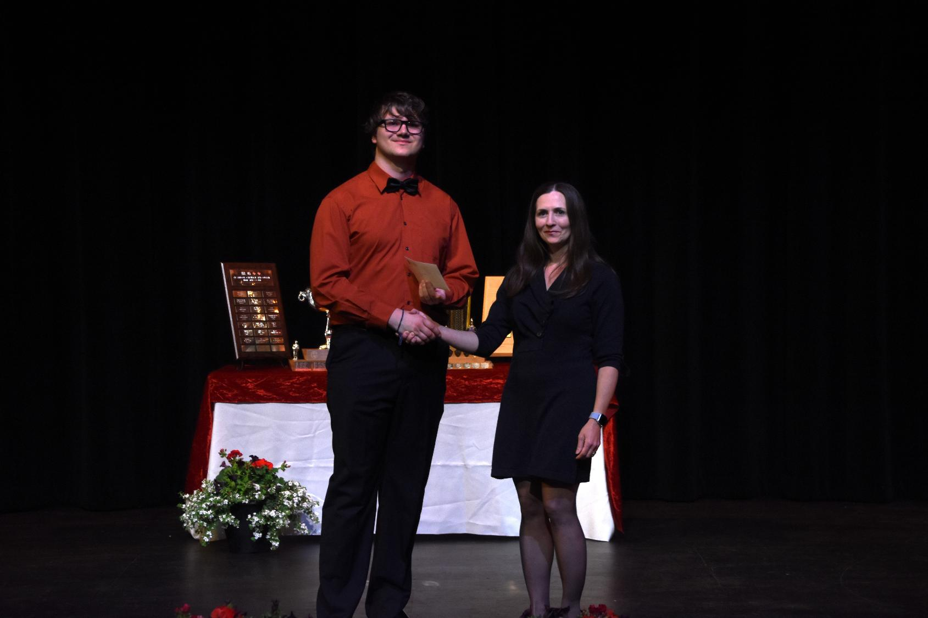
Canadian Parents for French Award
Rhys Denyes

Slide 6
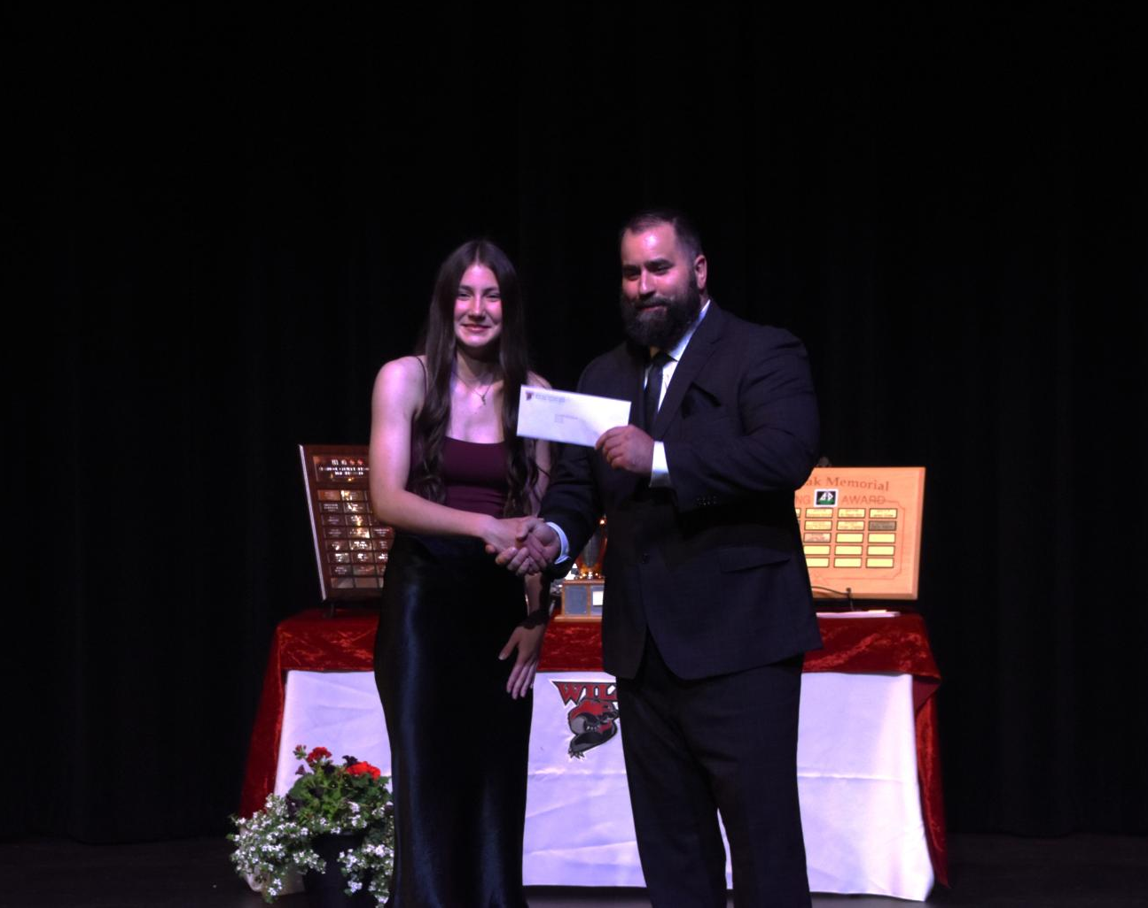
Laurie Middle School Scholarship (1982)
Ellora Palmer

Slide 7
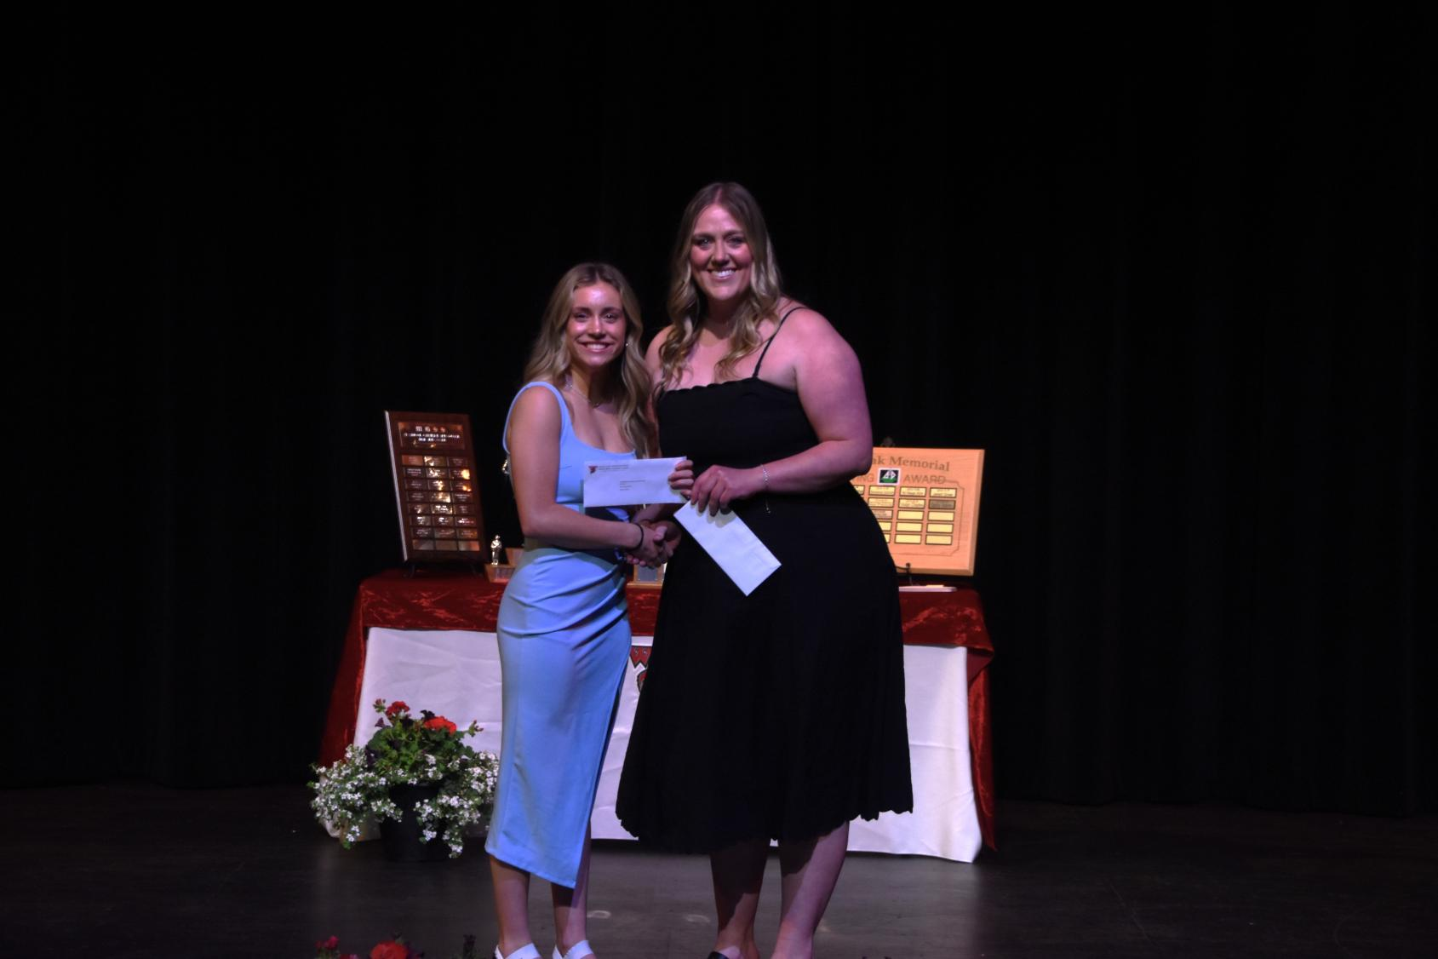
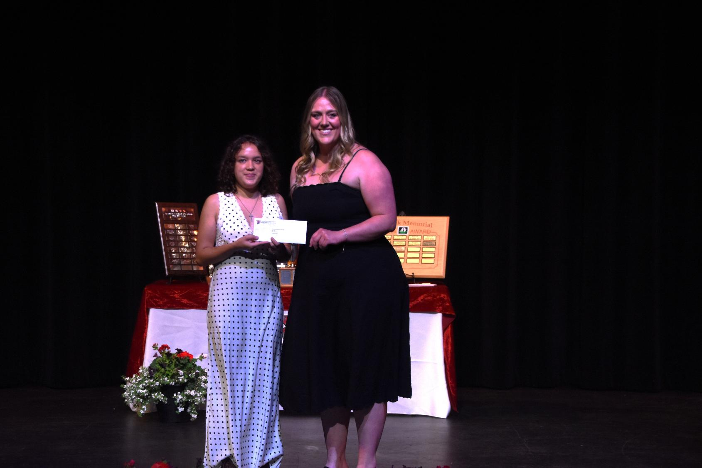
TM Roberts Elementary School Pac Bursaries
Norah Wolfs
Angelene Conner

Slide 8
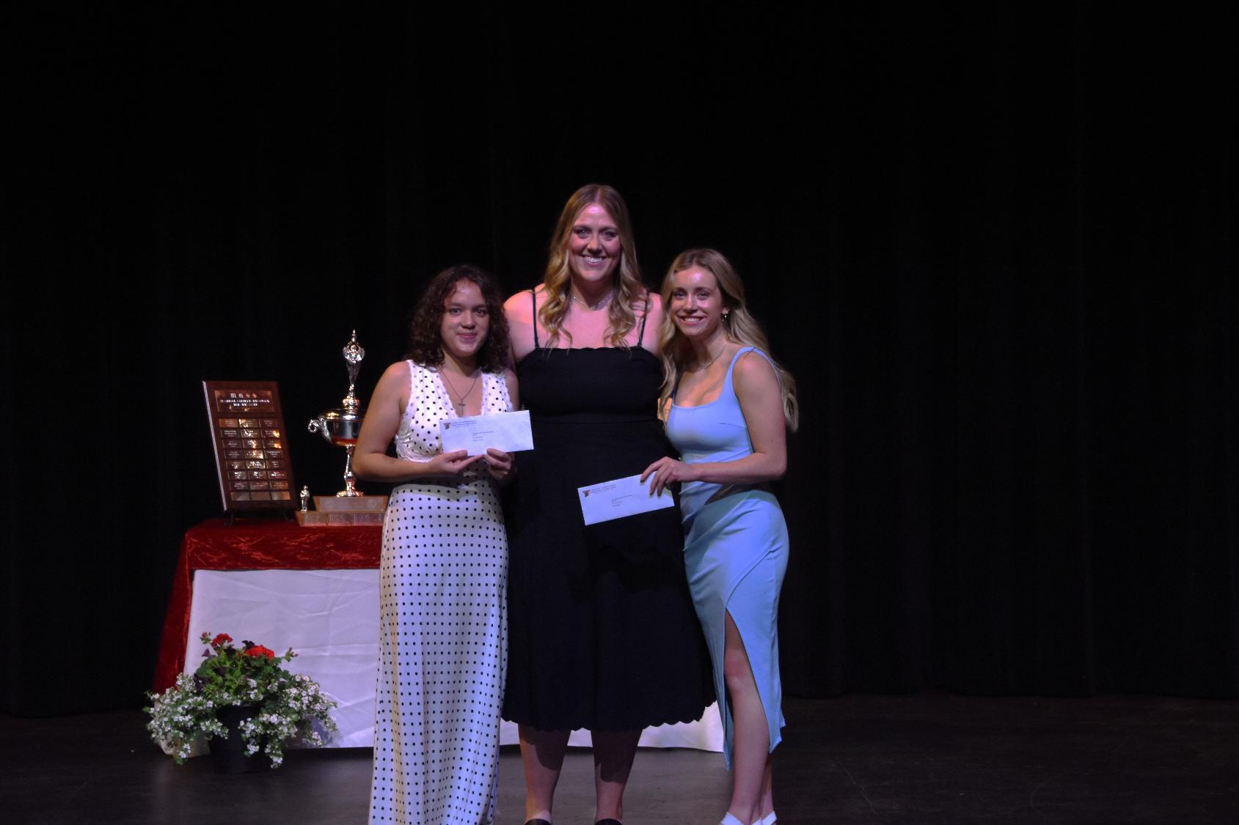

Slide 9
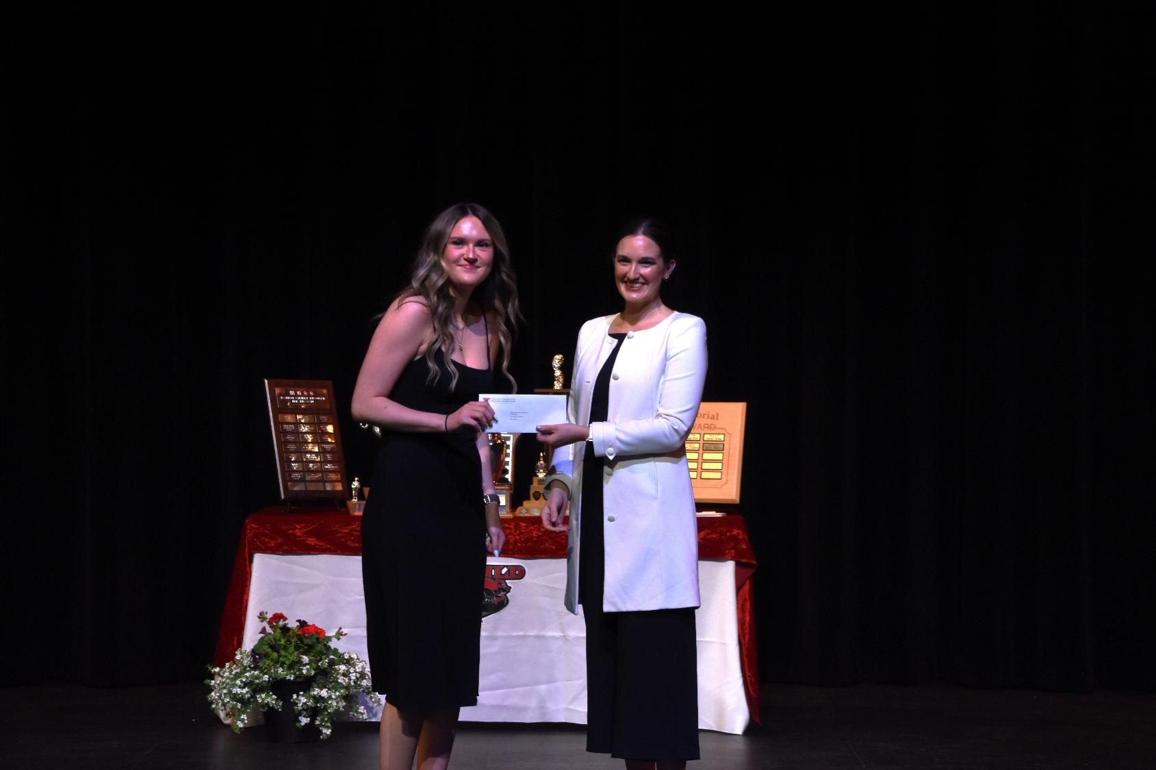
Melvin and Jean Bain Memorial Scholarship
- Skye Jensen

Slide 10
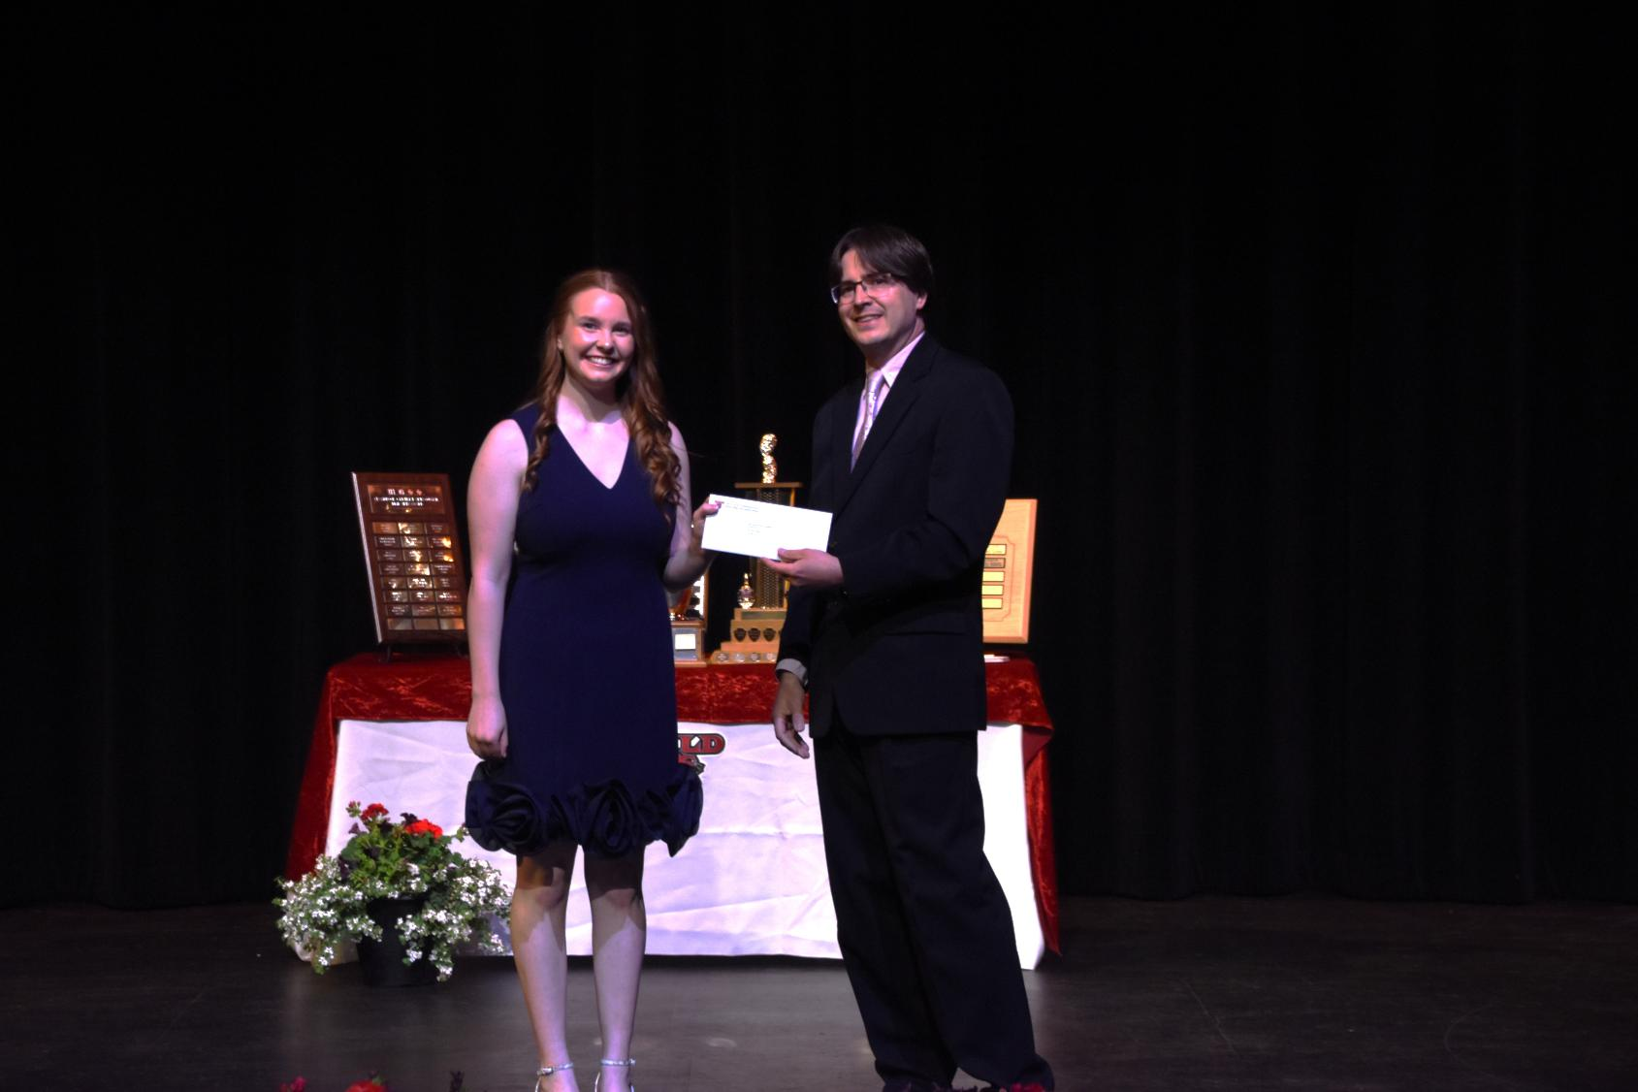
Alan Boden Second Language Scholarship
-Kate McInnes

Slide 11
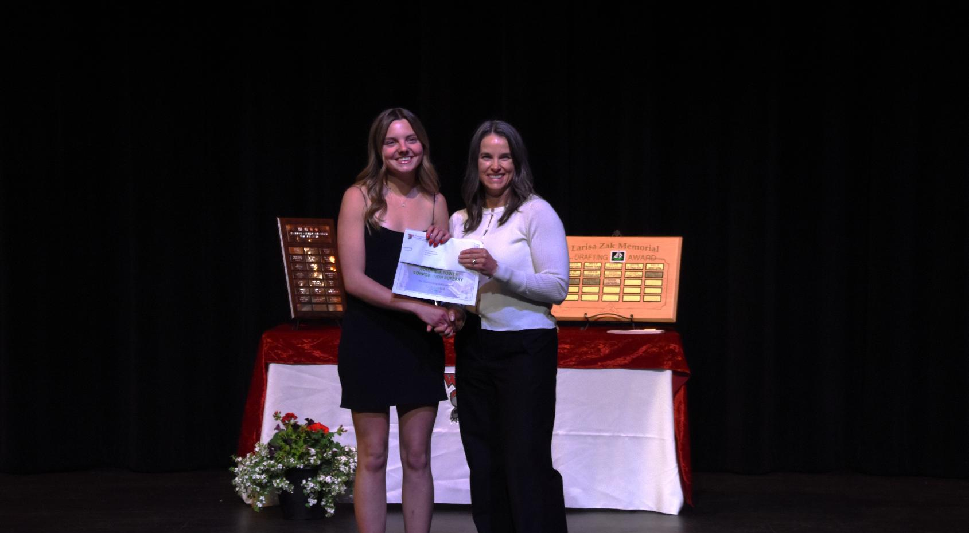
Columbia Power Bursary
Ava Murtack

Slide 12
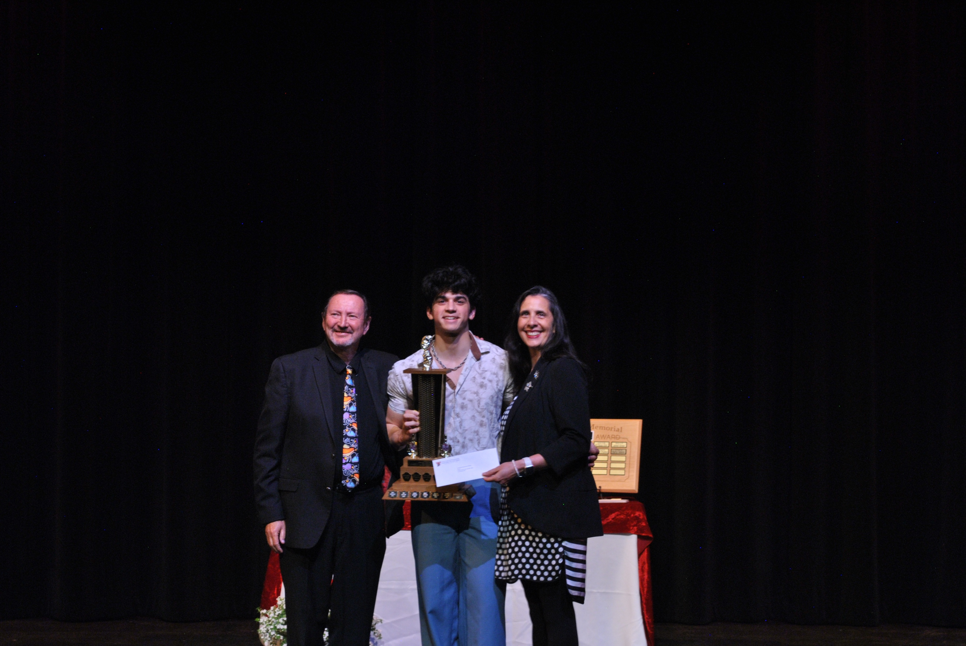
Cranbrook Community Theatre Award
Constantine Fisk

Slide 13
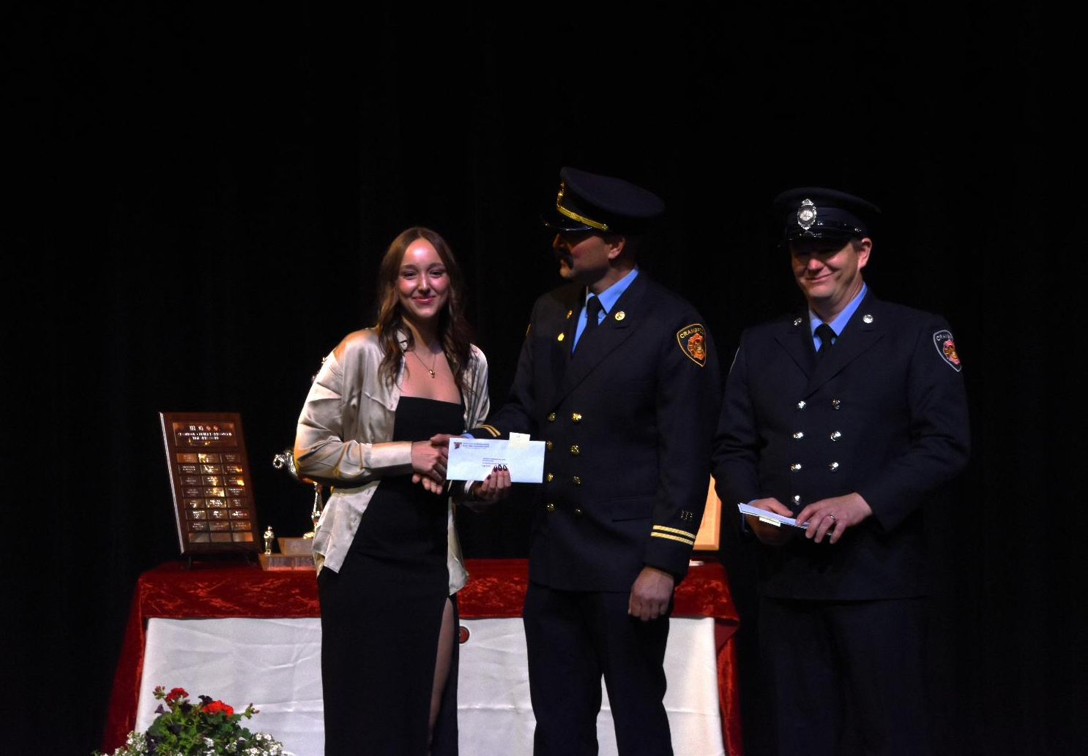
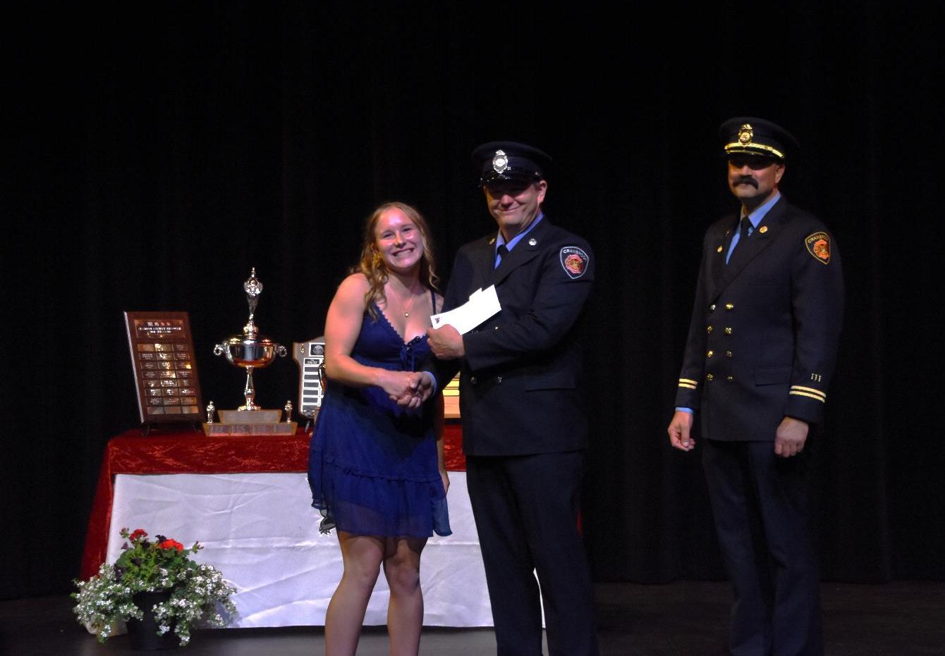
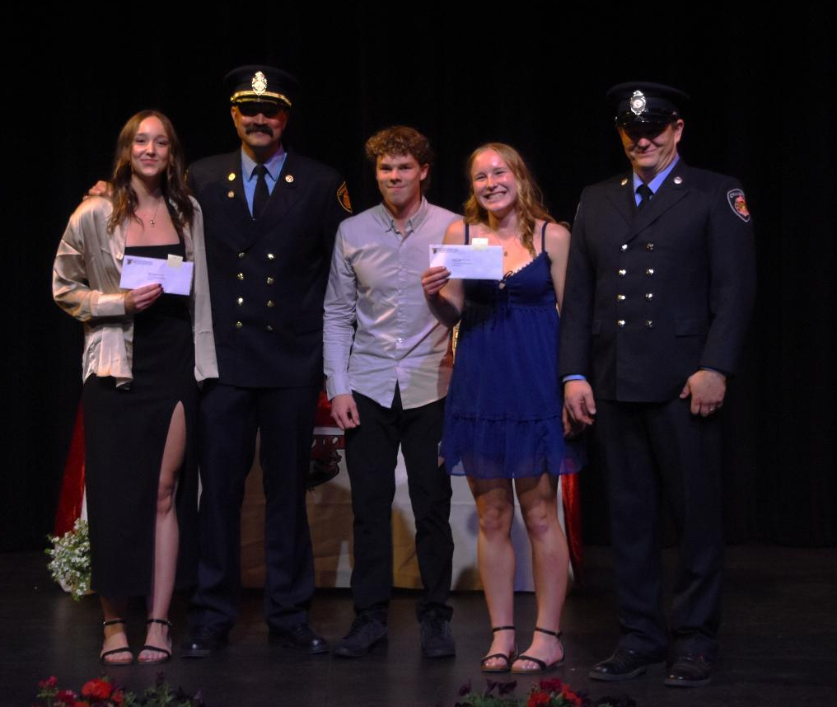
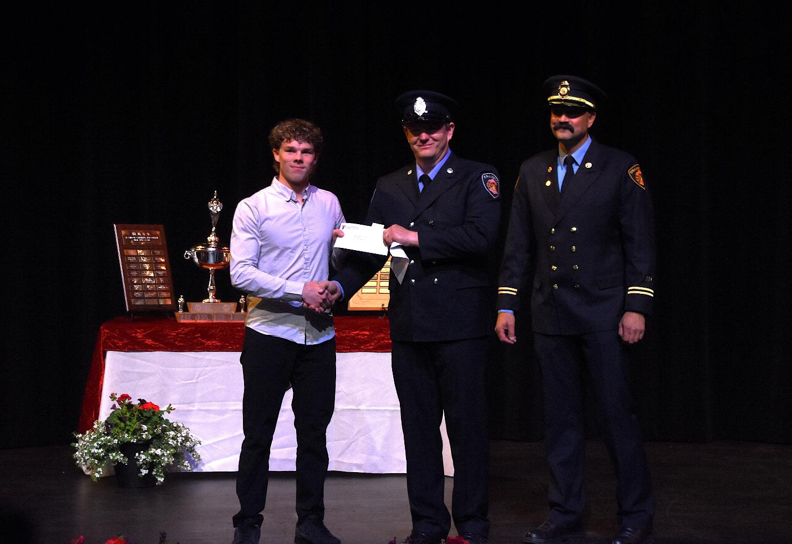
Cranbrook Firefighters I.A.F.F Local 1253 Scholarship
Hanna Bodnarchuk
Nolan Driver
Paige Relkoff

Slide 14
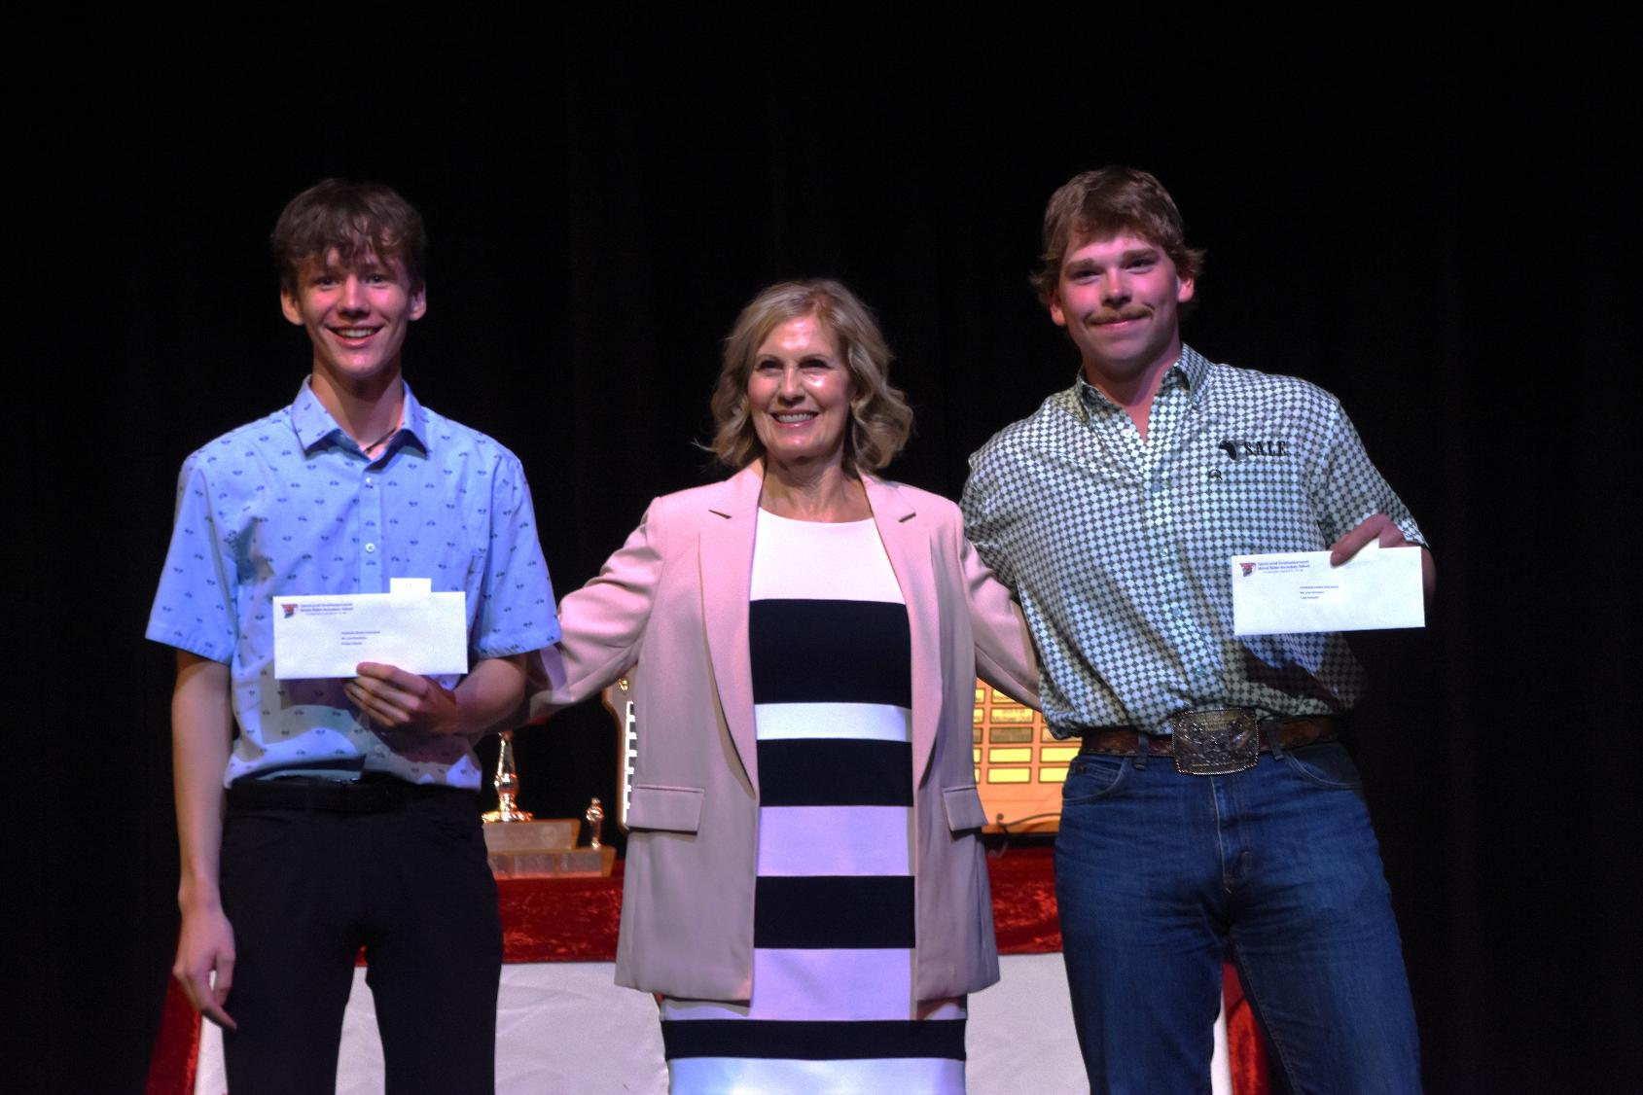
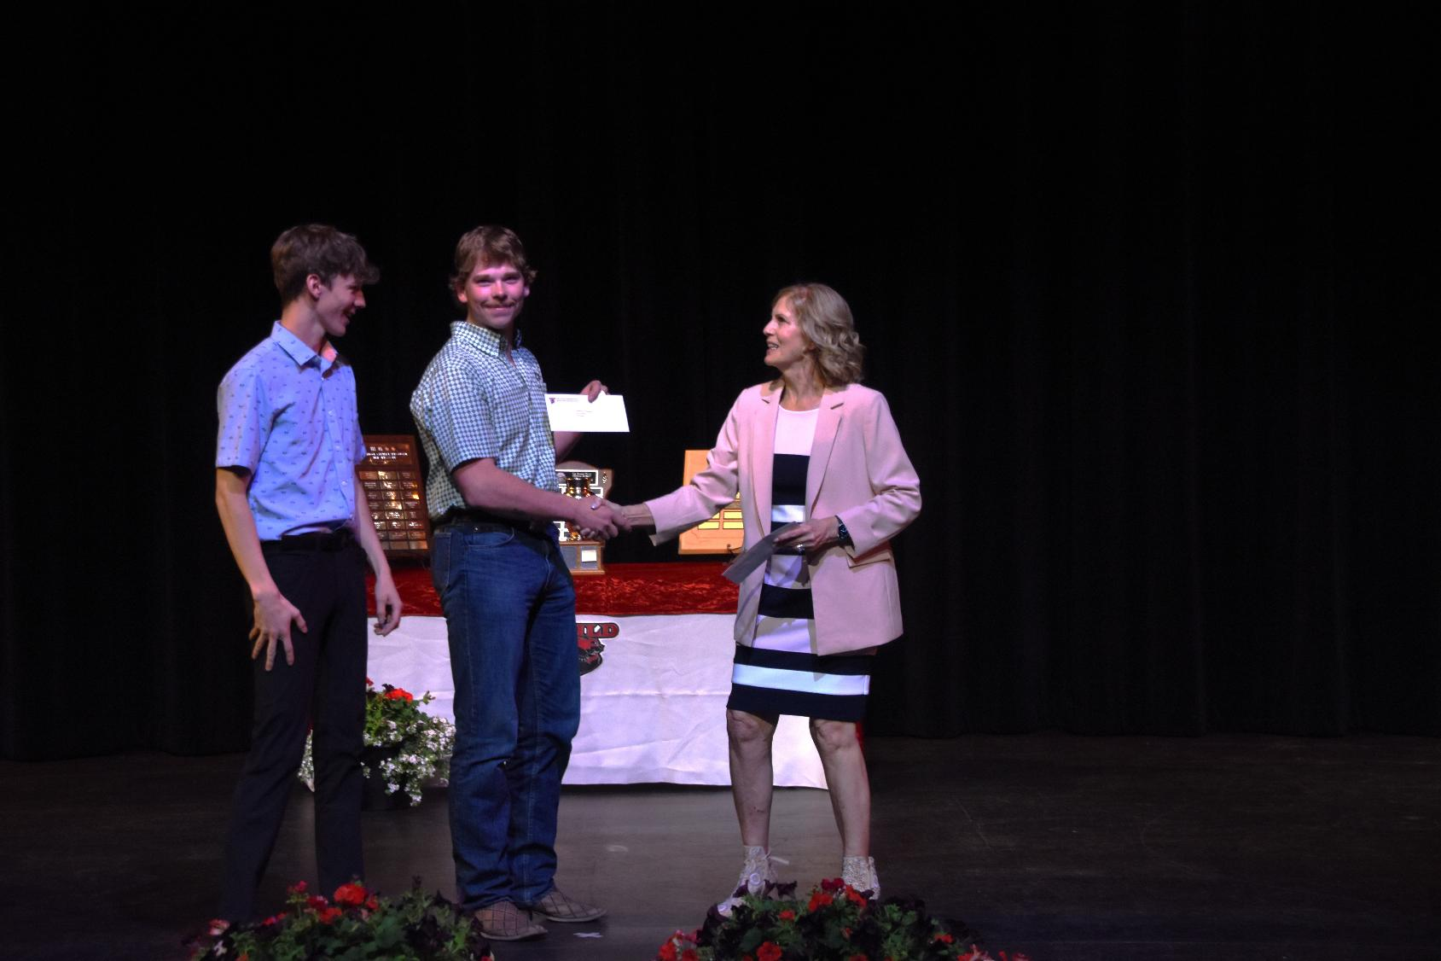
Cranbrook Garden Club Scholarship
Finnlay Teetaert and Tripp Rothwell

Slide 15
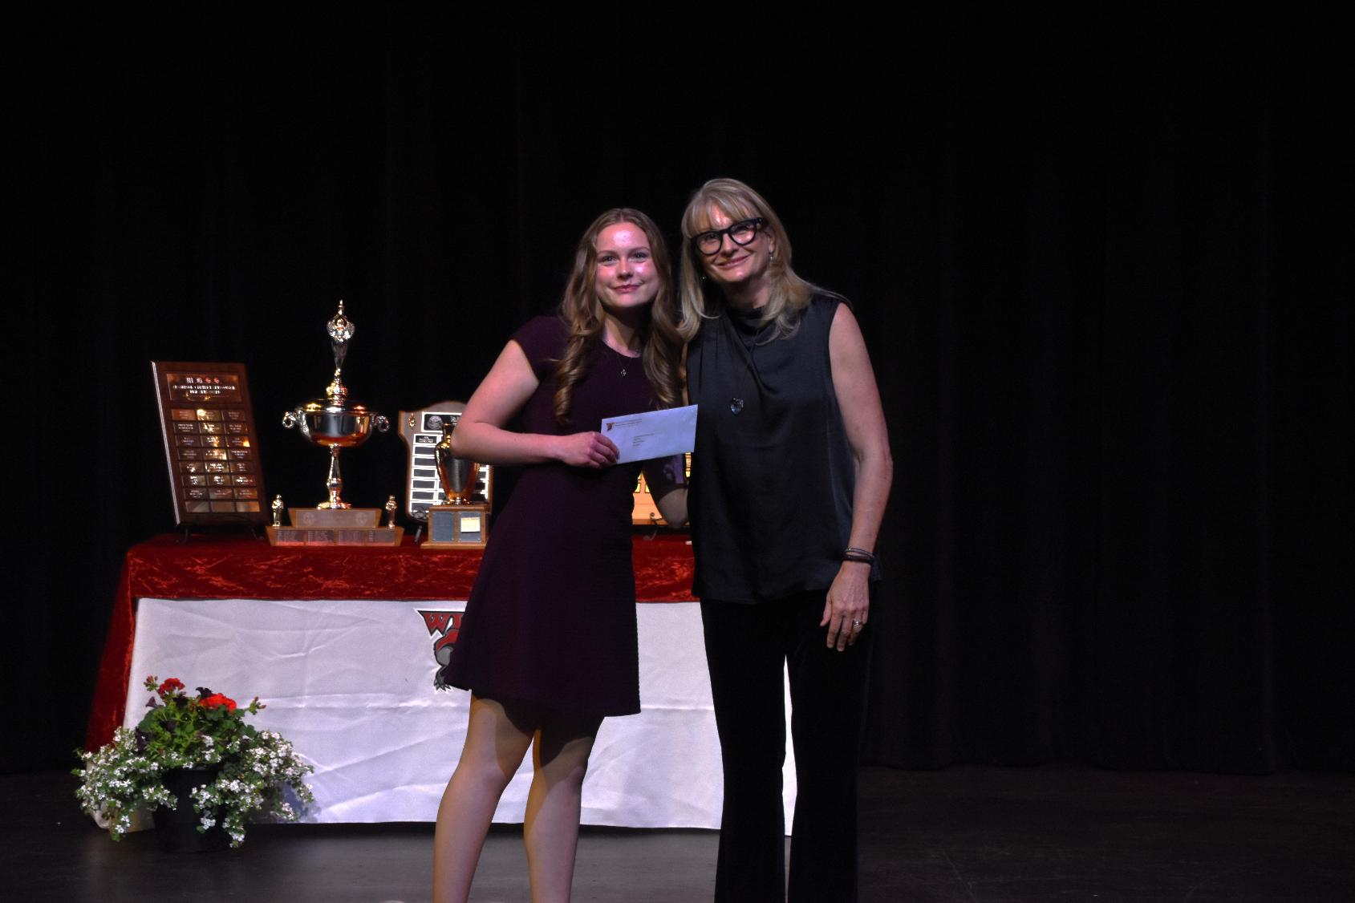
Cranbrook Rotary Interact Club Scholarship
Anna Adrian

Slide 16
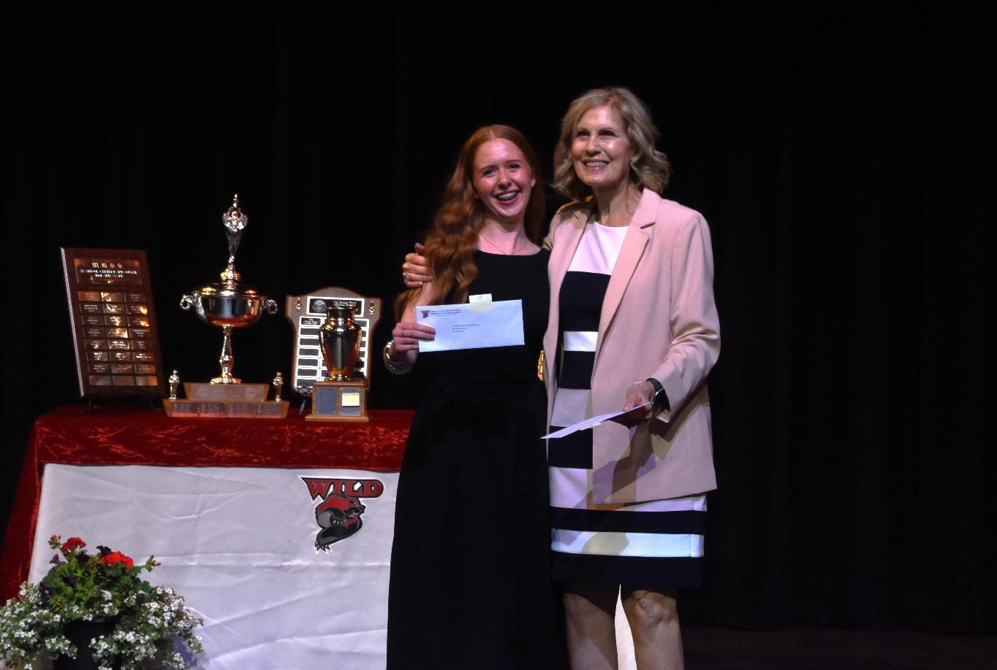
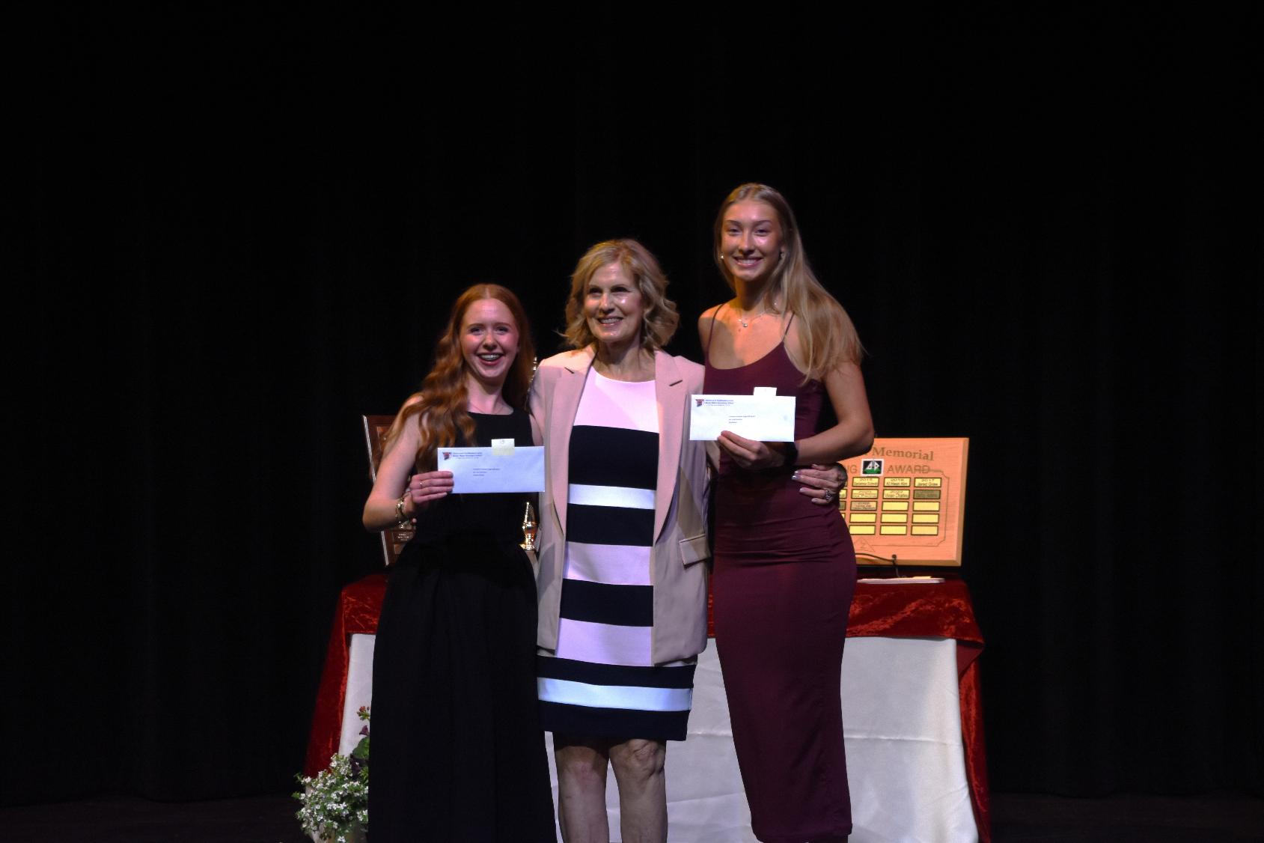
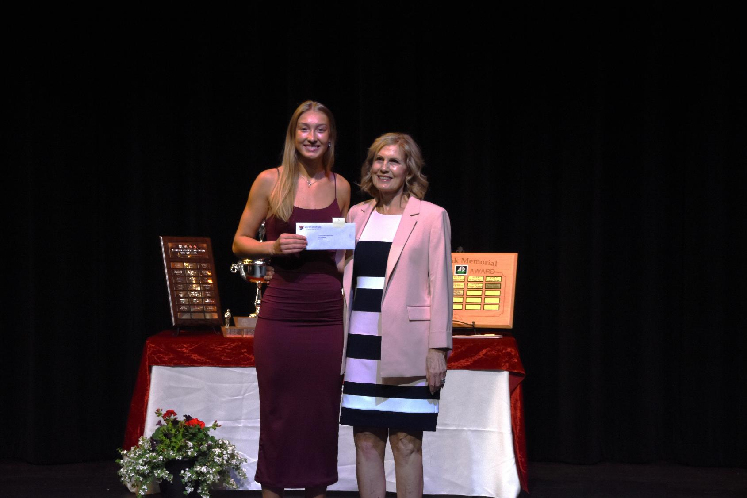
Cristoforo Colombo Lodge Scholarship (1980)
Mia Molnar and Avaiah Pelletier

Slide 17
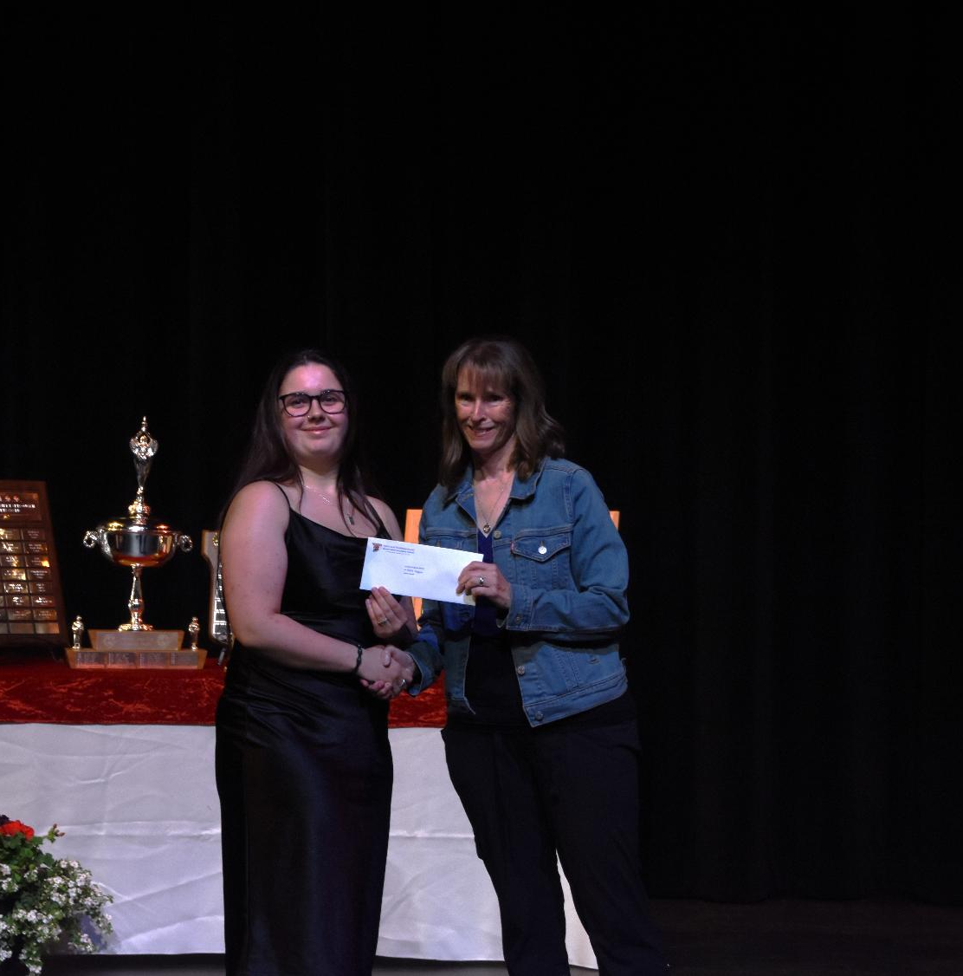
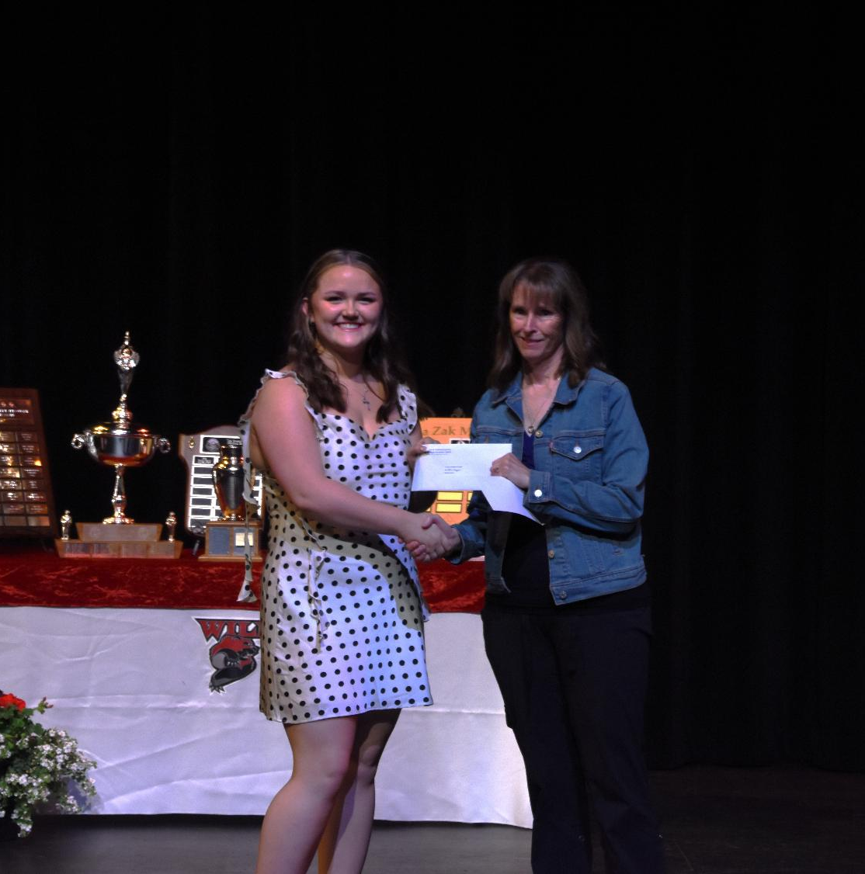
Cst Katie Forgeron Awards
Dyllan Hopkin and Mariah Whitney Smith

Slide 18
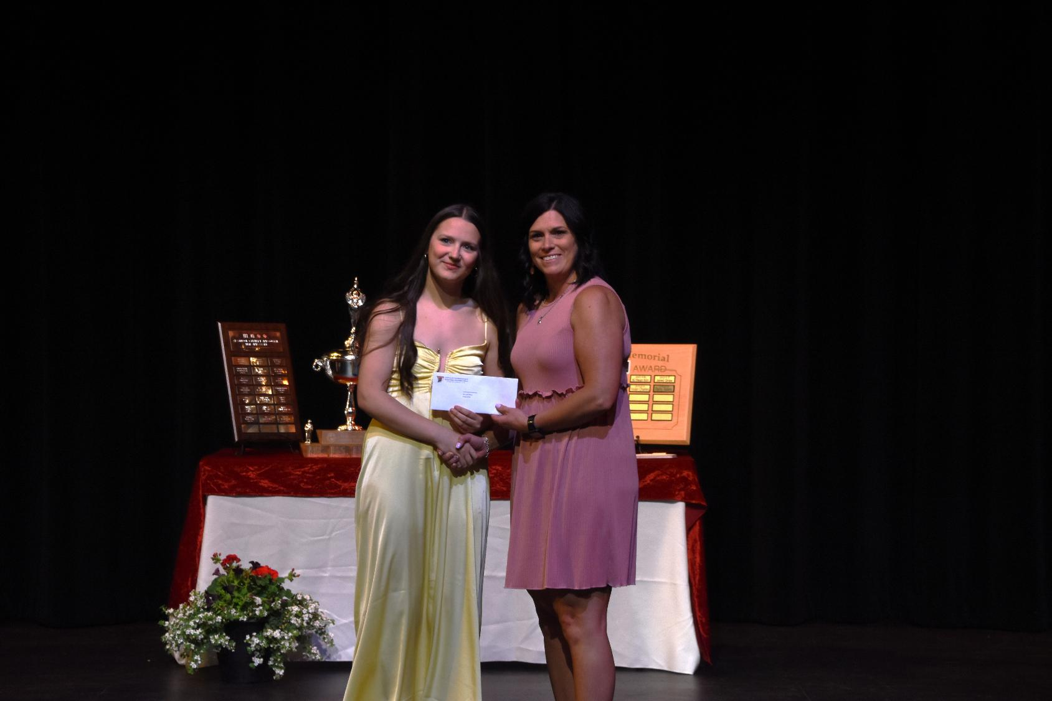
CUPE 4165 Bursary
Kaitlyn Teindl

Slide 19
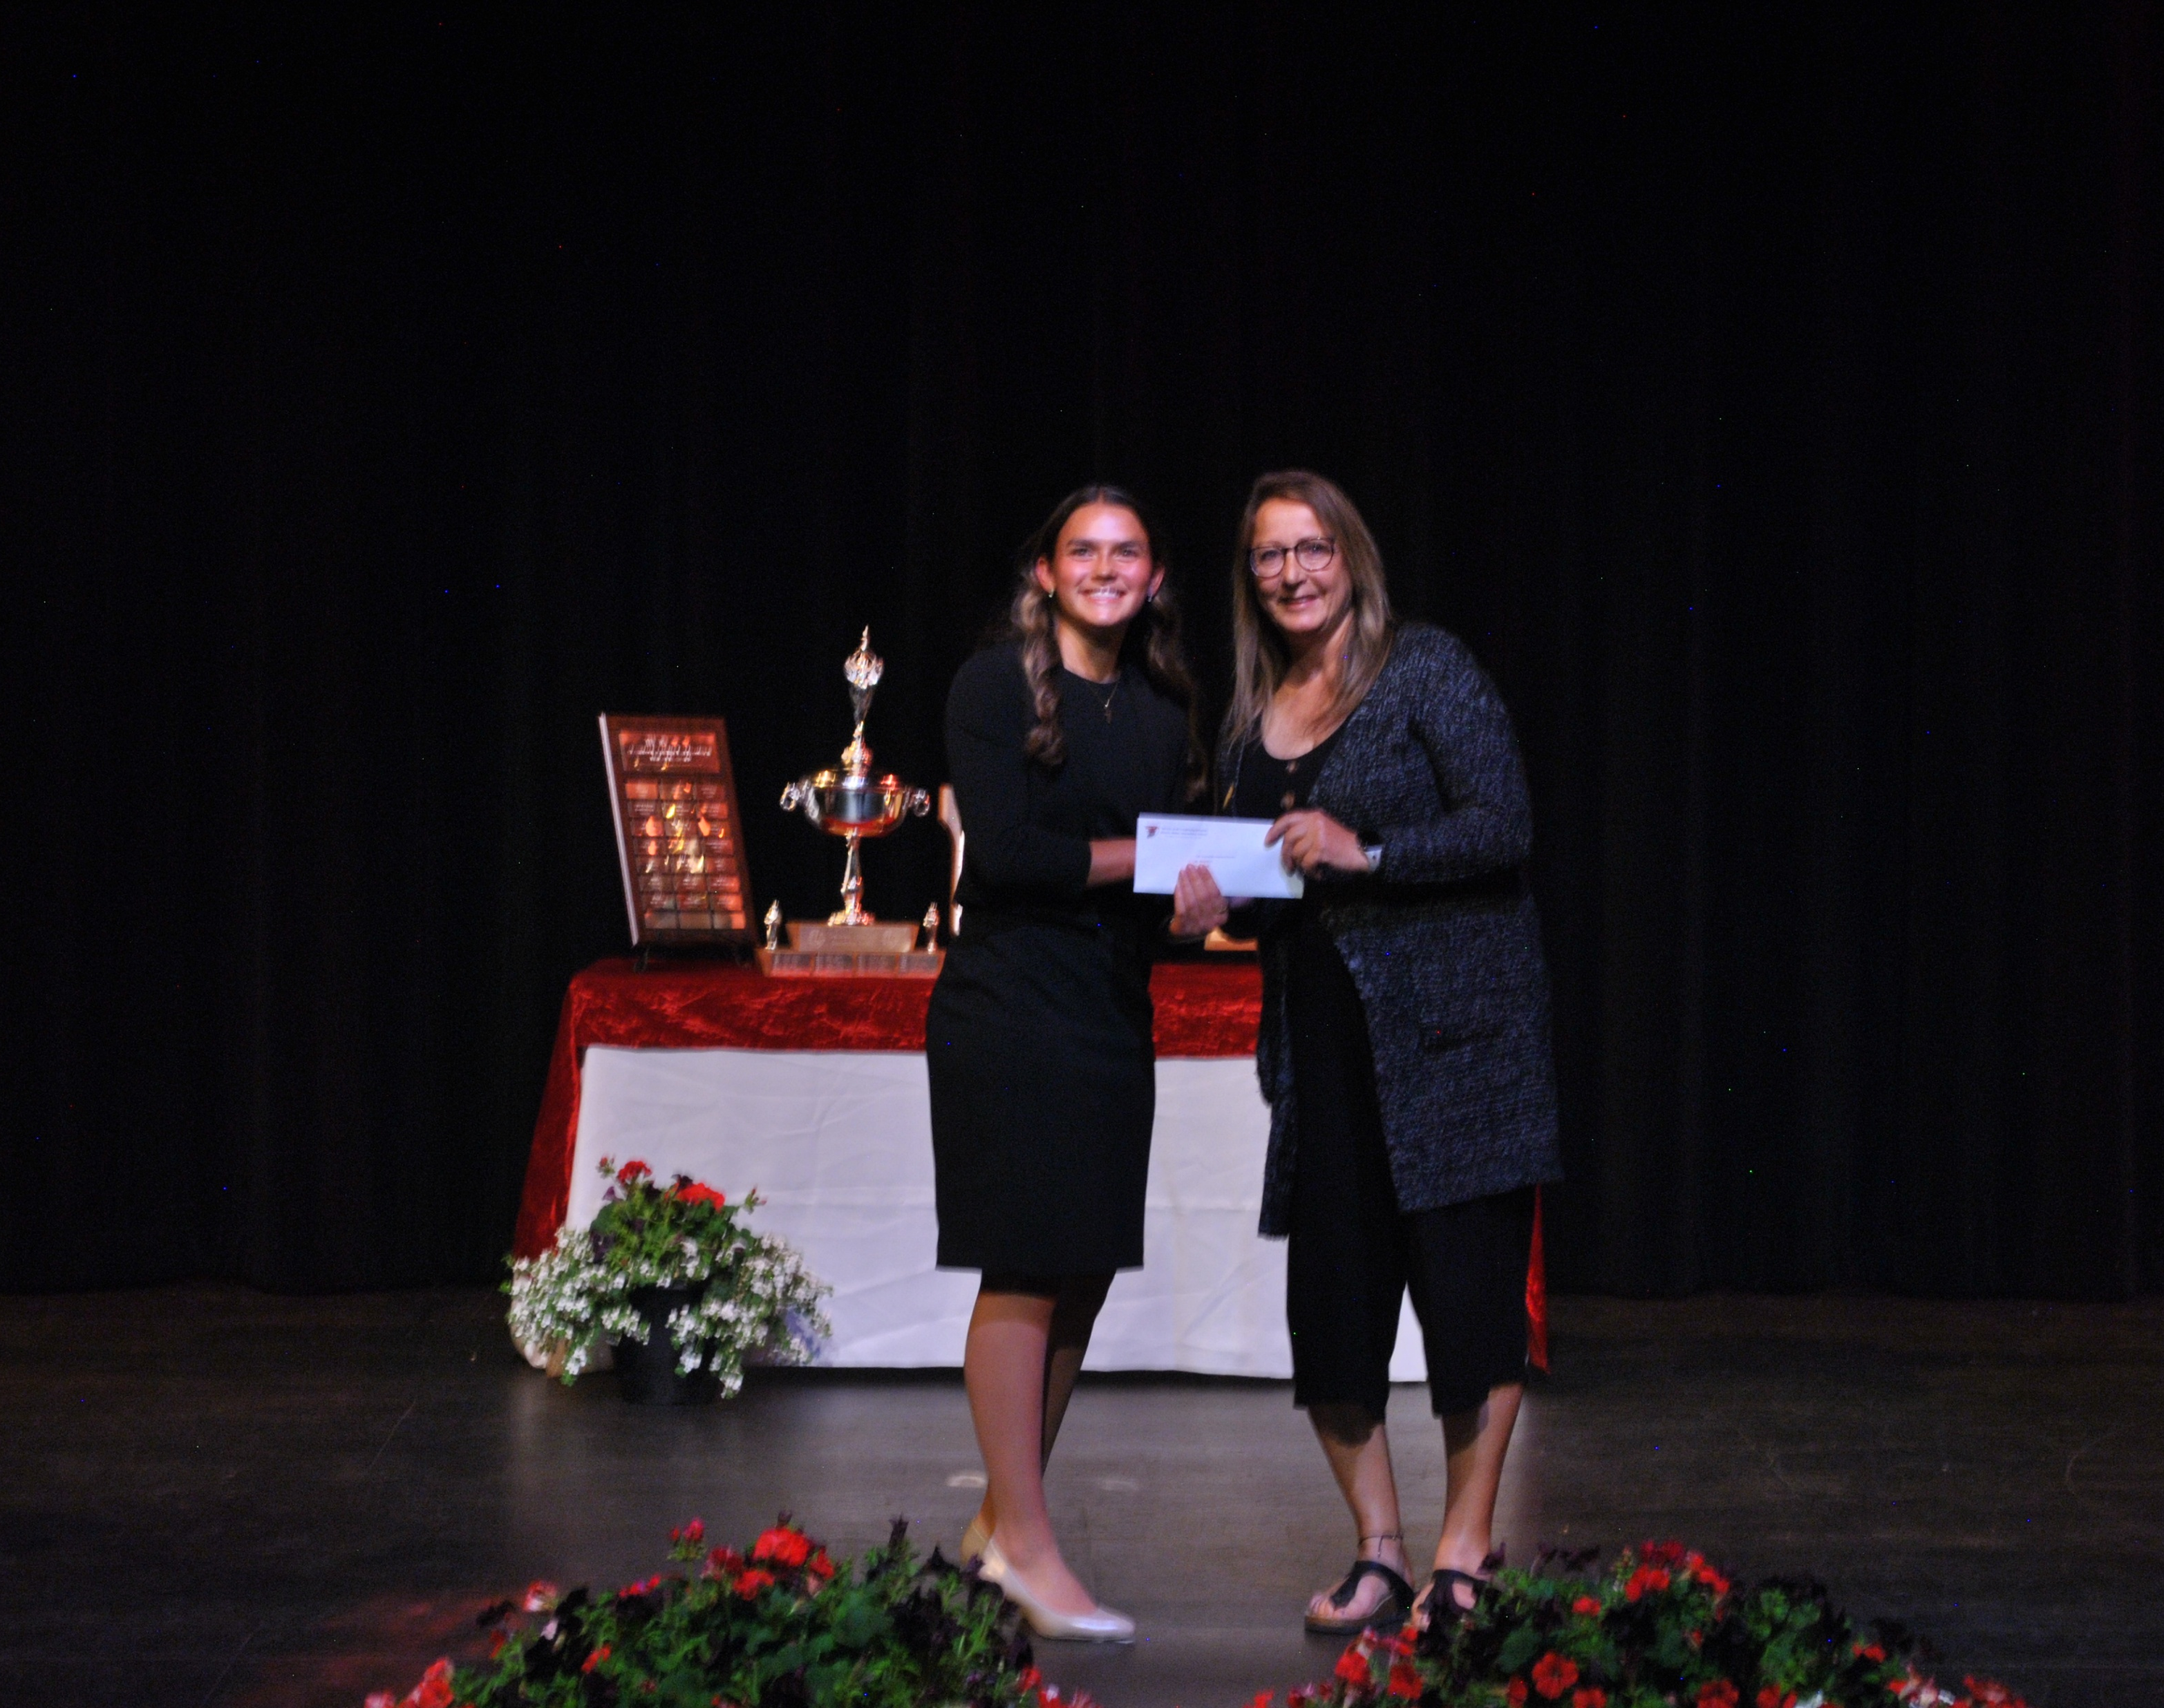
CUPE Local 4165 Indigenous Bursary
Paige Parnell

Slide 20
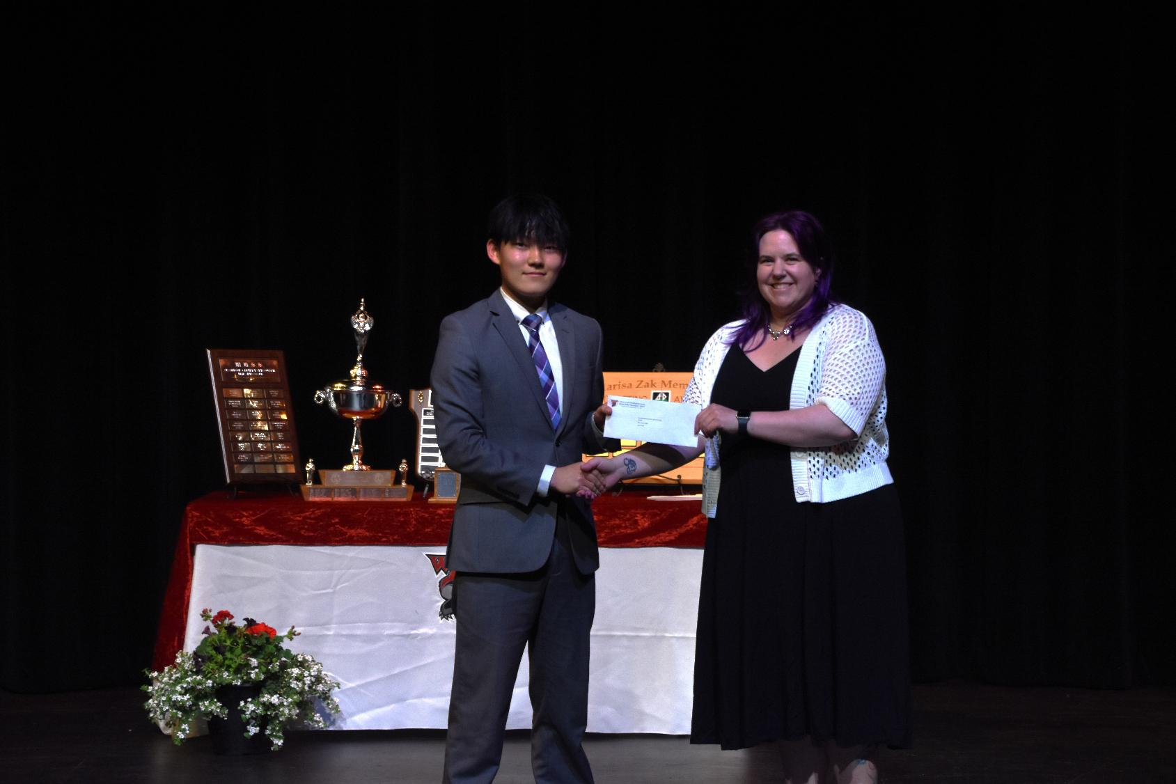
East Kootenay Labour District Council Award
Josh Hong

Slide 21
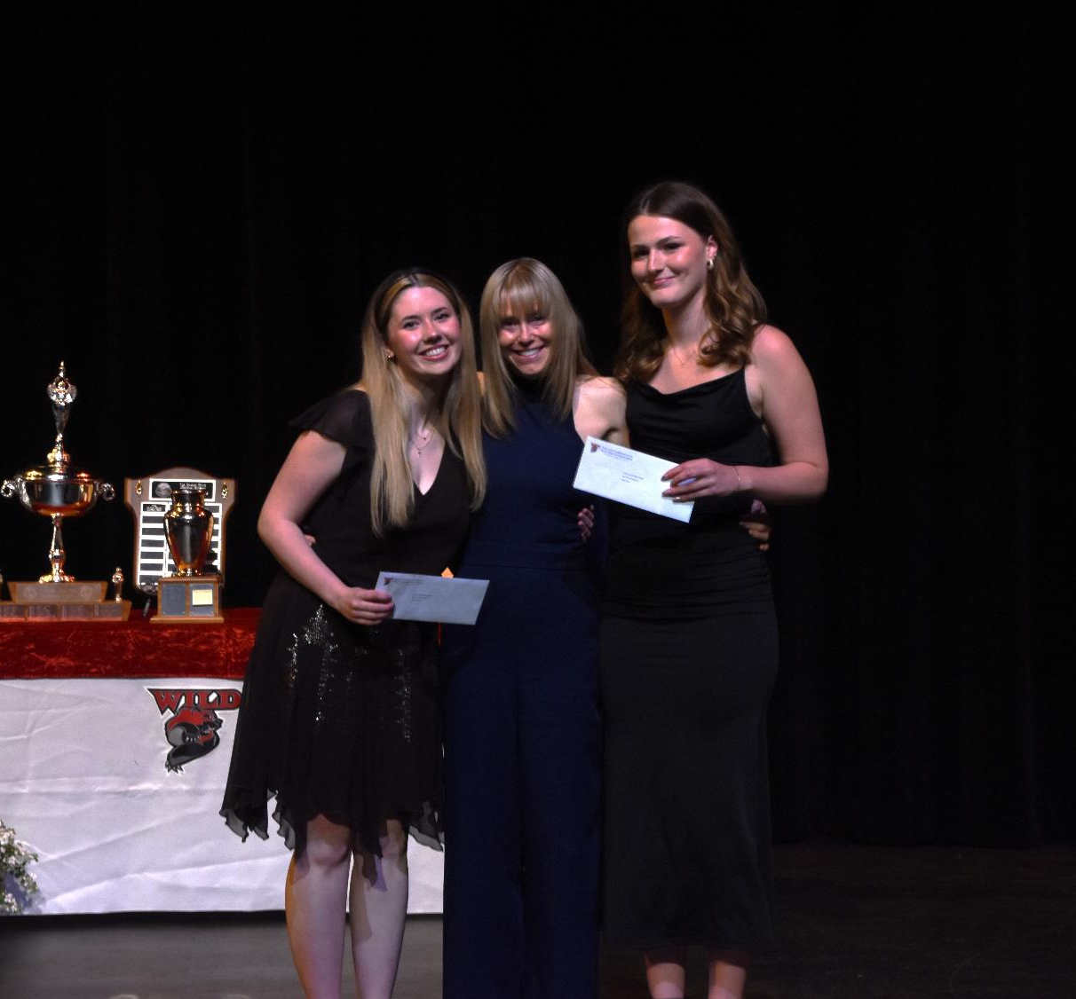
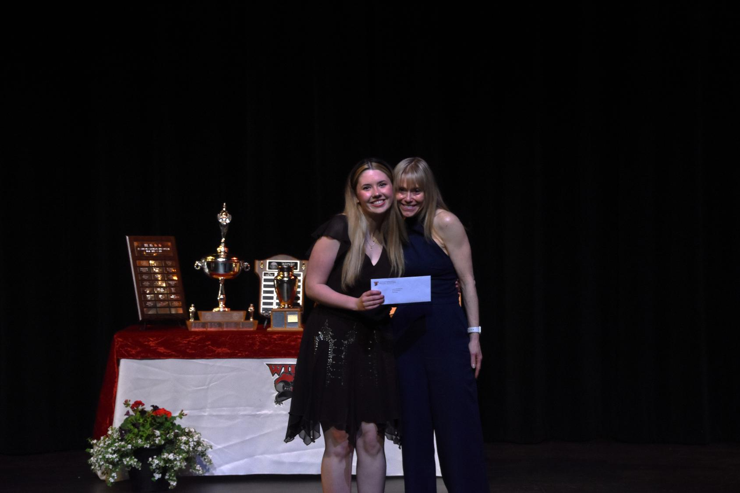
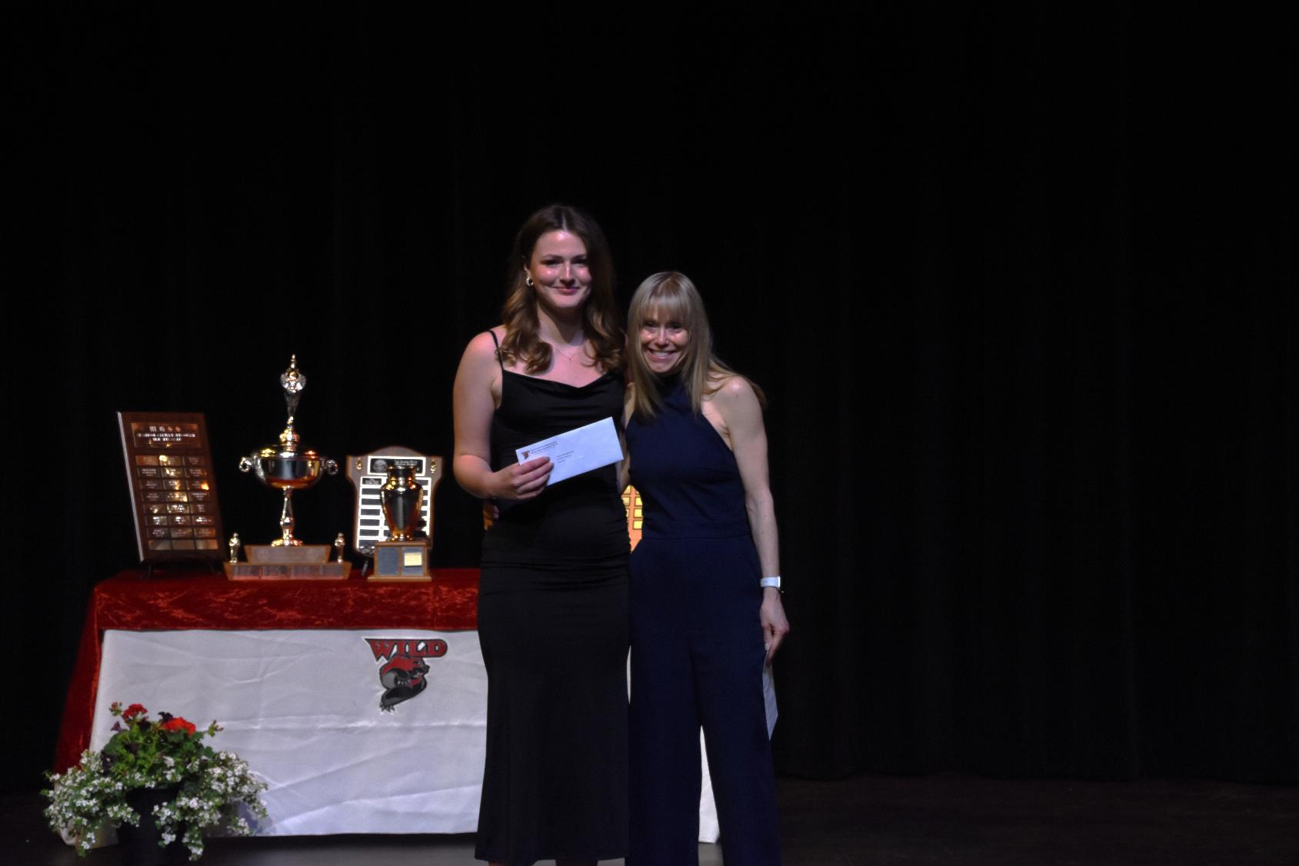
Fashion and Design Award
Ashlyn McKay and Kaiya Ewen

Slide 22
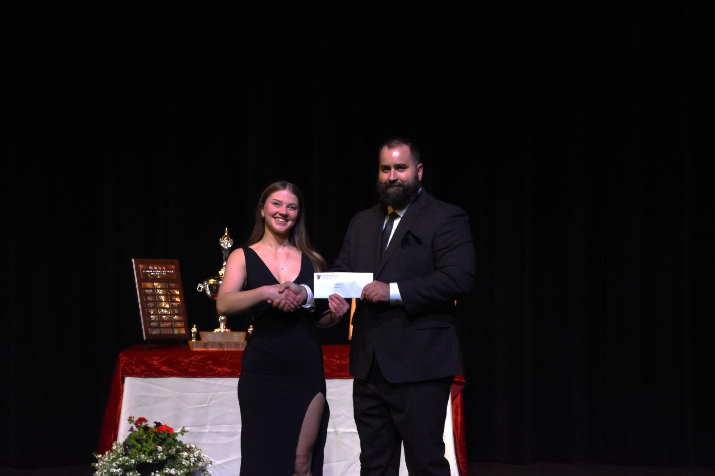
Highlands School Award
Sydney Westle

Slide 23
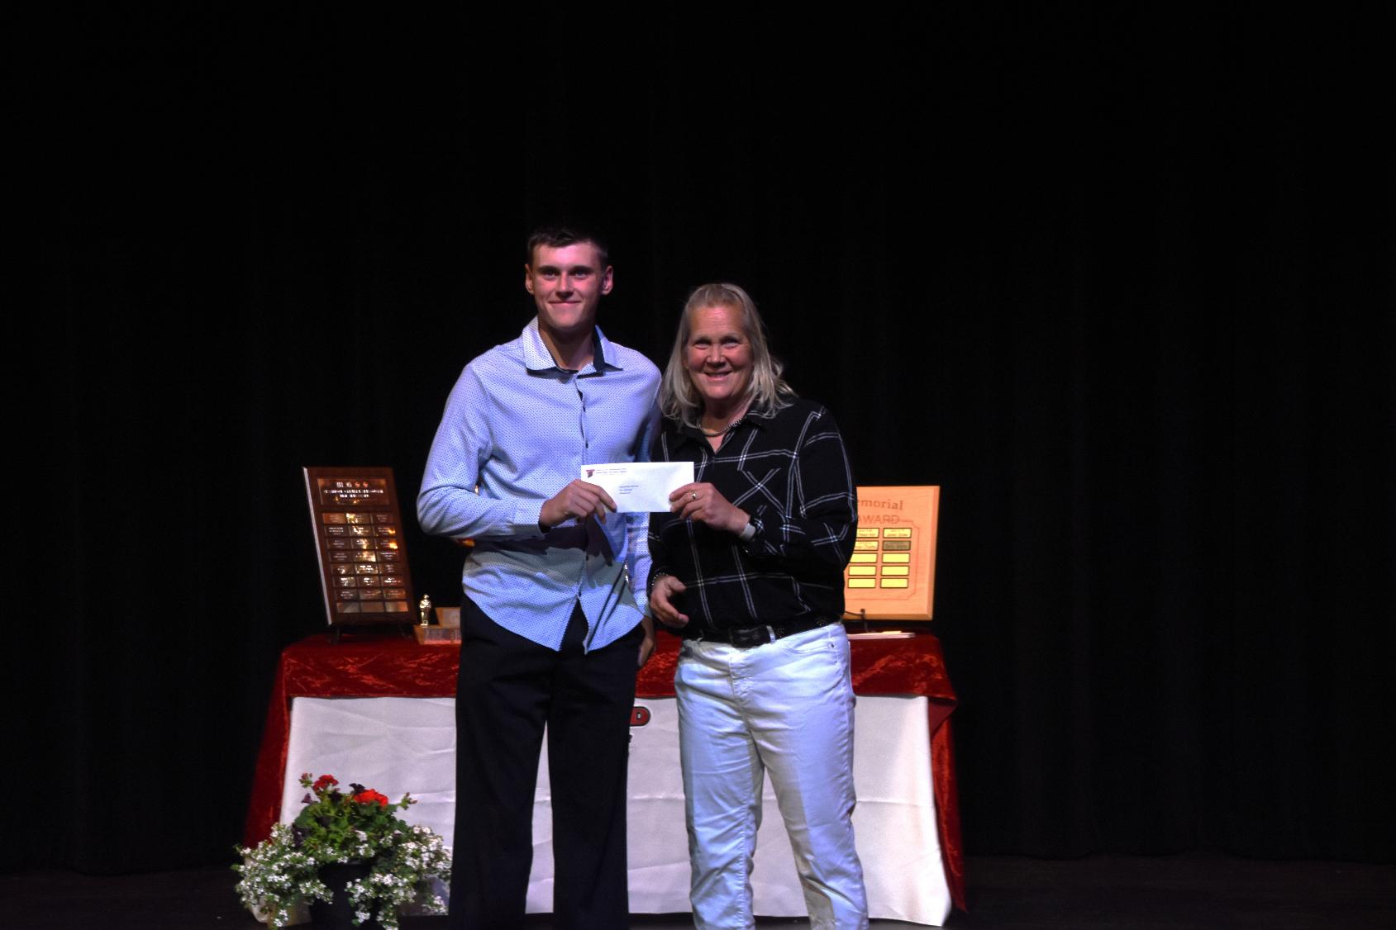
Kenton Barber Memorial Award
Nicholas Jantz

Slide 24
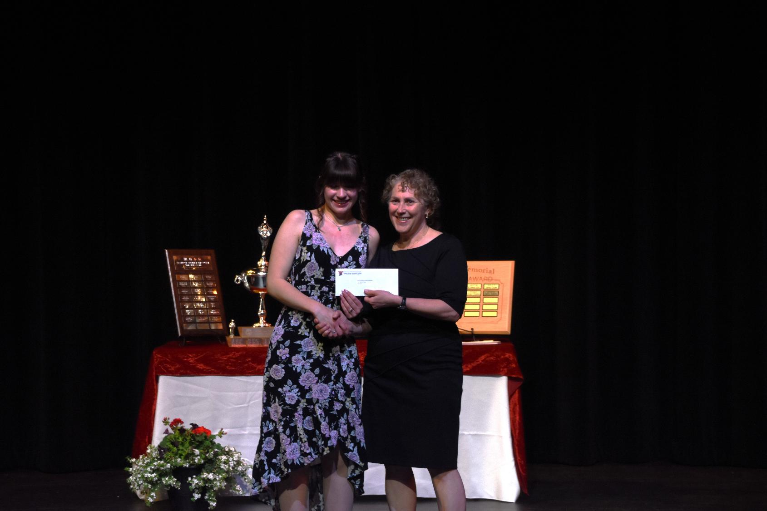
Key City Theatre Society Scholarship
Jaina Skene

Slide 25
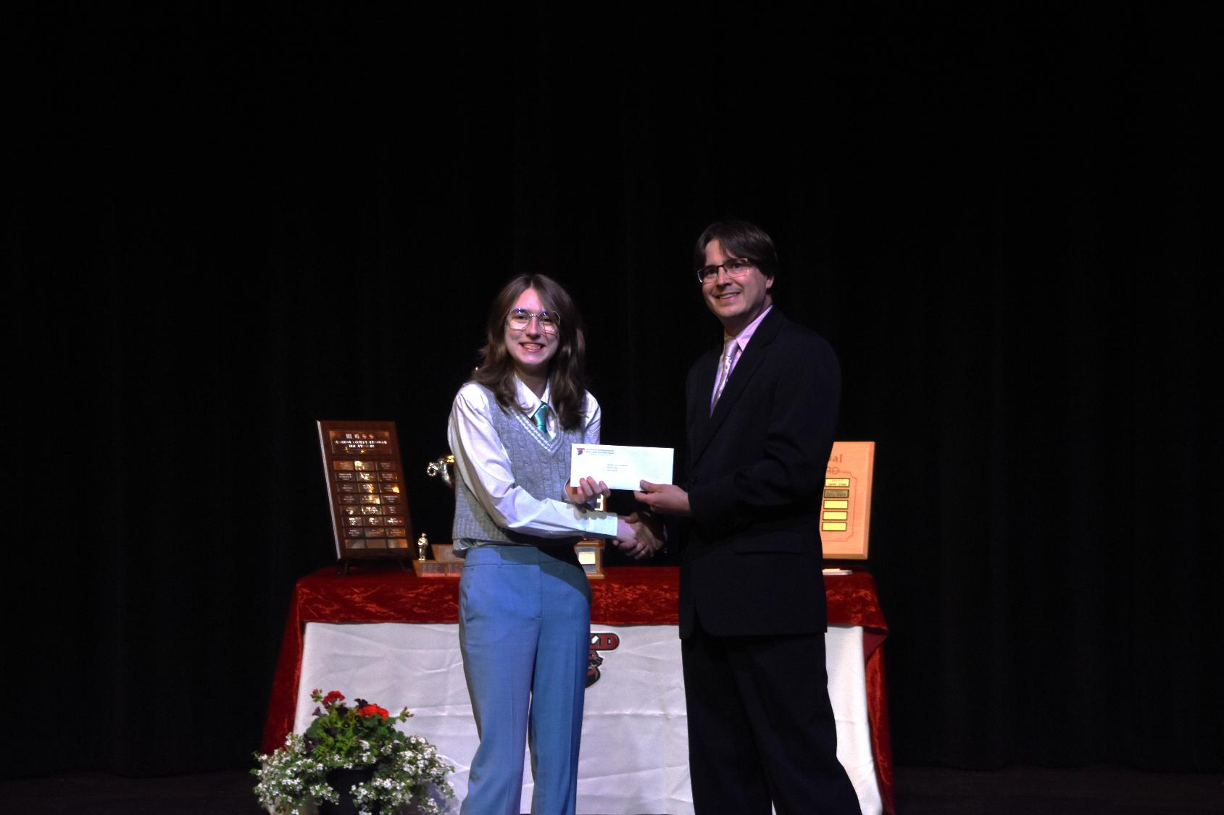
Kootenay Country Fair Bursary
Katara Reynolds

Slide 26
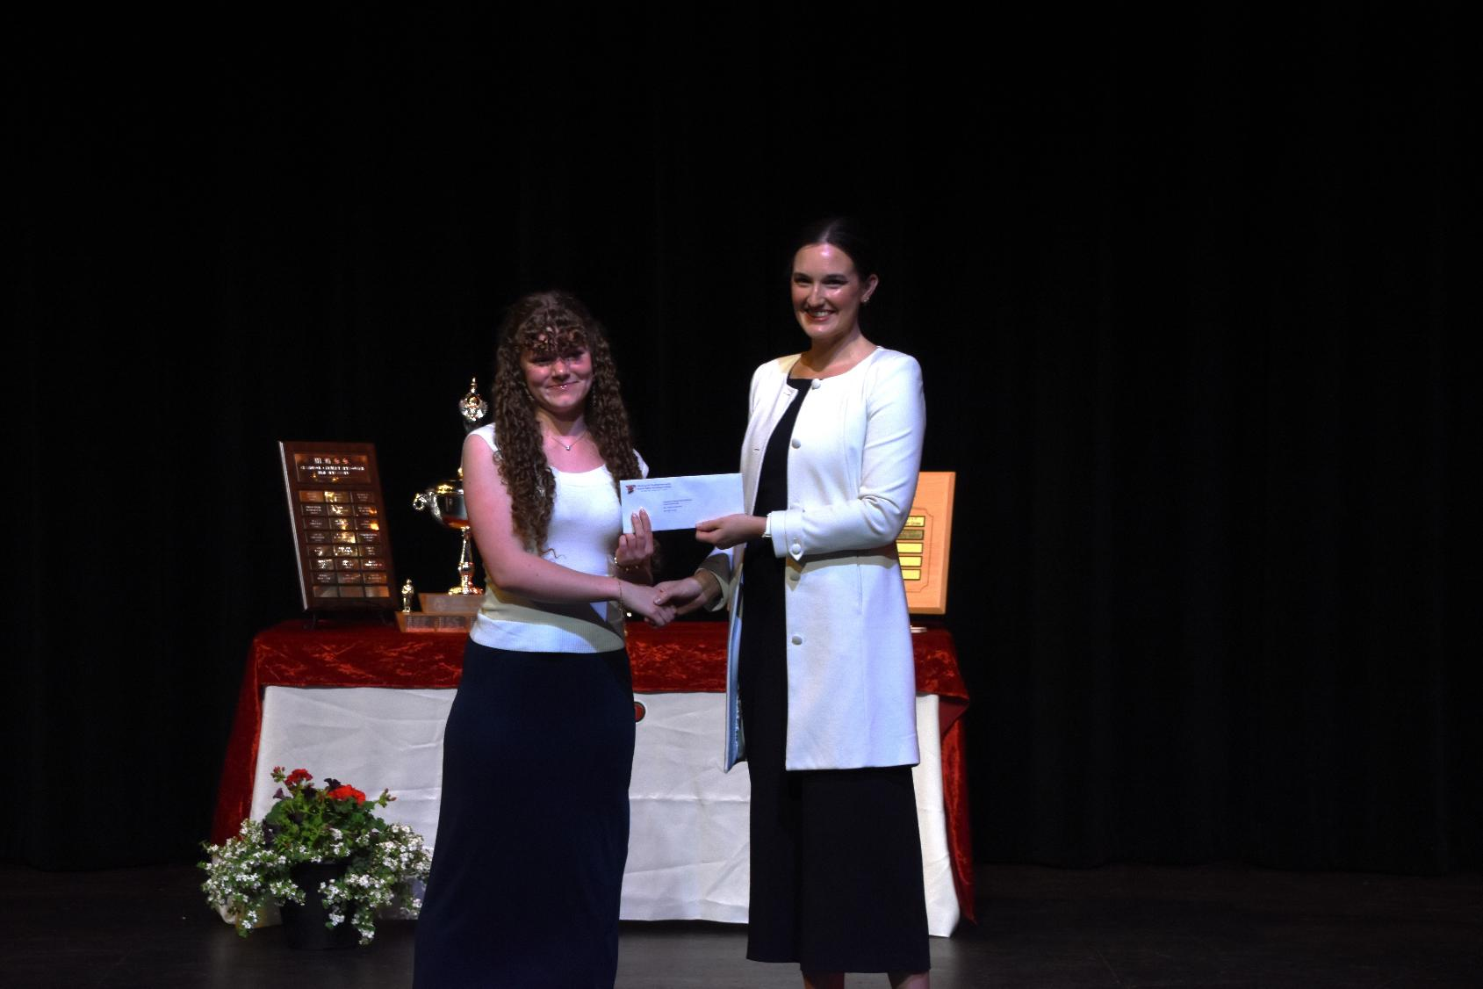
Kootenay Orchards PAC Bursary
Brooklyn Corner

Slide 27
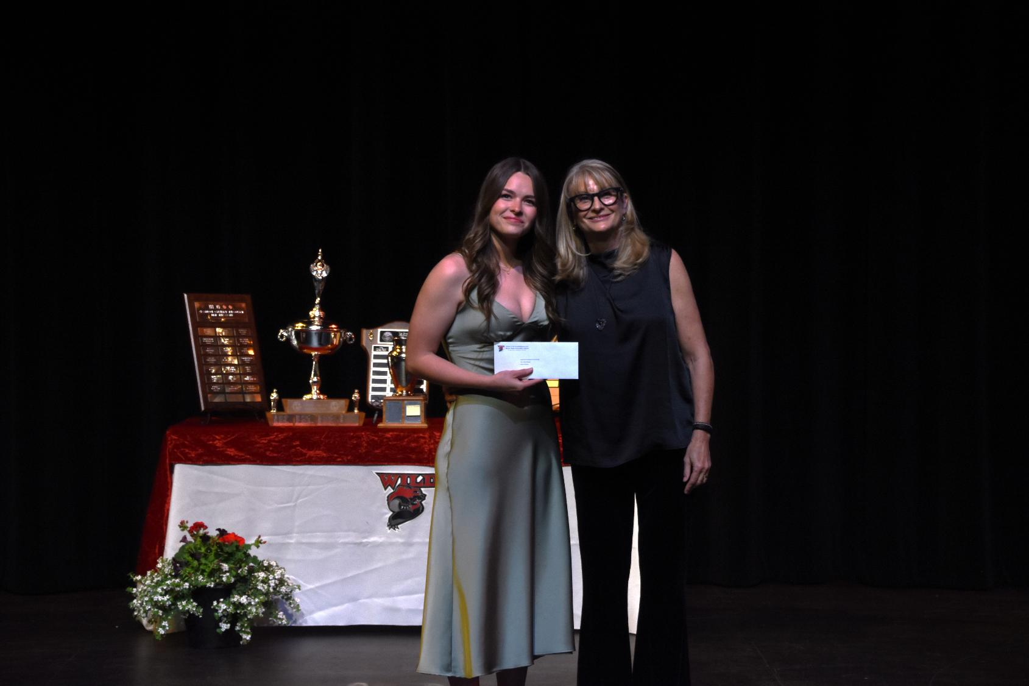
Kootenay Tax Services Scholarship
Sarah Johnson

Slide 28
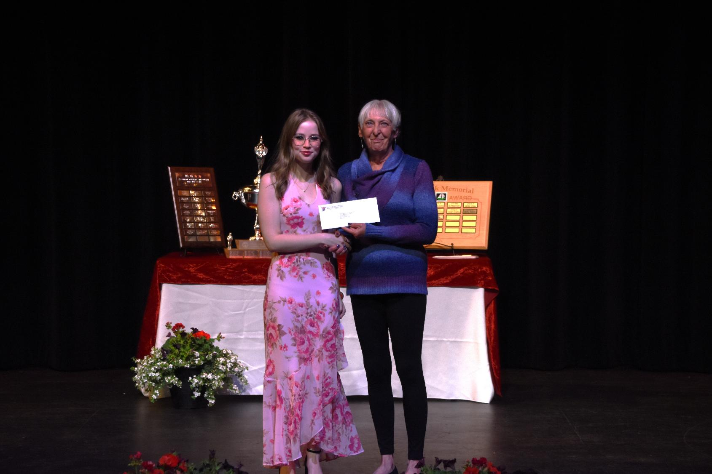
Ladies Auxiliary to FOE #3032 Regis Jacobson Memorial Bursary
Brylie James

Slide 29
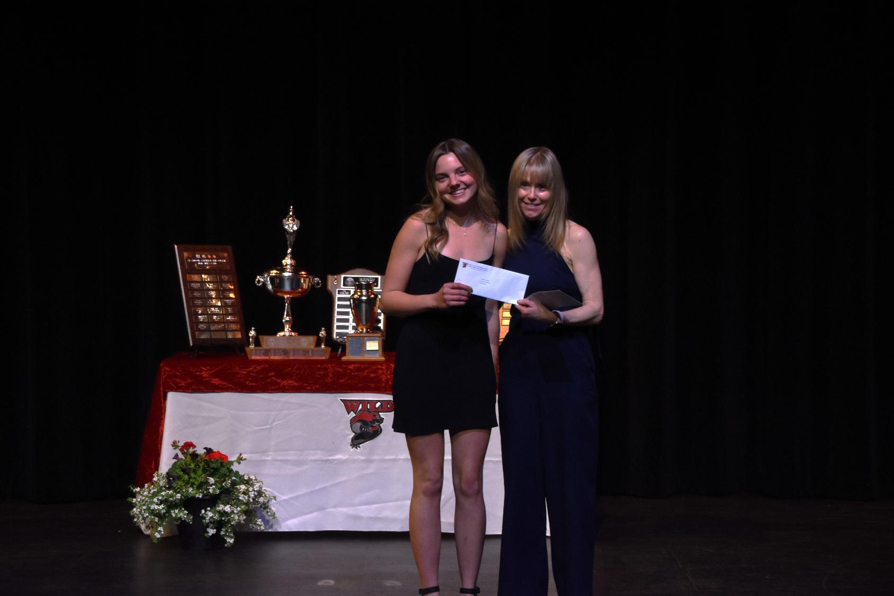
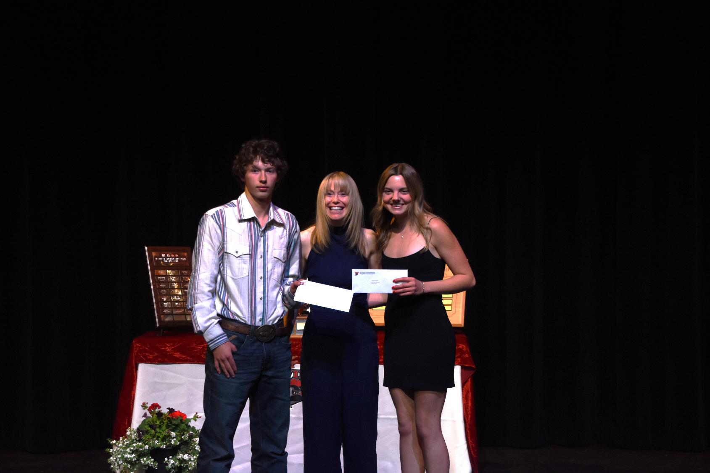
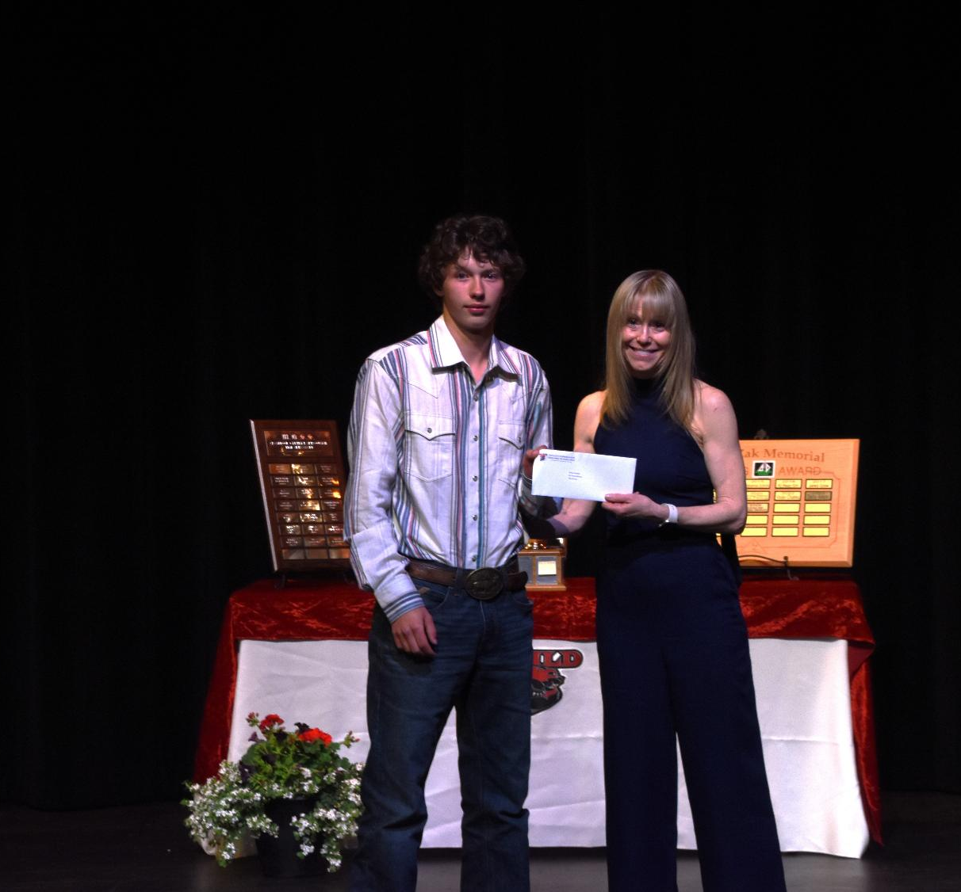
Lifetouch Canada Scholarships
Ava Murtack and Tate Portman

Slide 30
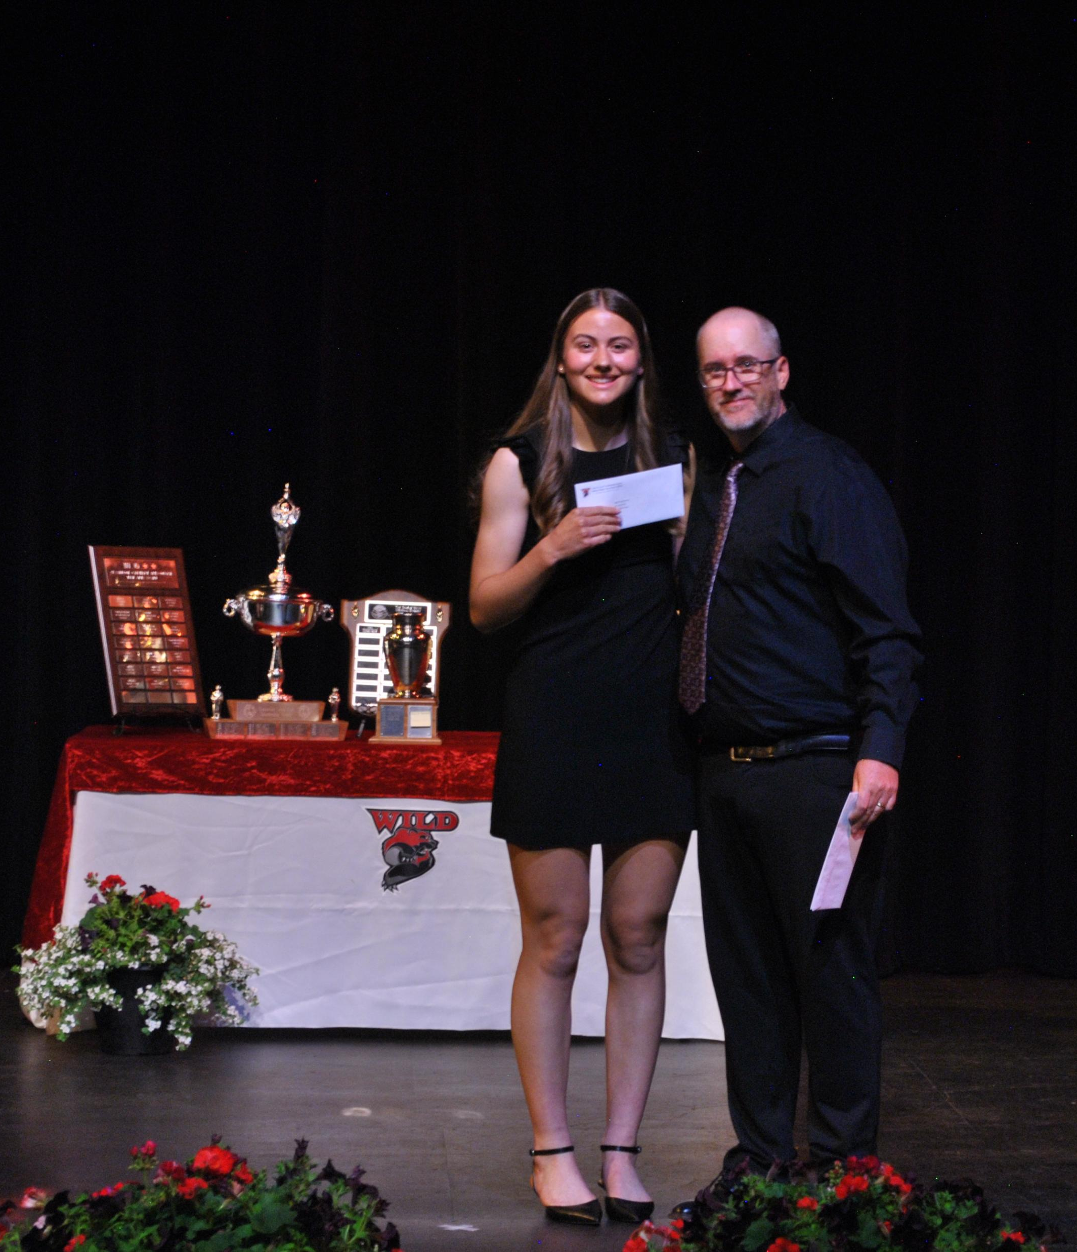
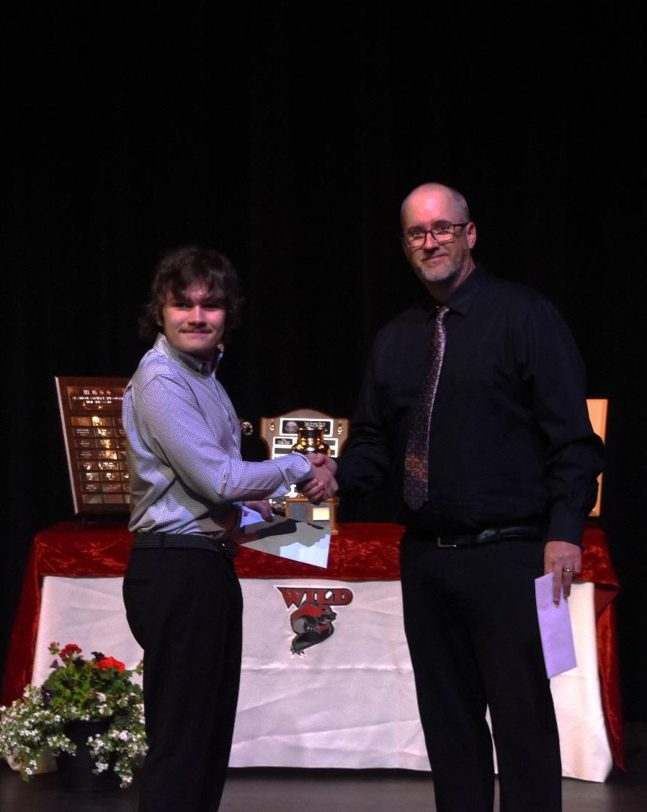
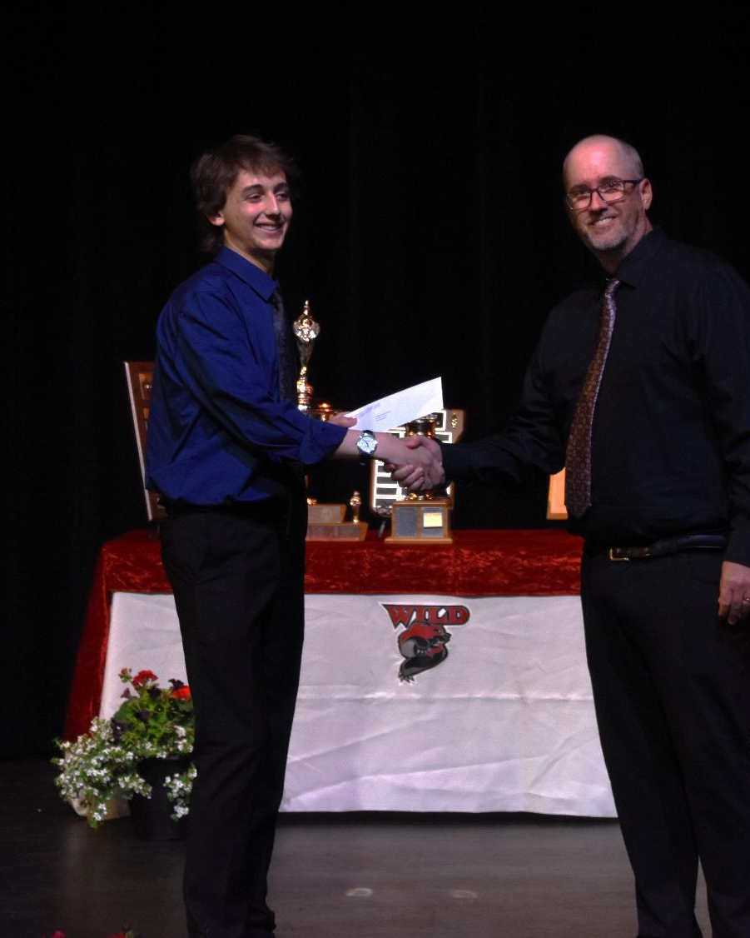
MBSS Principal Awards
Brooke Niedermayer, Chase Spyksma and Arron Welch
FamilyID=Office_ArchiveTorn

Slide 31
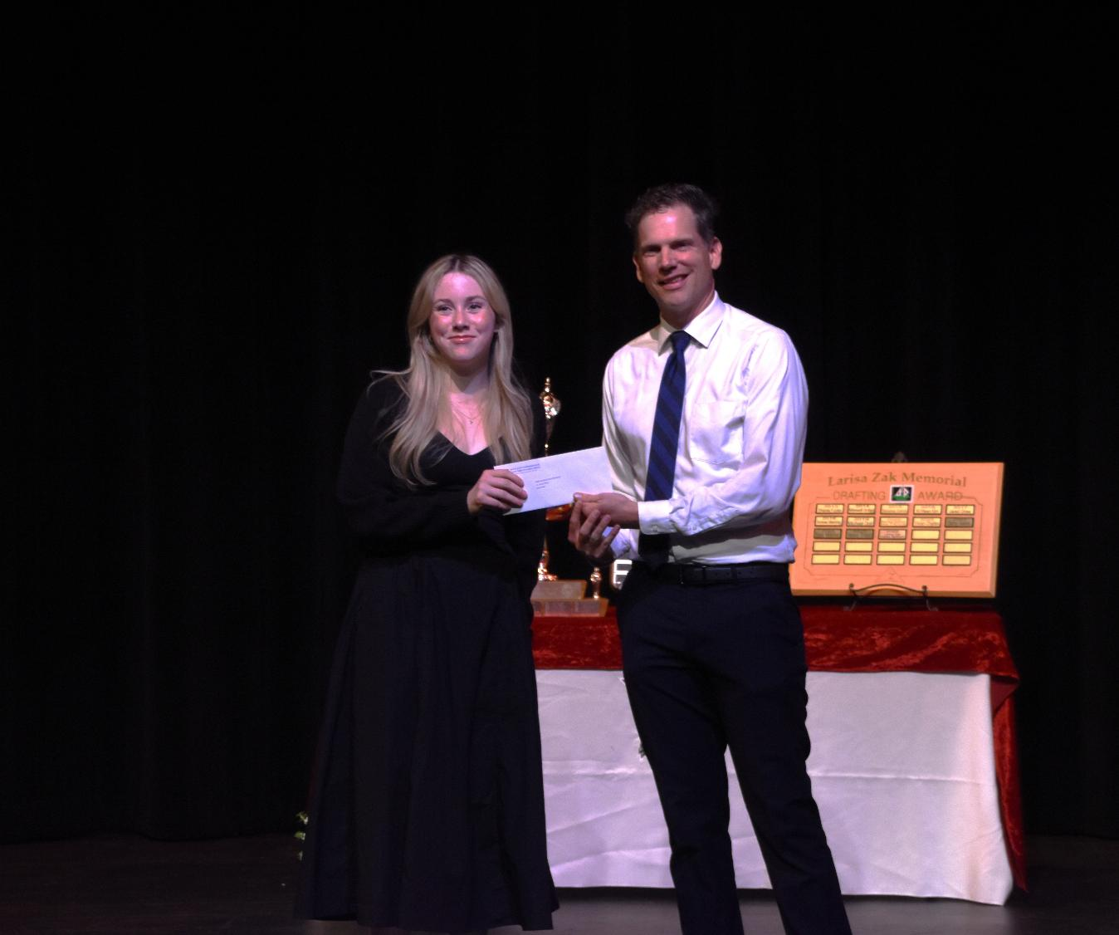
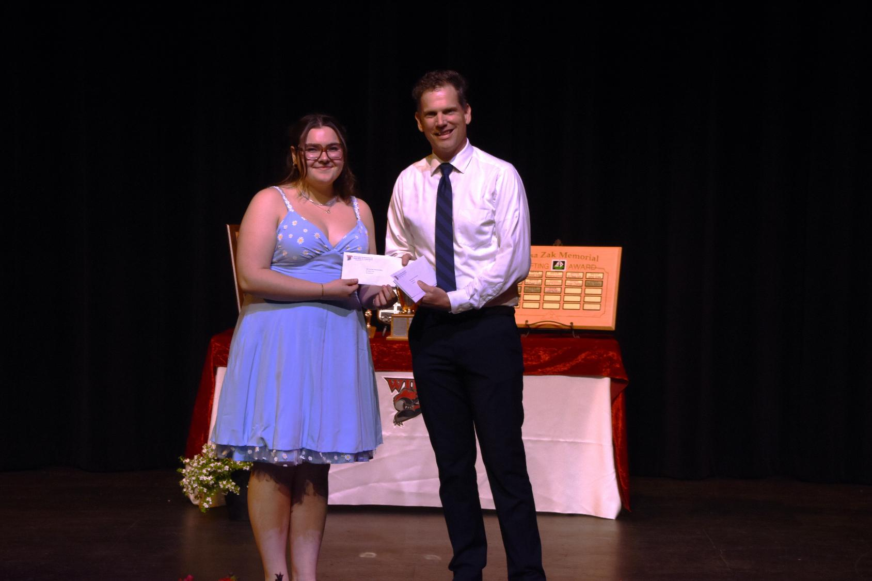
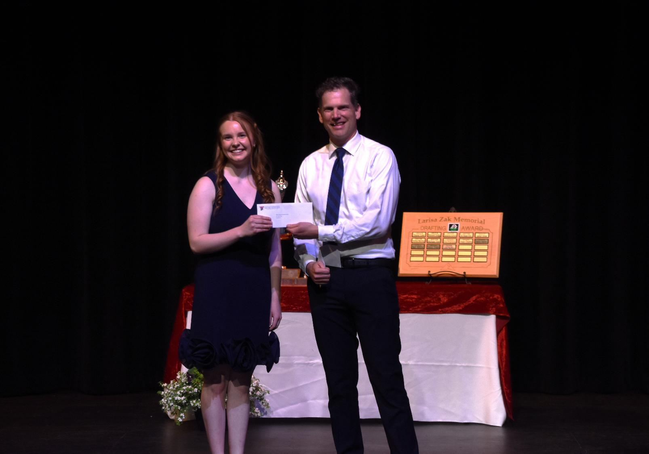
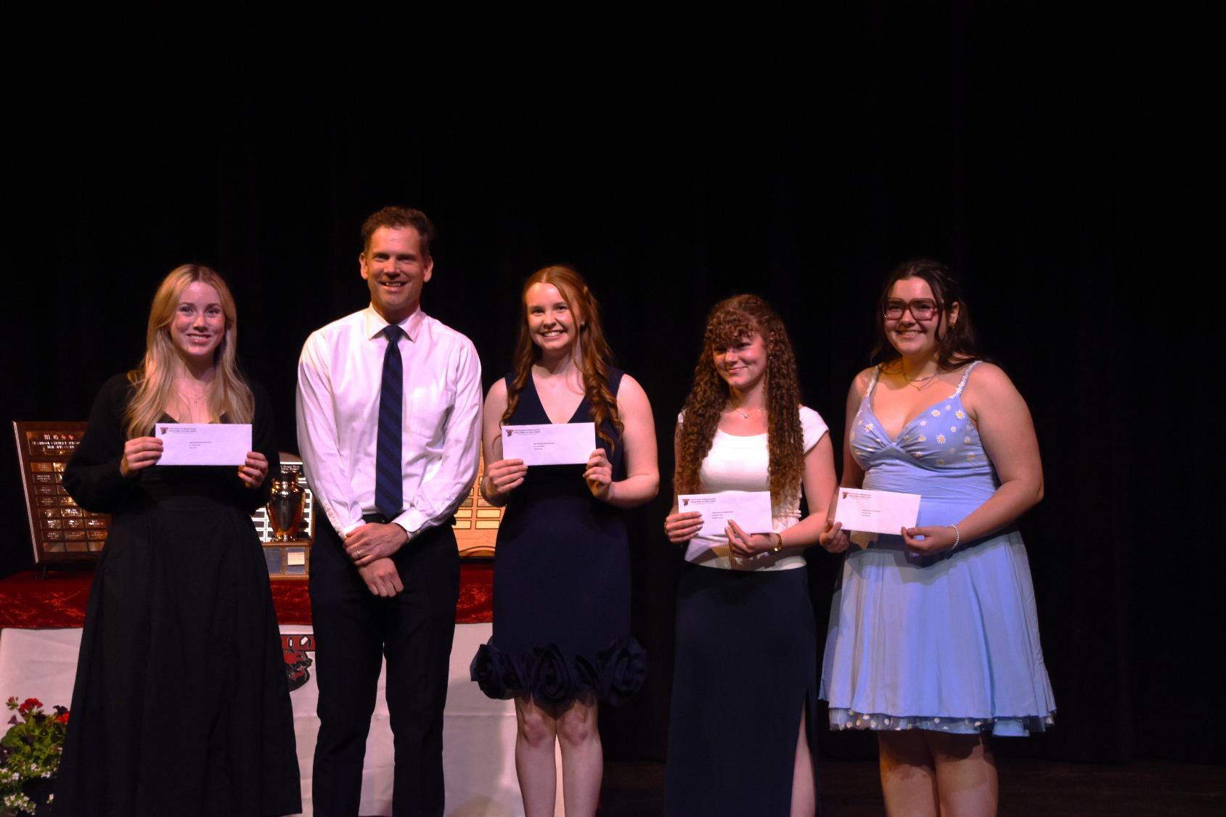
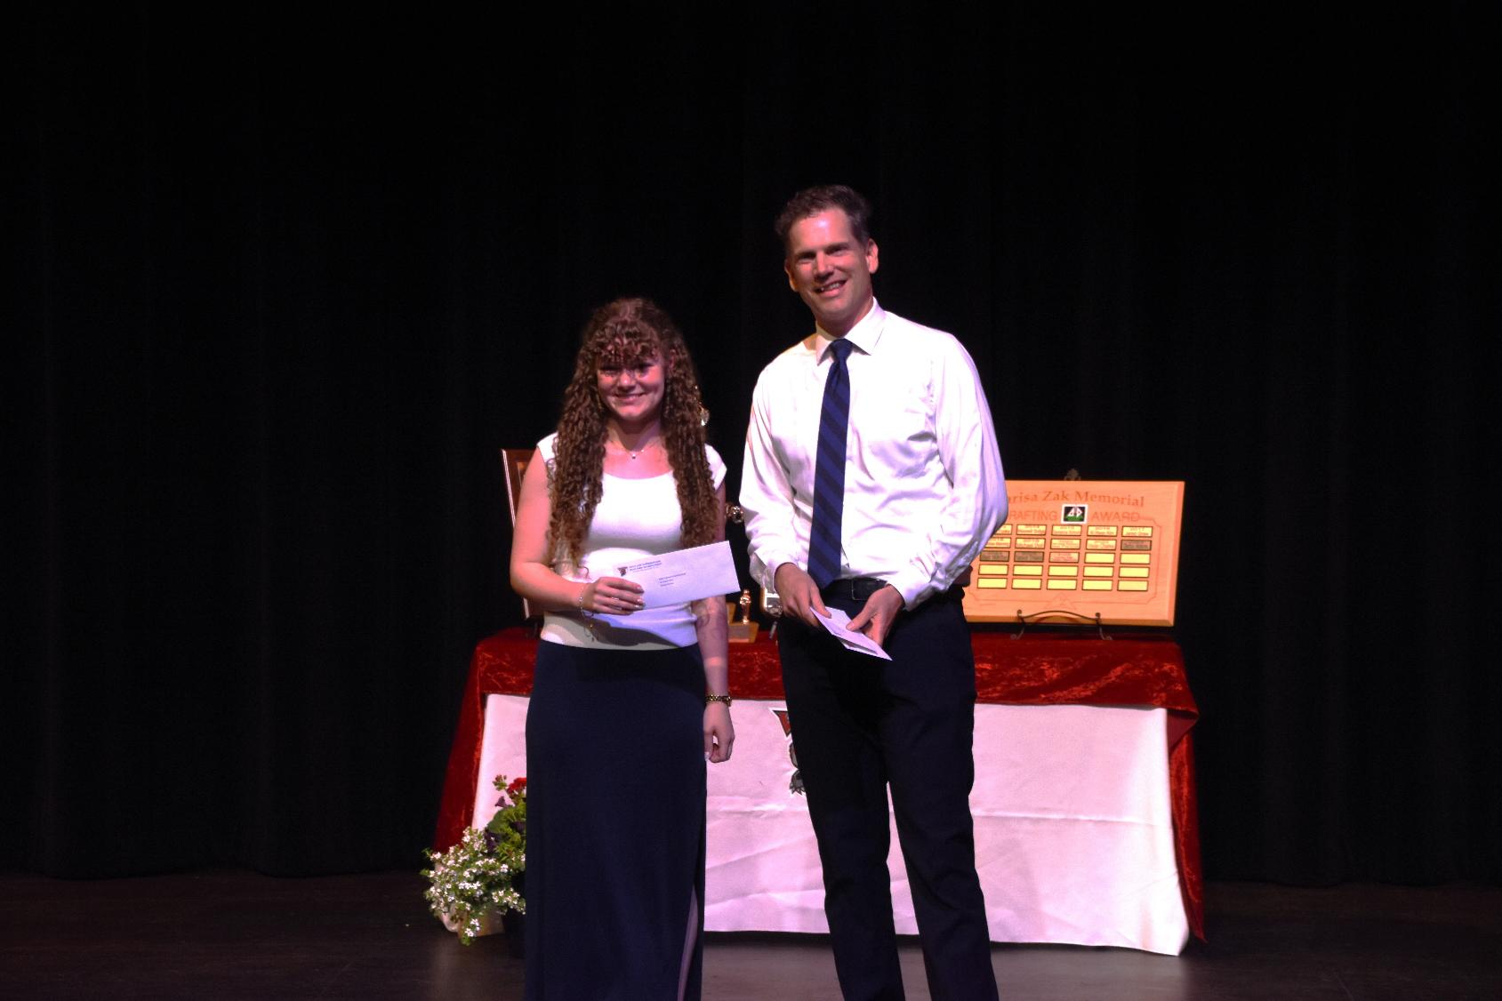
MBSS Yearbook Citizenship Awards
Olivia Boehmer, Aliya Eadie, Kate McInnes and Brooklyn Corner

Slide 32
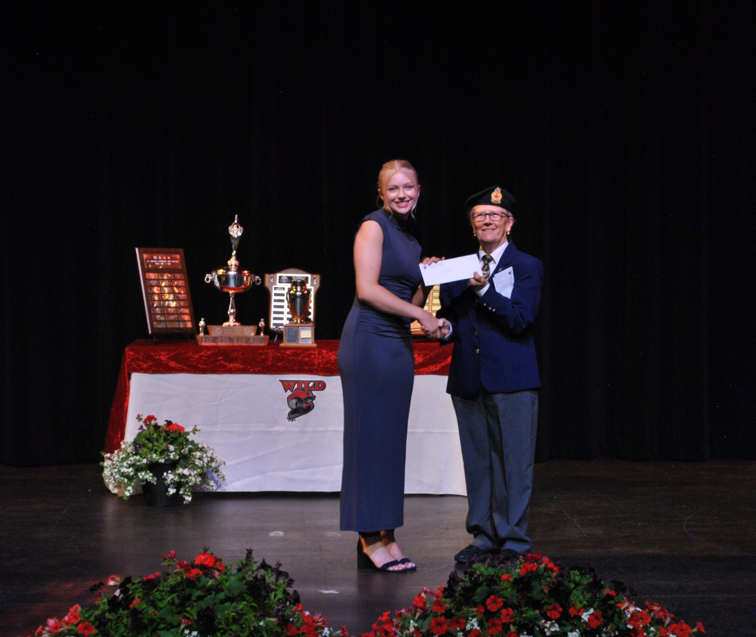




Royal Canadian Legion Scholarships
Chailyn Stanley, Kaila Koch, Eliana Schutz, Ethan Beninger and Brylie James

Slide 33

Royal Canadian Legion Scholarship, Branch 24 (1955)
Ethan Beninger, Brylie James, Kaila Koch, Eliana Schutz, and Chailyn Stanley

Slide 34

Sevilla Clark Memorial Bursary
Mylee Kozicky

Slide 35

Southeast Kootenay Principals’ and Vice Principals Associate Award
Alex Johnson

Slide 36

Steve Corbett Memorial Public and Private Workers of Canada, Local 15 Scholarship
Charlie Lockhart

Slide 37

William Henderson Scholarship (1988)
Sydney Westle

Slide 38



Mount Baker Class of 85’ Bursaries
Rory Rachwalski, and Jake Thompson

Slide 39

Dianne Wray Memorial Scholarship
Anna Adrian

Slide 40

Joyce Metcalfe Memorial Scholarship
Ethan Sawatsky

Slide 41

Abreast in the Rockies Scholarship
Eleanor Buck

Slide 42

Bob Newcombe Memorial Scholarship
Kate McInnes

Slide 43


Larisa Zak Memorial Drafting Award
Caden Murdoch

Slide 44



Western Inspirational Award
Naye Kim and Jaxson Turner

Slide 45

Apex Accounting Scholarship
Sarah Johnson

Slide 46

Colin Stevely Memorial Award
Abigail Chippett

Slide 47

Cranbrook and District Ambulance Association Award
Jonas Meulenbeld

Slide 48

Cranbrook and District Arts Council Fine Arts Award
Olivia Boehmer

Slide 49

Cranbrook Lions Bill Inman Memorial Award
Micah Stevenson

Slide 50



Cranbrook Ministerial Scholarships
Moyin Olabode and Catherine Niemand

Slide 51

Cranbrook Sunrise Rotary Vocational Bursary
Navy Gross

Slide 52

Denham Ford Unsung Hero Award
Kate Bowers

Slide 53

Ermin Alexander Award
Dominyc- James Mackenzie- Rae

Slide 54

F.W. Green Clinic Scholarship
Ireland Palmer

Slide 55

Frank and Teresa Torozzo Memorial Award
Jake Thompson

Slide 56

Gyro Open Scholarship
Lacey Faiers

Slide 57

Mark Mahovlic Memorial Scholarship
Ryan Campbell

Slide 58

Signal Collision Cranbrook Award
Colton Fountain

Slide 59

Terus Construction Award
Marcus De Zwart

Slide 60

Walker Willis Memorial Award on Behalf of Jubilee Chapter 64 Order of the Eastern Star
Brylie James

Slide 61


Yoo Deserve this Bursary/Scholarship of Technology
Daxton Hauprich
Liam VanStaden

Slide 62

Erin Beaulac Memorial Bursary
Ashlyn McKay

Slide 63


Key City Oldtimers Hockey League (KCOHL) Scholarships
Saesha Ross and Skye Jensen

Slide 64

Andy Dudka Memorial Bursary
Paige Reiben

Slide 65



Cranbrook District Teachers Association Scholarships
Ava Tichauer
Emmett Horvath

Slide 66


CUPE Bursary local 2090 City of Cranbrook Employees
Alex DeAngelis and Mylee Kozicky

Slide 67

CUPE 2090 Graeme Young Memorial Award
Addyson Price

Slide 68


Kin Club of Cranbrook Bursary/Scholarship
Preston Czernicki and Catherine Niemand

Slide 69

Pidoca Construction Group Memorial Scholarship
Nolan Driver

Slide 70

Skookumchuck Pulp Incorporated Excellence Award
Norah Wolfs

Slide 71


Cranbrook Rotary Club Local Bursaries
Kaila Koch and Naye Kim

Slide 72


Canfor Scholarships
Dyllan Beal and Sarah Johnson

Slide 73




Columbia Basin Trust Youth Community Service Awards
Genevieve Hall, Avaiah Pelletier and Paige Parnell

Slide 74

Fraternal Order of Eagles (Terry Werden Memorial) Award
Ryder Massicotte

Slide 75



Rick and Marg Jensen Family Awards
Constantine Fisk and Hanna Bodnarchuk

Slide 76


Cranbrook Health Care Bursary/Scholarship
Ben Tran and Kayte Wik

Slide 77

Cranbrook Lions Club Scholarship
Kara Kakuno

Slide 78

Friends of the Cranbrook Public Library
Jackson Tomlin

Slide 79

Neil Featherling Memorial Award
Georgia Zroback

Slide 80


Floyd and Mary Hall Memorial Bursary/Scholarship
Harrison Flitcroft and Dominyc-James Mackenzie-Rae

Slide 81

Cranbrook Rotary Club Scholarship
Jaina Skene

Slide 82

Nordquist Family Scholarship
Trystyn Keen

Slide 83

Stanley Gracie McNeil Student Aid Memorial Bursary
Nicolas Hochart

Slide 84

City of Cranbrook Memorial Scholarship
Khushi Patel

Slide 85

School District Authority Scholarships

Slide 86

College of the Rockies Entrance Scholarships

Slide 87





Students missing that received awards
Mariah Hirt, Bella Savage, Miranda Helvoigt, Dustin Tacloy and Detroit Canuel

