Slide 1
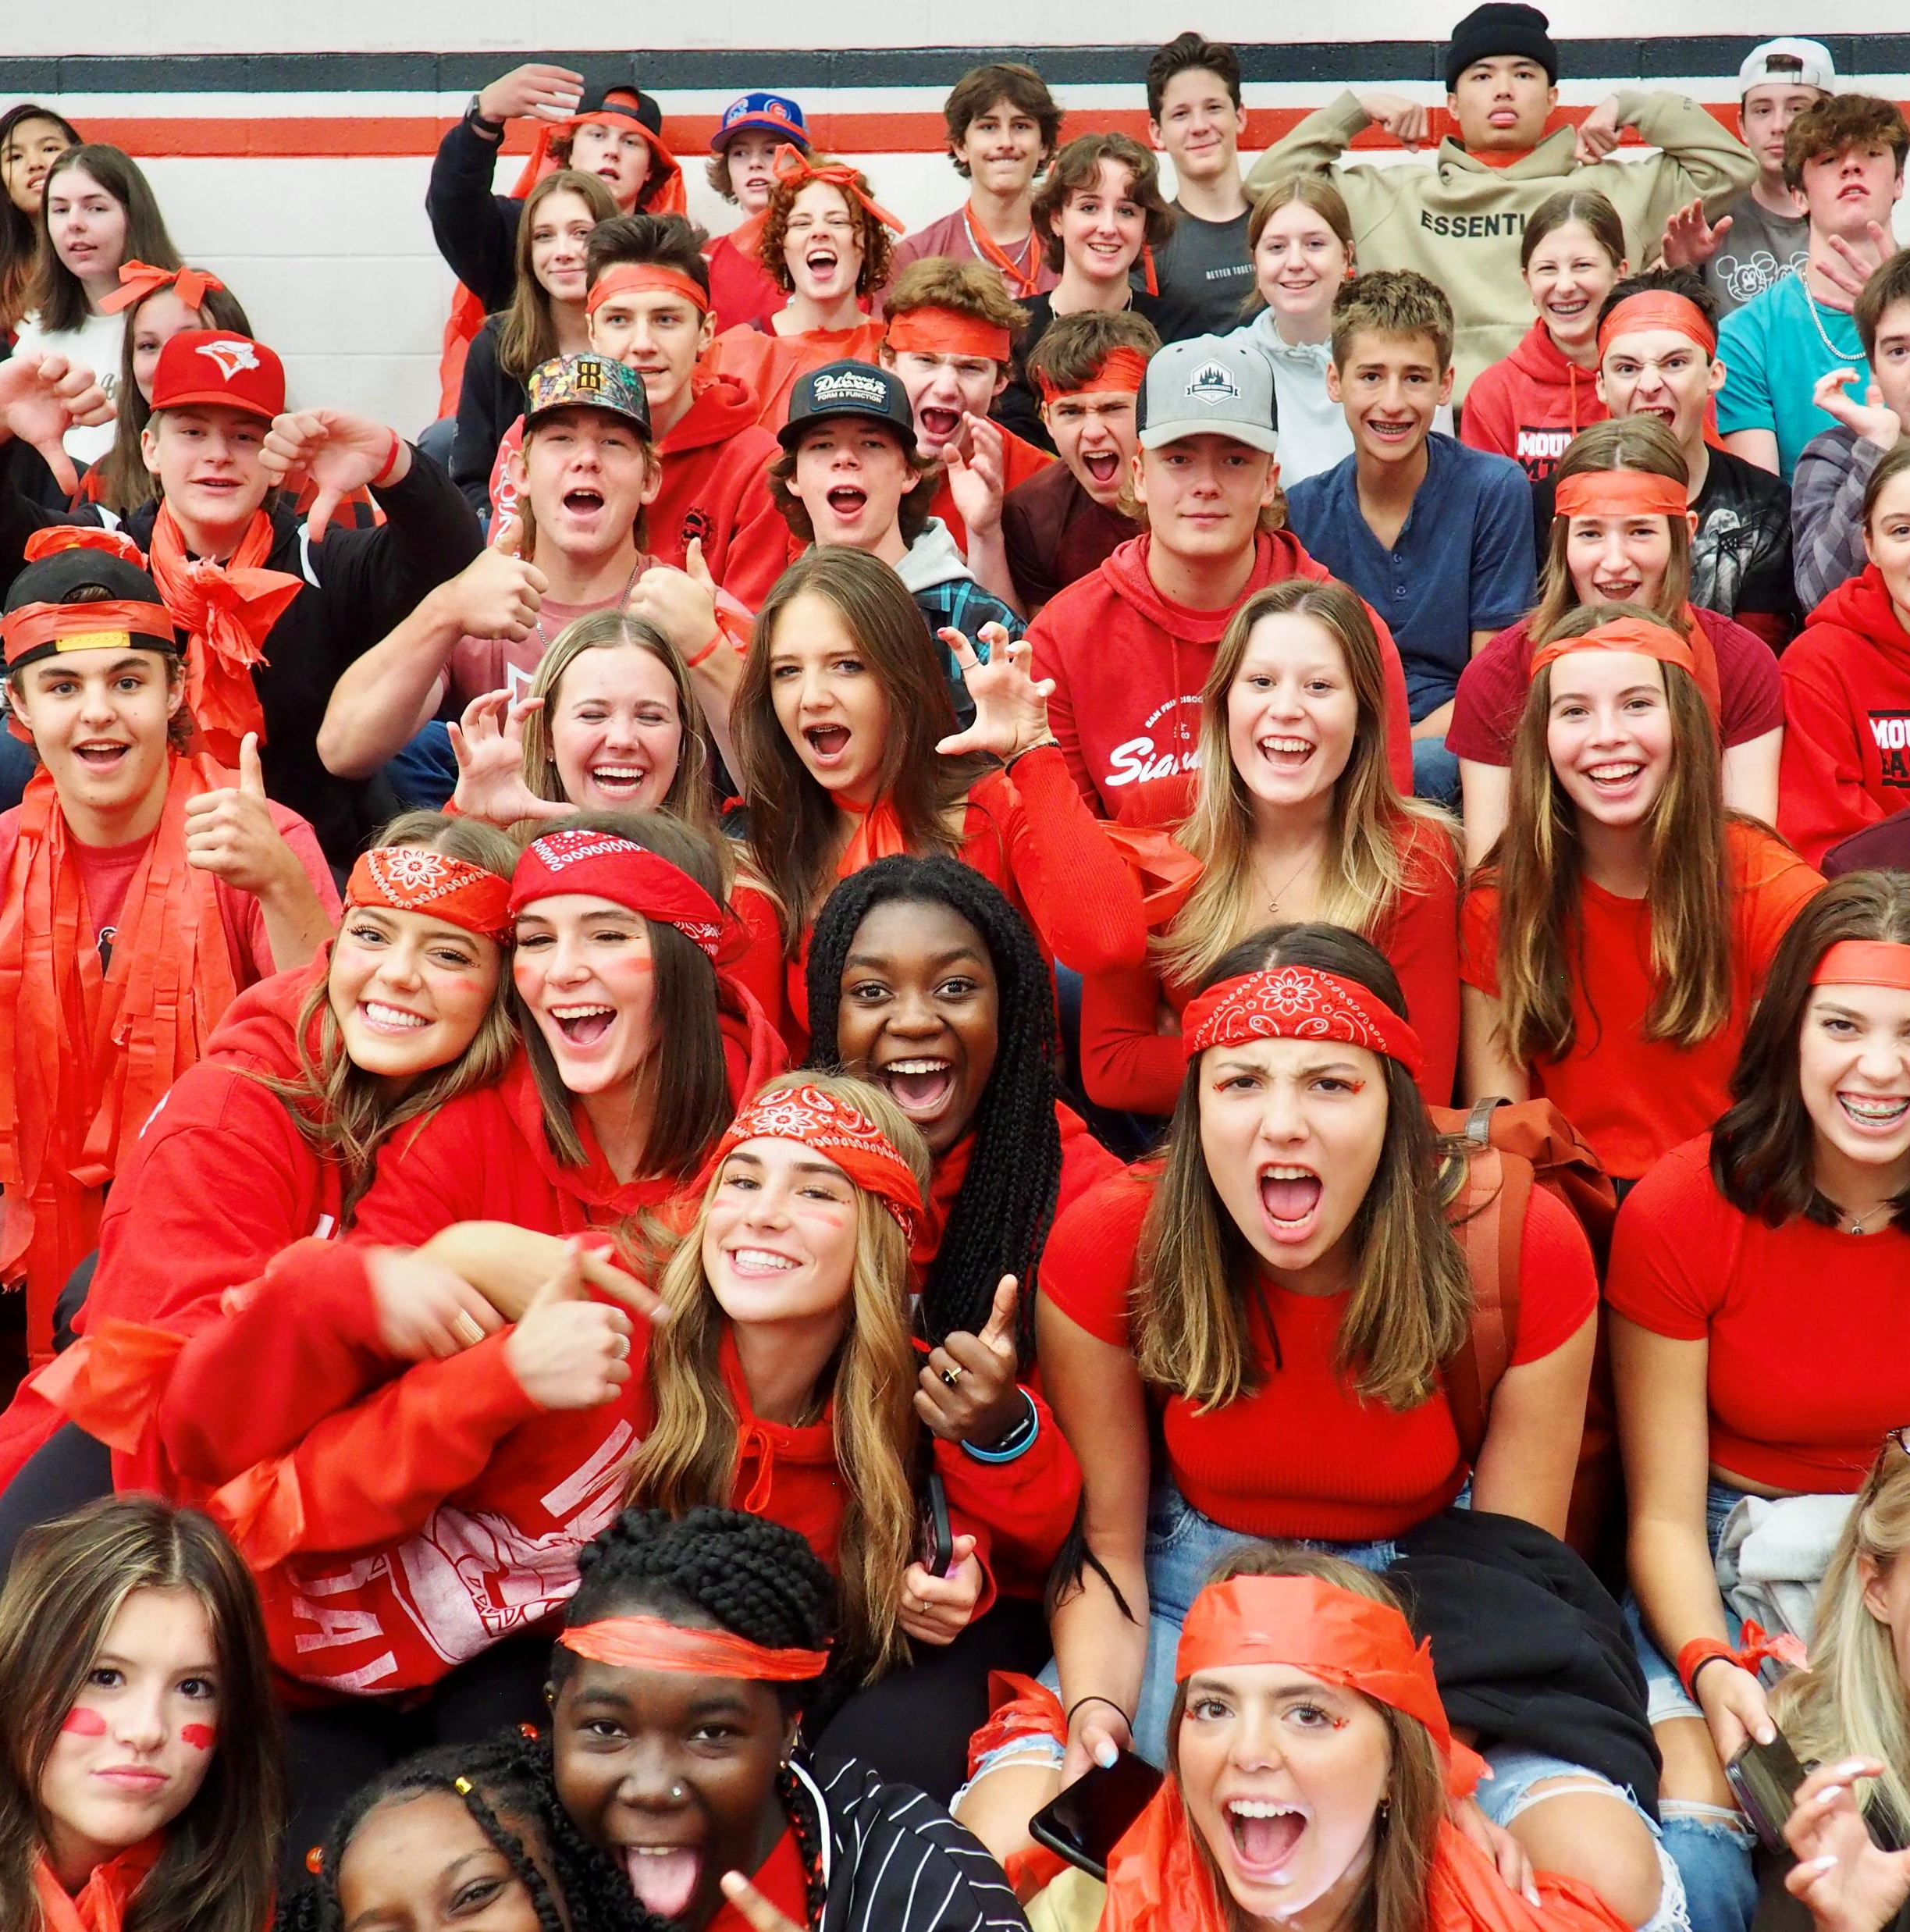

Welcome to Mount Baker Secondary!

Slide 2
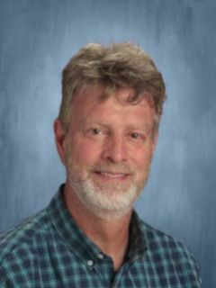
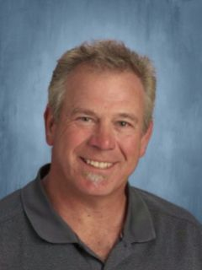
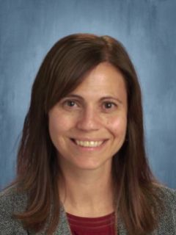
Administration team
Vice Principal
Mr. Sean Sinclair
Vice Principal
Ms. Christie Johnson
Principal
Mr. Dave Hill

Slide 3
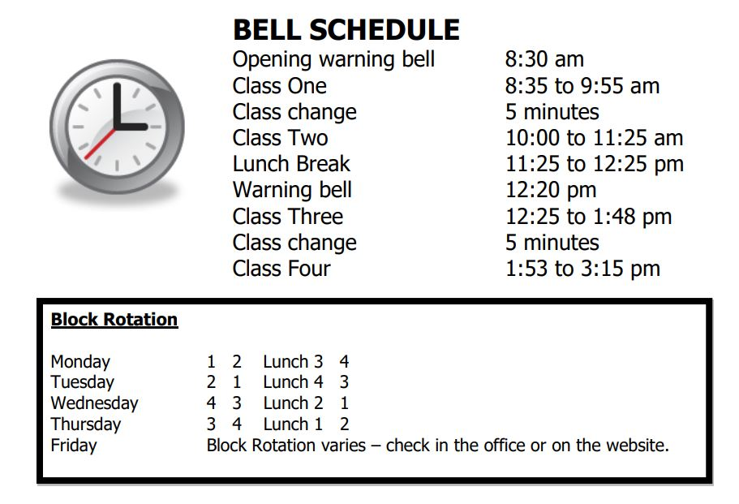
Class run on a block rotation…
2 semesters:
4 classes each semester
8 classes total in the timetable each year

Slide 4
Graduation: a 3 Year Plan
Grade 10 | Grade 11 | Grade 12
6 required courses Math English Science Socials Careers 10 P.E. | 4 required courses Math English Science Socials | 2 required courses An English 12 Career Life Conn. 12
2 electives *Additional core courses count as electives | 4 electives | 6 elective courses (or enough credits to reach 80 credits) *2 of these electives MUST be Grade 12 level courses.
Each course is worth 4 credits:
8 classes in one year = 32 credits
You need 80 credits to grad = (20 courses)
At least one Fine Arts or Applied Skills course
At least one Indigenous focused course
If you do not pass a required course, you will need to repeat it.

Slide 5
You may be interested in KES if:
You are emerging in all 4 (English/Socials/Math/Science)
You haven’t been successful in middle school
You have attendance struggles
You need something more self-paced
Interested? Contact your school counsellor or administrator
Kootenay Educational Services (KES) – our alternate school

Slide 6
Taking a grade 10 course online?
Online courses are completed on top of your 8 scheduled blocks at Baker.
You need to register for all courses required for graduation.
You will be enrolled in these until your online course is completed.
If you do not have 8 classes at Baker, you are not considered a full-time student. This means you may not get your top choice electives.
There are no support blocks for grade 10 students.
Full-time students receive first-consideration for scholarships in Grade 12 (courseload counts).
We recommend if you do work online, that you choose a course not offered at Baker…If you are doing a required course for grade 10 we will put that course in second semester until it is finished.

Slide 7
GRADE 10: Course selection
8 Courses Total:
6 Required Courses:
An English 10
A Math 10
Social Studies 10
Science 10
PE 10
Career Life Education 10
Plus :
2 Elective choices
or
1 Elective if you are taking Band
or
1 Elective if you are French Immersion
or
0 Electives if you are in Band and FI
*This course at Baker prepares you for Grade 12 Careers/Capstone
If you do not pass a required course…You will need to repeat it before moving on.
Notes:
Social Studies:
Explorations 11 is a non-academic course, but counts toward grad credits.
All grade 12 Socials Studies are academic (Comparrative Cultures/BC First Peoples/Contemporary Indigenous Studies/20th Century World History)
Law and Philosophy are academic, but do not count as a Social Studies entrance course into universities in Alberta.
See your counsellor for clarification.
Math:
(Pre-Calculus, Foundations, OR Computer Science)
Science:
Science for Citizens is a non-academic course, but counts toward grad credits.
Academic options for university: Chemistry/Physics/Life Sciences (Biology)
**any extra core classes you choose count as electives.)

Slide 8
Grade 10 Elective OPtions…
Beginner Chess Intermediate Chess 11 Art Studio 10 Photography 11 Yoga & Mindfulness 12 Guitar 10 Child Development/Caregiving 12 Food Studies 11 | Dance Foundations 11 Drama 10 Film & Television 11 Puppetry 10 Accounting 11 Entrepreneurship & Marketing 10 Computer Information Systems 11 Computer Programming 11 Computer Science 11 (Counts as Math 11) | Art Metal & Jewelry 12 Drafting 11 Electronics 11 Woodwork 11 Robotics 11 Metalwork 11 Core French 10 Spanish – Introductory 11
Inside timetable: within the school day →
Concert Choir 10 Vocal Jazz 10 Jazz Band 10 Yearbook 10 | Musical Theatre 10 Theatre Company 10 Theatre Production 10 Dance Foundations 11 | Studio Sports 11 Warriors 10 (Indigenous Leadership) Leadership 10
← Outside timetable: lunch/after school etc.

Slide 9
Grade 10 English and MATh options:
All English 10 courses are equivalent
Options:
Writing/Composition
or
Spoken Language
or
New Media
Math 10
Workplace Math 10 → leads to Workplace 11
(will be offered linear this year if you want to get your math requirements completed in grade 10)
or
Foundations of Math and Pre-Calculus 10 →
leads to any available option
Take the hardest option you can be successful at!

Slide 10
TRAIN in Trades Programs (TRNE)
Trades Offered:
Electrician, Industrial Mechanic, Hairstylist, Carpenter, Heavy Duty Mechanic, Welder, Cook, Auto Technician
Dual credit: students receive high school elective credit as well as Foundations apprenticeship credit while attending the College of the Rockies
Application required – available in counselling (early in grade 11)
There is a selection process that looks at conduct, attendance, work habits, etc.
CYFS: Child, Youth, Family Studies
4 courses aimed at becoming a Human Service Worker, Education Assistant or Early Childhood Educator
Delivered online in grade 11 or 12
For more information, contact Tristan Taylor:
ttaylor@cotr.bc.ca or 250-581-2382 (College Transitions Coordinator)

Slide 11
Assessments: Required for graduation
Grade 10 Literacy Assessment: usually done with English 10
Grade 10 Numeracy Assessment: usually done with Math 10
Grade 12 Literacy Assessment: usually done with English 12
French Immersion Assessments
Sample Assessments can be found at – https://www.awinfosys.com/eassessment/gradassessments_copyright.htm
“Google Graduation Assessment Information Parents and Students”

Slide 12
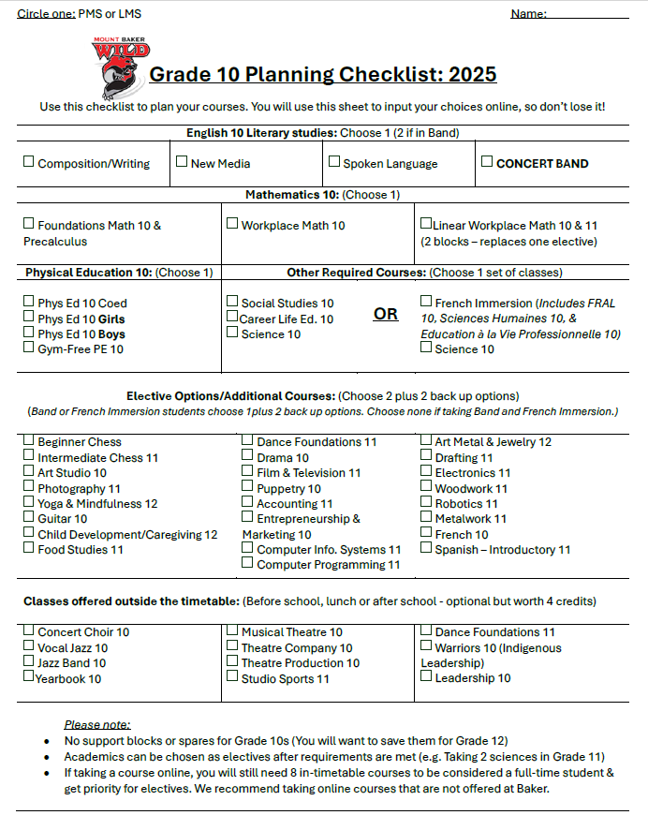
Grade 10 Course selection:
Will be completed by students online.
←This is a planning guide to help you choose courses.
Please take one home today & bring it back APRIL 2nd
Important Dates:
Presentation at LMS: February 25th
Presentation at PMS: March 4th
Grade 9 MBSS Visitation Day: March 11th (am)
Grade 9 Parent Night at MBSS: March 13th 7pm
Course Selection Input: APRIL 2nd (both LMS & PMS)
(Counsellors will return to the middle schools later in Spring
to make any necessary changes.)
Jodi Lode (Last name A-L): jodi.lode@sd5.bc.ca
Leah Draper (Last name M-Z): leah.draper@sd5.bc.ca

Slide 13
Important Information
The first day of school is staggered. Watch for more information.
The second day is a full day.
MAKE SURE EMAIL AND CONTACT INFO IS CORRECT
(so that absence phone calls go to the right number)
* No phone calls for lates
Fees are paid online at https://schoolcashonline.com
Lockers are assigned at the end of June. The locker number and combination will be on the timetable that students receive in September, if lockers are offered.

Slide 14
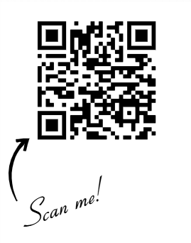
For more information, directions & Course Selection Guide (lists all elective options with video links):
https://www.sd5.bc.ca/mbss/page/7690/new-student

